Slide 1
References
“In Depth | Curiosity (MSL)” – NASA Solar System Exploration
“Water on Mars: The Story So Far” | News | Astrobiology
“Significant amounts of water' found in Mars' massive version ...” CNN
“Why Do We Care About Water on Mars?” | NASA Space Place – NASA
“NASA Confirms Evidence That Liquid Water Flows on Today’s Mars” NASA
“ESA - ExoMars discovers hidden water in Mars’ Grand Canyon” ESA
“First Discovery of Water on Mars” | NASA History | Phoenix
“NASA Confirms Evidence That Liquid Water Flows on Today’s Mars
“New Study Suggests Discovery of Liquid Water on Mars May Have…” MSN
“Water on Mars: Significant amounts found under planet's Grand ...”
USA Today
“Spacecraft discovers 'hidden water' in Mars Grand Canyon” - CNET
“Why Does Nasa Believe There Is Water On Mars ... “ Eclipse Aviation
“Large Reservoir of Liquid Water Found Deep Below the Surface ...” NASA

Slide 2

Are We EVER going to Mars ?
Follow the Water...

Slide 3
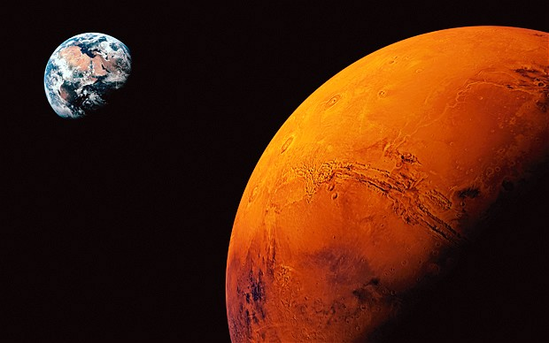
We will go to the Mars by the 2030s.

Slide 4
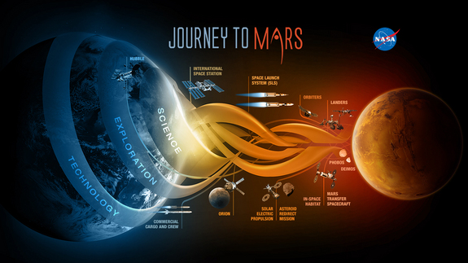

Slide 5
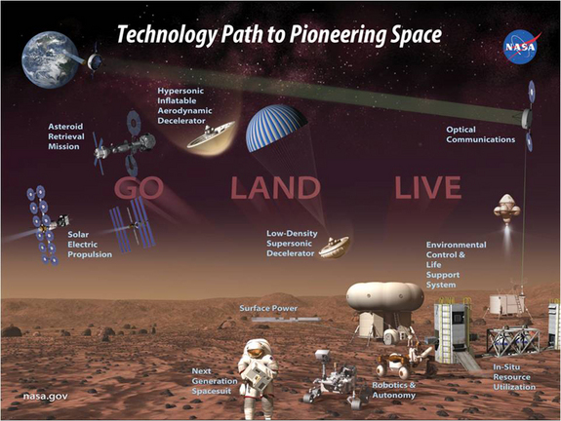

Slide 6


“When the first humans set foot on Mars, the moment will be more significant in terms of
technology, philosophy, history and exploration
than any that have come before it ---
we will no longer be a one-planet species.
Stephen Petranek
Author of How We’ll Live on Mars

Slide 7
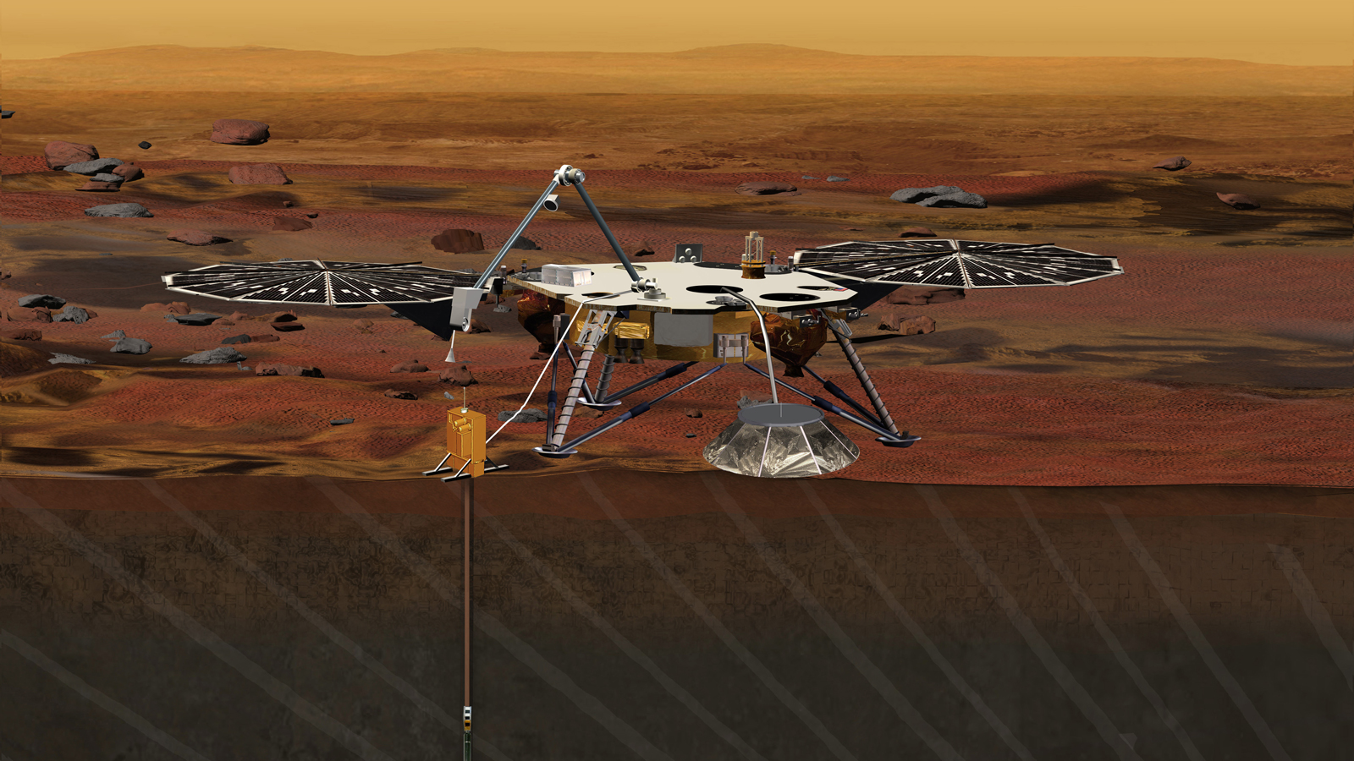
The Mars Lander Insight: Interior Exploration using Seismic Investigations, Geodesy, and Heat Transport
INSIGHT is now on Mars.

Slide 8
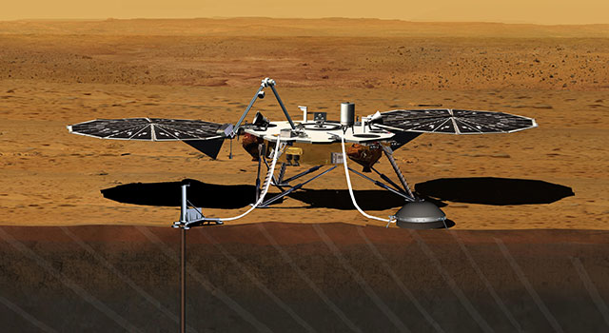
The Mars Lander Insight will drill approximately 9 feet into the surface of Mars, investigating how the rocky terrestrial inner planets were formed 4 billion years ago. It will measure the planet’s “vital signs”, its “pulse” (seismology), “temperature” (heat flow probe), and “reflexes” (precision tracking).

Slide 9
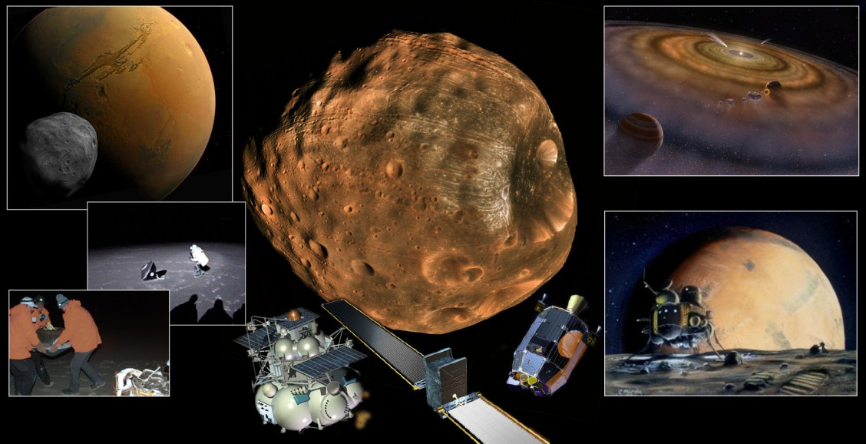
NASA is considering a 2024 mission to Mar’s Moon Phobos before landing on Mars.
Phobos is thought to harbor castoff dust and rock from Mars.

Slide 10
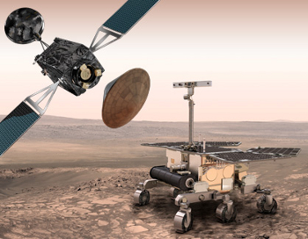
“EXO Mars Program: The European Space Agency's Exobiology on Mars Program is a series of missions designed to understand if life ever existed on Mars.”
Launch 2019

Slide 11
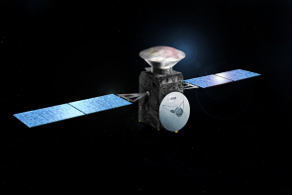
ESA and Roscosmos EXO Mars Trace Gas Orbiter (TGO) Launch March 14 of 2016
“…the instruments onboard the Orbiter will be deployed to detect a wide range of atmospheric trace gases (such as methane, water vapor, nitrogen dioxide, acetylene). The measurements carried out by the Orbiter will provide evidence about the location and sources of these gases; these locations could be targeted as prime landing sites for future missions.”

Slide 12

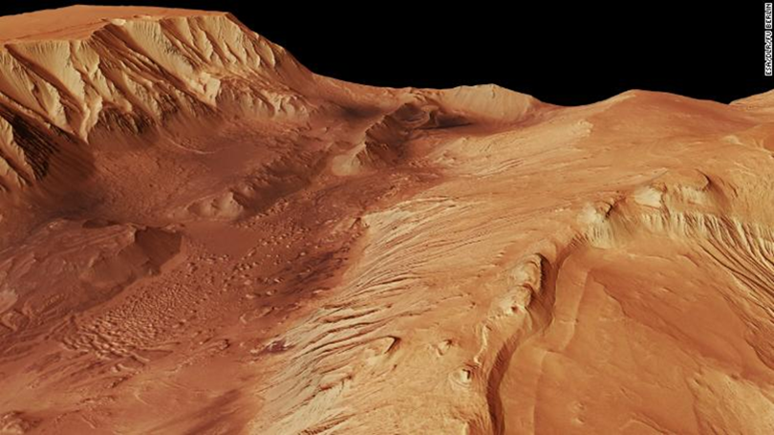
The Trace Gas Orbiter discovered “significant amount of water” under the surface of Mar’s version of the Grand Canyon which is much larger than Earth’s

Slide 13
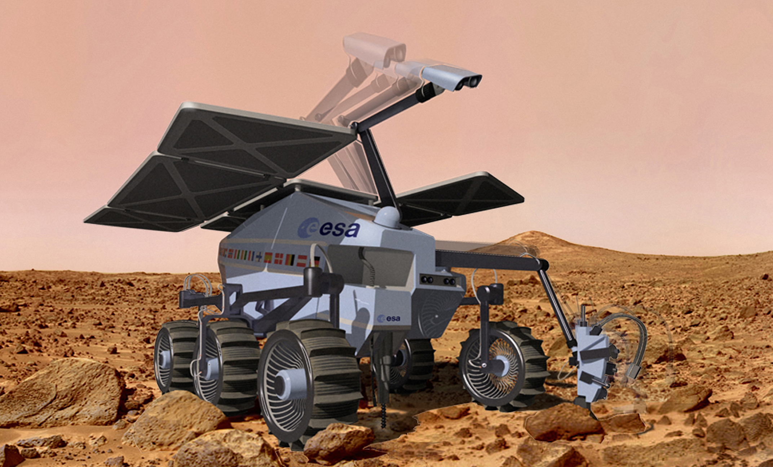
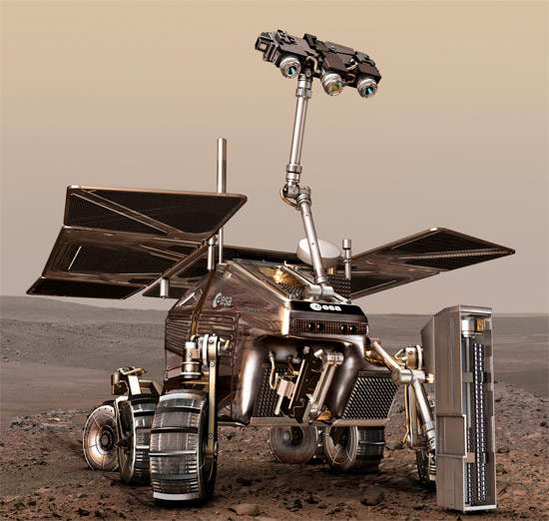
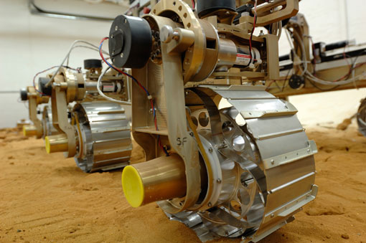
The First EXO Mars Rover crashed on Mars

Slide 14
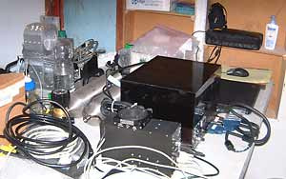

“Mars Organic Molecule Analyzer (MOMA) is the rover's largest instrument. It will conduct a broad-range, very-high sensitivity search for organic molecules in the collected sample. It includes two different ways for extracting organics: laser desorption and thermal volatilization, followed by separation using four GC-MS columns. The identification of the evolved organic molecules is performed with an ion trap mass spectrometer.”

Slide 15
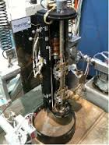
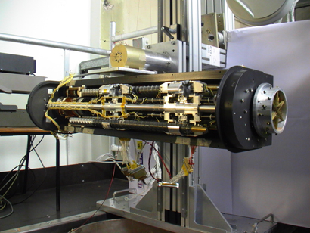


“Ma_MISS: Mars Multispectral Imager for Subsurface Studies Located inside the drill, Ma_MISS will contribute to the study of the Martian mineralogy and rock formation.”
“The ExoMars core drill is designed to acquire soil samples down to a maximum depth of 2 meters (6.6 ft) in a variety of soil types. The drill will acquire a core sample 1 cm (0.39 in) in diameter by 3 cm (1.2 in) in length, extract it and deliver it to the inlet port of the Rover Payload Module, where the sample will be distributed, processed and analyzed. The ExoMars drill embeds the Mars Multispectral Imager for Subsurface Studies (Ma-Miss) which is a miniaturized infrared spectrometer devoted to the borehole exploration.”

Slide 16

“ADRON To search for subsurface water and hydrated minerals.”

Slide 17

“MICRO MEGA visible plus infrared imaging spectrometer for mineralogy studies on Martian samples.”

Slide 18
“RLS: Raman Spectrometer: To establish mineralogical composition and identify organic pigments.
The RLS specific objectives are directly related with those of the mission: 1/ the search for past or present life, which is related to the direct identification of organic compounds, and 2) the identification of minerals products as indicators of biological activity; 3/ the description of water-related processes…”

Slide 19
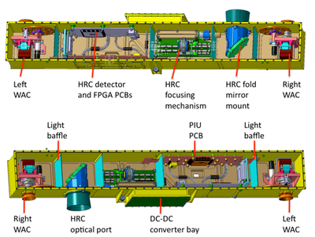

“PanCam: The Panoramic Camera To perform digital terrain mapping of Mars.”
“ISEM - Infrared Spectrometer for ExoMars: To assess the mineralogical composition of surface targets.”

Slide 20
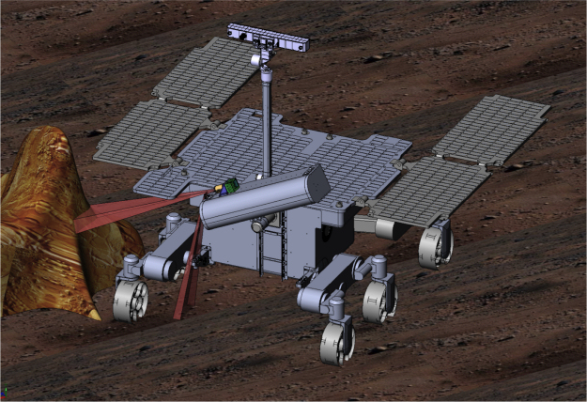

“CLUPI: Close - UP Imager: A camera system to acquire high-resolution color close-up images of rocks, outcrops, drill fines and drill core samples.”

Slide 21
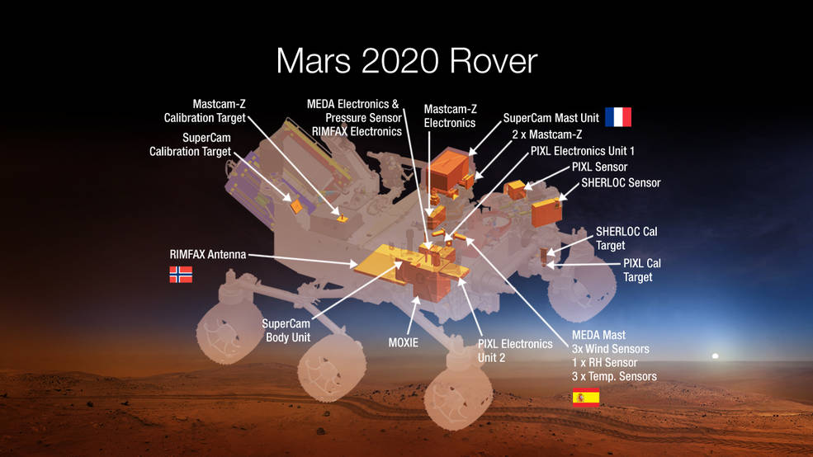
The Mars 2020 Rover is now called “Perseverance” - NASA
“Designed to advance high-priority science goals for Mars exploration, the mission would address key questions about the potential for life on Mars.”

Slide 22
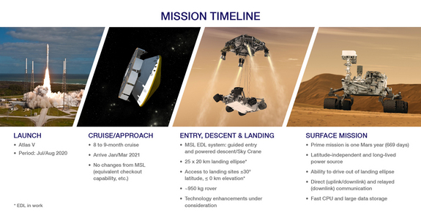

Slide 23
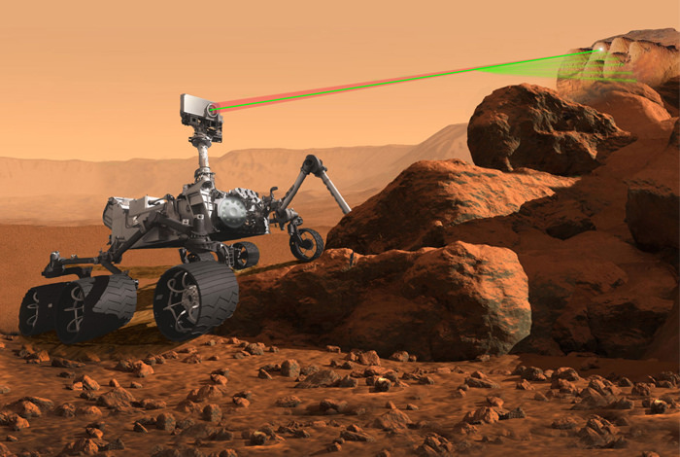
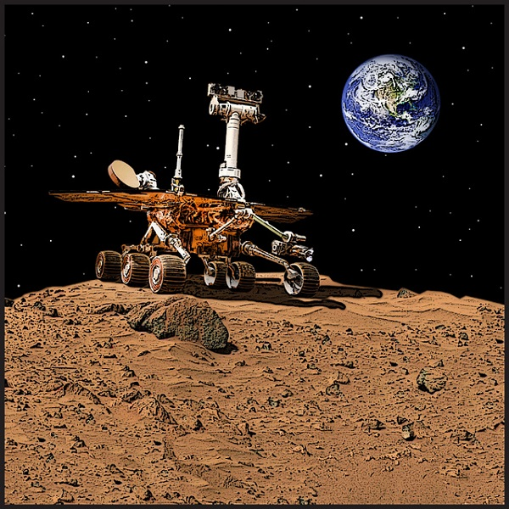
The 2020 rover will be based on the successful design of the Mars Science Laboratory Rover “Curiosity.”
“The Mars 2020 rover also will help advance our knowledge of how future human explorers could use natural resources available on the surface of the Red Planet. An ability to live off the Martian land would transform future exploration of the planet.”
“This mission will further our search for life in the universe and also offer opportunities to advance new capabilities in exploration technology.”

Slide 24
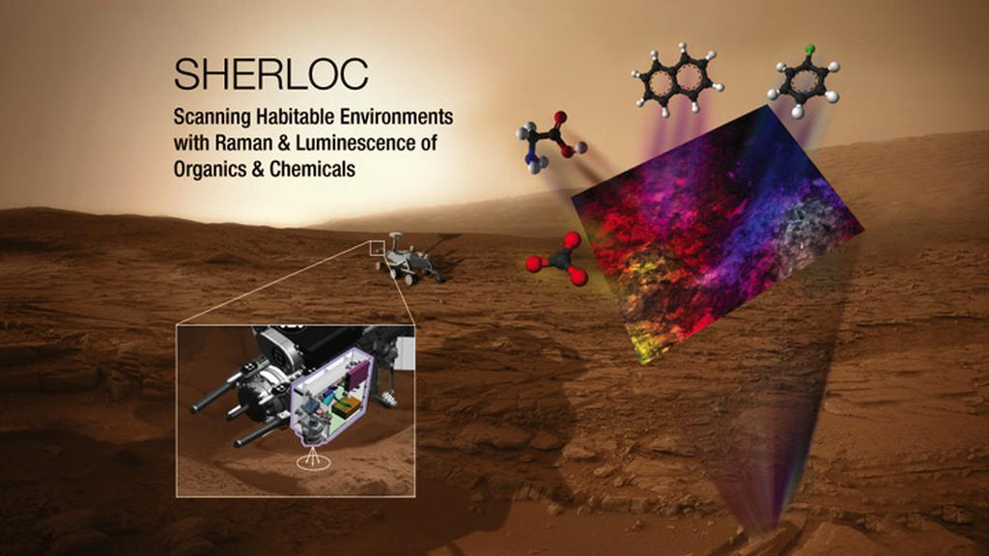
Mars 2020 Rover Instruments:
SHERLOCK: Scanning Habitable Environments with Raman & Luminescence for Organics and Chemicals
“ (SHERLOC)… a spectrometer that will provide fine-scale imaging and uses an ultraviolet (UV) laser to determine fine-scale mineralogy and detect organic compounds”.

Slide 25
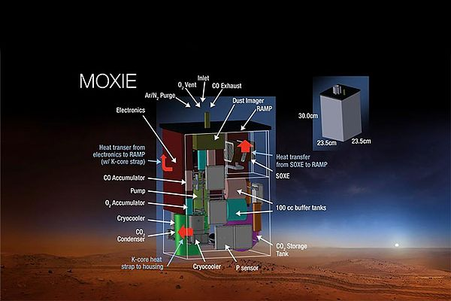
Of MAJOR importance is:
“The Mars Oxygen In Situ Resource Utilization Experiment (MOXIE), (is) an exploration technology investigation that will produce oxygen from Martian atmospheric carbon dioxide.” (Mar’s atmosphere is 95% carbon dioxide.)
Essential for Mars surface missions and colonies.

Slide 26
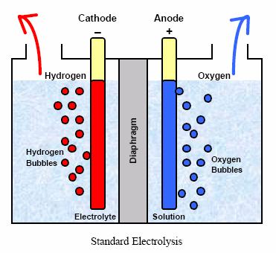
Obtaining Oxygen through Electrolysis:
“The process involves placing two electrodes in a tank with water in it and switching on an electric current to run through the water. Viola ! Oxygen can be collected at one end of the tank, near the anode, and hydrogen can be collected at the other end, the cathode.”
(Note: hydrogen and oxygen are rocket propellants.)

Slide 27
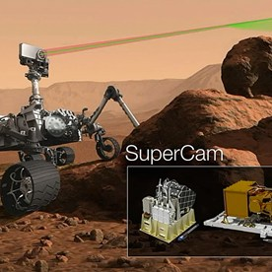
“SuperCam, an instrument that can provide imaging, chemical composition analysis, and mineralogy.”

Slide 28
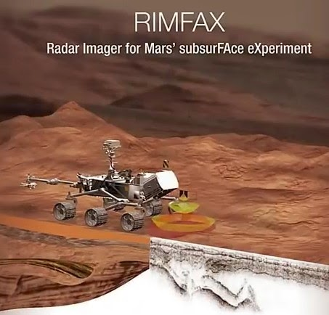
“The Radar Imager for Mars' Subsurface Experiment (RIMFAX), a ground-penetrating radar that will provide centimeter-scale resolution of the geologic structure of the subsurface.”

Slide 29
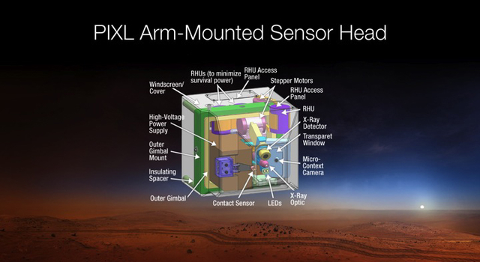
“Planetary Instrument for X-ray Litho chemistry (PIXL) (will) determine the fine scale elemental composition of Martian surface materials.”

Slide 30
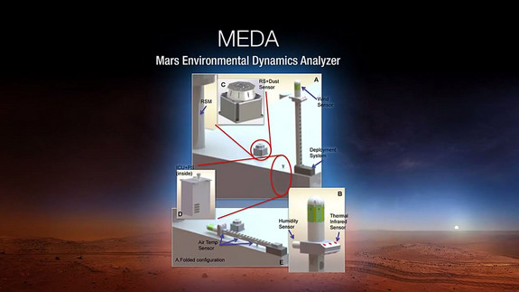
“Mars Environmental Dynamics Analyzer (MEDA), (comprises) a set of sensors that will provide measurements of temperature, wind speed and direction, pressure, relative humidity and dust size and shape.”

Slide 31
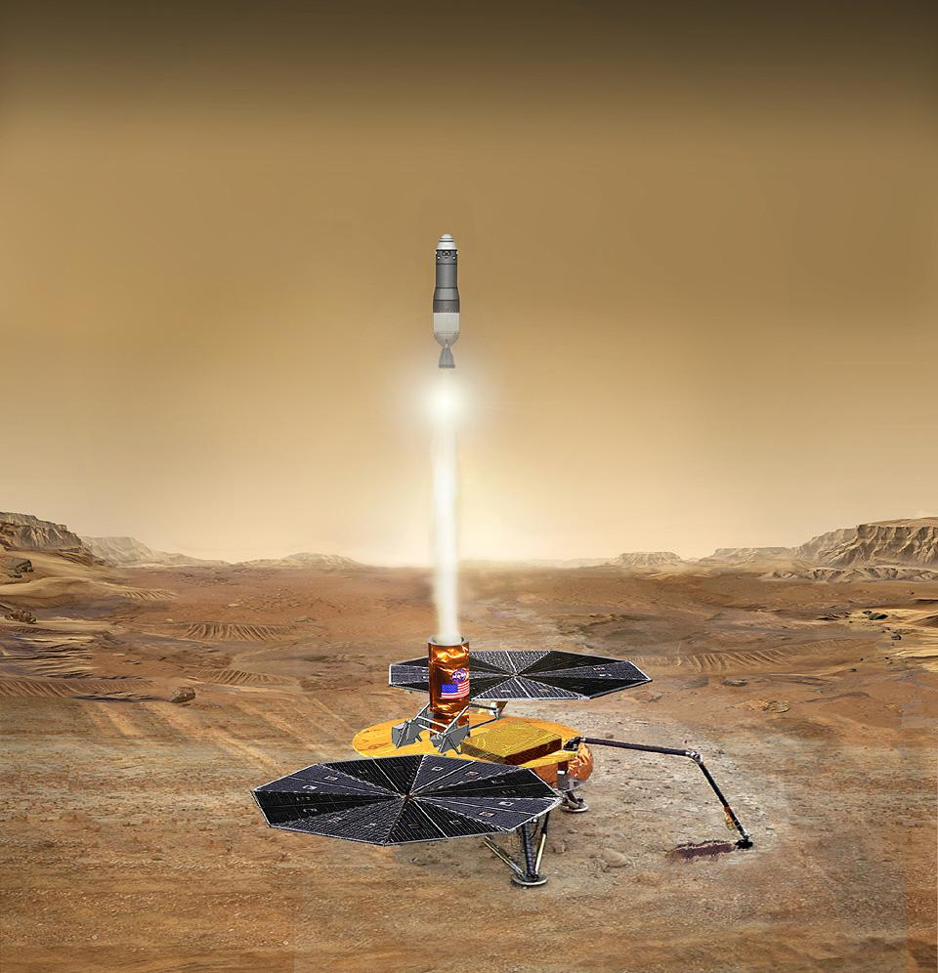
Mars Sample Return Mission
The 2020 rover will collect samples for a future Mars Sample Return Mission.

Slide 32
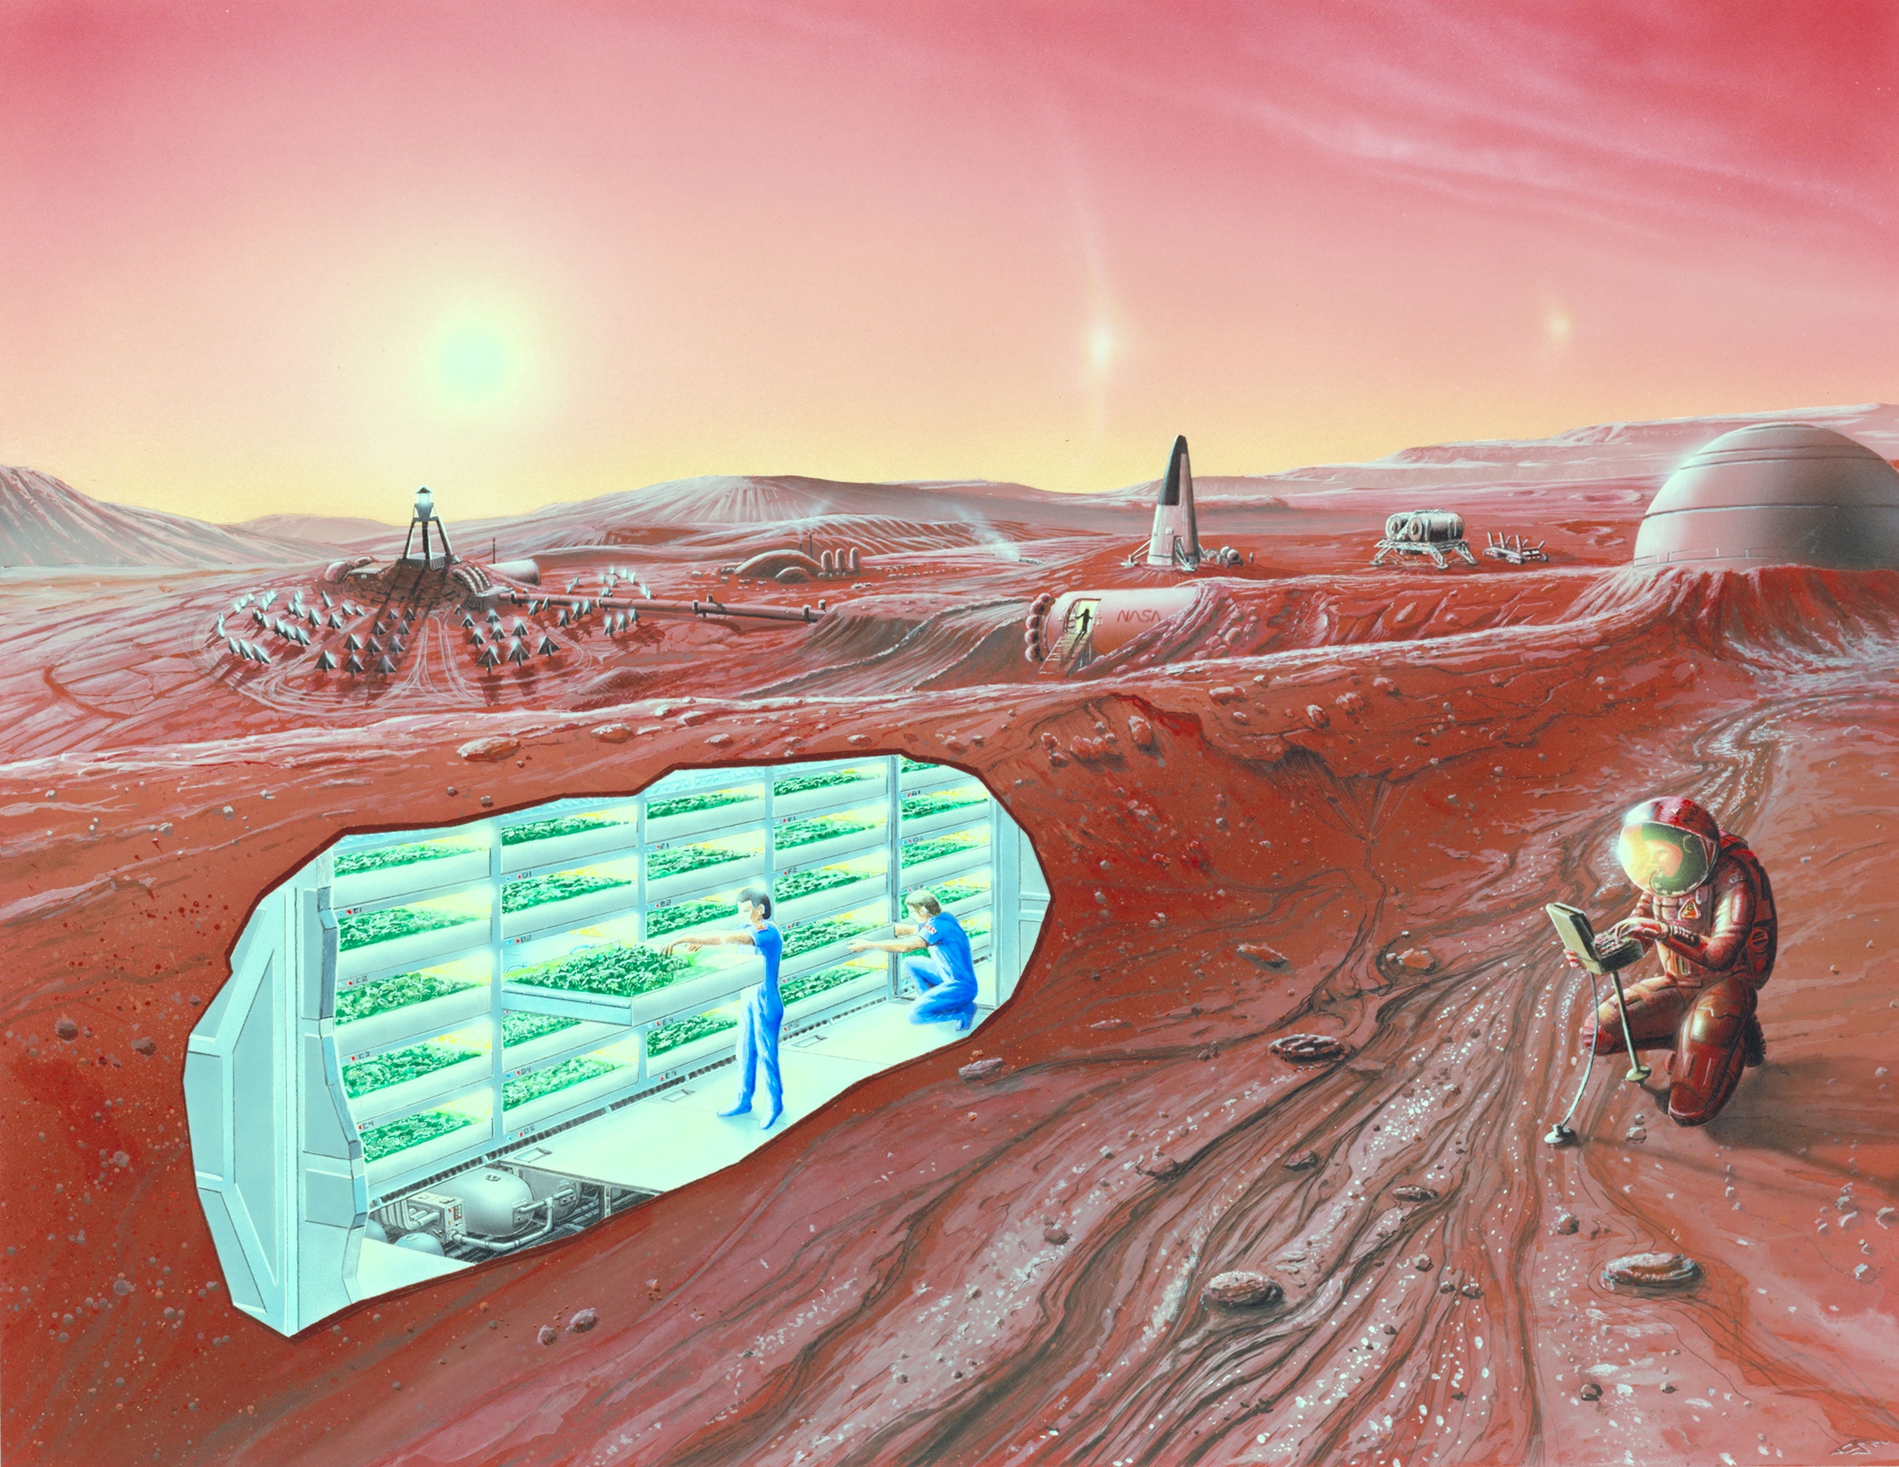
Mar’s radiation is 2x that of Earth.
Habs buried 10 to 16 feet or in caves or in covered craters
“The safety of astronauts is of paramount importance to NASA. Mars lacks an ozone layer, which on Earth shields us from lethal doses of solar ultraviolet radiation. A more detailed understanding of the radiation environment will provide the information necessary to assess the effects of UV radiation on astronauts, as well as help engineers design protective space suits and habitats.”

Slide 33

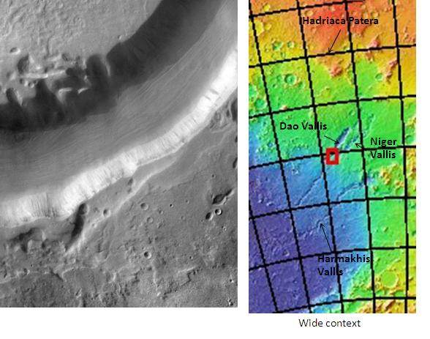

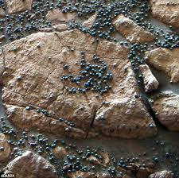
Water on Mars: Water = oxygen + hydrogen
Indications of past water deposits, streams, rivers beds have been discovered by Mariner 9, Viking, Mars Global Surveyor, Mars Pathfinder, Mars Odyssey, Mars Reconnaissance Orbiter, Phoenix, Spirit, Opportunity, and Curiosity,

Slide 34
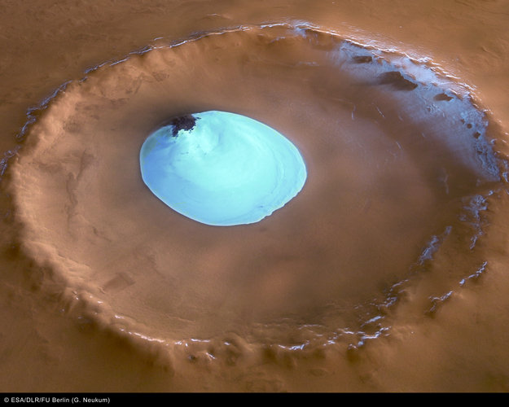

IN LOOKING FOR EXTRATERRESTRIAL LIFE,
THE NASA DIRECTIVE IS TO “FOLLOW THE WATER.”
WATER ICE FOUND IN A “YOUNG” CRATER ON NORTH POLE OF MARS
(FOUND BY MARS EXPRESS SPACECRAFT) IN 2005

Slide 35
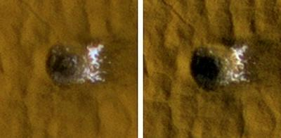
In Sublimation…
Water ice
water ice goes from solid to gas, not liquid.
IN 2005 THE MARS RECONNAISSANCE ORBITER FOUND WATER ICE IN A FRESH CRATER NEAR THE EQUATOR ON MARS.

Slide 36
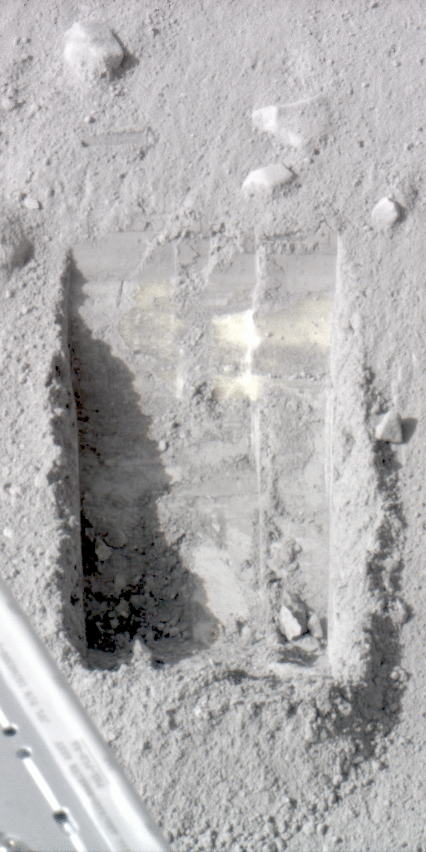
IN 2008, THE “PHOENIX” SPACECRAFT DISCOVERED WATER ICE TWO INCHES UNDER ITSELF.

Slide 37
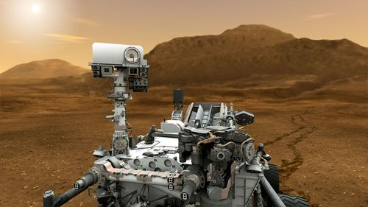
A NASA STATEMENT SAYS THAT
“MARS COULD HAVE SUPPORTED PRIMITIVE LIFE.”

Slide 38
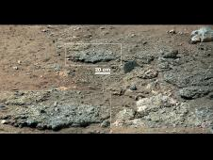
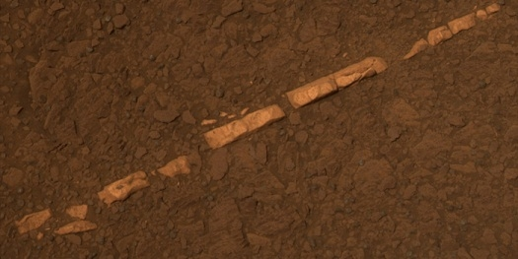
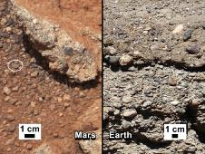


In 2013 THE MARS ROVER “CURIOSITY” FOUND PROOF OF WATER THAT “COULD HAVE SUPPORTED LIFE AND WOULD HAVE BEEN DRINKABLE.”

Slide 39

“Curiosity” found an ancient streambed that would have been waist high and warm. Yellowknife bay was “a few meters to tens of meters deep.”

Slide 40
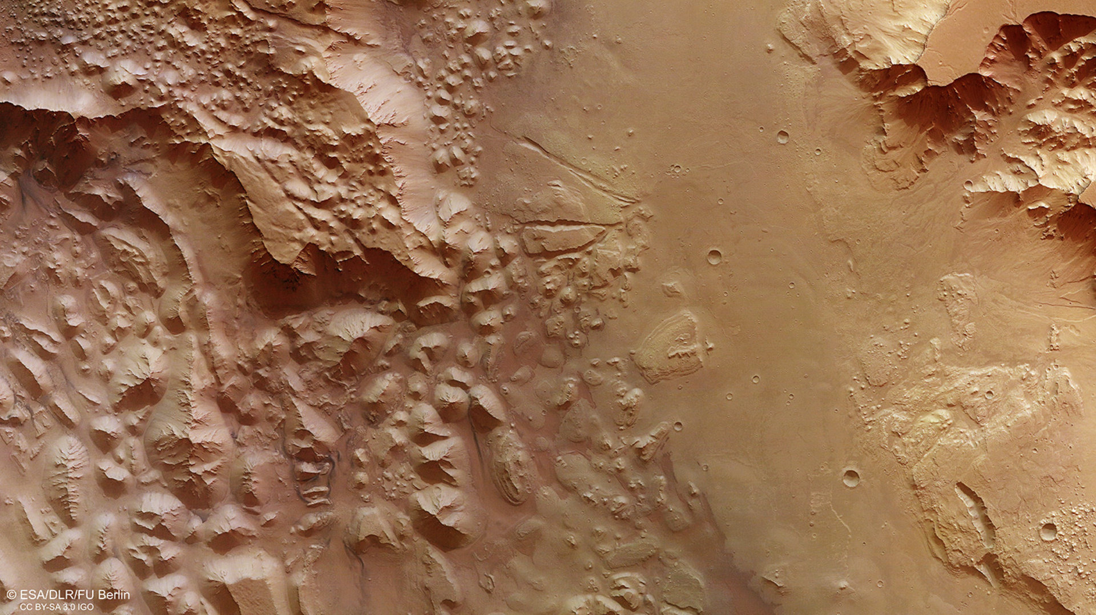
Vast volumes of water once flooded through this deep chasm on Mars that connects the ‘Grand Canyon’ of the Solar System – Valles Marineris – to the planet’s northern lowlands.

Slide 41
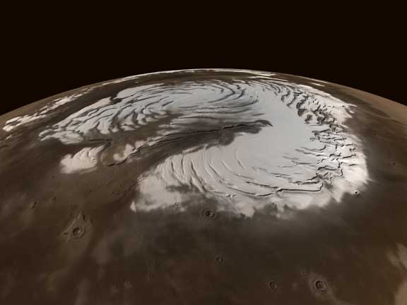
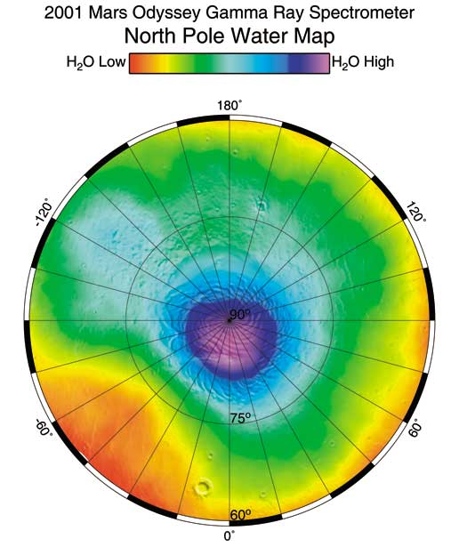
North Pole of Mars

Slide 42
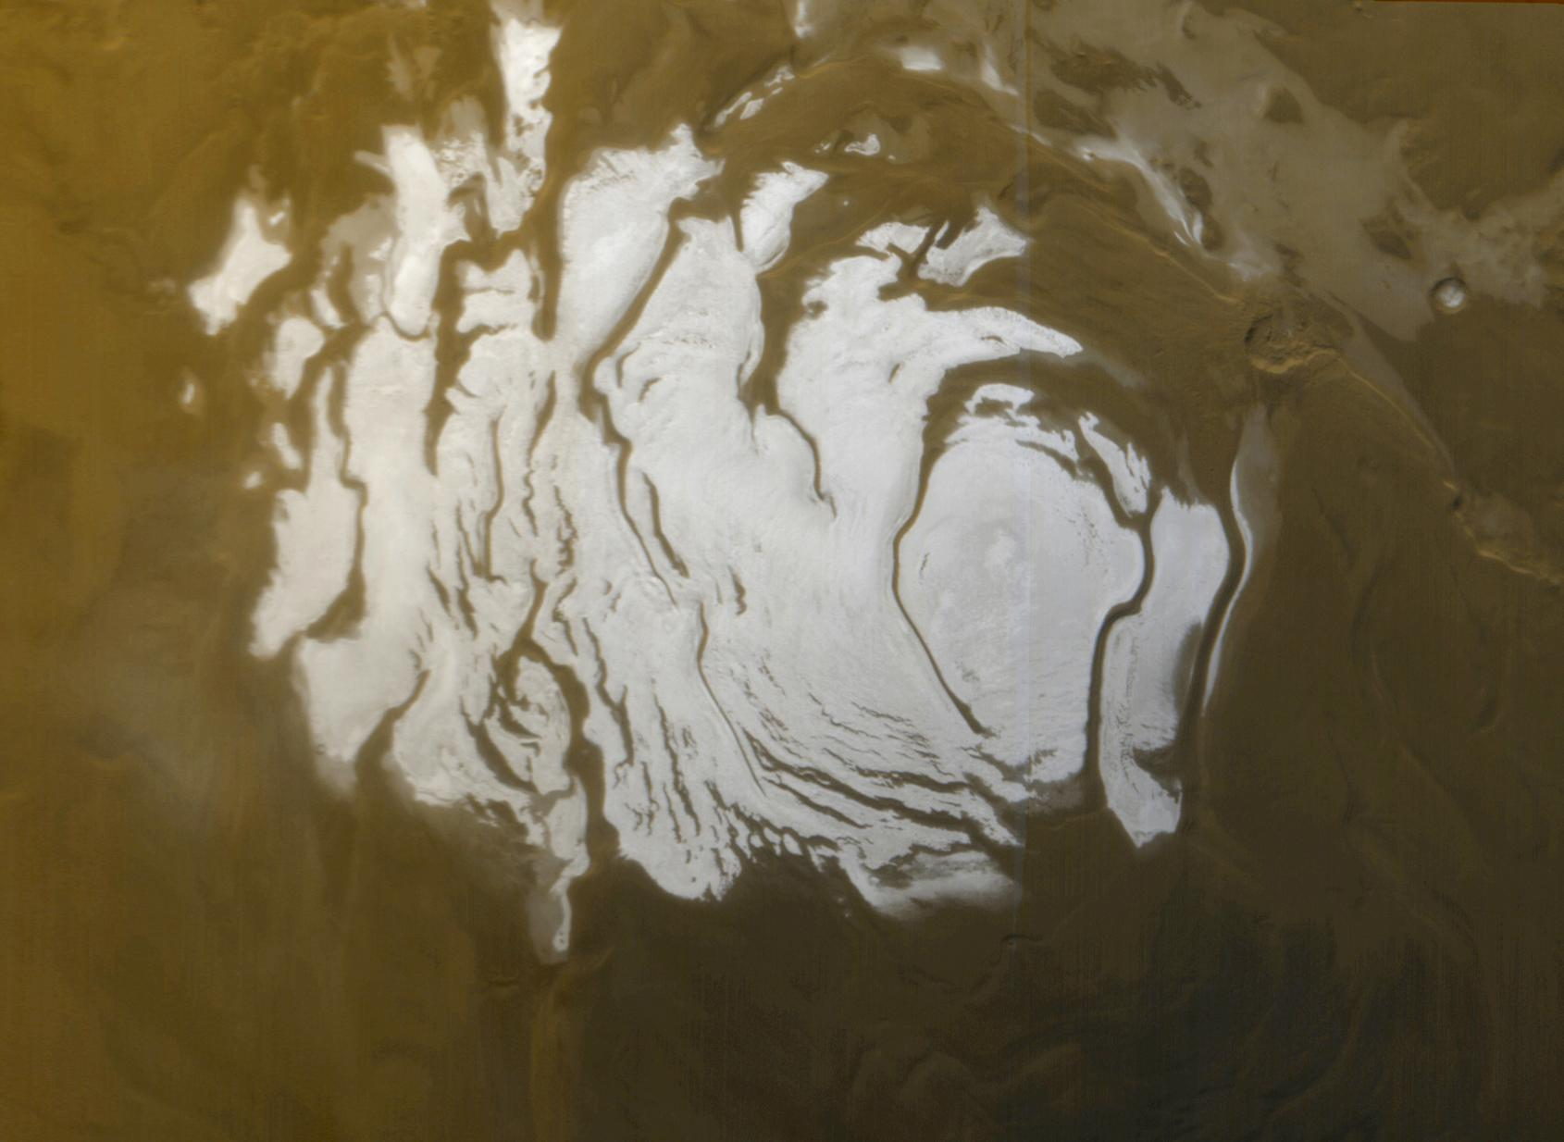
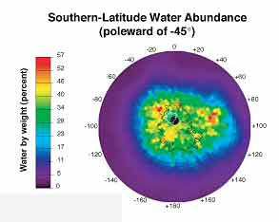
South Pole of Mars
“Mars is unlikely to sport beachfront property anytime soon, but the planet has enough water ice at its south pole to blanket the entire planet in more than 30 feet of water if everything thawed out.”
One futurist envisions giant solar power arrays to direct sunlight to defrost Mars poles.

Slide 43
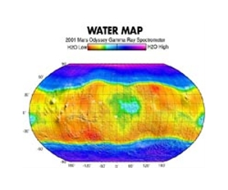

Slide 44
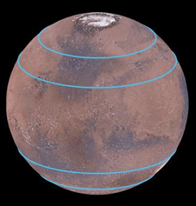
“Mars distinct polar ice caps, but Mars also has belts of glaciers at its central latitudes – between the blue lines, in both the southern and northern hemispheres. A thick layer of dust covers the glaciers, so they appear as the surface of the ground, but radar measurements show that there are glaciers composed of frozen water underneath the dust. (Credit: Mars Digital Image Model, NASA/ Nanna Karlsson)”

Slide 45
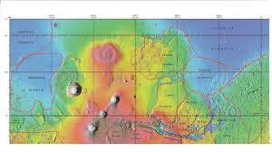
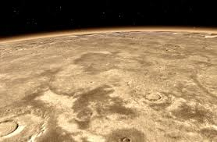
“A giant slab of ice as big as California and Texas combined lurks just beneath the surface of Mars between its equator and north pole, researchers say.
This ice may be the result of snowfall tens of millions of years ago on Mars, scientists added.”

Slide 46
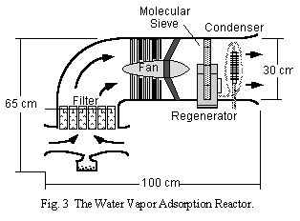
Water Farming on Mars:
the Water Vapor Absorption Reactor (WAVAR) Mars atmosphere is thin but its humidity is 100%.
WAVAR would draw Mars atmosphere over water absorbing minerals. “Once it has reached saturation, the water vapor is desorbed from the bed, condensed, and piped to storage.”
Seven components: “…a filter, and adsorption bed, a fan, a bed rotating mechanism, a condenser, and an active control system.”
University of Washington 1998

Slide 47

Thirsty?
“Heating dirt forces the water out of it. About 3 cubic feet of (Mars) dirt would produce 6 pints of water, enough for one person for 1 day.” “Curiosity” found water molecules with its SAM instrument suggesting that soil on Mars contains 2 pints of water per cubic foot of soil.

Slide 48
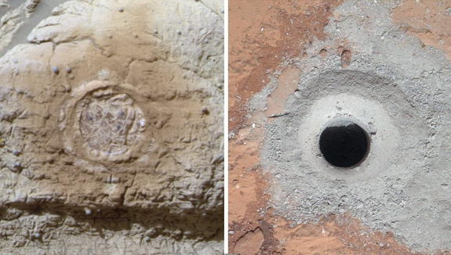

THE MARS ROVER “CURIOSITY”
“IDENTIFIED SOME OF THE KEY INGREDIENTS FOR LIFE on MARS:
SULPHUR, NITROGEN, (HYDROGEN), OXYGEN, PHOSPHOROUS, AND CARBON.”
“THAT’S A VIRTUAL FEAST FOR BACTERIA KNOWN AS CHEMOLITHOAUTOTROPHS WHICH THRIVE ON EARTH IN SULFUROUS CAVES AND AROUND HYDROTHERMAL VENTS.”

Slide 49

THE SAMPLE ANALYSIS AT MARS
INSTRUMENT (SAM)
“…DETECTED TWO SIMPLE CHOLORINATED
AT THE JOHN KLEIN SITE -
CHOLORMETHANE AND DICHLOROMETHANE”
ORGANICS

Slide 50


Slide 51

110 microorganisms were found in a salty ice cave in Canada.
Most were new.
“No need for organic material to support life.”
"The microbes we found and described at Lost Hammer Spring (Canada) are surprising, because, unlike other microorganisms, they don't depend on organic material or oxygen to live," adds Whyte. "Instead, they survive by eating and breathing simple inorganic compounds such as methane, sulfides, sulfate, carbon monoxide and carbon dioxide, all of which are found on Mars. They can also fix carbon dioxide and nitrogen gasses from the atmosphere, all of which makes them highly adapted to both surviving and thriving in very extreme environments
on Earth and beyond."

Slide 52

Water on Mars would have existed for 100s of millions of years. On Earth, that was enough time for simple life forms to develop.

Slide 53

Buzz Aldrin has proposed a spaceship to cycle from Earth to Mars
.
The Mars Cycler concept

Slide 54

Boeing concept Mars Configuration for Mars Surface Mission

Slide 55


Barcan Dunes on Mars are shaped by wind.

Slide 56




Slide 57

Terraforming: Got a 1,000 years?

Slide 58


Slide 59


Mars or Bust!

