Slide 1
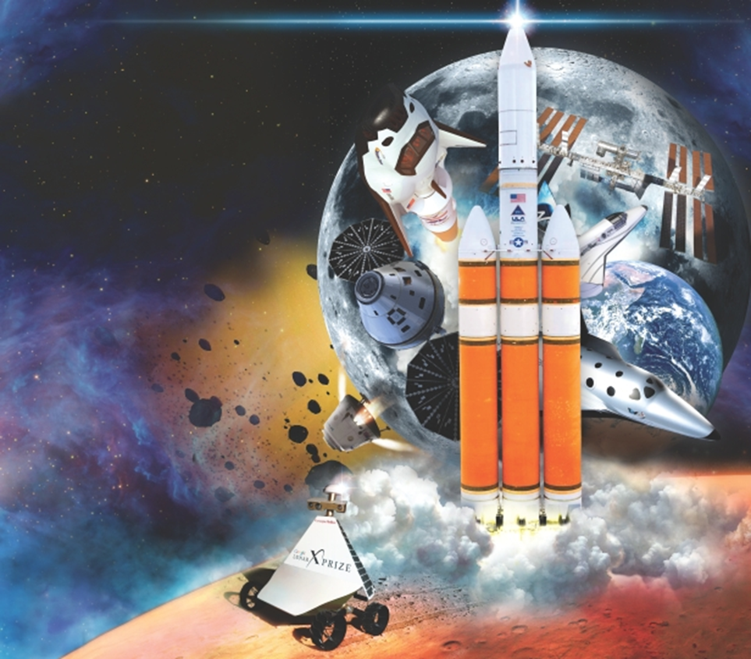

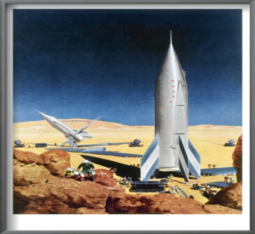
NASA Space Exploration:
The Only Way is UP!

Slide 2
References:
“All about Europa” The Book of Space
“20 Incredible NASA Projects” All About Space
“Europa Tides” Astronomy Magazine
“Life Beyond Earth” National Geographic
“Europa or Bust” Popular Science “Wow! Ancient Mars Could Have Supported Primitive Life, NASA Says” Space.com
“Is Anybody Out There?” Discover
“Is There Life on Jupiter’s Moons?” Space Today
“Jupiter Moon May Have Life” National Geographic
“Astrobiology…Life, the Universe, and More” Astrobiology Institute
“How NASA’s Europa Mission works” How It Works

Slide 3
“NASA Exploration Roadmap: A return to the Moon’s Surface documented” Spaceflight.com
“Journey to Mars” Space.com
“NASA Eyes Plan for Deep-Space Outpost Near the Moon” Space.com
“Extreme Shrimp May Hold Clues to Alien Life” NASA
“NEXT provides propulsion for Deep Space Missions” NASA
“Is Warp Drive Real?” NASA
“NASA’s 100 Year Space Ship Project sets sights on Interstellar travel” Space.com
“NASA Announces MAR 2020 Payload to explore the Red Planet” NASA
“NASA is planning to deflect an asteroid in 2022 to learn how to protect Earth” Mars VOX
“Mars Surface Mission Workshop” Lunar and Planetary Institute
“SHERLOC to micro-map Mars minerals and carbon rings” JPL
“NASA announces Mars 2020 Rover Payload to explore the Red Planet as never before” NASA

Slide 4
“NASA is mulling a plan to visit Mars via its Moon Phobos” NASA
“Boeing SLS Mission Booklet” Boeing
“A Mission to Phobos will also provide samples from Mars” Astrobiology Magazine
Welcome to Mars Buzz Aldrin
“How We will Live on Mars” Steven Petranek
“Elon Musk will reveal Mars Colonizing Spaceship this Year” Business Insider
“Elon Musk and SpaceX want to Colonize Mars in a Decade” Daily Caller
“Giant Pool of Water Ice at Mars South Pole” Space.com
“ExoMars Schiaparelli Lander Crashed due to a Computer Glitch” IU4News
“ESA’s EXOMARS Rover now has a name-Rosalind Franklin”
“Orion Suit Equipped to Expect the Unexpected on Artemis Missions” NASA
“NASA picks Lockheed Martin to build rocket to carry Mars samples back to Earth” Space.com

Slide 5
“NASA’s New Spacesuit has a Built-in Toilet” Space.com
“NASA Unveils Artemis Generation Spacesuits for Moon Journey & South Pole Landing” Space UP Close
“NASA Just Unveiled the Spacesuit to be Worn by First Woman on the Moon” Space.com
“NASA Unveils Its New Spacesuits That Will Take Us To The Moon And Mars, And They're Pure Sci-Fi” IFL Science
“The origins of life on Earth” Austrailian Academy of Science
“The moon's top layer alone has enough oxygen to sustain 8 billion people for 100,000 years” The Conversation
“Northrop Grumman reveals plans for new astronaut moon buggy” Space.com
“What will the James Webb Space Telescope Uncover?” Sky & Telescope

Slide 6
In looking for signs of life, the directive is to
“follow the water…”
NASA

Slide 7
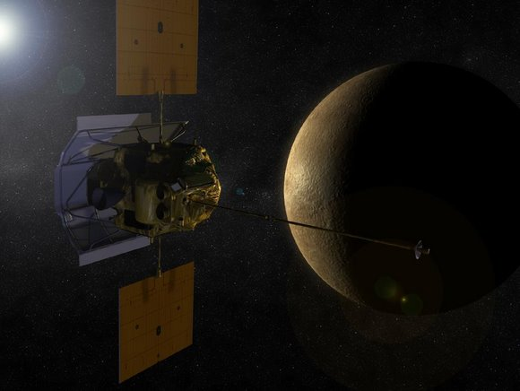
Mercury
Messenger Spacecraft

Slide 8
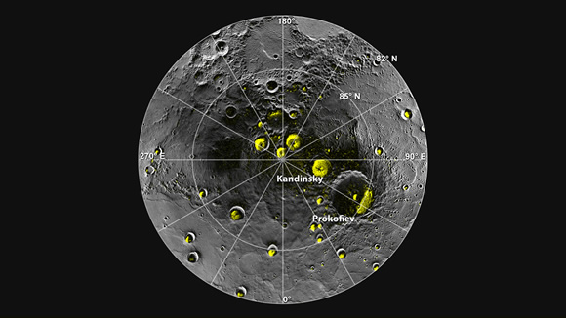
Messenger Discoveries: Organic materials and water ice
North Pole

Slide 9
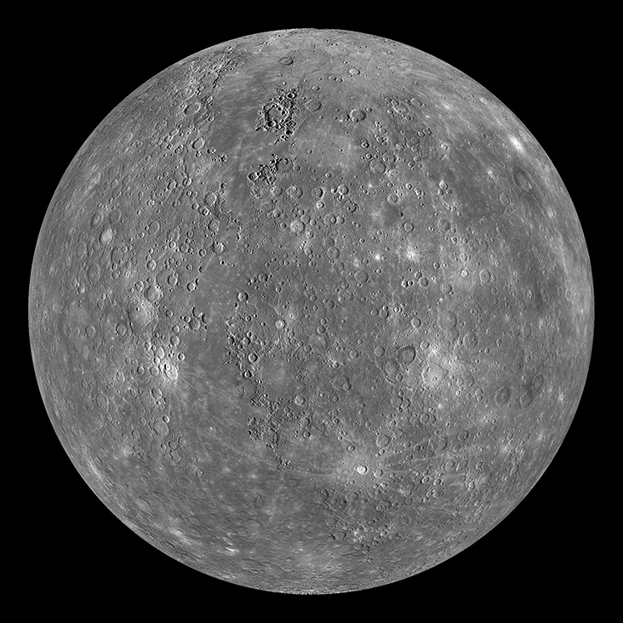
Scientists estimate the planet holds between 100 billion and 1 trillion tons of water ice, perhaps as deep as 66 feet in some places.

Slide 10
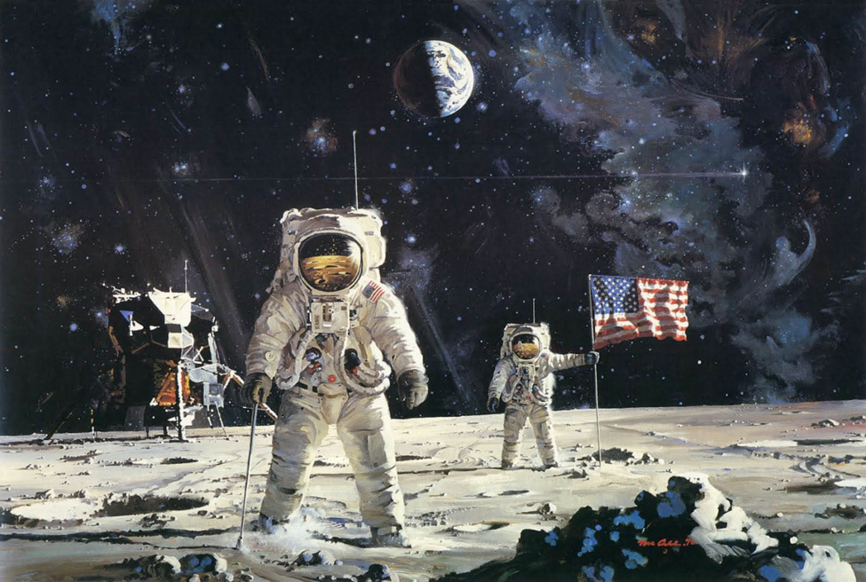
Our Moon Luna…

Slide 11
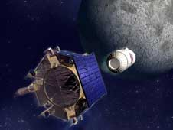
LCROSS:
Lunar Crater Observation & Sensing Satellite
The Centaur upper stage separates from LCROSS to later impact with the moon throwing up a plume studied in a flyby through the plume.

Slide 12
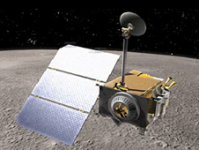
Lunar Reconnaissance Orbiter
Took measurements of the plume ejected by LCROSS impactor.

Slide 13
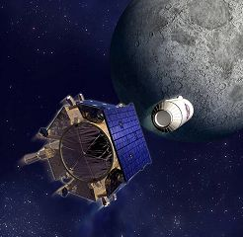
The impact plumes of the Lunar CRater Observation and Sensing Satellite (LCROSS) and its Centaur rocket stage in Cabeus crater near the south pole of the Moon on 9 October 2009 indicated concentrations of roughly 6% water in the impact area.

Slide 14
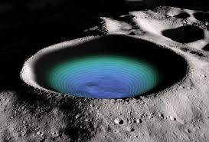
The Moon has no sandstones, shales, clays, or limestones such as indicate water-borne processes. Water has been found on the Moon as ice found in craters at the poles and in pyroclastic deposits – water trapped in “glass beads.”. Some astrophysicists estimate vast deposits.

Slide 15
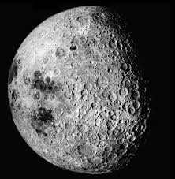
The Indian Chandrayaan-1 Moon Mineralogy Mapper experiment showed low-concentration hydroxyl signatures over much of the lunar surface, not just in permanently shadowed craters. The Mini-SAR experiment indicated possible large deposits of water-ice in the northern lunar craters.

Slide 16
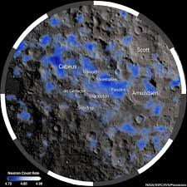
"Indeed, yes, we found water. And we didn't find just a little bit, we found a significant amount."
Anthony Colaprete, LCROSS project scientist and principal investigator from NASA's Ames Research Center.

Slide 17
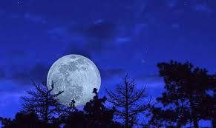
Water can be separated into hydrogen for rocket fuel and oxygen to breathe.

Slide 18
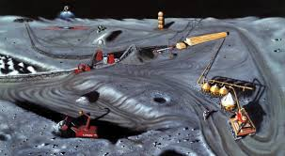
Helium-3, a lighter isotope of the helium used in balloons, exists scattered on the Moon’s surface.
The moon has 1 million to 5 million tons of helium-3.

Slide 19
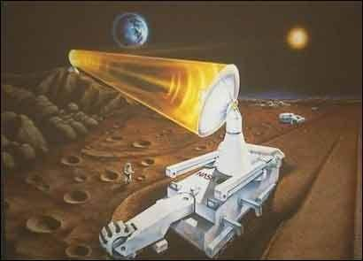
Just 40 tons of Helium 3 has enough potential energy to meet the total U.S. electricity demand for a year. However, there is almost no helium-3 on Earth. The closest supply is on the moon.

Slide 20
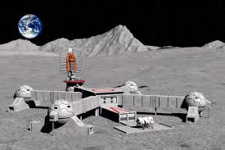
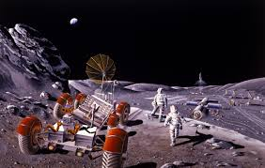
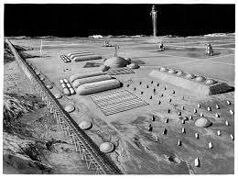
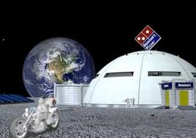
This would require bases on the Moon and fusion reactors on Earth.

Slide 21
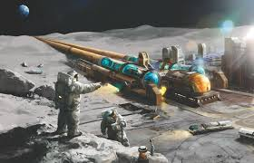
A mass driver is a large rail gun which would fire helium 3 modules toward Earth orbit where they would be mated with landing modules.

Slide 22
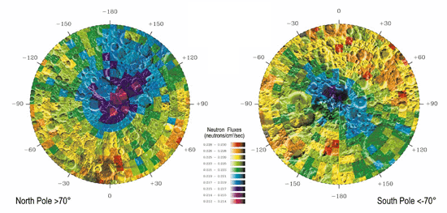
“Significant amount” of water ice and hydrogen found.
Image Above: The dark blue and purple areas at the moon’s poles indicate neutron emissions that are consistent with hydrogen-rich deposits covered by desiccated regolith.

Slide 23
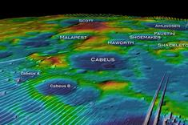
South Pole
The biggest revelation uncovered by researchers in recent years is the discovery of water on the moon, in ice and rocks, across huge craters and vast lunar plains. LRO helped discover the moon's hidden water by watching its partner probe LCROSS crash into the lunar surface in October 2009. LRO and other spacecraft ultimately found evidence of tons of water ice at the moon's north pole and elsewhere.

Slide 24
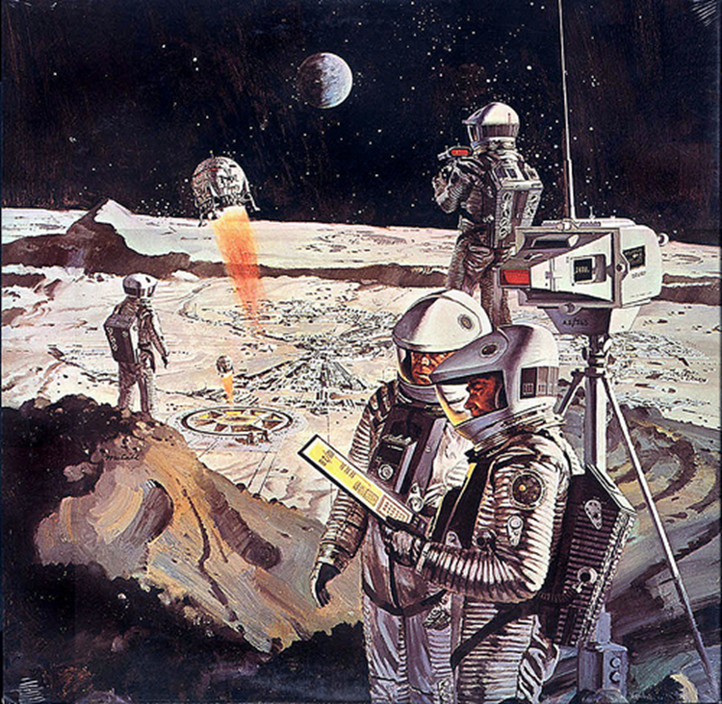
Remember, that water can be processed into oxygen and hydrogen fuel.

Slide 25
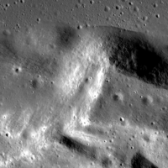
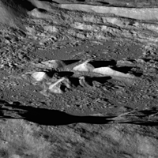
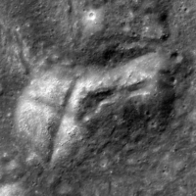
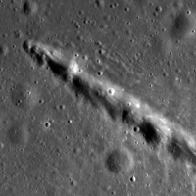
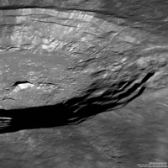
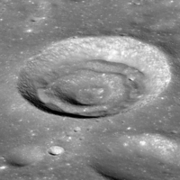
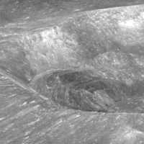
Square Crater
X marks the spot
Chain of Craters
Luna-
pics

Slide 26

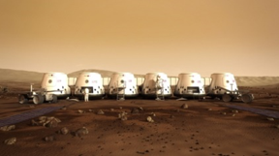
Is there water on Mars?
Proposed Martian Habitats

Slide 27
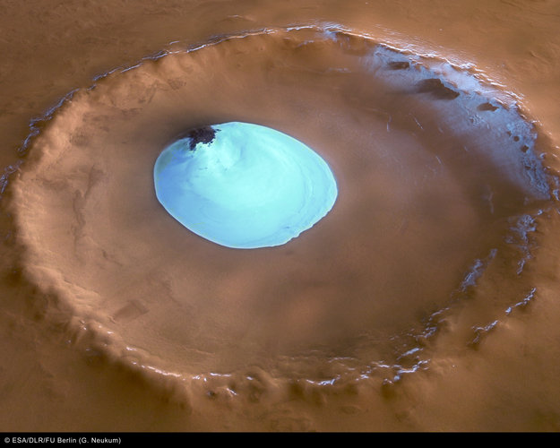

“FOLLOW THE WATER IN LOOKING FOR EXTRATERRESTRIAL LIFE,
THE NASA DIRECTIVE IS TO “follow the water.”
WATER ICE FOUND IN A “YOUNG” CRATER ON NORTH POLE OF MARS
(FOUND BY MARS EXPRESS SPACECRAFT) IN 2005

Slide 28
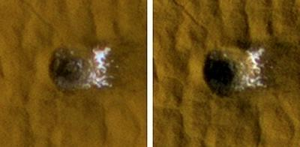
In Sublimation…
Water ice
water ice goes from solid to gas, not liquid.
IN 2005 THE MARS RECONNAISSANCE ORBITER FOUND WATER ICE IN A FRESH CRATER NEAR THE EQUATOR ON MARS

Slide 29
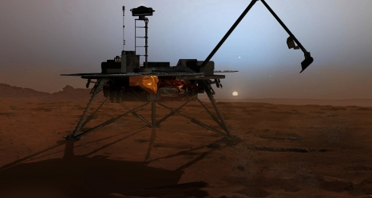
NASA's Phoenix lander detected water ice at its landing site in 2008 and its onboard mass spectrometer found traces of water vapor when the sample was heated above freezing.

Slide 30
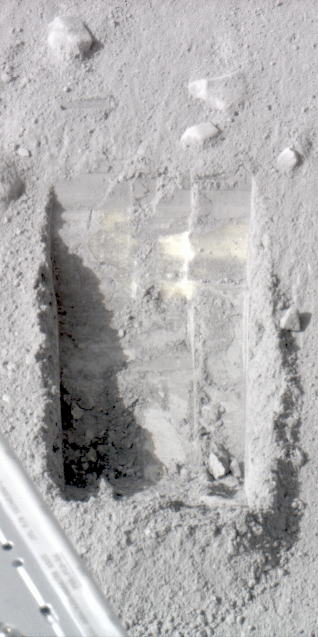
IN 2008, THE LANDER “PHOENIX” ALSO DISCOVERED WATER ICE BURIED TWO INCHES UNDER ITSELF.

Slide 31
“NASA Phoenix results point to Martian Climate Cycles, favorable chemistry, and episodes with thin films of liquid water during ongoing, long-term climate cycles may sometimes make the area where Phoenix landed last year a favorable environment for microbes…”

Slide 32
The Mars Science Laboratory Rover
“Curiosity”

Slide 33
NASA's Curiosity Rover
detected water molecules
in soil samples analyzed
by its SAM (Sample Analysis at Mars) instruments,
suggesting Martian soil contains about
two pints of water per cubic foot of soil !!!

Slide 34
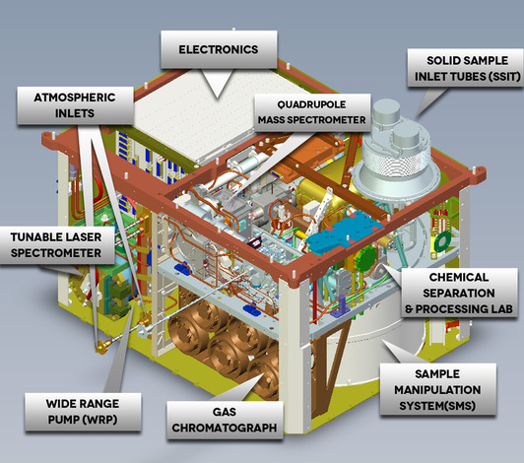
The SAM Instrument

Slide 35
Could life have existed
on Mars?
YES !!!

Slide 36
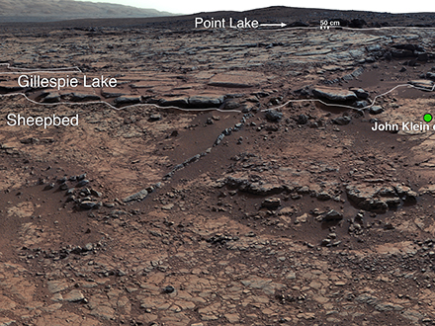
Mar’s John Klein Rock
at Yellowknife Bay

Slide 37
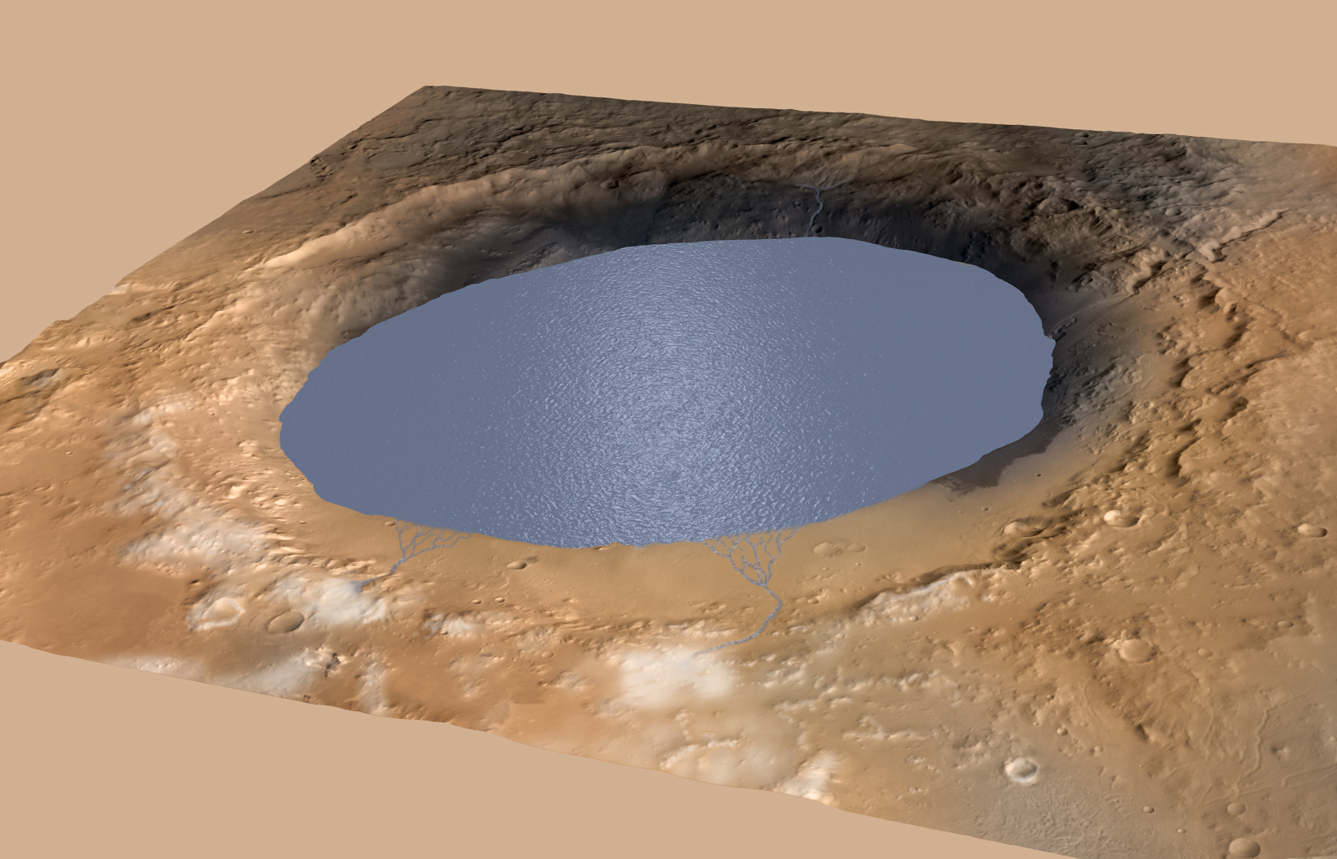
The stream that once flowed here was:
waist deep, warm, and had a Ph range that
could have supported LIFE…
Gale Crater is now considered to have been a vast lake existing on and off for many thousands of years.

Slide 38
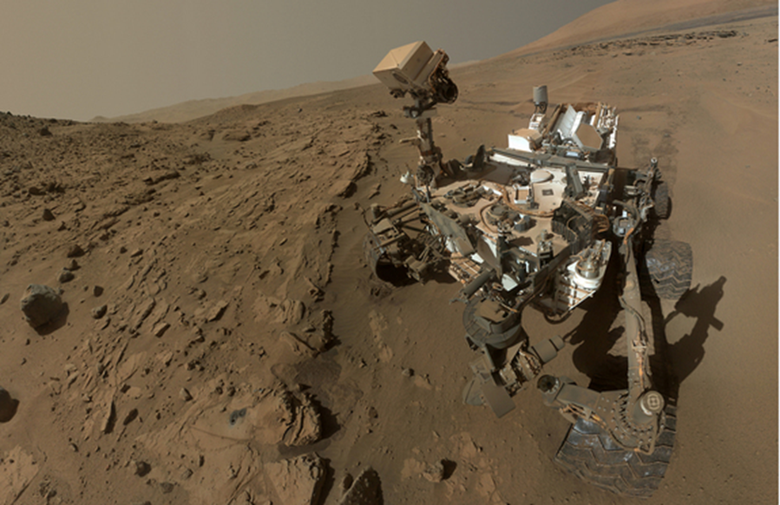
"Curiosity explored Yellowknife Bay and found that it was in an ancient lake-bed environment that several billion years ago offered fresh water and all the key ingredients for life and a chemical source for microbes, if indeed any existed at that time."
The river causing the rounded rocks is considered to have been 30-40 miles long.

Slide 39
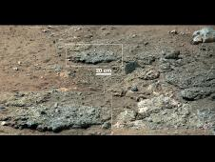
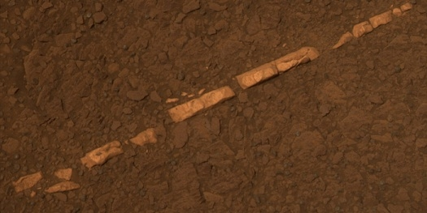
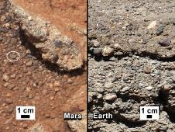
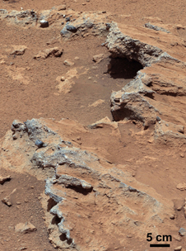
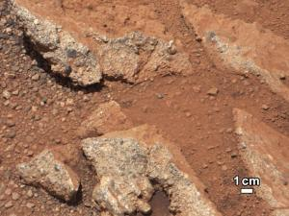
In 2013 THE MARS ROVER “CURIOSITY” FOUND PROOF OF WATER THAT “COULD HAVE SUPPORTED LIFE AND WOULD HAVE BEEN DRINKABLE.”

Slide 40
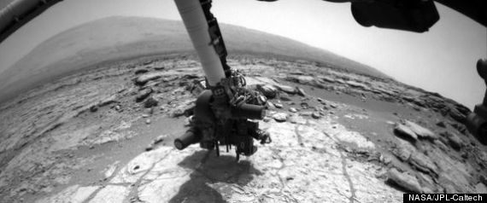
This wet environment was characterized by
neutral pH, low salinity, and variable oxidation of iron- and sulfur-containing minerals.

Slide 41
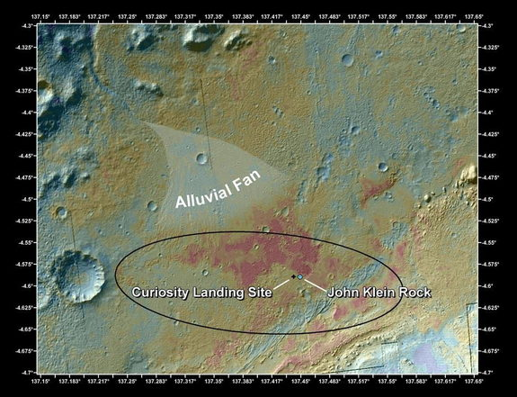
THE SAMPLE ANALYSIS AT MARS
INSTRUMENT (SAM)
“…DETECTED TWO SIMPLE CHOLORINATED
AT THE JOHN KLEIN SITE -
CHOLORMETHANE AND DICHLOROMETHANE”
ORGANICS

Slide 42
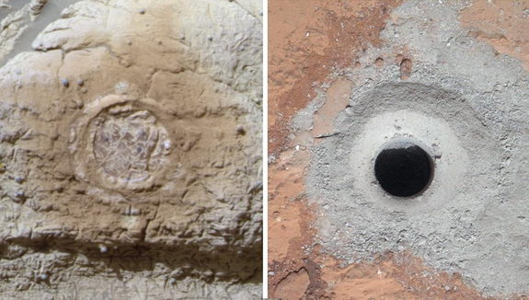
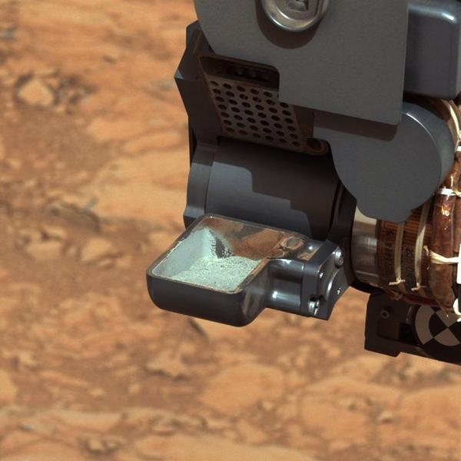
THE MARS ROVER “CURIOSITY”
“IDENTIFIED SOME OF THE KEY INGREDIENTS FOR LIFE
IN THE DUST OF MARS:
SULPHUR, NITROGEN, OXYGEN, HYDROGEN, PHOSPHOROUS, AND CARBON.”

Slide 43
“WE FOUND
CARBON, SULPHUR, AND OXYGEN,
AND A NUMBER OF OTHER ELEMENTS IN STATES
THAT LIFE COULD HAVE TAKEN ADVANTAGE OF.”

Slide 44
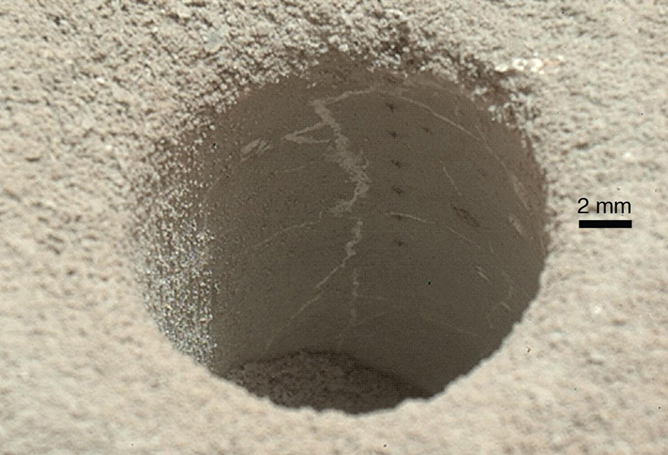
.
These results highlight the biological viability of
fluvial-lacustrine environments
(streams and lakes)
in the history of Mars after the earliest era
of the Martian past, called the Noachian Era.

Slide 45
“THE SAM INSTRUMENT
IS TELLING US THAT THESE ROCKS CONTAINED
ALL OF THE INGREDIENTS NECESSARY FOR A HABITABLE ENVIRONMENT.”

Slide 46
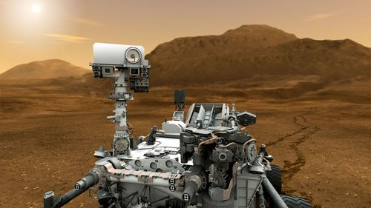
A NASA STATEMENT
SAYS THAT
“MARS COULD HAVE SUPPORTED PRIMITIVE LIFE.”

Slide 47

Stardust Sample Return Capsule from the Comet Wild -2 has been returned to Earth.

Slide 48

Found:
“Glycine…an amino acid…used by organisms to make proteins.”

Slide 49


Comet particles hitting the aerogel “tennis racket”
Sample returned to Earth January 15, 2006
Spacecraft continues on to Jupiter…

Slide 50

The MAVEN Spacecraft Orbiter:
Mars Atmosphere and
Volatile Evolution
Mission

Slide 51

Launched 2014
Arrival at Mars Sept 2015

Slide 52

The atmosphere of Mars

Slide 53
The MAVEN Spacecraft Orbiter
is studying the atmosphere of Mars…and Mar’s
Extreme Climate Change…

Slide 54
Future Missions

Slide 55

INSIGHT: Interior Exploration Using Seismic Investigations, Geodesy and Heat Transport Mars Lander
Arrival at Mars March 2016

Slide 56
Lander will pierce beneath the Martian surface to study its interior. The mission will investigate how Earth-like planets formed and developed their layered inner structure of core, mantle and crust, and will collect information about those interior zones using instruments never before used on Mars.

Slide 57


Slide 58

Mars Rover 2020 will search for evidence of former life, organic compounds, and suitability of Mars as a habitat.
Rover will also test refining oxygen from carbon dioxide in the atmosphere.

Slide 59


Slide 60


Slide 61


OSIRIS-Rex Sample Return Mission to the Comet Bennu
Launch September 2016

Slide 62
Osiris-REx:
The Origins Spectral Interpretation Resource Identification Security -- Regolith Explorer
2016

Slide 63
The OSIRIS-REX Spacecraft will return a 2.1 ounce sample of the Comet BENNU to Earth.

Slide 64
The Spacecraft Base will remain to study the Comet

Slide 65

The DAWN spacecraft entered orbit around the asteroid Vesta on February 14, 2015.
A study of and the dwarf planet Ceres will follow.

Slide 66
By studying both these two distinct bodies with the same complement of instruments on the same spacecraft, the Dawn mission hopes to compare the different evolutionary path each took as well as create a picture of the early solar system overall.

Slide 67

Galileo, Voyager and Cassini Missions to the Outer Planets…

Slide 68


Slide 69

Saturn

Slide 70

Saturn
Pillars of ice in the rings

Slide 71

Saturn’s Hexagon
at the north pole.

Slide 72



Saturn’s Hexagon
North Pole

Slide 73

Saturn’s Hexagon
20,000 miles across and 200 miles per hour…

Slide 74

Saturn’s spokes in the rings

Slide 75

Saturn’s spokes…

Slide 76

Saturn Storm…
giant
storm
head

Slide 77

Saturn’s long lived storm
Thought to extend through all layers

Slide 78

Encke Gap

Slide 79

Braided rings

Slide 80

Saturn’s churning atmosphere

Slide 81

Saturn’s Auroras

Slide 82


Slide 83

Northern Aurora

Slide 84

False color mosaic

Slide 85

The Europa Clipper will orbit in 2025.
A landing mission would follow to penetrate the icy crust and look for a suspected salty sea.

Slide 86

Saturn’s Moon Europa
Artist’s simulation
Geysers spouting water ice…

Slide 87


Slide 88
Europa is thought to be a moon of ice over a salt water sea with a silicate rock base and iron core.
With abundant liquid water, and energy and chemistry provided by tidal heating, Europa could be the best place in the solar system to look for present day life beyond Earth.
Scientists postulate deep “smokers” like those in the Pacific and Caribbean where minerals and nutrients support abundant life such as shrimp.

Slide 89

Water plume in blue

Slide 90
Jupiter’s Europa “appears to contain likely ingredients for life:
water
an energy source (tidal heating by Jupiter)
organic compounds,
and millions of years for development…

Slide 91

Europa: clay minerals found:
Evidence of water activity

Slide 92

Saturn’s Moon Enceladus
Fountain-like Geysers of the fine spray of material that towers over the south polar region.

Slide 93

The geysers of Enceladus
100s of miles high,
are spewing out…

Slide 94

water vapor, ice crystals, nitrogen gas, carbon dioxide, ammonia, propane, and acetylene.

Slide 95

Add these simple hydrocarbon chains, an organic mixture, a heat source, and liquid water---
all of these are the key ingredients
for LIFE.

Slide 96
Scientists infer the ocean is salty because water plumes shooting out of cracks in Enceladus’ southern pole and sampled by Cassini contain salts, as well as organic molecules. That would happen if minerals from underlying rock were leaching into water, a chemistry that bodes well for the development and evolution of life.

Slide 97


Slide 98



Titan
Hydrocarbon rainfall fills lakes
Hydrocarbons are a form of organic compound that is also found naturally on Earth and includes methane

Slide 99


Slide 100

Titan pebbles

Slide 101

Titan
“In fact, Titan's rich mixture of organic chemicals is one of the qualities that make it such an interesting place to study, since conditions on our own world might have been similar (although much warmer) early in Earth's history, before the appearance of life.”

Slide 102

The yellow represents clouds and the magenta is the atmosphere of nitrogen (95%), methane (5%), and organic compounds.
“The organic molecules contain carbon and hydrogen, and often include nitrogen, oxygen and other elements important to life on Earth.”

Slide 103

Mosaic of river region

Slide 104

Titan

Slide 105

Jupiter
The primary scientific goal of the Juno mission is to significantly improve our understanding of the formation, evolution and structure of Jupiter. Concealed beneath a dense cover of clouds, Jupiter, the archetypical "Giant Planet," safeguards secrets to the fundamental processes underlying the early formation of our solar system. Present theories of the origin and early evolution of our solar system are currently at an impasse.

Slide 106

Recent Hubble Space Telescope images of the storm show that it is now 10,250 miles (16,496 kilometers) across, which is less than half the size of the storm in the late 1800s. At one point, scientists theorized that three Earths could fit inside the Great Red Spot, but today, only the width of one Earth could fit within the raging tempest.

Slide 107

Mimas and Death Star

Slide 108

Hyperion
sponge-like structure

Slide 109


The New Horizons Pluto-Kuiper Belt Mission, launched in January 2006 and due to arrive at Pluto in 2015, will help us to understand the icy worlds at the edge of our solar system. The mission will then visit one or more Kuiper Belt Objects beyond Pluto. New Horizons made a close flyby of Jupiter in Feb. 2007 in order to get a gravitational boost enroute to Pluto, shortening its cruise time by about 3 years. The instruments were exercised successfully and returned exciting Jupiter science to earth, including images of a 200 mile high plume from the active Tvashtar volcano.

Slide 110

The Space Launch System

Slide 111

Block 1
Block 2
Payload of154,000 pounds to orbit
Payload of 286,000 pounds to orbit.
Michoud Assembly Center
Aerojet Rcketdyne by Pratt Whitney at Stennis Space Center
Main rockets built at Michoud Assembly Center

Slide 112


Slide 113


The James Webb Space Telescope
2019?

Slide 114

  JWST will be a powerful time machine with infrared vision that will peer back over 13.5 billion years to see the first stars and galaxies forming out of the darkness of the early universe.

Slide 115

The International Space Station will be decommissioned and de-orbited at some point after 2024.

Slide 116

NASA’s Orion Spacecraft will fly with a crew for the first time, possibly taking astronauts to visit an asteroid.

Slide 117

The Orion Spacecraft will eventually take astronauts to the Moon.

Slide 118

Orion will eventually take astronauts to Mars.

Slide 119

The Search for Exoplanets
Extra-solar Planets

Slide 120

How are Exoplanets found?
Astrometry: The planet is discovered by the gravitational “wobble” it causes in its star.
Astrometry: As seen above, a star without a companion would appear to travel on a straight line compared to the background stars, but if the star has a companion it will not.

Slide 121

Photometric Transit Method
When a planet passes in front of its star, the star’s brightness dims in a partial eclipse.
.

Slide 122

The light of the star dims when a planet passes in front of it.
Star’s brightness
Lessened brightness

Slide 123

Radial velocity: When the planet around the star will be moving away from us, its tug will drag the star away from us too, which will cause a redshift in the light we receive from it. When the planet is approaching it, the same thing will happen to the star, only that the light is shifted towards blue.
The cross in the image is the gravitational center.
Doppler spectroscopy

Slide 124

Kepler has discovered 960 confirmed Exoplanets
and 3,800 Exoplanet candidates

Slide 125


Slide 126


Slide 127

THE NASA EXOPLANET ARCHIVE lists
1,713 Planets around 1,042 Stars
443 Systems with Multiple Planets
3,845 Kepler Candidates and Confirmed Planets
21,267,578 Transit Survey Light Curves

Slide 128


NASA HAS DISCOVERED WATER ON 5 EXOPLANETS
First direct image of an exoplanet.

Slide 129

The Spitzer Space
Telescope has
discovered a
GIANT planet

Slide 130
“with organic molecules such as water, methane, and carbon dioxide…”

Slide 131

“SCIENTISTS NOW BELIEVE THAT THERE ARE
simulated
TENS OF BILLIONS OF PLANETS

Slide 132

THE GENERAL SIZE OF EARTH
IN OUR MILKY WAY GALAXY ALONE…”

Slide 133
ASTRONOMERS SAY THERE ARE 100 – 200
BILLION GALAXIES,
EACH WITH 1000’s
OF BILLIONS OF STARS.

Slide 134
And billions of EARTH LIKE PLANETS IN OUR Galaxy

Slide 135
SOME ASTRONOMERS BELIEVE THERE ARE
100 BILLION TO A TRILLION GALAXIES

Slide 136
AND EACH GALAXY HAS 100 BILLION TO A TRILLION STARS! WOW !!!

Slide 137
It is estimated that there are
17 or 34 BILLION ROCKY PLANETS LIKE EARTH, depending on which astrophysicist you ask.

Slide 138

Kepler discovers 1st earth-size planet in habitable zone (warm enough for liquid water - deemed necessary for life)
Artist’s simulation
Most planets discovered are 40% larger than Earth

Slide 139

What an amazing universe…
Hubble

Slide 140

Hubble

Slide 141

Hubble

Slide 142

Double click the image for video

Slide 143


