Slide 1
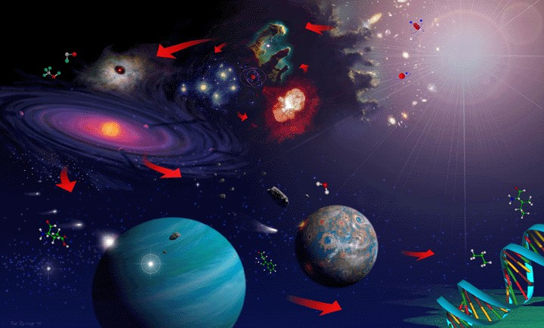
The Origins of Life
The Biological from the Non-biological
Picture by Carl B Pilcher

Slide 2
The Origins of Life:
The Biological from the non-biological

Slide 3


What constitutes life?
A living organism needs all of its essential parts, together and working --- the essential pieces of the puzzle of life.
LIFE

Slide 4
What does life do? It eats, metabolizes, excretes, and stores and passes genetic information when it reproduces.
LIFE

Slide 5
Prebiotic means having the ingredients for life, but not yet alive.

Slide 6
“Prebiotic Chemistry investigates how
synthesis of biomolecules
may have occurred
prior to the beginnings of life as we know it.”

Slide 7
Prebiotic chemistry studies how
biomolecules formed from
abiotic (lifeless) materials.

Slide 8

Evolution of Complexity
Life must have evolved from abiotic components (non-living) through “…successive increases in biochemical complexity and organization.”

Slide 9

Evolution of Complexity
“Among these are the inception of information storage and transmission to offspring (heredity), the origin of catalytic activity (enzymes), the formation of cell structure (membranes), and the beginning of energy utilization to make and maintain biomolecules (metabolism).”
The theories below each present a process happening before the other.

Slide 10
Theories about the origin of life:
Endogenous Nucleotide* Formation (on Earth)
Exogenous Nucleotide Formation (from outside)
RNA First Hypothesis (“RNA WORLD”) (Favored theory)
Proteins First Hypothesis (“Protein World”)
Lipids-First Hypothesis (“Lipid World”)
*“Neucleotides, primary units of biological information, are composed of a … five carbon sugar connected to a phosphate group and a nitrogen-containing base.”

Slide 11

Endogenous Nucleotide* Formation (Life Developed on Earth)
“…precursors (e.g., ribose, nitrogenous bases) originated on the early Earth… either in subsurface in volcanic aquifers or on the surface of metal-sulfide minerals.”
*“Neucleotides, primary units of biological information, are composed of a … five carbon sugar connected to a phosphate group and a nitrogen-containing base.”

Slide 12
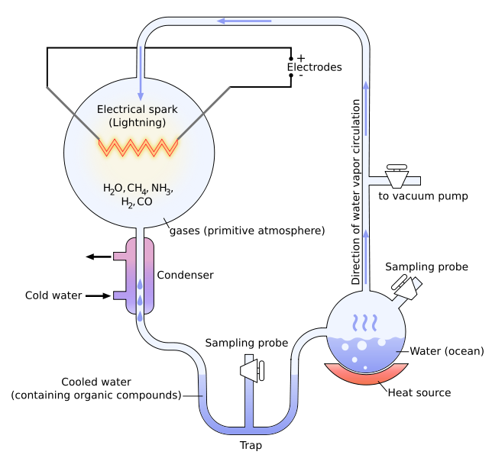
THE MILLER-UREY EXPERIMENT
COMBINED MATERIALS PRESENT AT THE BEGINNING OF THE EARTH’S HISTORY
and added electricity to simulate lightning and got the basic elements that form RNA and DNA…
THE BASIC BUILDING BLOCKS OF LIFE

Slide 13
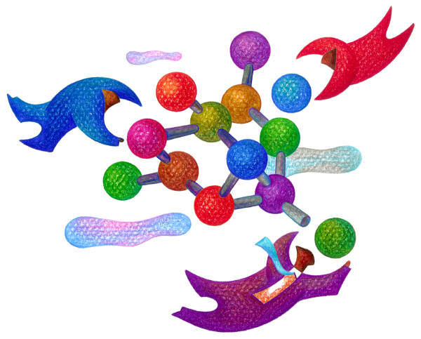
The basic parts of living creatures.

Slide 14
Exogenous Nucleotide Formation (Life originated elsewhere)
“Alternately, nucleotide precursors may have formed exogenously (elsewhere) and then been transported to Earth…on a class of carbonaceous chondrites. (meteorites)
Carbonaceous chondrites are over 3% carbon, often in the form or organic material, including amino acids, polycyclic aromatic hydrocarbons, and carboxylic acids.”

Slide 15
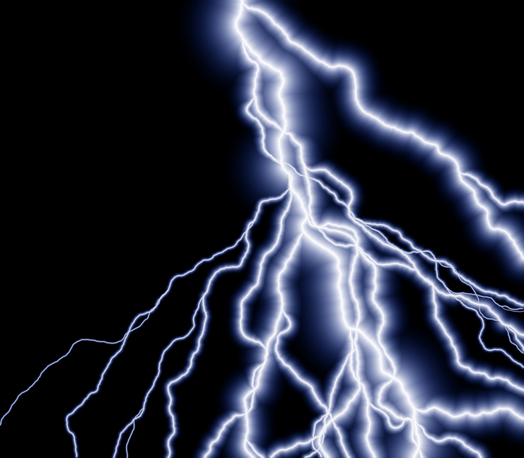
“When we copy Jupiter’s lightning by passing electric sparks through its known gases,
every amino acid is created within a week.”

Slide 16
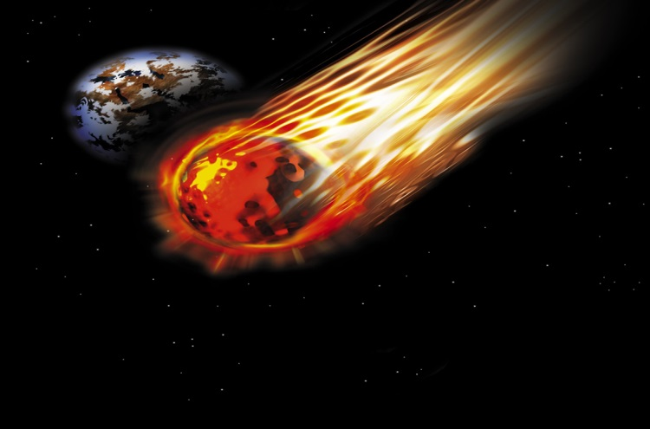
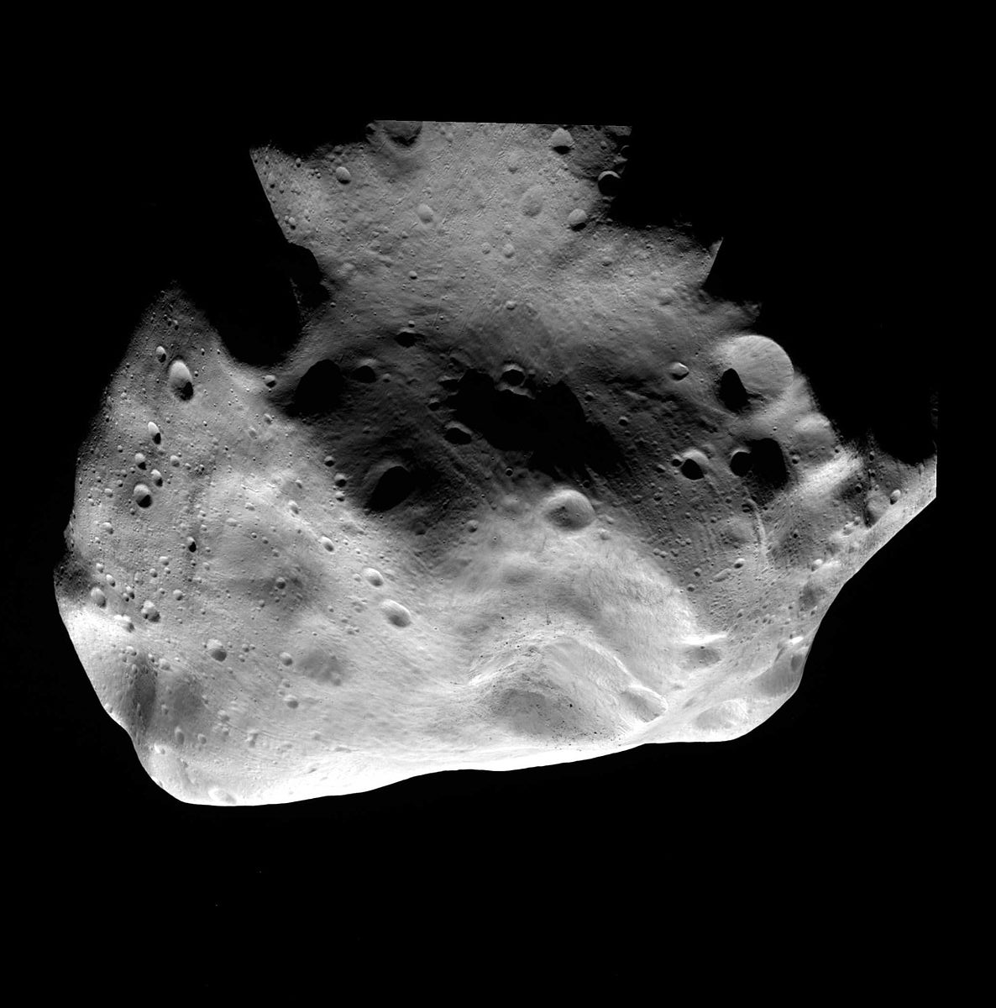
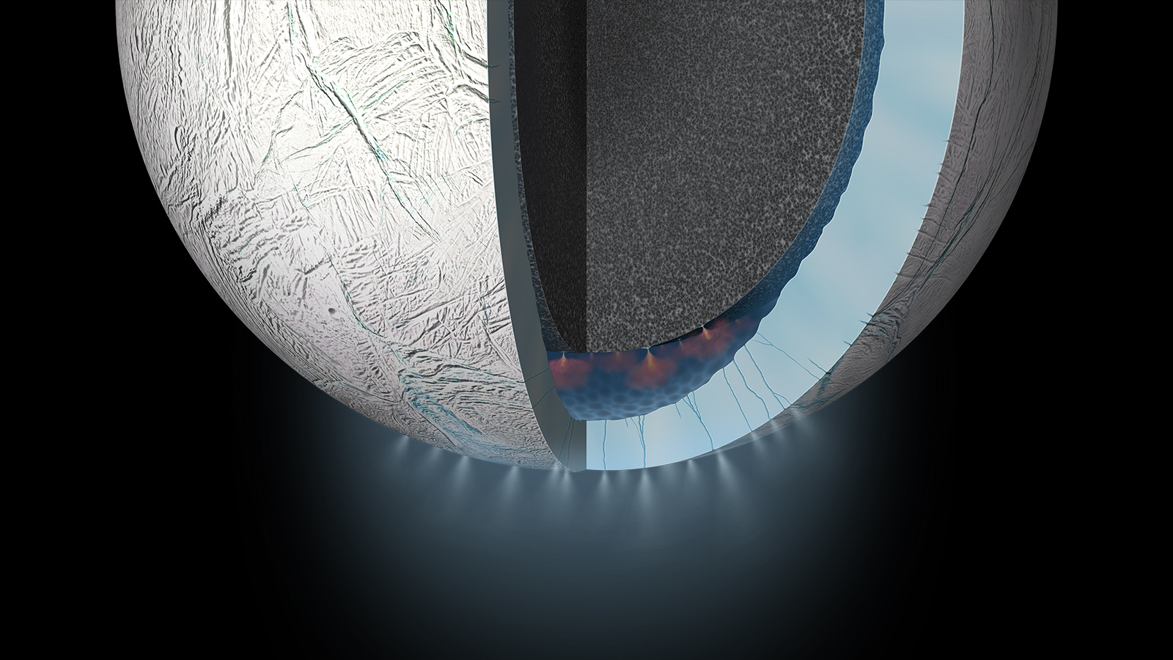
“The basic ingredients for life ---
what we call ‘prebiotic chemistry’ ---
are abundant in many Solar System objects such as
comets,
meteorites,
asteroids,
and icy moons.”

Slide 17
Life on Earth may have been seeded by such comets, asteroids, or meteorites.

Slide 18
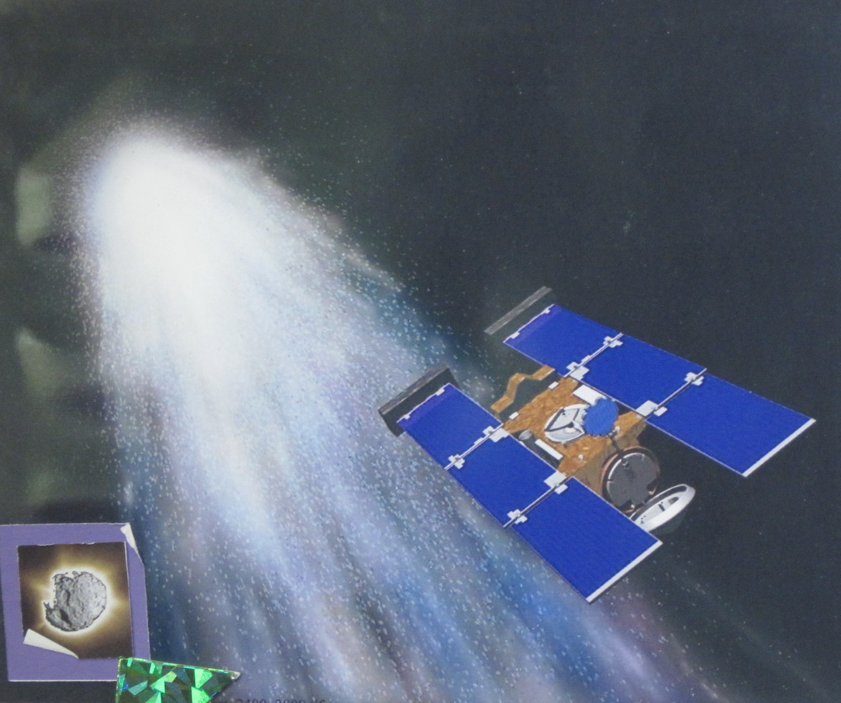
Stardust was NASA’s sample return mission to the Comet Wild 2
The head of the comet

Slide 19
The returned sample
contained
“…glycine…an amino acid used by organisms to make proteins.”
Also found: interstellar dust.

Slide 20
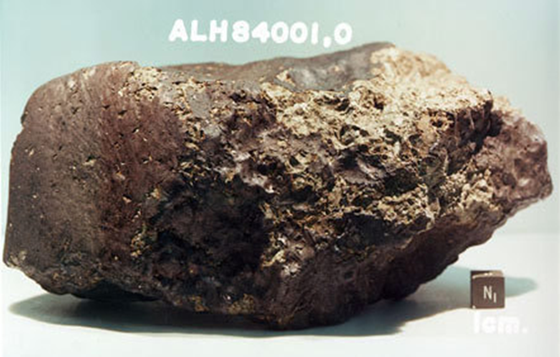
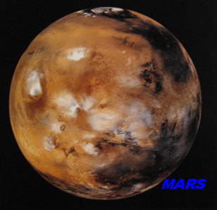
A meteorite found in Alaska was proven to have come from Mars.

Slide 21
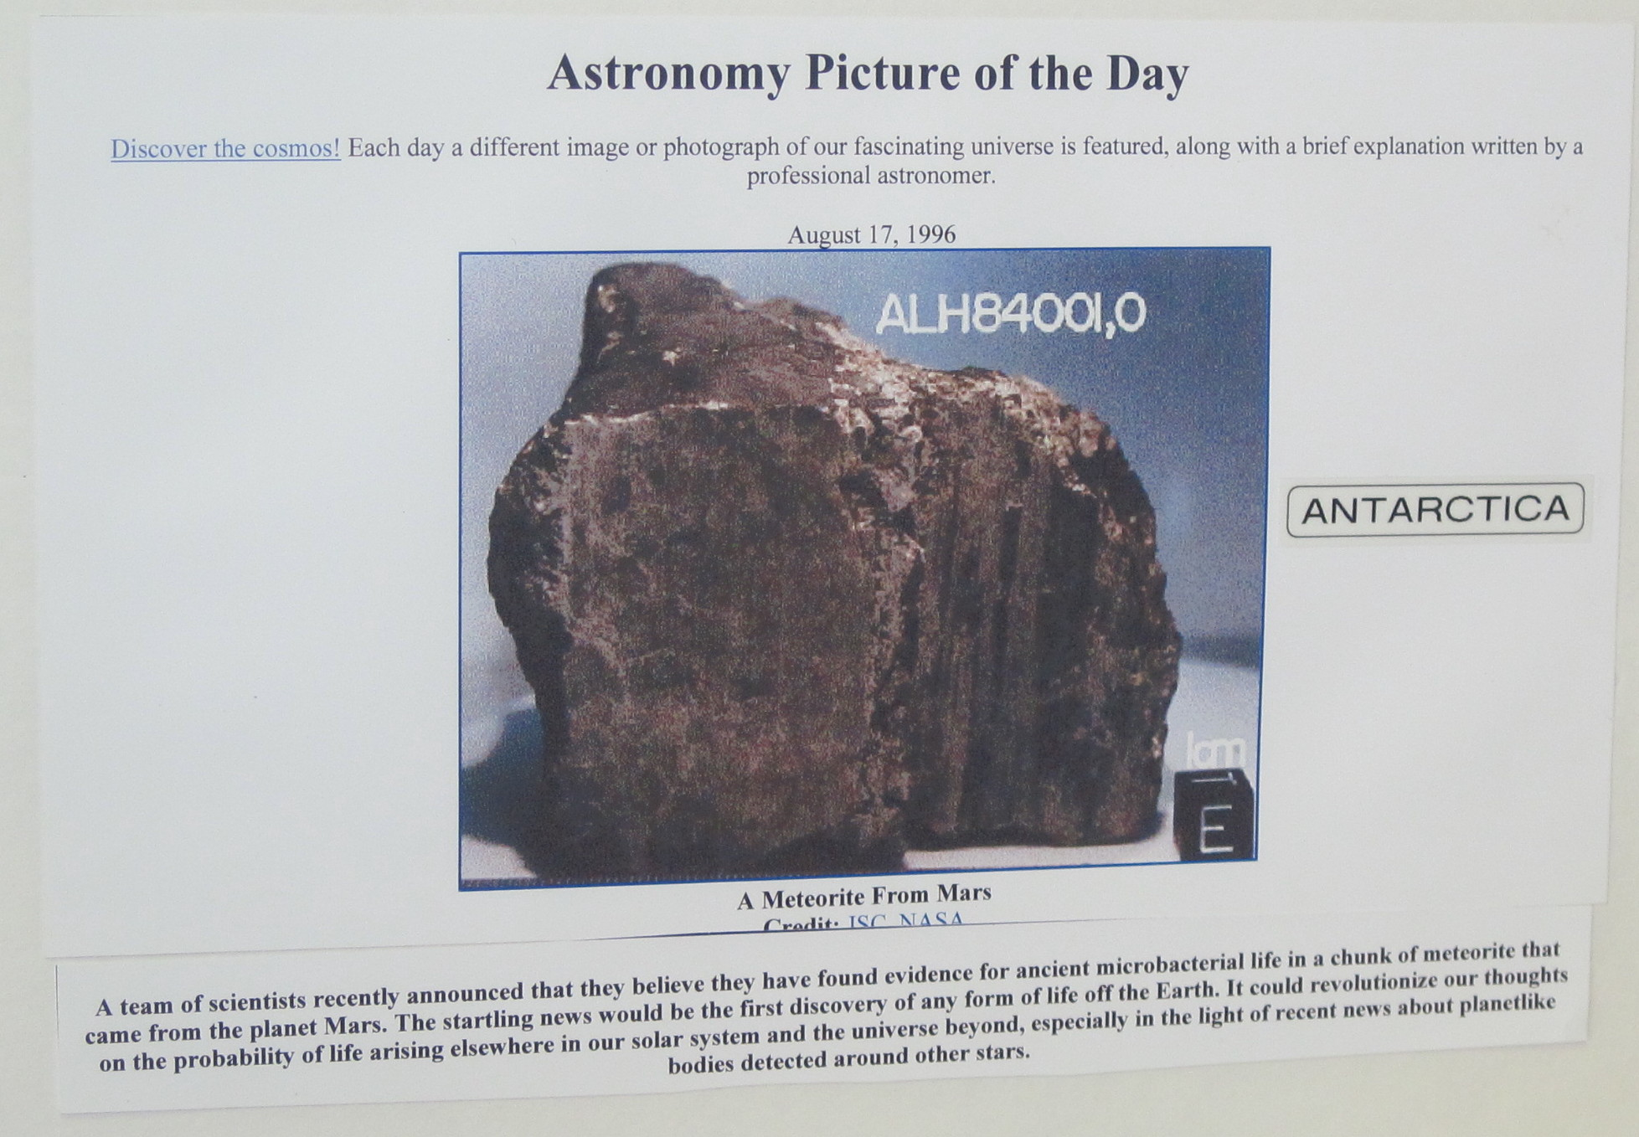

Slide 22
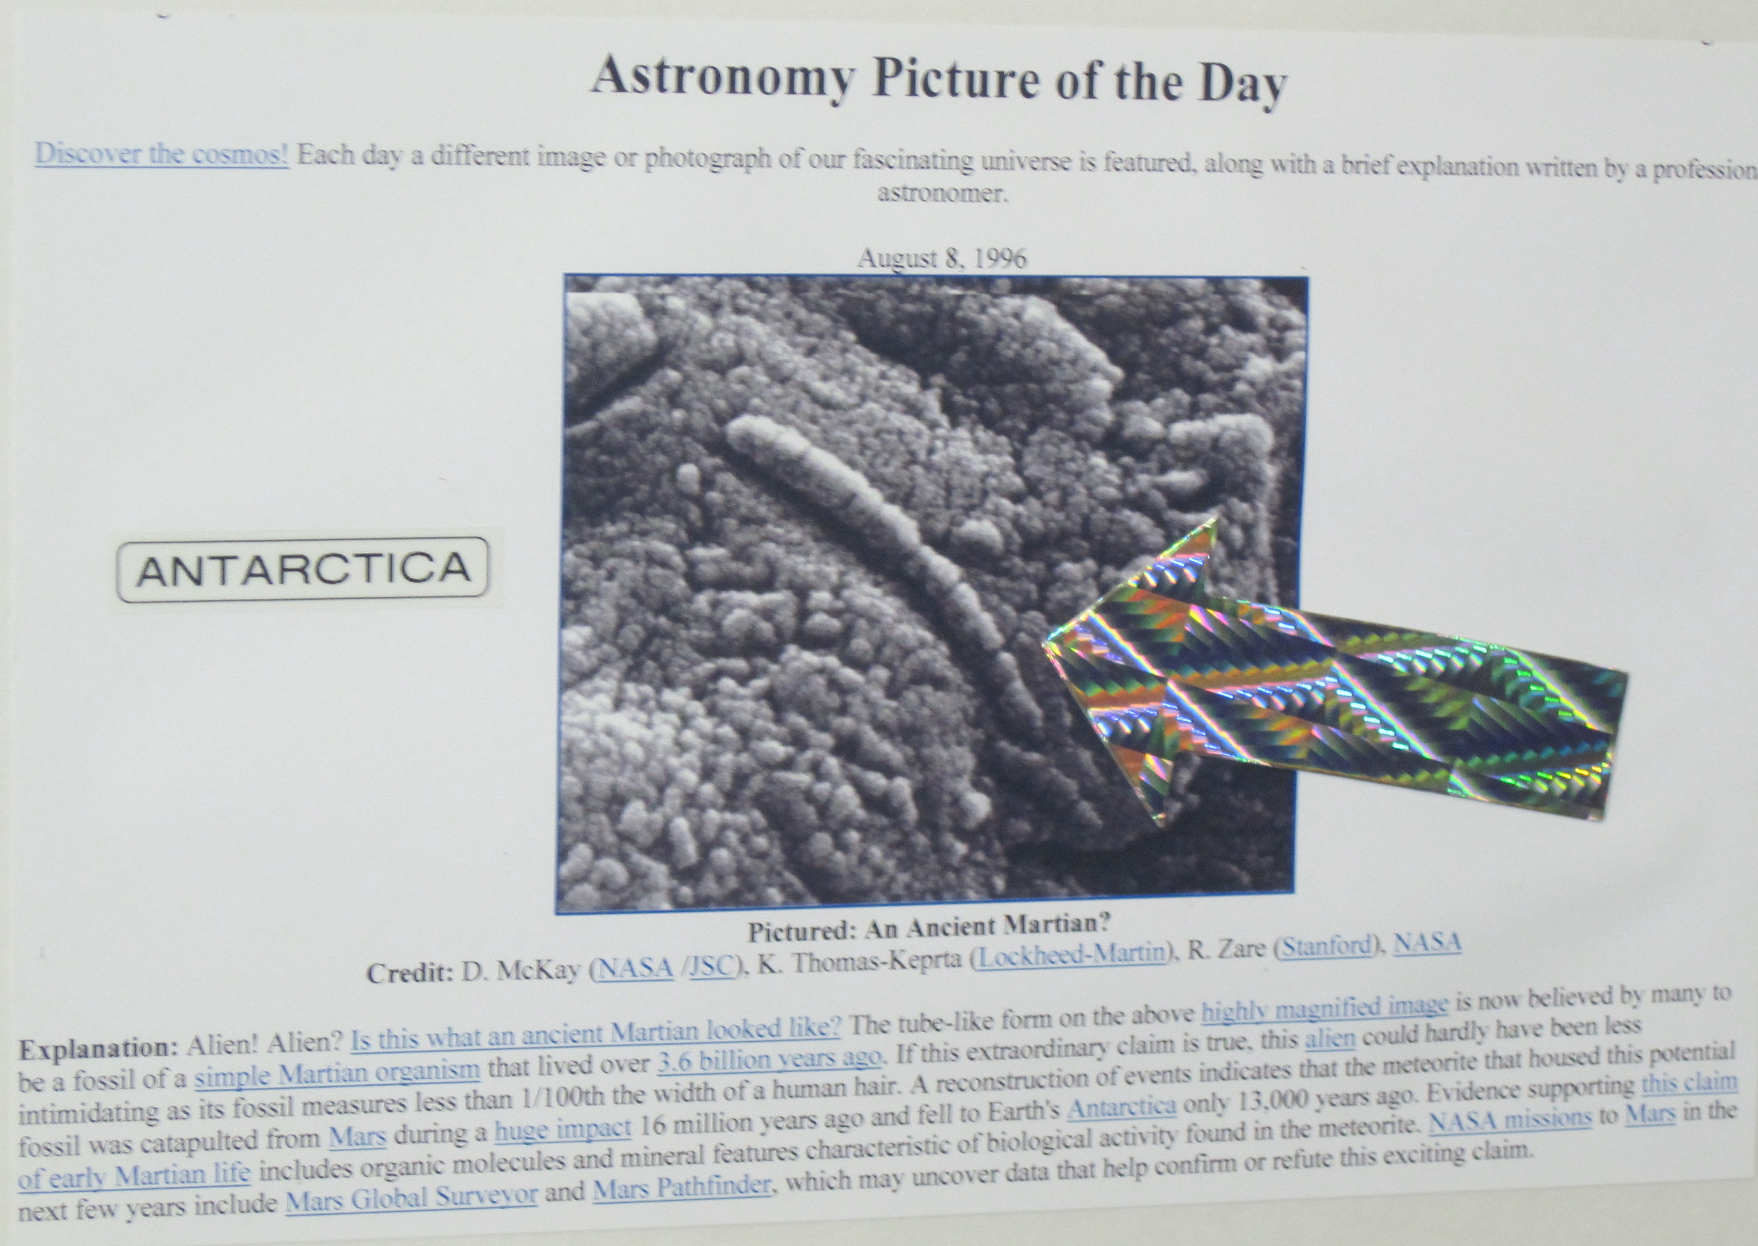

Slide 23
This meteorite was found to contain structures similar to those of bacteria.

Slide 24

many forms of carbon and organics and
millions of amino acids, the basic building blocks of life.

Slide 25
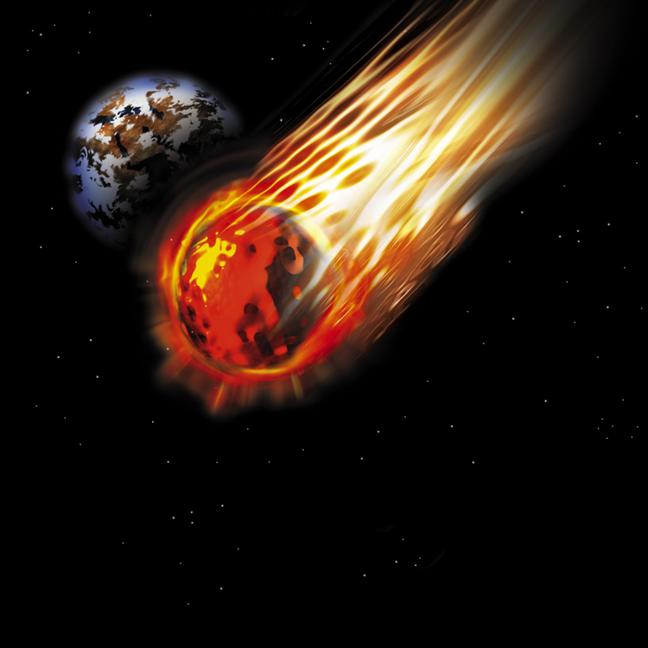
A 200 pound meteorite fell on Murcheson, Australia, in 1969 and contained millions of amino acids, the basic building blocks of life.

Slide 26
“The Murchison meteorite, an extensively studied carbonaceous chondrite contains amphiphilic molecules that form vesicles in aqueous solution.”
(Vesicles are like envelopes for moving elements around in cells.)
*Note: “Carbonaceous chondrites contain unusually high amounts of hydrocarbons…”

Slide 27
RNA First Hypothesis (“RNA WORLD”) (Favored theory)
“Primitive self-replicating systems must have been able not only to
encode genetic information but also
catalyze biochemical reactions.”
Neither DNA nor proteins can do this at the same time.

Slide 28
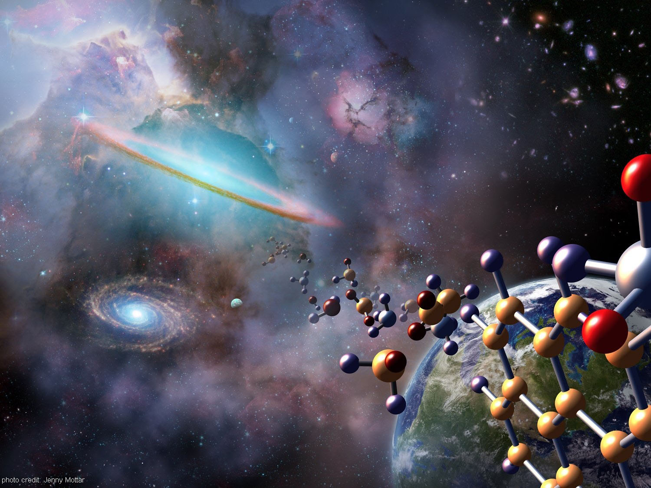
“It has been hypothesized, however, that primitive forms of life could use RNA as their sole hereditary and catalytic material. “Ribozymes,” naturally occurring RNA molecules that exhibit enzymatic activity, suggest the possibility of an RNA world in which organisms have RNA but lack DNA and proteins.

Slide 29
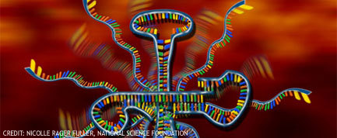
Artist rendering of "small RNAs" able to regulate cellular development, pathogen defense and stress response.
Credit: Nicolle Rager Fuller, National Science Foundation

Slide 30
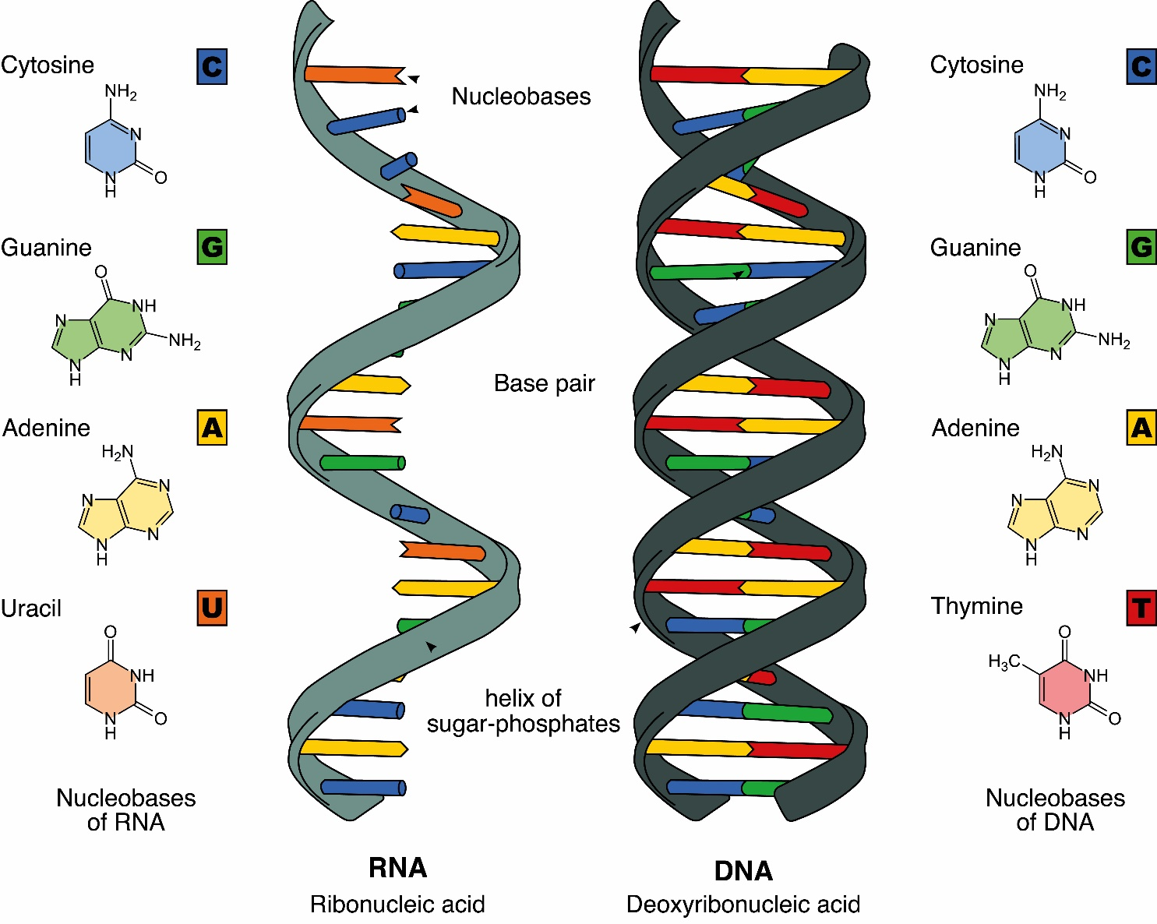

Slide 31
“Ribozymes have been shown to be capable of synthesizing the sugar-phosphate backbone of RNA (i.e., self-assembly) and catalyzing peptide bonds (i.e., protein formation).”

Slide 32
“While studies to define the catalytic potential of ribozymes are ongoing, it is possible that these molecules were important for both the maintenance of an RNA world and a subsequent transition to protein-based catalysis.”

Slide 33
“Though abiotic synthesis of ribonucleotide monomers have occurred on early Earth, successful transmission to an RNA world would have required a mechanism for concentration and growth into self-replicating polymers.
Mineral surfaces have provided a regular template upon which organic compounds could absorb and ultimately polymerize.”

Slide 34
Proteins First Hypothesis (“Protein World”)
“…some support a peptides-first hypothesis, which suggest that proteins were the first catalysts used by life.
Only later was the information inherent in protein structure transferred to nucleic acid (probably RNA) for long-term storage.”

Slide 35
“A peptides-first scenario is supported by the fact that amino acids and peptides form relatively easily in simulated early Earth conditions, whereas the abiotic origin of nucleic acids is much more difficult to explain and demonstrate in an experimental setting.”

Slide 36
“As of yet, however, there is no strong evidence to suggest a primitive polypeptide-to-nucleic acid transition.
The hypothesis that information storage and replication began with a self-replicating clay mineral has been put forward, but this scenario lacks experimental verification.”

Slide 37
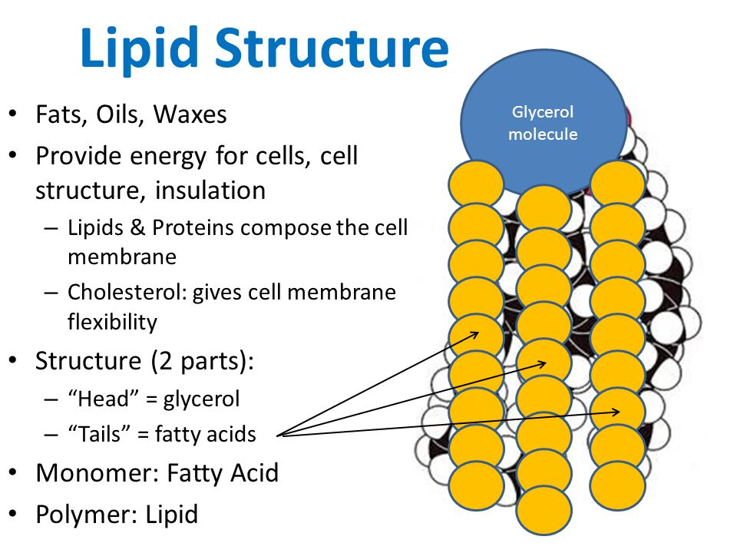
Lipids-First Hypothesis (“Lipid World”)
“Modern organisms are defined, in part, by their structure. All known organisms (excluding viruses) are composed of cells with membranous boundaries composed of lipid molecules.

Slide 38
“Lipid membranes play a vital role in
compartmentalization, material transport, signal transduction, energy production and storage, and metabolic reactions.”

Slide 39
“Amphiphilic molecules (with both hydrophobic (hating water)
and hydrophilic (loving water) ends), such as lipids, may have formed on the early Earth.”

Slide 40
“Long-chain fatty acids and fatty alcohols have been shown to form under hydrothermal conditions from gaseous precursors such as CO, H₂, and CO₂
(i.e., Fisher-Tropsch reactions.)

Slide 41
“The Murchison meteorite, an extensively studied carbonaceous chondrite * contains amphiphilic molecules that form vesicles in aqueous solution.”
*Note: “Carbonaceous chondrites contain unusually high amounts of hydrocarbons…”

Slide 42
“Organic molecules usually form a carbon ‘backbone’ which supports any number of other elements ---
Primarily:
hydrogen,
phosphorus,
and sulfur.”

Slide 43
“Additionally, illumination with ultraviolet light can fuel oxidation of alkanes (hyrdocarbons containing only C---C and C---H bonds) to amphiphilic long-chain acids.”
Self-aggregation of such compounds could have facilitated the concentration of organics necessary for biochemistry.”

Slide 44
“Alternatively, prebiotic lipids may have been brought to Earth by carbonaceous meteorites.”

Slide 45

“Biomolecules refers to a set of compounds common in, but not exclusive to, living organisms.”

Slide 46
“Most biochemisty involves long-chain molecules (polymers) made up of identical or nearly identical subunits called (monomers).
The so-called biogenic elements (C,H, N, O, P, and Sulfur)
along with trace amounts of other elements
(e.g., iron, magnesium),
combine to form the three primary
‘biomonomers’ or building blocks of life:
sugars, amino acids, and nucleotides.”

Slide 47

“A fourth class of biological molecule,
lipids,
includes organic molecules …
that allow reactions
with water and organic solvents.”
Metabolism p765

Slide 48
Sugars create poly-saccharides.
Amino acids create proteins.
Nucleotides create nucleic acids.

Slide 49
“Carbohydrates (sugars),
the most abundant biomolecules on earth and the primary energy sources for many organisms,
are named for their principal components ---
carbon, hydrogen, and oxygen,
which typically form to the ratio
CH₂O.”

Slide 50
The three classes of carbohydrates are:
monosaccharides,
oligosaccharides, and
polysaccharides.

Slide 51
“Monosaccharides, or simple sugars,
consist of a chain or ring of carbons with
accessory oxygen and hydrogen atoms.”

Slide 52
“The most abundant monosaccharide
in nature is the six-carbon sugar,
d-glucose,
used in energy storage for most organisms.”

Slide 53

“Oligosaccharides consist of
several simple sugar subunits
bound together.
The most common contain
only two monomers
(e.g., glucose + fructose =
sucrose).

Slide 54

“Polysaccharides,
on the other hand,
consist of many monomers
(often hundreds or thousands)
joined in
linear or branched chains.”

Slide 55

“The ability of organisms to form
biomolecules from
abiotic (not biotic) components
defines
‘primary producers’ or ‘autotrophs’.”

Slide 56
“Autotrophes use
light energy (photosynthesis) or
chemical energy (chemosynthesis)
to string together
carbon atoms (inorganic) to form
monosaccharide subunits (organic).”

Slide 57
These subunits can then be used to form
the metabolic and structural components of the cell,
including the polysaccharides used as structural support
(e.g., cellulose in plants,
peptidoglycan in bacteria)
for energy storage (e.g., starch).

Slide 58
“Complex biomolecules are built by
stringing together two carbon molecules
or larger pieces
from in the breakdown of food.”
“Thus the biosphere runs on captured energy
from solar and chemical sources that is
stored as sugars and released in respiration.”

Slide 59
Lipids (Fats)
“Lipids,
the primary component of cell membranes,
are a functionally diverse groups of biomolecules (that are)
weakly soluble in organic solvents.”

Slide 60
Amino acids
Polypeptides (Proteins)
“Amino acids, the building blocks of proteins, consist of a central carbon atom bonded to four different side chains:
an amine group (NH₂)
a carboxyl group (COOH),
a hydrogen atom, and a
highly variable “R” group.”

Slide 61

“Amino acids may function singly
(e.g., as the biological signal molecules
epinephrine, serotonin, histamine)
or link together.”

Slide 62
“Amino acids bond via…peptide linkages to form polymers called polypeptides.”
“22 standard amino acids form the monomers for almost all polypeptides in terran organisms.”

Slide 63
“One or more polypeptides folded into a functional three-dimensional structure (make) a protein.”
“In modern cells, proteins are fundamental structural components.”

Slide 64
“Perhaps more importantly, proteins called enzymes catalyze (speed up a reaction) almost all cellular biochemical reactions, including those of
energy metabolism, biosynthesis, cell-to-cells signaling, nucleic acid replication, and cell division.”

Slide 65
Neucleotides
Nucleic Acids
DNA (Deoxyribonucleic Acid) and RNA (Ribonucleic Acid)

Slide 66
“Neucleotides, primary units of biological information, are composed of a … five carbon sugar connected to a to a phosphate group and a nitrogen-containing base.”

Slide 67
“Single nucleotides often function as signaling mechanisms in the cell.
Adenosine triphosphate (ATP), a nucleotide ring with 3 phosphate groups, is the primary energy currency within every cell.”

Slide 68

“Energy from sunlight,
reduced chemical compounds,
or food
can be stored in a phosphate bond.”
“Breaking a phosphate bond in ATP releases energy for metabolic reactions.”

Slide 69
“Nucleotide polymers are called nucleic acids.”
“In modern organisms, DNA and RNA constitute the primary information storage and delivery molecules of the cell.”

Slide 70

“The … nitrogenous bases of these molecules belong to one of two types, purines or pyrimidines.”
“In DNA and RNA, the two major purine bases are adenine (A) guanine (G).”
“DNA and RNA both utilize cytosine (C) , but where DNA has thymine (T), RNA has uracil (U).”

Slide 71
“Two nucleic acid strands can thus bind together all alone their length and form the characteristic double helix.”
Hence the storage and transmission of
genetic information.

Slide 72
The Central Dogma:
DNA RNA Protein
“…information is stored in DNA and
transferred to proteins
by way of RNA.”
“Almost all information for building and maintaining an organism comes encoded in DNA.”

Slide 73
“Detailed plans for proteins, the active element of biochemistry can be found as a series 3 letter codons.
Codons contain 3 sequential nucleotides
(A, C, G, or T/U)…
A specific codon (AUG) signals the start of a new polypeptide chain.
In contrast, the end of a chain is encoded by one of three possible stop codons
(UAA, UAG, or UGA).

Slide 74
“Information transfer occurs in a two-step process.
DNA, which is repaired and copied by proteins
(e.g., DNA replicase and helicase),
forms the primary molecule
for information storage.

Slide 75

“Proteins called RNA polymerases copy codon sequences from DNA to messenger RNA (mRNA) in a process known as ‘transcription.’
Protein/RNA complexes called ribosomes then direct protein synthesis from RNA by ‘reading’ the codons and inserting the corresponding amino acids into a growing peptide chain (‘translation’).”

Slide 76
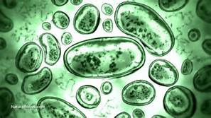
RNA World or DNA World?
The RNA First Hypothesis
“It has been hypothesized…that primitive forms of life could use RNA as their sole hereditary can catalytic material. “Ribozymes,” naturally occurring RNA molecules that exhibit enzymatic activity, suggest the possibility of an RNA world in which organisms have RNA but lack DNA and proteins. Ribozymes have been shown to be capable of synthesizing the sugar-phosphate backbone of RNA, (i.e., self-assembly) and catalyzing peptide bonds, (i.e., protein formation.”

Slide 77
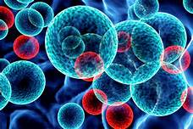
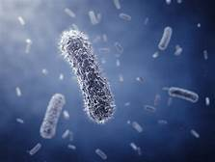
Cell Formation
One of the things which strike me is the container, the cell wall, which held the ingredients together so they could interact and form life.
“At some point, catalytic molecules must have become encapsulated within lipid membranes.
…cyclic environmental changes may have been involved.”

Slide 78
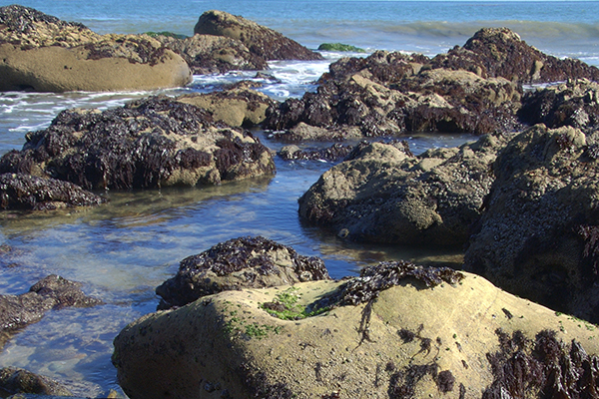
“For example, lipids undergoing hydration-dehydration and freeze-thaw cycles may have been shown to encapsulate their biomolecules (proteins, nucleic acids) in lipid vesicles.”
Shallow pools, anyone?

Slide 79
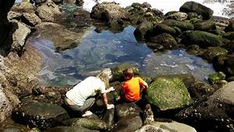
So here we leave it,
Life:
The biological from the non-biological.

Slide 80


Slide 81
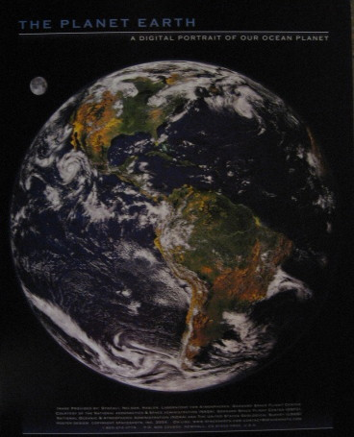
LIFE

Slide 82
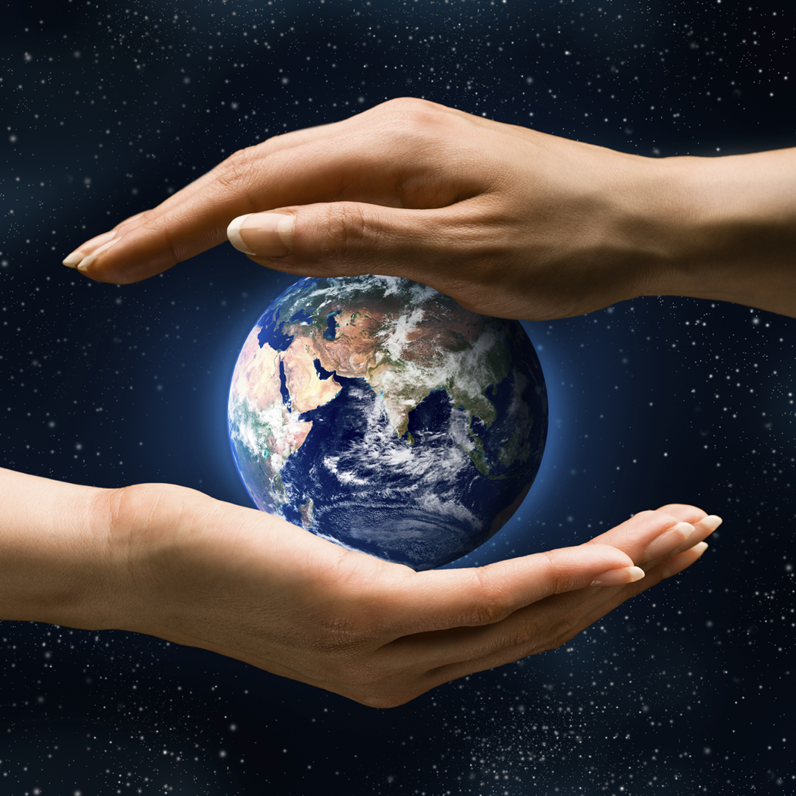

Slide 83
References
The Astrobiology Primer: An Outline of General Knowledge---Version 1, 2006 by Lucas J. Mix et al

