Slide 1
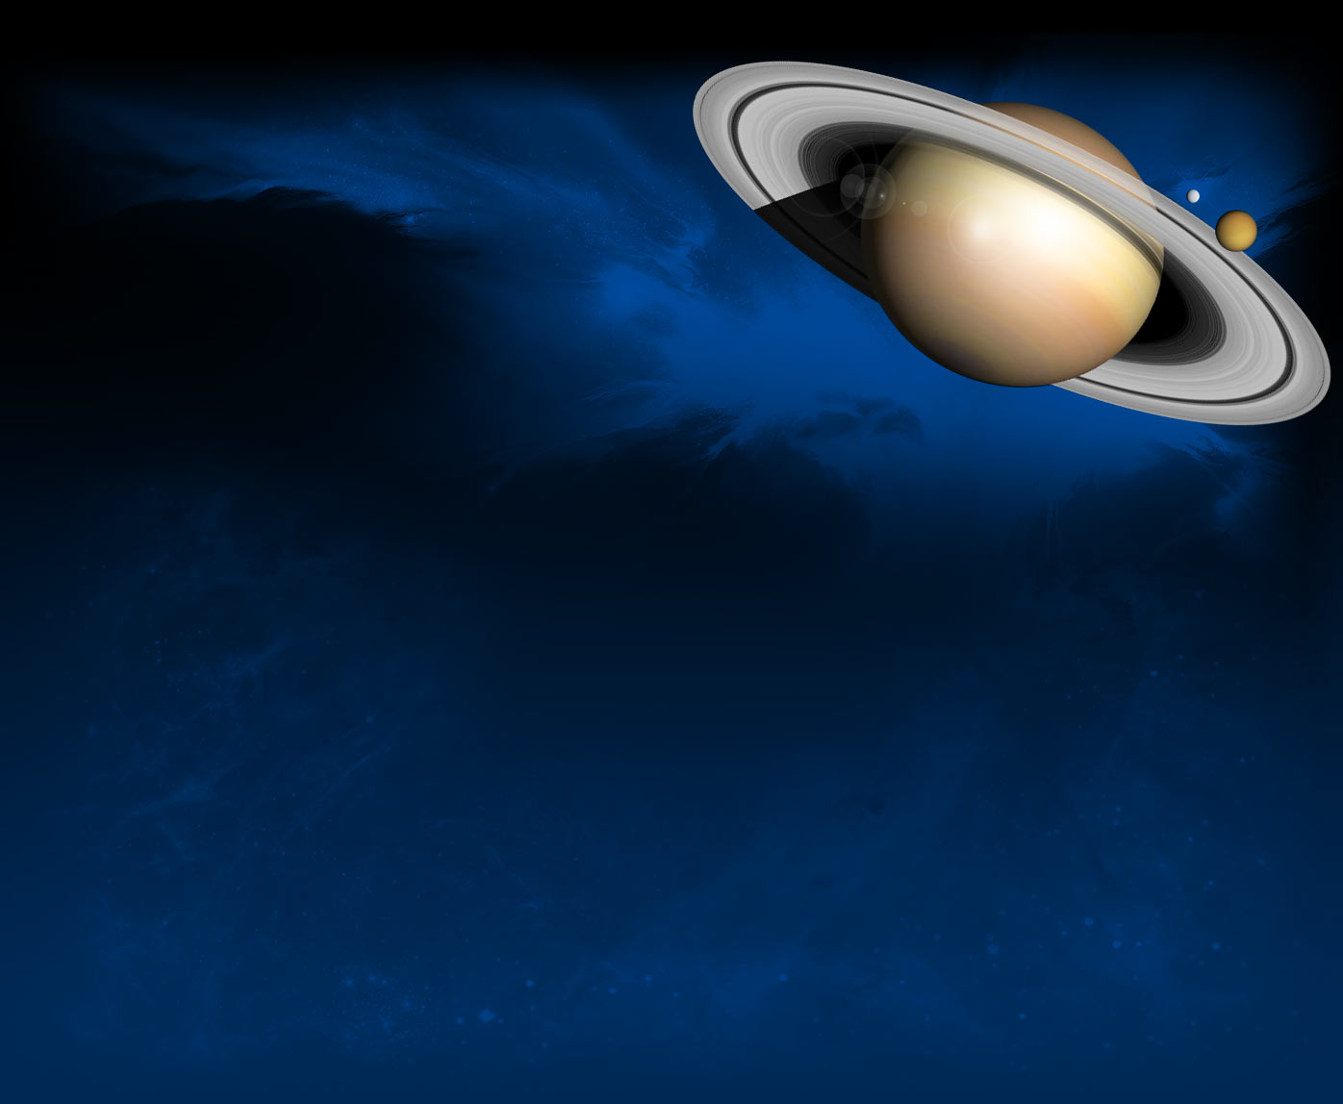
Quantum things
& fizzy strings
Quantum Physics and
String Theory

Slide 2
References
Physics by Paul Pancella, PhD and Marc Humphrey, PhD
Quantum Physics by Marc Humphreys, Phd, Paul Pancella, PhD,and Nora Berrah, Phd.
The Quantum Universe by Brian Cox and Jeff Forshaw
We Have No Idea by Jorge Cham and Daniel Whiteson
You are the Universe by Menas Kafatos (Astrophysicist) and Deepak Chopra, M.D.
Quantum Physics in Minutes by Gemma Lavendar
“Crossing the Quantum Divide” by Tim Folger Scientific American
String Theory by George Musser
The Little Book of String Theory by Steven Gubser
“The Forgotten Force” by Abagail Beall All About Space
“Something’s Wrong with Gravity” by Eric Verlinde Science Focus
“The Higgs’s Boson” Space.com
“The Standard Model” by Glenn Starkman Conversation Website
“Is it Higgs?” Live Science
“Quantum Mechanics” Wikipedia
“The Standard Model” Wikipedia
“Beyond Time” by Carlo Rovetti Discover

Slide 3
References
“Six Things Everyone Should Know about Quantum Physics” by Chad Orzel Forbes.com
“Explainer: Standard Model of Particle Physics” by Jonathan Carroll The Conversation
“6 Implications of finding the Higgs Boson” by Clara Moskowitz Live Science.com
Quantum Physics in Minutes by Gemma Lavender
“Quantum Mechanics” Science Daily
“Antimatter is both a particle and a wave” Space.com
“What are Elementary Particles?” Space.com
“What is faster than the speed of light? Quantum Entanglement!” Louis de la Monte

Slide 4
Quantum things
& fizzy strings
Parts is Parts
all the way down …
…

Slide 5
“Quantum”, plural “quanta”
“Quantum is the Latin word for amount and, in modern understanding, means the smallest possible discrete unit of any physical property, such as energy or matter”
whatis.techtarget.com/definition/quantum

Slide 6
The Greeks once thought the universe was made of four elements:
fire
earth
air
water

Slide 7
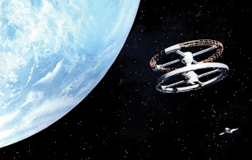
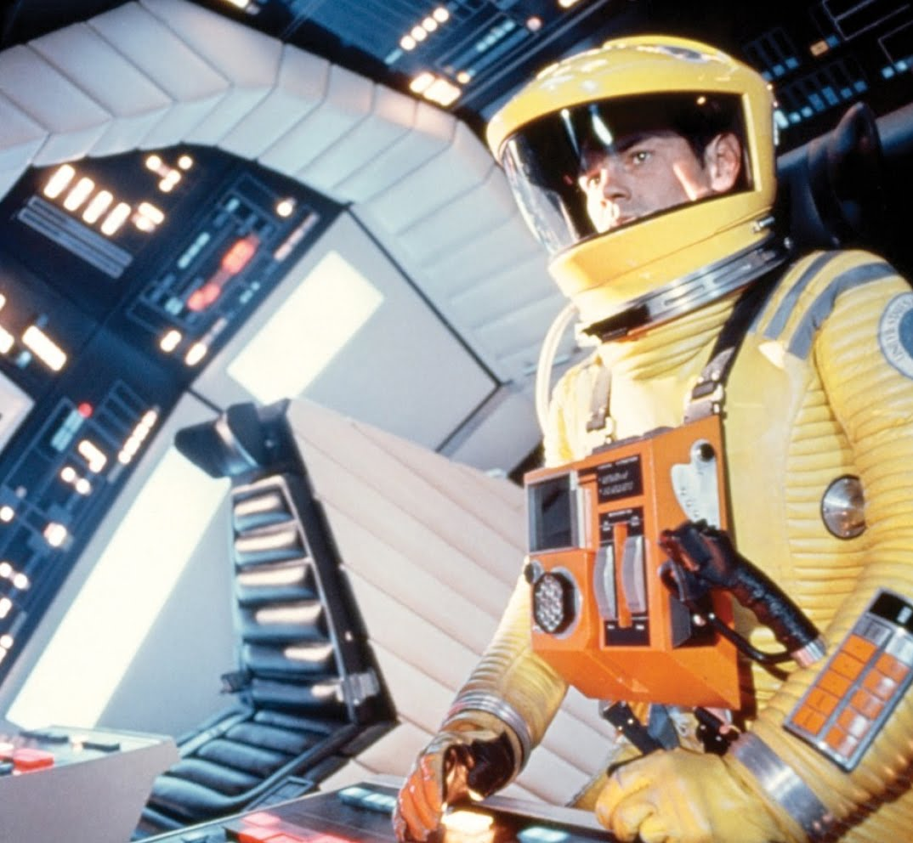
Everything is hunky dory up here in the world of Classical Physics.

Slide 8
The world of Classical Physics is the everyday world we see about us.
It is the world as presented by Isaac Newton and Albert Einstein.
However, when we get into the
very small of the universe,
the landscape changes…

Slide 9
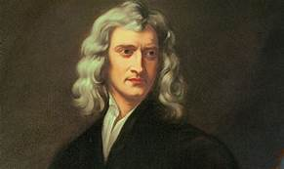
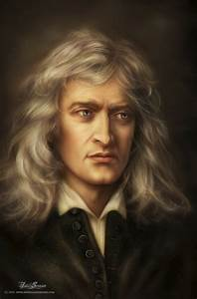
The Classical World as discovered
by Isaac Newton
“Newton's First Law of Motion, or the Law of Inertia, states that "every object in a state of uniform motion tends to remain in that state of motion unless an external force is applied to it." This means that there is a natural tendency for a moving object to maintain its motion, unless an external force interferes. (such as gravity or wind resistance.)
A still object will continue to sit there (be inert) unless acted upon by a force.
“According to the Second Law of Motion, acceleration is produced when a force acts on a mass. The greater the mass, the greater the amount of force required. Force equals mass times acceleration.” (F = ma.)
“The Third Law of Motion states that for every force, there is a reaction force that is equal in size, but opposite in direction. Therefore, whenever one object pushes another object, it gets pushed in the opposite direction equally as hard.”
Reference.com
Newton also presented light as a particle, a “stream of little bullets.”
The Quantum Universe

Slide 10
…

Slide 11
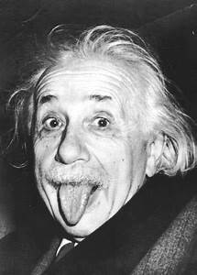
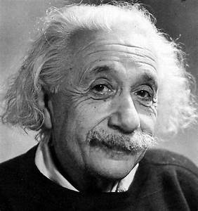
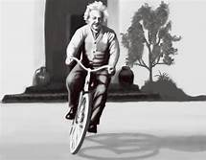
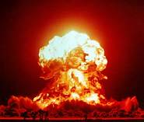
To paraphrase of the first law of thermodynamics:
"Nothing disappears; everything goes somewhere.“
Matter, for example, cannot be destroyed, but only turned into energy.
E=mc² is the equation that describes the amount of energy it turns into.”
This is called the energy – matter equivalence.
“Matter can be thought of as highly organized energy, and energy can be viewed as disorganized matter. Turning one into the other can only be done at a certain ratio, and that ratio is what Einstein's equation provides. Splitting a heavy atom makes two lighter atoms, but their combined weight is not equal to the weight of the original atom; it's slightly lower. The difference in mass was converted to energy at a rate of E (energy released) = m (difference in mass) x c (the speed of light)².”
Reference.com
The “strong “force

Slide 12
When we burn wood, it becomes heat and light and ash.

Slide 13
The Standard Model of particle physics: The absolutely amazing theory of almost everything…
“ The Standard Model explains how the basic building blocks of matter interact, governed by four fundamental forces.
That means on a fundamental level it is the theory of [almost] everything
(aside from things like [gravity], dark energy, the multiverse theories, string theory, etc).”

Slide 14
The four forces are
the electromagnetic force,
the gravitational force,
the weak nuclear force, and the strong nuclear force.
The two nuclear forces hold particles together

Slide 15
The electromagnetic force:
“The force arising from the attractions and repulsions associated with electric and magnetic fields.
The electromagnetic force is one of the four basic forces in nature, being weaker than the strong nuclear force but stronger than the weak force and gravity.”
www.thefreedictionary.com/electromagnetic+force
“The electromagnetic force is definitely the force that the electromagnetic field exerts on electrical charged particles. The bonds that link the constituents of solids, liquids, gases and plasma are basically based quantum photonic interactions as defined by electromagnetic force.”
www.chemistry.tutorvista.com/.../electromagnetic-force.html

Slide 16
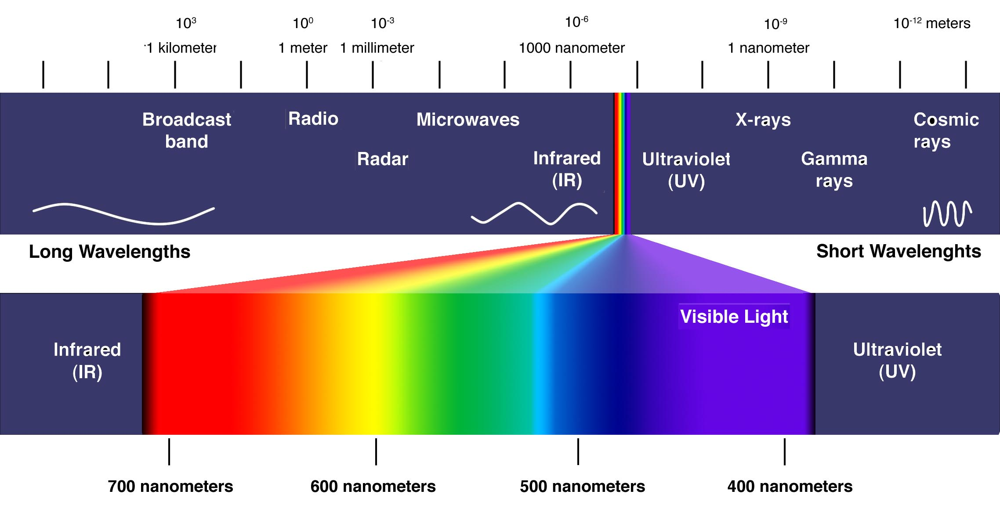
“The electromagnetic spectrum:
The photon: A photon is a particle of light defined as a discrete bundle (or quantum) of electromagnetic (or light) energy. Photons are always in motion and, in a vacuum (a completely empty space), have a constant speed of light to all observers.”
www.thoughtco.com/what-is-a-photon-definition-and..

Slide 17
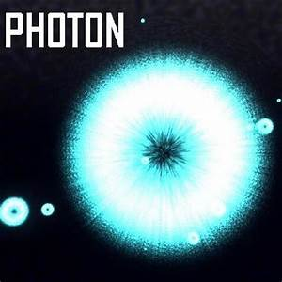
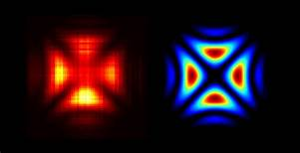
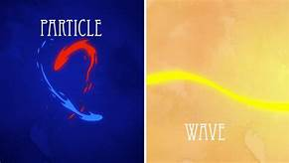
Wave particle duality: Newton said light was a particle and Maxwell showed light is an “electromagnetic wave surging through space.” The Quantum Universe
A photon is a wave AND a particle.

Slide 18
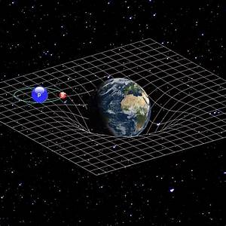
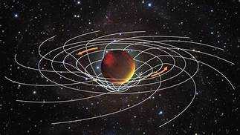
The gravitational force, or gravity:
“the force that attracts a body toward the center of the earth, or toward any other physical body having mass.
Gravity is a weak force but involves things having great mass”.
Oxford Dictionary
“At the atomic level, where masses are very small, the force of gravity is negligible, but for objects that have very large masses such as planets, stars, and galaxies, gravity is a predominant force, and it plays an important role in theories of the structure of the universe.”
www.dictionary.com/browse/gravity
“The fundamental element of gravity is the
Graviton which is proposed but has not been found.”

Slide 19
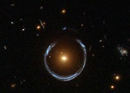
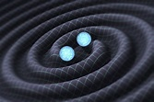
The bending of light by gravity can lead to the phenomenon of
gravitational lensing, in which multiple images of the same distant astronomical object are visible in the sky. (We can see a distant galaxy behind another by the blue halo.)
General relativity also predicts the existence of gravitational waves , which have since been observed directly by the physics collaboration LIGO
Laser Interfereometry Gravitational-Wave Observatory (at Livingston, La and Hanford, Washington.
www.ligo.caltech.edu/image/ligo20160211a

Slide 20
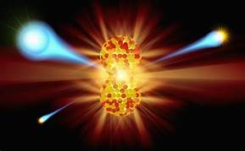
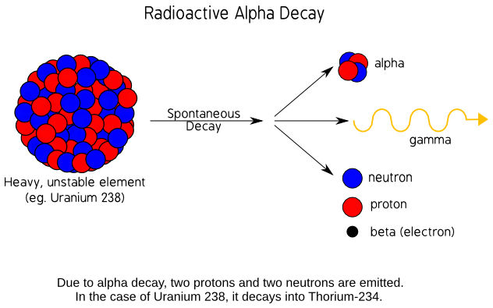
the weak nuclear force
“In particle physics, the weak interaction (the weak force or weak nuclear force) is the mechanism of interaction between sub-atomic particles that causes radioactive decay and thus plays an essential role in nuclear fission.”
“The weak force, which mediates certain nuclear reactions, is carried by two fundamental particles, the W and Z bosons.”

Slide 21
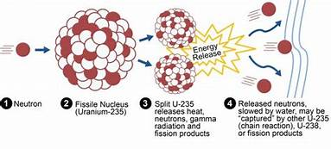
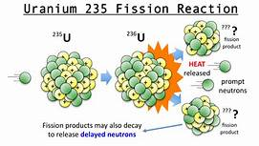
The strong nuclear force
the bond within the nucleus
“Gluons carry the strong nuclear force and reside with quarks inside of protons and neutrons.”

Slide 22
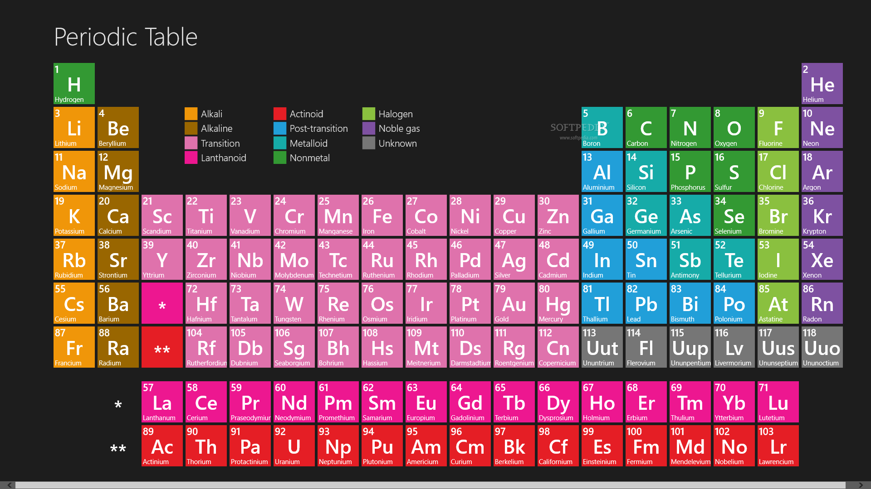
Periodic Table of the Elements

Slide 23
“Here are some standard model facts designed as a simple introduction and overview of the standard model of particle physics:
There are two types of elementary particles, Fermions (quarks and leptons) that form the basis of matter, and bosons that “mediate the interactions” between
fermions.
There is also a special type of boson; the”Higgs Boson” gives massless energy particles their mass.
Each particle has an anti-particle or is its own anti-particle.
When fermions interact they exchange virtual particles via the bosons.”
Reference.com

Slide 24
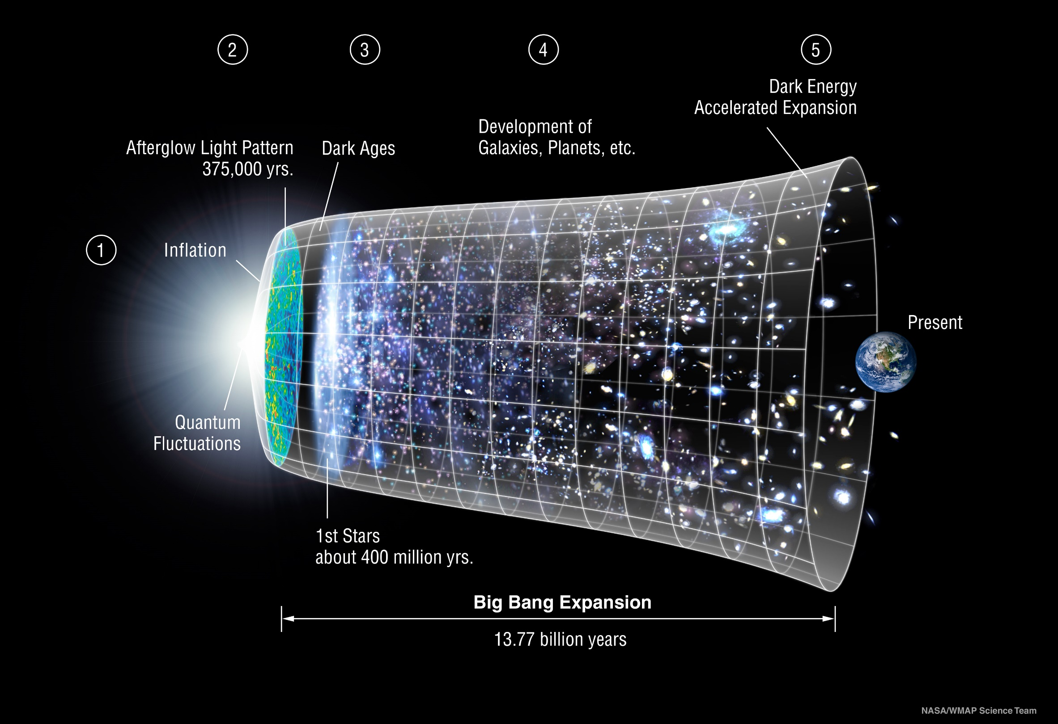

Slide 25
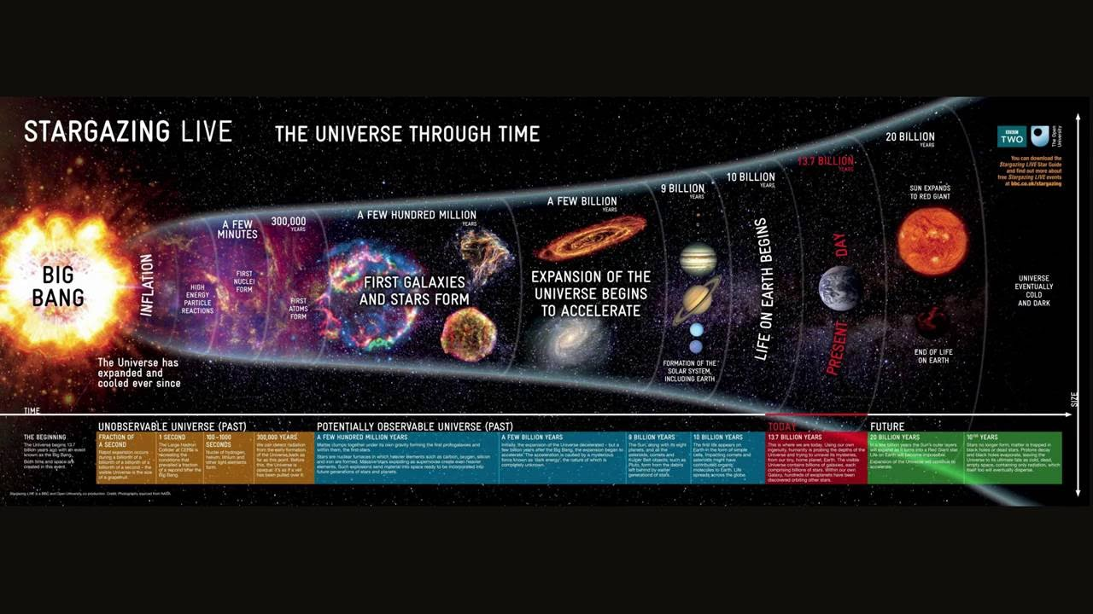

Slide 26
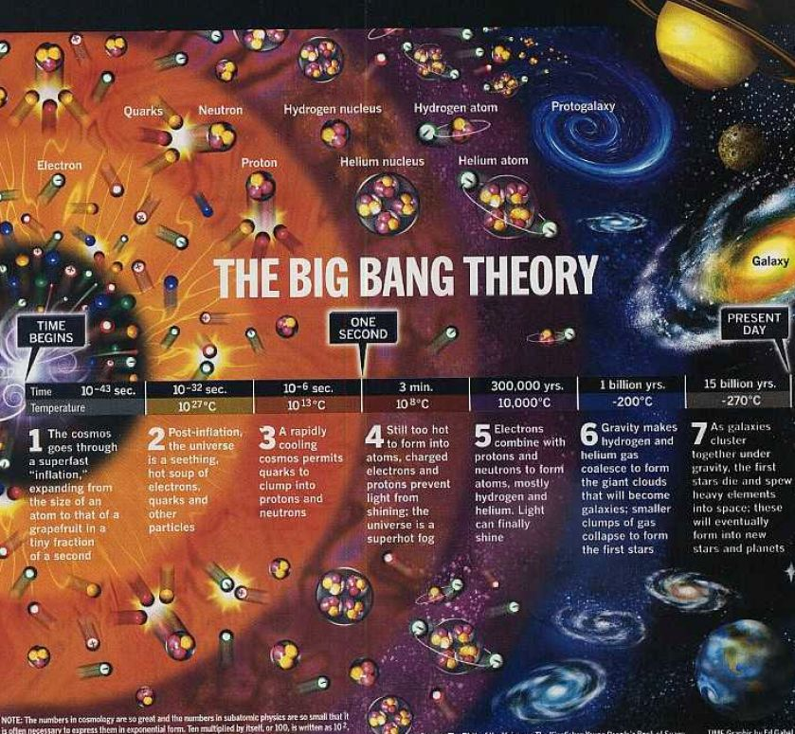

Slide 28
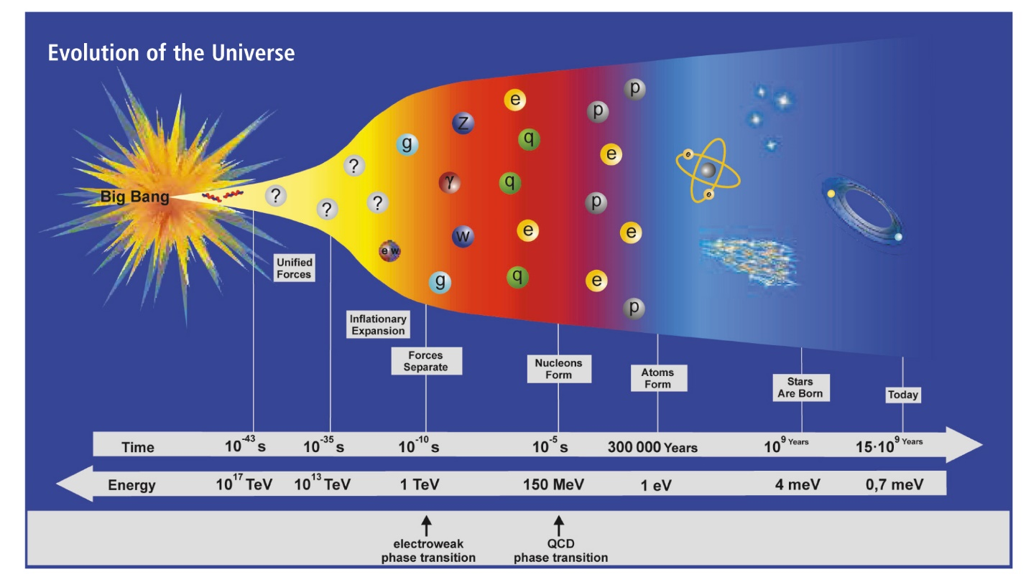

Slide 29
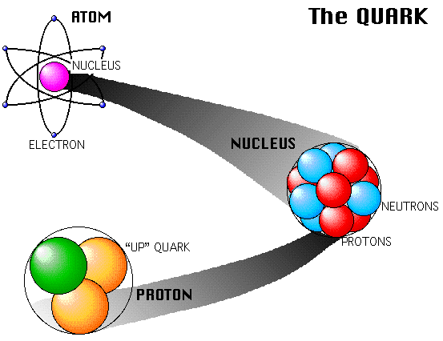

Slide 31
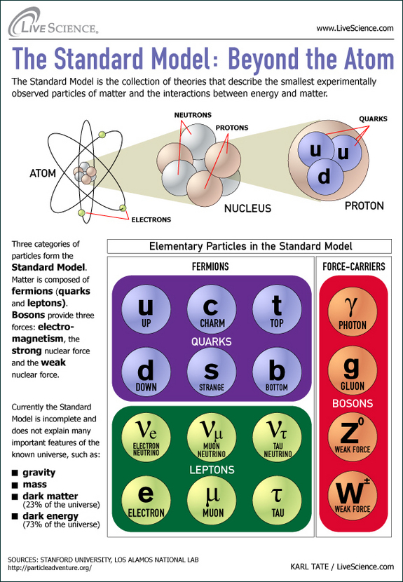

Slide 32
“In simple terms, each force has a corresponding boson. Importantly, the well-known photon is the only carrier of the electromagnetic force.
The less common, but equally important gluon, “glues” composite particles together. Learn more about the four forces.
There are still some things that the standard model doesn’t explain like dark energy, quantum gravity, and a few other complicated subjects. So it’s not a theory of everything.
The best place for information on the standard model is CERN. I also love Fermilab’s YouTube channel and PBS spacetime. If something more basic is needed, SciShow is always a good choice.”
FACT/MYTH

Slide 33
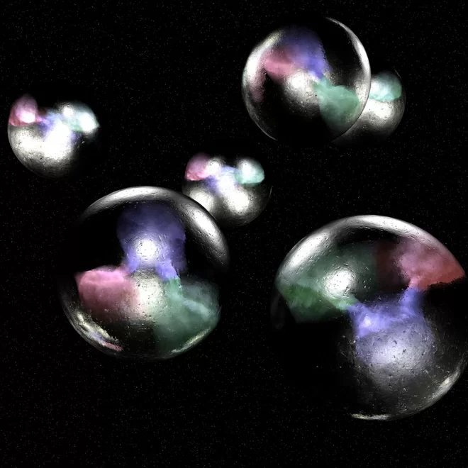
Quarks is Quarks

Slide 34
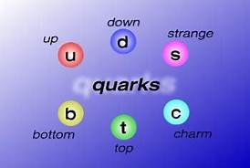
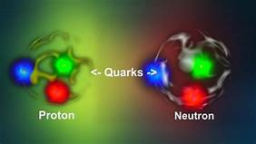
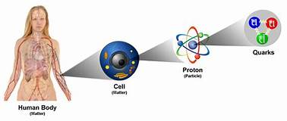
Quarks is Quarks
“FLAVORS” OF QUARKS

Slide 36
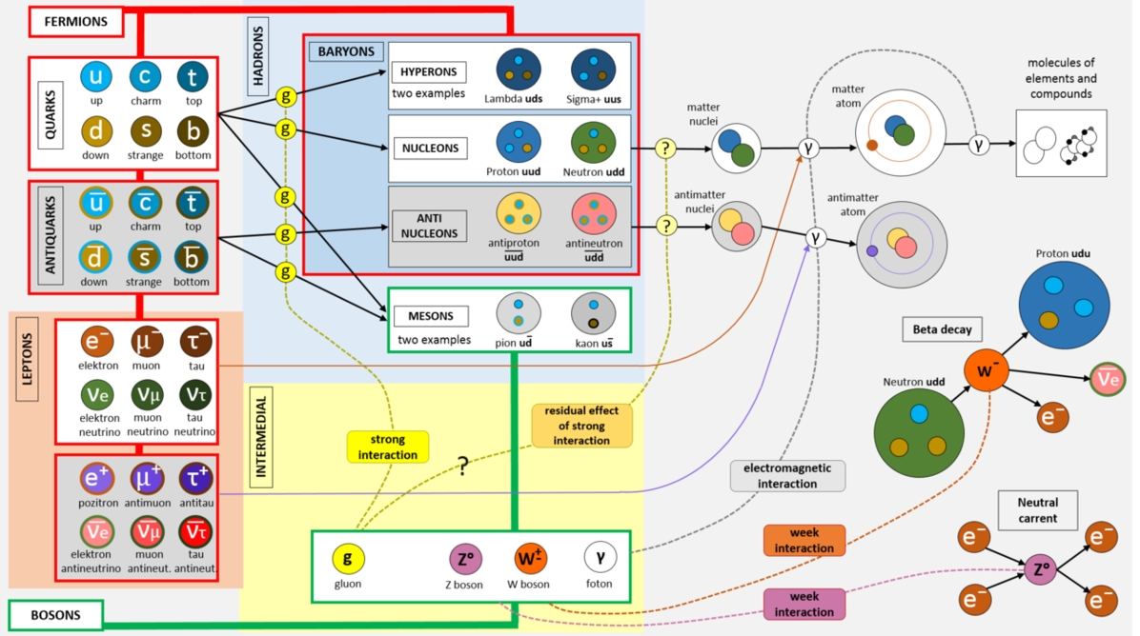

Slide 37
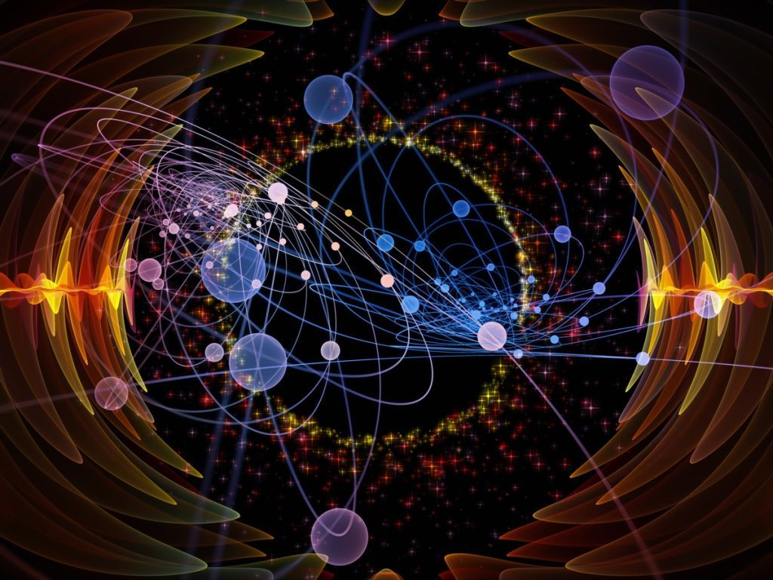

Slide 38
Prepare to enter the
Twilight Zone,
The realm of the unreal,
The place of contradictions,
The world of Quantum Physics…

Slide 39
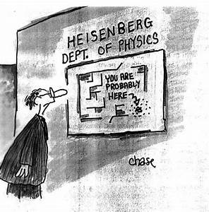
Heisenberg’s Uncertainty Principle
We can know position or momentum accurately, but not both simultaneously…

Slide 40
“The Heisenberg Uncertainty Principle means that,
at the quantum level,
Nature is fundamentally random and
cannot be predicted to any degree of accuracy.”
Quantum Physics in Minutes
Einstein rejected this idea, claiming that reality was there whether it was being measured or not.

Slide 41
The Copenhagen Interpretation
First,
What is Entanglement?
When a laser beam goes though a crystal, for example,
2 photons can emerge Entangled.
What one does to one particle, affects the other particle – no matter how far away they are, even in extreme distances.
“For example, it is possible to prepare two particles in a single quantum state such that when one is observed to be spin-up, the other one will always be observed to be spin-down and vice versa, this despite the fact that it is impossible to predict, according to quantum mechanics, which set of measurements will be observed.
As a result, measurements performed on one system seem to be instantaneously influencing other systems entangled with it.” Science Daily

Slide 42
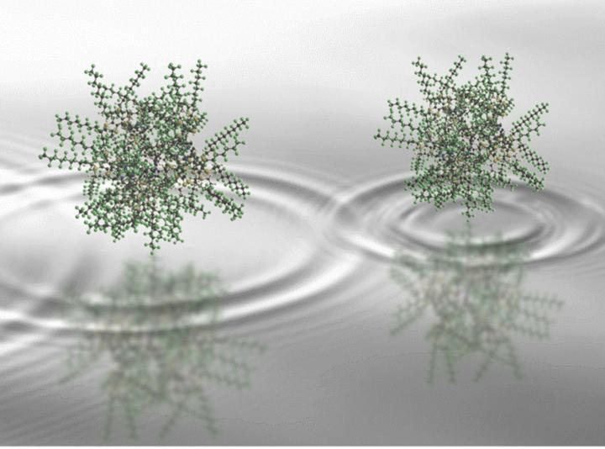
2,000 Atoms Exist in Two Places at Once in Unprecedented Quantum Experiment

Slide 43
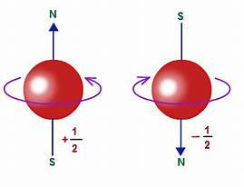
“Ok, then
What is Spin?
Spin is an intrinsic property of the particle --- like saying it is blue.
Its SPIN is either UP or DOWN, Arrow Up or Arrow Down + ½ or - ½.
Spin refers to the position, direction of the particle.
The particle does not actually spin around like a planet does in the ‘Classical World’ of Einstein and Newton.”

Slide 47
Oddly enough, quantum entanglement
can go faster than the speed of light.
“This phenomenon has been widely verified and the scientific community accepts it as a fundamental feature of quantum mechanics. In recent years, further experimentation related to quantum entanglement has shaken one of the fundamental pillars of modern science, namely, the speed of light as the upper limit that mass or information could travel. Recent experiments (Juan Yin, et al. (2013). “Bounding the speed of `spooky action at a distance”. Phys. Rev. Lett. 110, 260407) have shown that the quantum entanglement information transfer occurs at least 10,000 times faster than the speed of light. It might even be faster. Quantum mechanics holds that the quantum change occurs instantaneously. In other words, the separated particles act as if they were one, even when they are separated by a significant distance. “According to quantum physics, entanglement is independent of distance,” physicist Rupert Ursin of the Austrian Academy of Sciences said in a statement to livescience.com .”

Slide 48
“The phenomenon of quantum entanglement has been demonstrated experimentally with photons, electrons, molecules and even small diamonds. It is real and an area of active research in physics. There is no widely held theory within the scientific community that explains how the particles are able to communicate faster than the speed of light. There are numerous speculations, which I will not go into in this article in the interest of remaining factual.
Anyone who can explain quantum entanglement to the satisfaction of the scientific community is likely a candidate for the Nobel Prize. It has been a mystery for almost a hundred years.”

Slide 49
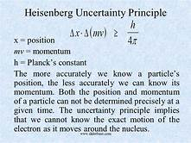
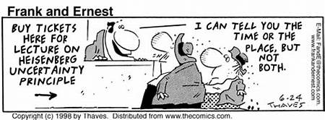
Quantum physics says that we change something when we measure it: for example, when we take a picture of something in order to measure it, we bathe it in photons which change it.
Example: If I take a picture of a wave, can measure its height but not its speed.

Slide 50
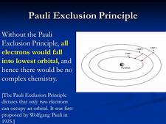
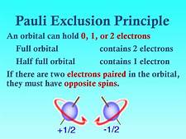
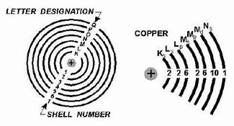
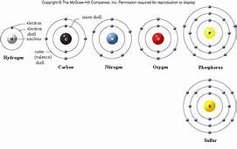
The outer shell is where chemical reactions occur---without it there would be no chemistry, no reality as we perceive it.
Electrons like to fall to the lower orbital.

Slide 51
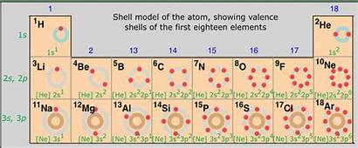
Carbon with its electrons is very friendly and likes to play well with others.

Slide 52
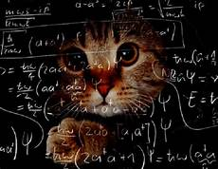
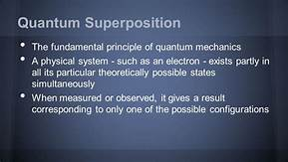
Shrodinger’s Cat is a THOUGHT EXPERIMENT to explain Superposition
No cats were killed in
this thought experiment!
Don’t ask me.
I’m just the messenger…

Slide 54
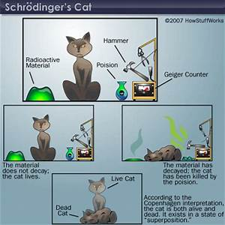

Slide 55
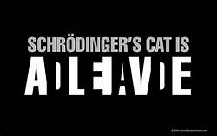
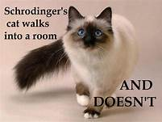
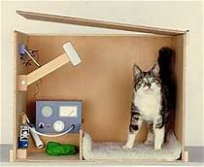
The cat is both dead and alive until you force the issue by opening the box.
Wanted DEAD or ALIVE!

Slide 56
Strings and Things

Slide 57
String theory has given rise to interesting formulae but has not yet been proven through experimentation.

Slide 58
“Universe” means
“one verse” or
“one word” or
“one song”
And that brings us to vibrating strings…

Slide 59
Everything vibrates.
The vibrational rate of hydrogen is 1.32 × 10^14 Hz.
Reference https://www.physicsforums.com/threads/estimating- the- vibrational-frequency-of-hydrogen-molecule.670156/
“According to string theory, yes, everything vibrates so slowly and calmly; you can't see or feel it. It is said that if something stops vibrating, it will disappear to a different dimension.”
http://www.answers.com
“According to string theory, absolutely everything in the universe—all of the particles that make up matter and forces—is comprised of tiny vibrating fundamental strings”.
www.pbs.org/wgbh/nova/elegant/resonance.html

Slide 60
“The fundamental notes of strings correspond to the particles of the Standard Model and the overtones to a heavier breed of particles.
A string can stop vibrating in one way and start vibrating in another, like a guitar string playing a new note.
In this way, a particle can metamorphose from one type to another---an electron, say, to a quark, or even a particle of matter to a particle of force.”
“Strings can pulse like a heartbeat.”

Slide 61
“A part of a string can pinch off, creating a new string---hence a new particle---that another particle can absorb.”
The grey indicates the pinching off points.

Slide 62
“A typical estimate is 10 ⁻³⁴ meter, although one could be as small as the Plank Scale of 10 ⁻³⁵ meter.”

Slide 63
Open String
Closed String

Slide 64
“…String Theory is more of an approach, a set of ideas or tools, than a full fledged theory.”
“What the exact theory is or whether it even exits, no one yet knows.
String theorists call this ultimate formulation “M-Theory,” but the
“M” doesn’t stand for anything in particular---deliberately.
It is just a stand-in for ignorance.” String Theory
(This is like “dark matter” and “dark energy.”
We use the word “dark” to indicate our ignorance.)

Slide 66
The vibration of the string takes place on the “worldsheet---the inner space.”
“A closed string can vibrate by expanding in one direction and squeezing in the perpendicular direction, then squeezing in the first direction and expanding into the second, back and forth, over and over.
And that’s what gravitational waves do! So a string vibrating in this way must be acting as a graviton. Firing off gravitons is how particles exert force of gravity on one another.”
“A vibrating loop behaves like a graviton, and this graviton then flies across space and does its thing. In other words, forces are still transmitted by particles, as in the Standard Model. It’s just that the particles themselves are strings vibrating in a certain way.”
String Theory
Note: The graviton is a proposed, theoretical, particle or wave.
It has not been observed or proven to exist, but logically, should.

Slide 67
A vacuum is empty,
Right?

Slide 69
brane
/brān/
noun
1.an extended object with any given number of dimensions, of which strings in string theory are examples with one dimension. Our universe is a 3-brane.
Powered by Oxford Dictionarie

Slide 70
“Branes, eat Branes…”
“A brane is a two-dimensional membrane or analogous object in lower or higher dimensions.
A 0-brane is a point: .
A 1-brane is a type of string:
A2-brane is a sheet:
and a 3 brane is a solid body:
A d-brane is a special type of brane that open-ended strings attach themselves to.” (like flypaper).

Slide 71
You can have anti-branes which destroy their namesake!

Slide 76
A two dimensional Calabi-Yau shape which is a TORUS.

Slide 77
“Four dimensional Calabi-Yau space, sliced and projected into 2-D image.”

Slide 78
String Theory posits the existence of multiple dimensions.
A six dimensional Calabi-Yau space, sliced and projected into 2 dimensional space.

Slide 81
String Theory posits the existence of the multiverse.
The Big Bang was one universe that hit the “Big Crunch” and contracted to a finite point which squeezed through a hole, creating the Big Bang, cyclically.

Slide 82
New Universes springing into existence:

Slide 83
String theory posits that the Big Bang was two of the multiverses dividing.

Slide 86
Einstein’s equations posited the Wormhole wherein space is turned on end and the wormhole provides a pathway, thus shortening your trip.

Slide 89
Prepare to enter the
Twilight Zone,
The realm of the unreal,
The place of contradictions,
The world of Quantum Physics…

