Slide 1
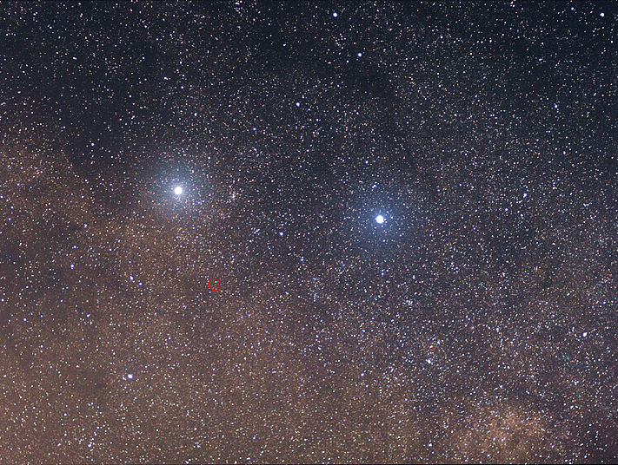
Proxima Centauri b: so near and so promising…
but…
Proxima Centauri b is 4.22 light years away from space.
A light year is the distance light travels in one year through vacuum: about 6 trillion miles.
It is in the Goldilocks zone: not too hot, not too cold. Capable of liquid water which scientists think is essential for life processes to exist.

Slide 2
What do we know about Proxima Centauri b? Not much at this point
Orbiting a small red dwarf star much cooler (5030 °F) than the Sun (9940 °F), 0.15% of Sun’s luminosity
Receives 65% as much starlight as Earth receives from the Sun
11.2-day orbital period
Orbital eccentricity < 0.35
Tidally locked, probably synchronously rotating (keeps the same face to the star), or slowly rotating
At least 1.3 times the mass of the Earth, so good chance it is a rocky planet rather than a giant planet

Slide 3
Put it all together, and Proxima Centauri b is in the middle of its star’s habitable zone! So is it the Earth twin we’ve been looking for? Well, not exactly…

Slide 4
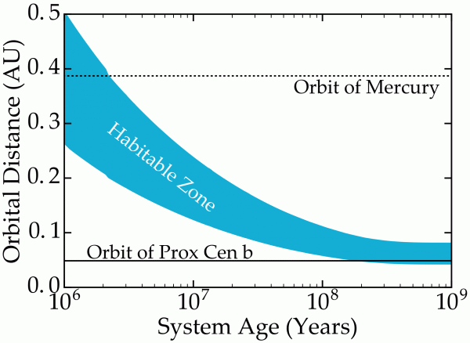
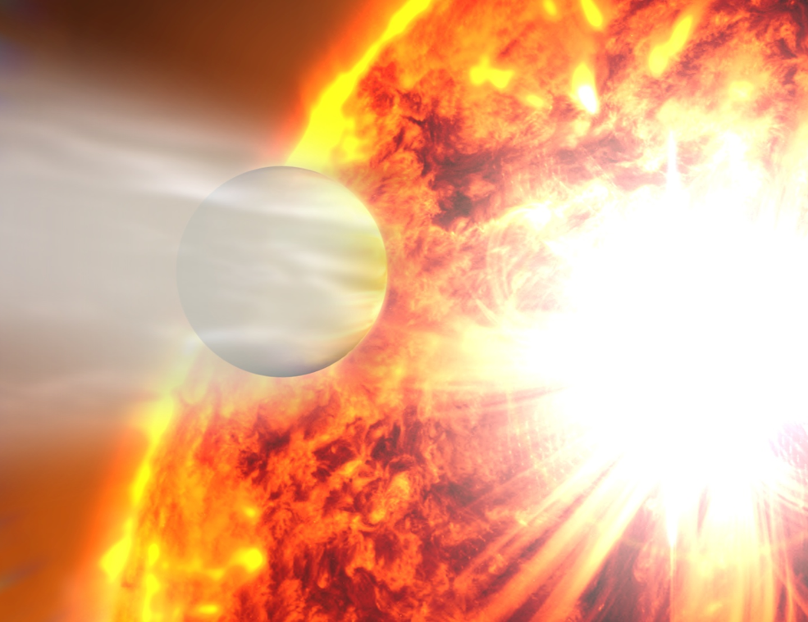
Many ways for Proxima Centauri b to be uninhabitable ☹
Runaway greenhouse as star
contracted
Especially if it formed in its
current location (very close to its star) – likely that it lost its water
Stripping of atmosphere by stellar flares
(Barnes et al., 2016)
But if it formed farther out and migrated in or was scattered into its current position….
maybe, just maybe, it
could be habitable
Image credit: NASA

Slide 5
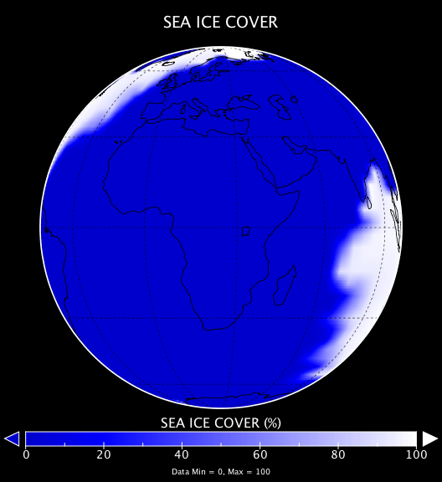
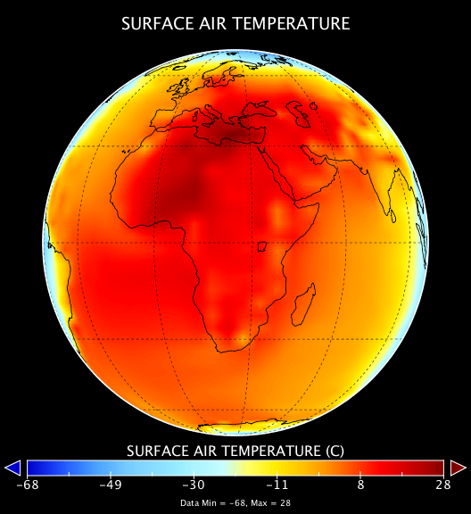
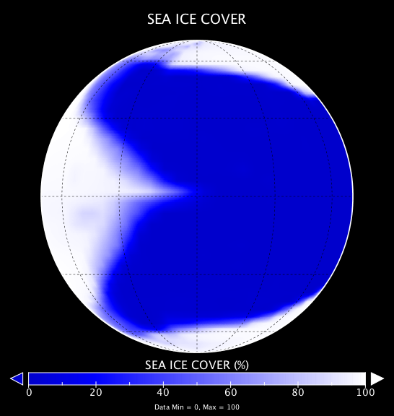
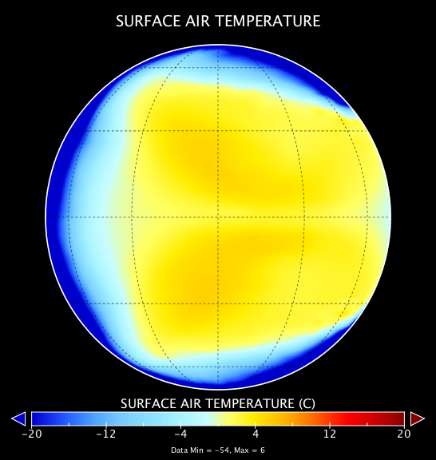
Two hypothetical views of Proxima Centauri b with an
Earth-like atmosphere
With Earth-like
continents and
oceans
As an all-ocean
“aqua planet”
(“lobster Earth”)
Dayside stays warm but not hot due to thick clouds – like
our ancient Venus!

Slide 6
However,
Proxima Centaur B is bathed with X-rays and ultraviolet light so life would have to live underground.

Slide 7
Stephen Hawking, the Einstein of our age, has proposed
Project Starshot to send a swarm of small star sail probes weighing only a gram
to travel to Proxima b at one fourth the speed of light.
It would arrive in about 20 years and send
photos and information back to Earth.

Slide 8
Most of this show from
Tony Del Genio
NASA Goddard Institute for Space Studies
For NASA Solar System Ambassadors

Slide 9
References
“Proxima Centauri b - Exoplanet Exploration: Planets Beyond ... » Exoplanets NASA
“Proxima b Is Surely Not “Earth-like.” But It’s a Research ...” Exoplanets NASA
“Proxima Centauri b: Have we just found…” | The Planetary Society

