Slide 1
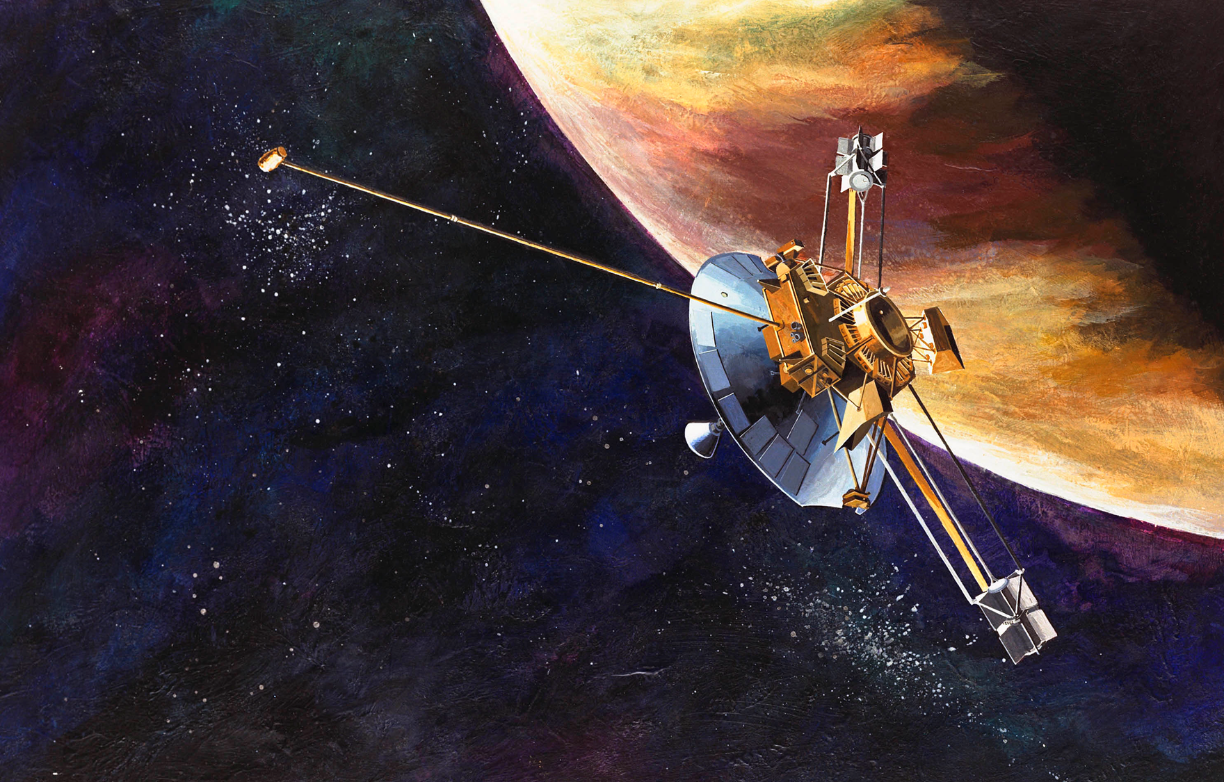
Now, Voyagers,
we are an Interstellar Species...
45 years in space as of 2022

Slide 2
To envision the Sun's presence in the Milky Way galaxy, think of a ship plowing through the ocean, being tossed by currents. As the ship sails ahead, a bow shock spreads around the vessel.
The area under the Sun's influence, stretching well beyond the planets and forming what's called the heliosphere, is like a ship. The outer edges of the heliosphere are gently buffeted by interstellar wind, the gas and dust between the stars. As the Sun orbits the center of the Milky Way galaxy, the heliosphere moves as well, creating a bow shock ahead of it in interstellar space.
Termination Shock:
Blowing outward billions of kilometers from the Sun is the solar wind, a thin stream of electrically charged gas. This wind travels at an average speed ranging from 300 to 700 kilometers per second (700,000 - 1,500,000 miles per hour) until it reaches the termination shock. At this point, the speed of the solar wind drops abruptly as it begins to feel the effects of interstellar wind.
Heliosphere:
The solar wind, emanating from the Sun, creates a bubble that extends far past the orbits of the planets. This bubble is the heliosphere, shaped like a long wind sock as it moves with the Sun through interstellar space.
Heliosheath:
The heliosheath is the outer region of the heliosphere. Voyager entered the heliosheath about 14 billion kilometers (approximately 8.7 billion miles) from the Sun. This is about 94 times the distance from the Sun to Earth.

Slide 3
The heliosheath is just beyond the termination shock, the point where the solar wind slows abruptly, becoming denser and hotter. The solar wind piles up as it presses outward against the approaching wind in interstellar space.
Heliopause:
The boundary between solar wind and interstellar wind is the heliopause, where the pressure of the two winds are in balance. This balance in pressure causes the solar wind to turn back and flow down the tail of the heliosphere. Once Voyager passes the heliopause, it will be in interstellar space.
Bow shock:
As the heliosphere plows through interstellar space, a bow shock forms, much as forms in front of a boulder in a stream.

Slide 4
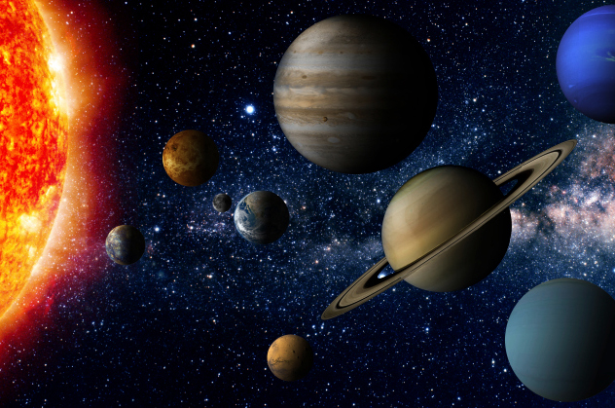

Slide 5
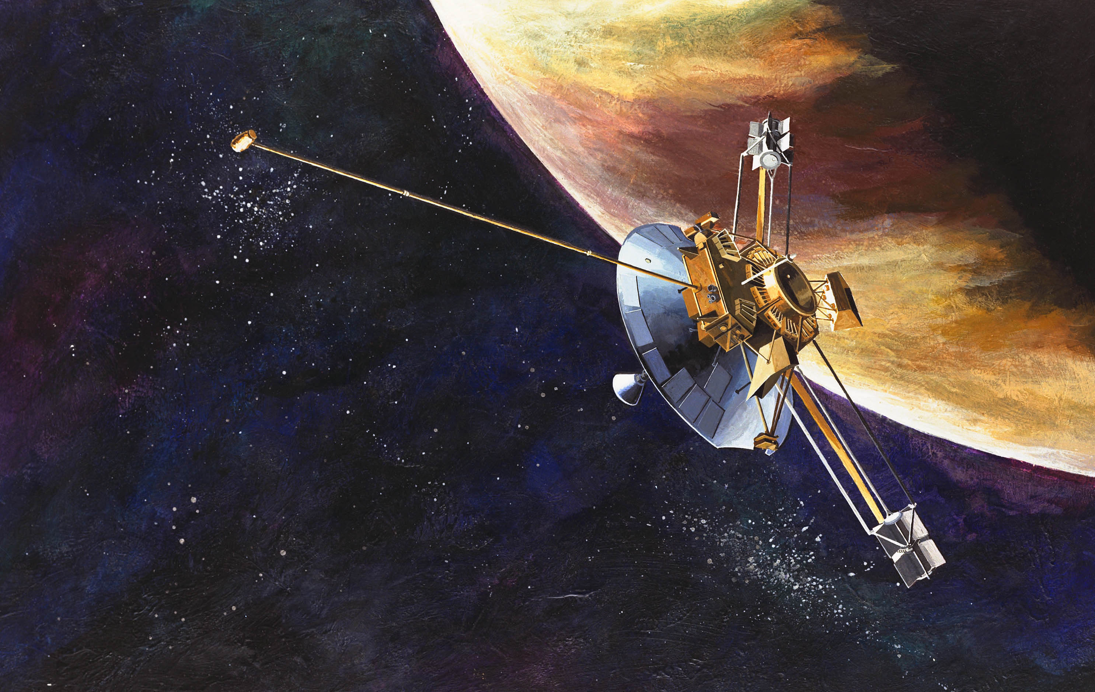
Pioneer 10 launched on March 2, 1972 Pioneer 11 launched on April 6, 1973
"We're way beyond our warranty," says Lasher. "Pioneer 10 was only intended to last 21 months, but it's been going for nearly 30 years." (34 years)

Slide 6
The US spacecraft Pioneer 10 and 11 have travelled
7.6 Billion and 9.3 Billion miles

Slide 7
Pioneer 10 and 11 have left the Solar System
making us an interstellar species…

Slide 8
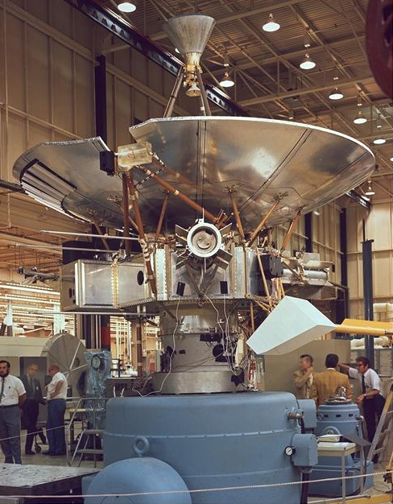
,
Pioneer

Slide 9
They carry a message to the Stars…

Slide 10
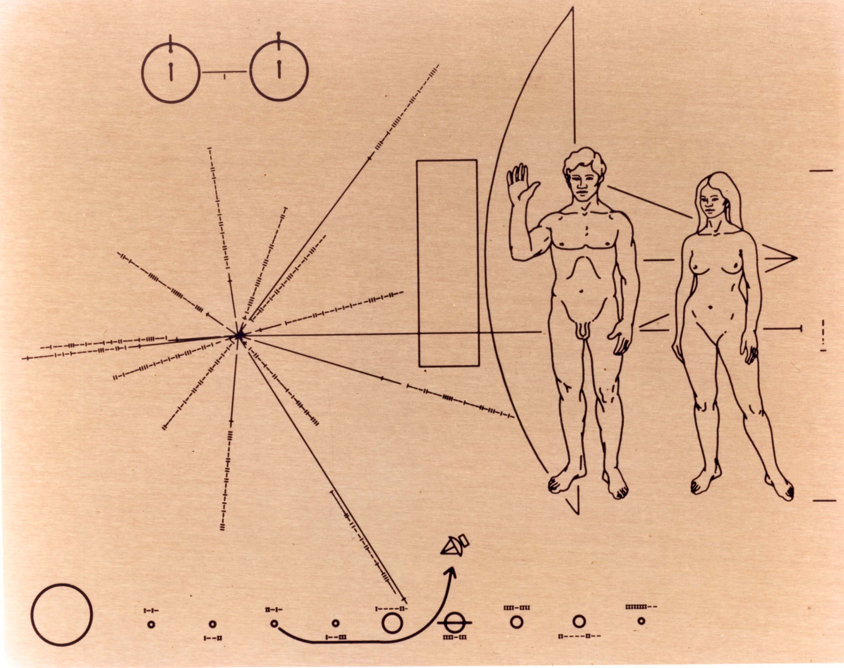
The Hydrogen Atom
Greetings from Earth
Location of Earth in reference to 14 Pulsars
Pioneer’s Path through the Solar System

Slide 11


Estimated time of arrival is
2 million and
4 million years from now…

Slide 12
But wait,
there’s more…

Slide 13
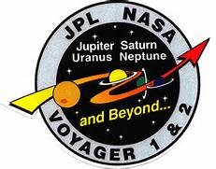
In 1977, almost 40 years ago,
on Voyager 1 and Voyager 2,
we blasted off to become an interstellar species…

Slide 14
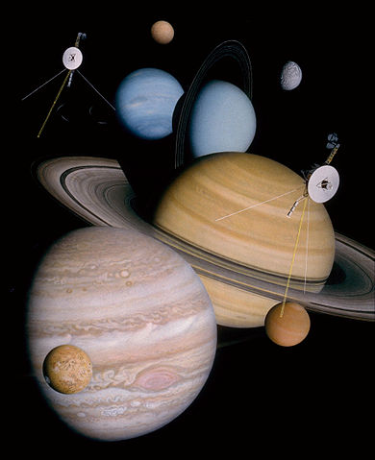
A montage of the planets visited by the Voyager Spacecraft

Slide 15
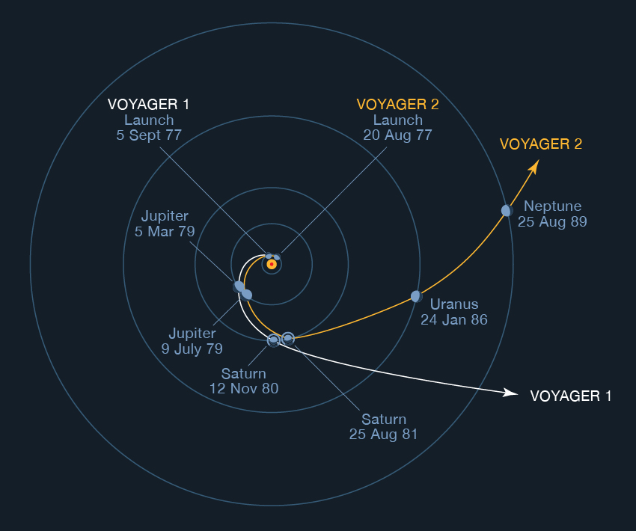

Slide 16
Older data as of November of 2016
VOYAGER 1
DISTANCE FROM EARTH = 12.4 BILLION MILES
20,069,733,453 KM
DISTANCE FROM THE SUN = 20,169,753,362 KM
134.82647359 AU *
ROUNDTRIP OF LIGHT:
TIME FROM THE EARTH = 37:11:30
VOYAGER 2
DISTANCE FROM EARTH = 10.6 BILLION MILES
16,570,810,886 KM
110.76902906 AU *
DISTANCE FROM THE SUN = 16,612,142,580 KM
111.04531436 AU *
ROUNDTRIP OF LIGHT:
TIME FROM THE EARTH = 30:42:28
* An astronomical unit is the distance between the Earth and the Sun.

Slide 17
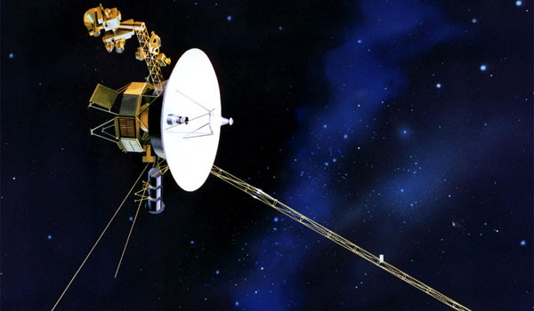
Mission Objective
“The mission objective of the Voyager Interstellar Mission (VIM) is to extend the NASA exploration of the solar system beyond the neighborhood of the outer planets to the outer limits of the Sun's sphere of influence, and possibly beyond. This extended mission is continuing to characterize the outer solar system environment and search for the heliopause boundary, the outer limits of the Sun's magnetic field and outward flow of the solar wind.”

Slide 18
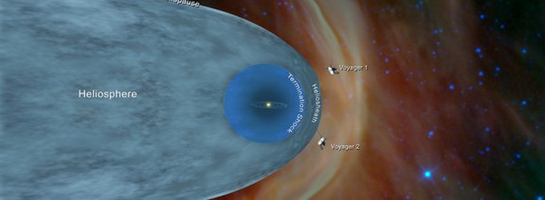
Our Voyagers have now left the Solar System as of 2018
Interstellar Space

Slide 19
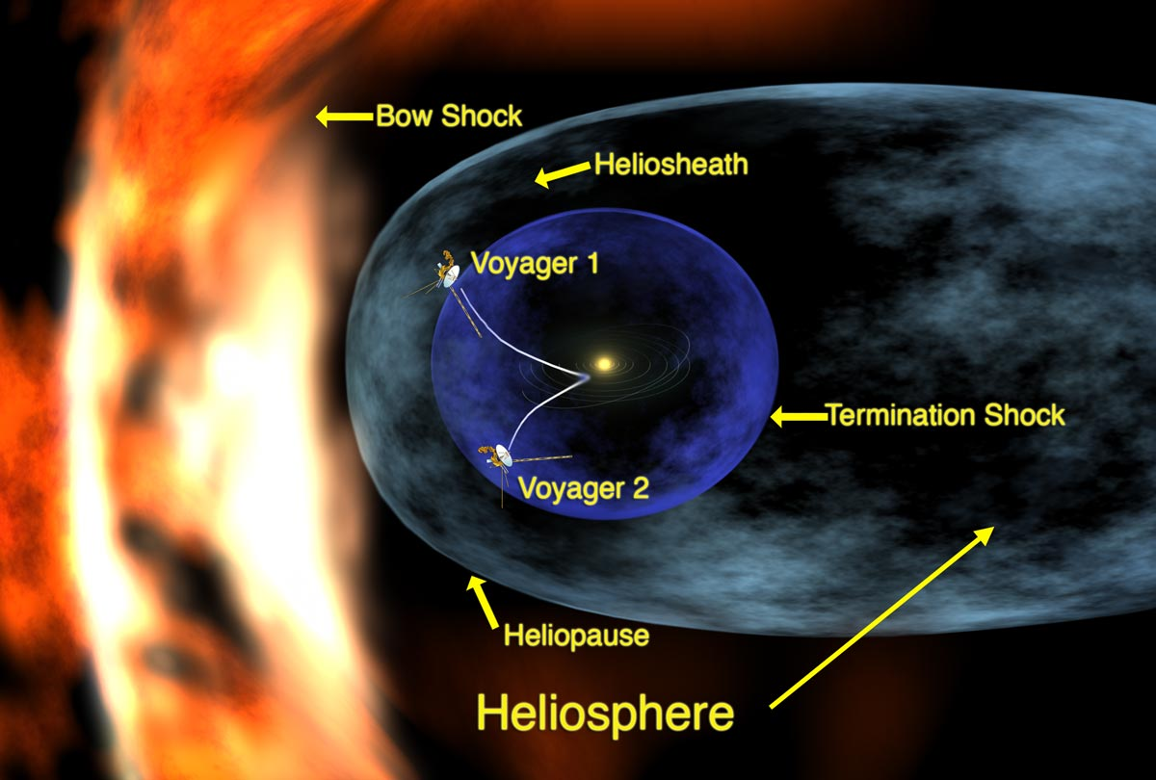
As the heliosphere plows through interstellar space, a bow shock forms, much as forms in front of a boulder in a stream.
The heliosheath is the outer region of the heliosphere
Both have left the Solar System
The boundary between solar wind and interstellar wind
The solar wind, emanating from the Sun, creates a bubble that extends far past the orbits of the planets

Slide 20
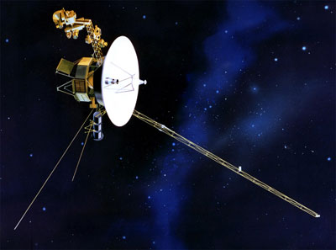
The two Voyager Spacecraft contain our message to the Universe…

Slide 21
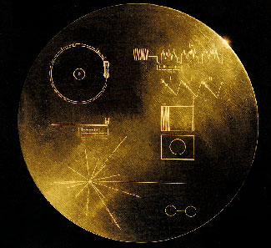

Slide 22
It contains a 12 inch copper phonograph record which contains the following….

Slide 23
Voyager’s Content:
A message from President Carter
Music from various countries and centuries

Slide 24

Voyager includes:
Electronic diagrams, pictures, and printed words

Slide 25
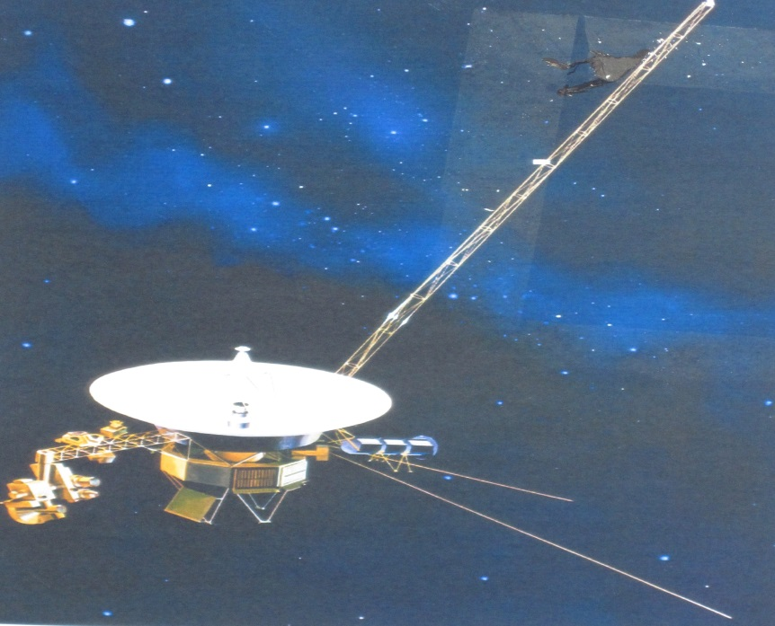
Voyager 1 will stop sending signals when it is 12.4 Billion Miles away from our Sun

Slide 26
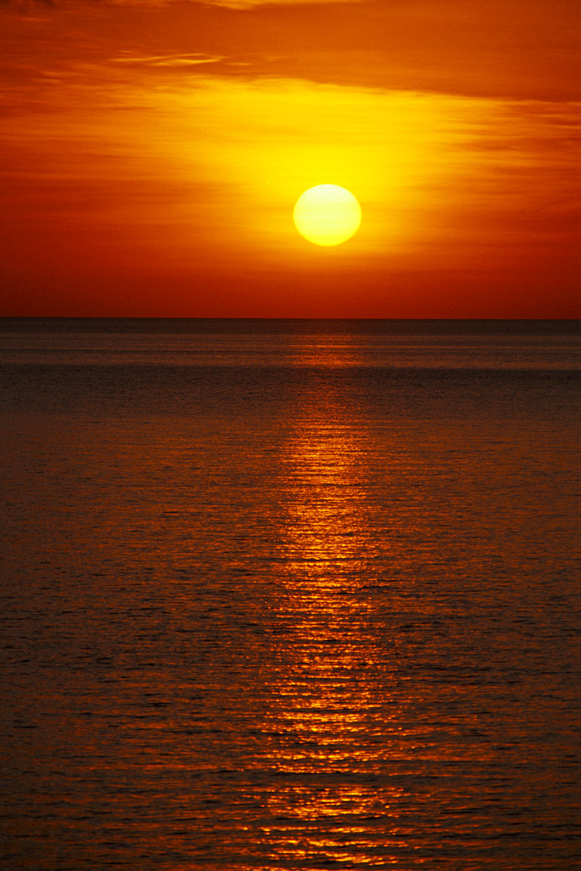
Voyager 2 will stop sending signals when it is 10.5 Billion Miles away from our Sun

Slide 27
The Voyage spacecraft have enough power to send signals until the year 2025

Slide 28
If the Voyagers do not crash into anything in their path, they will continue to travel at “9 miles each second, forever…”
The Voyagers will eventually orbit the center of the Milky Way Galaxy.

Slide 29
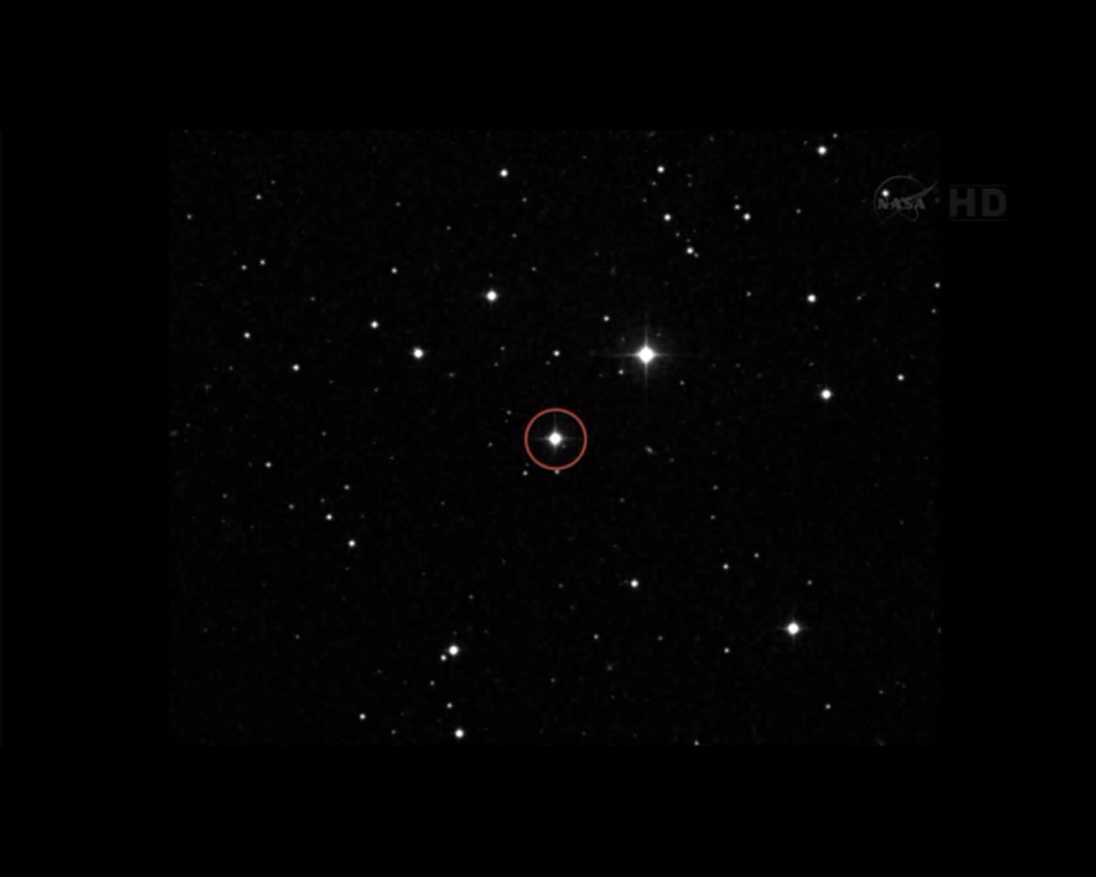
Voyager 1’s destination in 40,000 years is a star in the Camelopardalis constellation, designated AC+79 3888

Slide 30
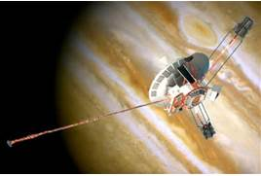
4 robotic emissaries from Earth are now voyaging through interstellar space.

Slide 31
But wait,
there’s more…

Slide 32

We have reached out
to the Universe…

Slide 33
Can you hear me now?

Slide 34
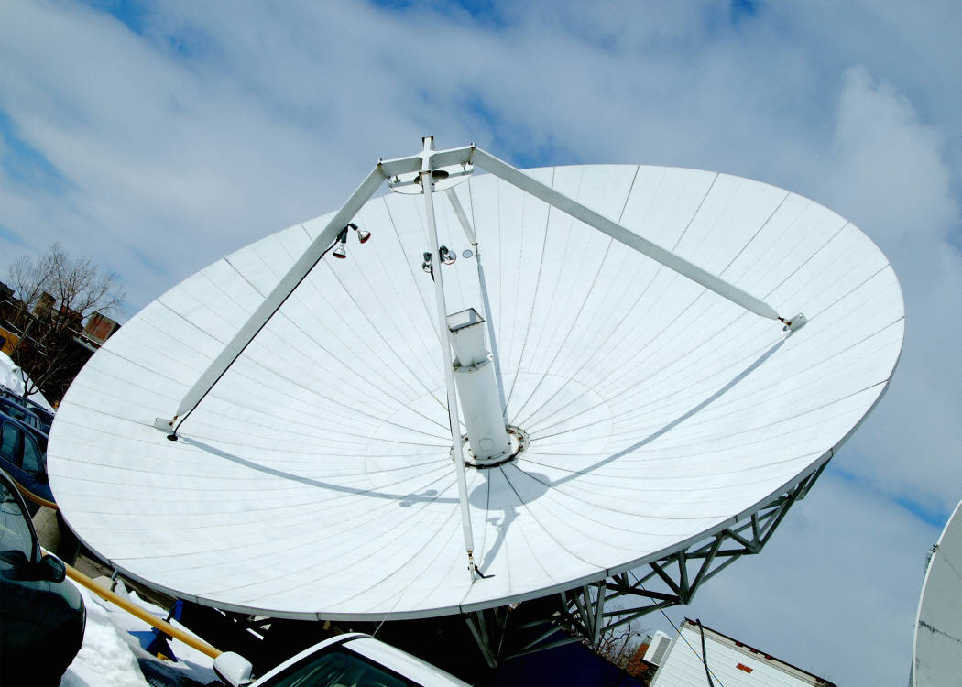
Our radio waves travel at 670, 616, 629 miles per hour

Slide 35
Our radio waves have travelled 116 light years, or about 529.1 Trillion Miles

Slide 36

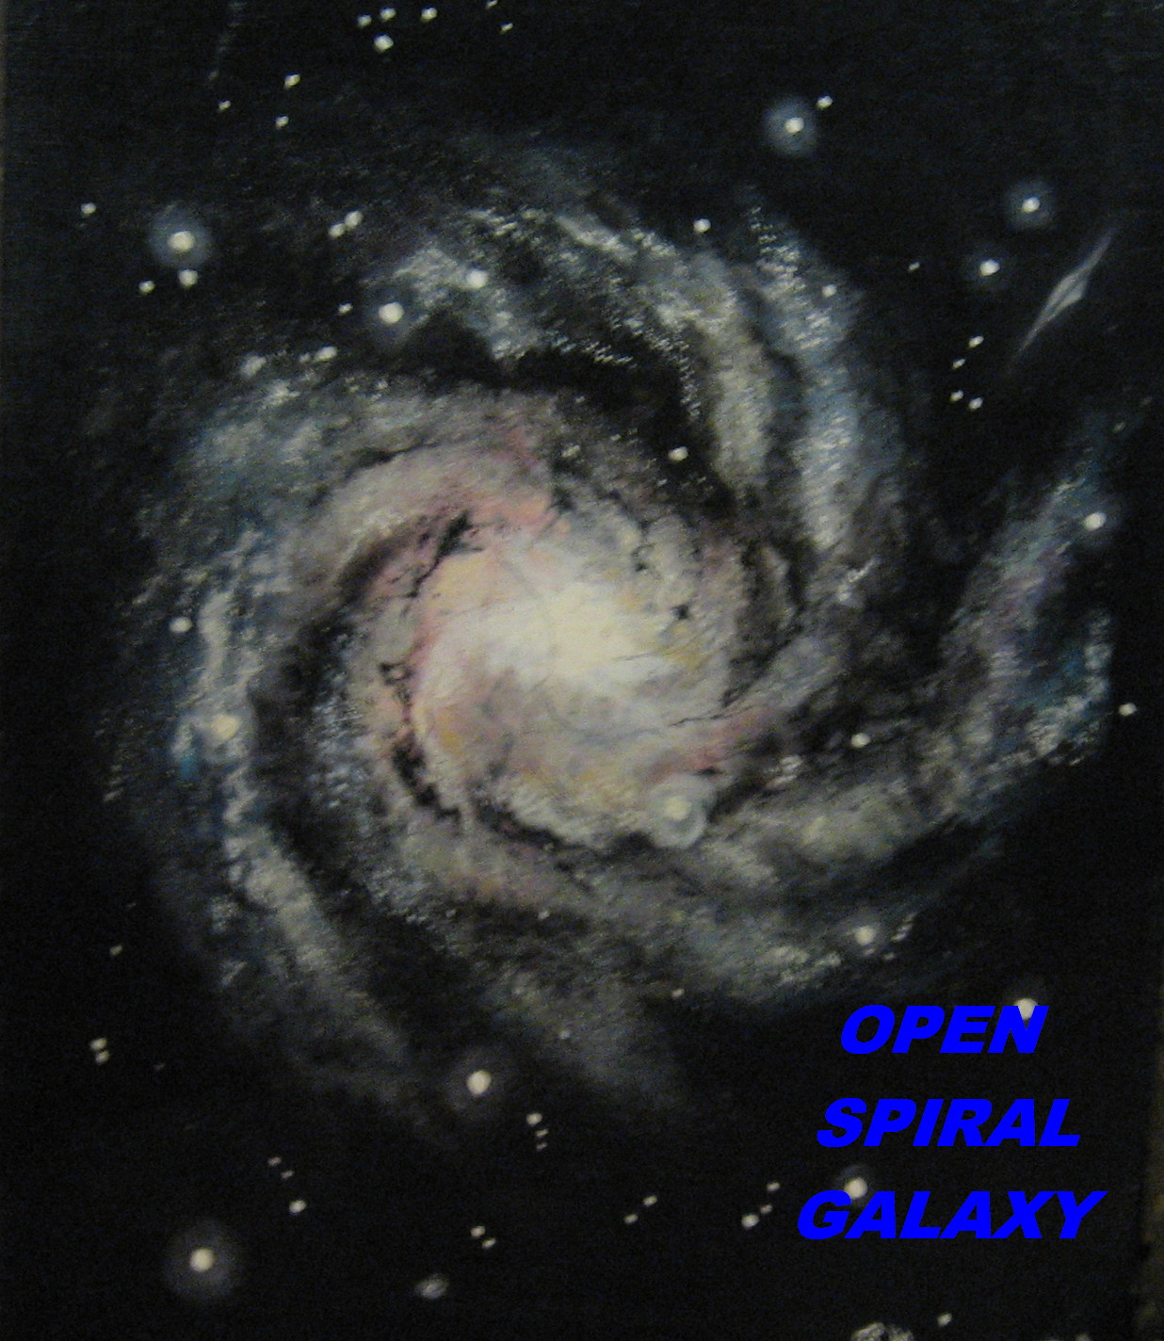

Our television signals have been travelling since 1925 and have travelled 117 Light Years (529.1 Trillion Miles)

Slide 37

The Alpha Centauri Star system has received TV Signals as recent as 2009

Slide 38
TV signals bounced back were broadcast on the BBC in England in 2014 *
* It is thought that the signals bounced back from an asteroid belt.

Slide 39

Scientists have recently received BACK our TV shows that were broadcasted 47 years ago.

Slide 40


We are sending but is anyone OUT THERE listening?

Slide 41
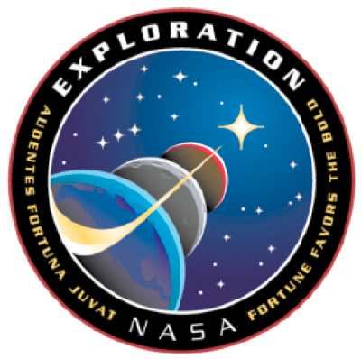
“We have put our ships into the cosmic ocean. The waters are benign and we have learned to sail. No longer are we bound to our solitary island… Earth !”
Carl Sagan

Slide 42
“Earth is the cradle of humanity, but mankind cannot stay in the cradle forever.”
Konstantin Tsiolkovsky

Slide 43
References
“Voyager” JPL - NASA
“Voyager - Mission Status” NASA
“In Depth | Voyager 1” – NASA Solar System Exploration
”In Depth | Voyager 2” – NASA Solar System Exploration
”The Golden Record: The Film” - videoveracity.org

