Slide 1
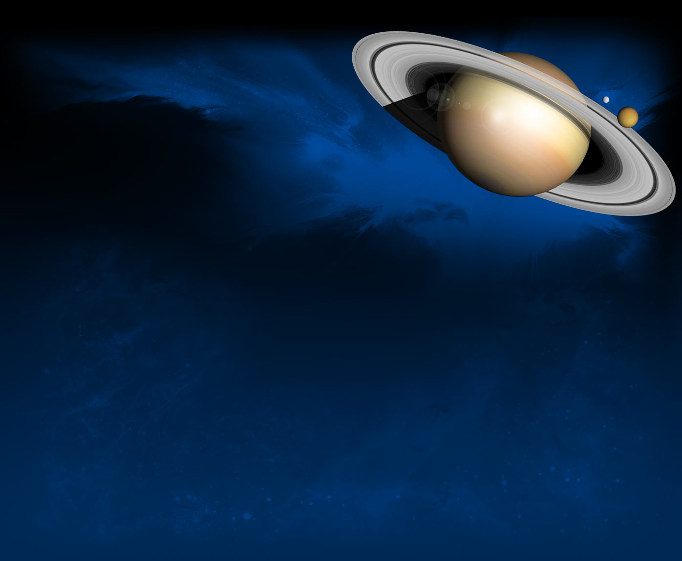
The Best Bets for
Life
in Our Solar System:
Enceladus, Europa,
& Ganymede
& Clalisto

Slide 3
References
“The Making of Life” by Michael L. Wong Planetary Report
“The Possible Emergence of Life and Differentiation of a Shallow Biosphere on
Irradiated Icy Worlds: The Example of Europa” Astrobiology Magazine
The Ecology of Deep-Sea Hydrothermal Vents by Cindy Lee Van Dover “The Drive to Life on Wet and Icy Worlds” Astrobiology Magazine
“Europa Erupts! Possible Geyser of Water Seen on Jupiter’s Moon” Slate
“A List of Animals that live near Thermal Vents” Animals
“Looking for LUCA- the Last Universal Common Ancestor” Astrobiology Magazine
“Astrobiology Top 10: Could Shallow Biospheres Exist Beneath the Icy Ceilings of Ocean Moons?” Astrobiology Magazine
The Astrobiology Primer: An Outline of General Knowledge---Version 1, 2006 by Lucas J. Mix et al
“Exploring Life’s Origins” Exploring Origins Project – NSF
“Enceladus Ocean Moon” Cassini
“Enceladus’ Sea Floor has Hydrothermal Vents like Ours” Astronomy.com
“NASA Finds Evidence of Hydrothermal Vents on Saturn’s Moon Enceladus” Pop Mech
“Hydrothermal Vents and the Origins of Life” Chemistry World

Slide 4
References
“Complex Organics Bubble up from Ocean-world Enceladus”
NASA Solar System Exploration
“Metal Cells may have held the chemicals of Life’s Origin Captive” Leslie Mullen
“Possible Keys to Life’s Chemistry Revealed in 50 Year-old Experiment” Live Science
““Earth Life may have Originated at Deep-sea Vents” Astrobiology Magazine
“Complex Organic Molecules discovered in Enceladus’ Plumes could Hint At Life”
Astrobiology Magazine
“New Study Identifies Possible Ancestors to RNA” Astrobiology Magazine
“What is Astrobiology“?” NASA
“Astrobiology: Thinking about Life, the Universe, and More”
Solar Systems Educator’s - Astrobiology Institute – Dr Margaret Race
“Does Jupiter's moon contain LIFE? Nasa confirms Ganymede has an underground ocean beneath icy surface” The Daily Mail – U.K.
“6 Most Likely Places for Alien Life in the Solar System” Space.com
“Complex Organics Bubble up from Ocean-world Enceladus” Jet Propulsion Laboratory
“Simulating early ocean vents shows life's building blocks form under pressure”
Astrobiology reported in Space Daily
“Aquatic Rover Goes for a Drive Under the Ice” Jet Propulsion Laboratory
“Hints of life on Venus” Space Daily
“Study pinpoints process that might have led to first organic molecules” Space Daily

Slide 5
REFERENCES
“Oxidation processes diversify the metabolic menu on Enceladus” Science Direct
“Wonderland of iridescent worms and hydrothermal vents found off Mexican coast”
Live Science
“How Much Life Would Be Required to Create the Phosphine Signal on Venus?”
Universe Today
“A gas found on Earth that signifies life has been detected in the clouds on Venus” CNN
“Astronomers find possible sign of life on Venus” CBS News
“The Astrobiology Primer – Version 1, 2006” Astrobiology
“When did Life Originate?” Understanding Evolution
“'Chaos' regions of Jupiter's icy moon Europa may increase chance for life” Space.com
“Two of Uranus’ moons could host oceans, new research suggests” Digital Trends
“4 of Uranus’ moons could have liquid water oceans” Space News Digital Trends
“Saturn's Icy Moon Enceladus Is Likely the 'Perfect Age' to Harbor Life” Space.com
“What are the ingredients of Life” Live Science
“JWST has spotted an enormous plume of water coming out of Enceladus” New Scientist
“NASA's James Webb Space Telescope detects carbon on icy moon Europa” ABC Science

Slide 6
Only on Earth have we found ALL of the ingredients for Life.
life

Slide 7
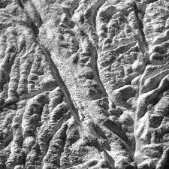
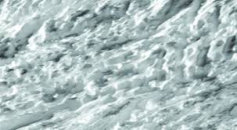
Many astrobiologists regard
Europa and Enceladus, which are both thought to harbor oceans of liquid water beneath their icy shells, as the solar system's two best bets to host alien life.”
Enceladus
and Europa

Slide 8
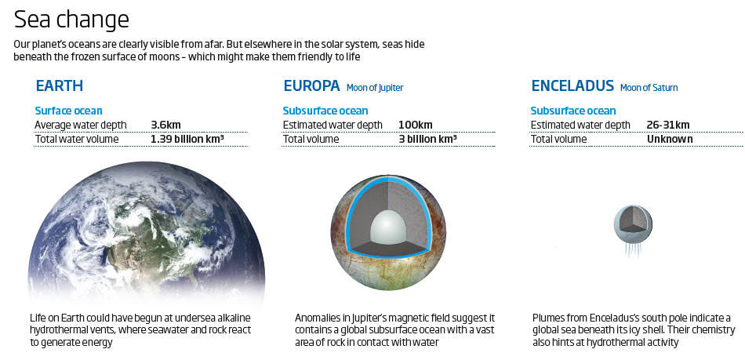

Slide 9
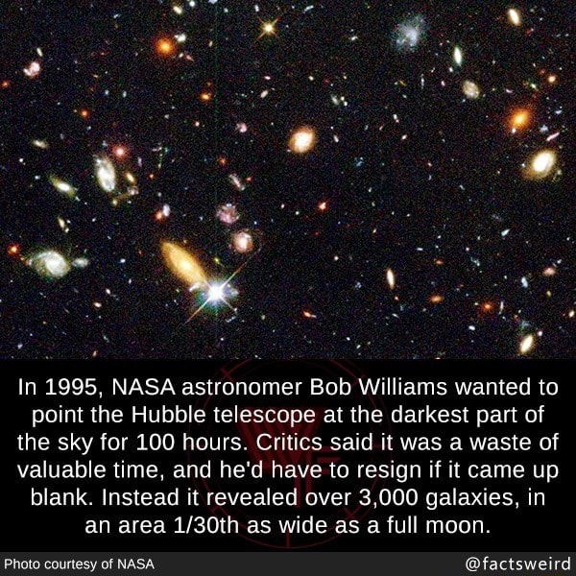
Showing 10,000 galaxies in one picture.

Slide 10
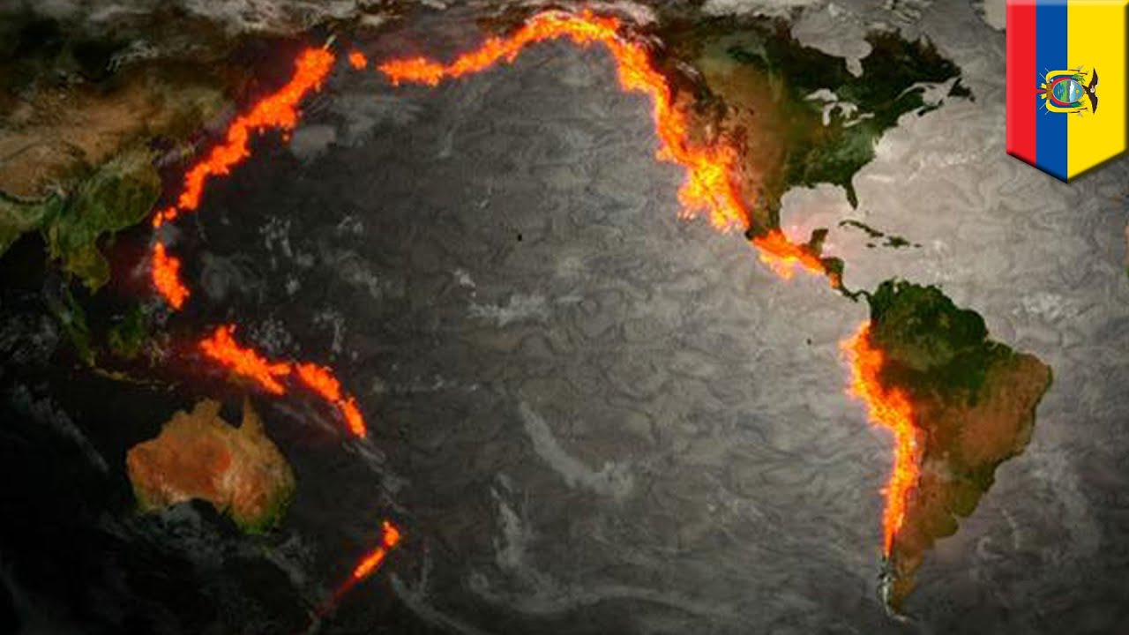
All around the Pacific Ocean is the Ring of Fire -- where the tectonic plates cross over / under each other the “Ring of Fire” arises where the volcanic magma escapes.

Slide 11
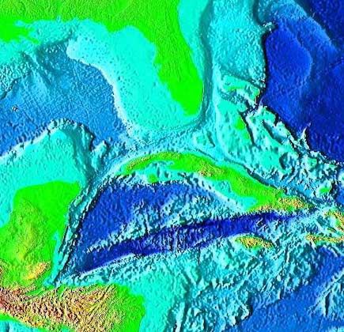
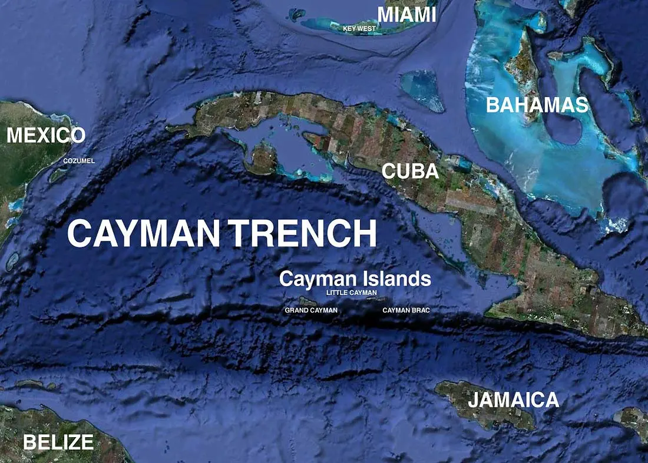
The Cayman Trench was so deep and dark that oceanographers thought no life could survive there.
Three MILES down and in complete darkness

Slide 12
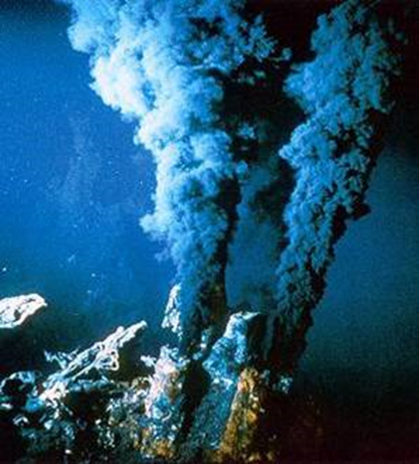
Once upon a time, an oceanographer told his colleagues he wanted to send a ROV
(remotely operated vehicle) 3-5 miles deep into the Cayman Trench in the Caribbean. When they stopped laughing, the ROV dove deep and discovered Hydrothermal Vents.
BUT ITS AT LEAST 800 ℉ !!!
BUT THERE’S NO LIGHT!
NOTHING CAN LIVE DOWN THERE !!!
THE PRESSURE WILL BE ENORMOUS !

Slide 13
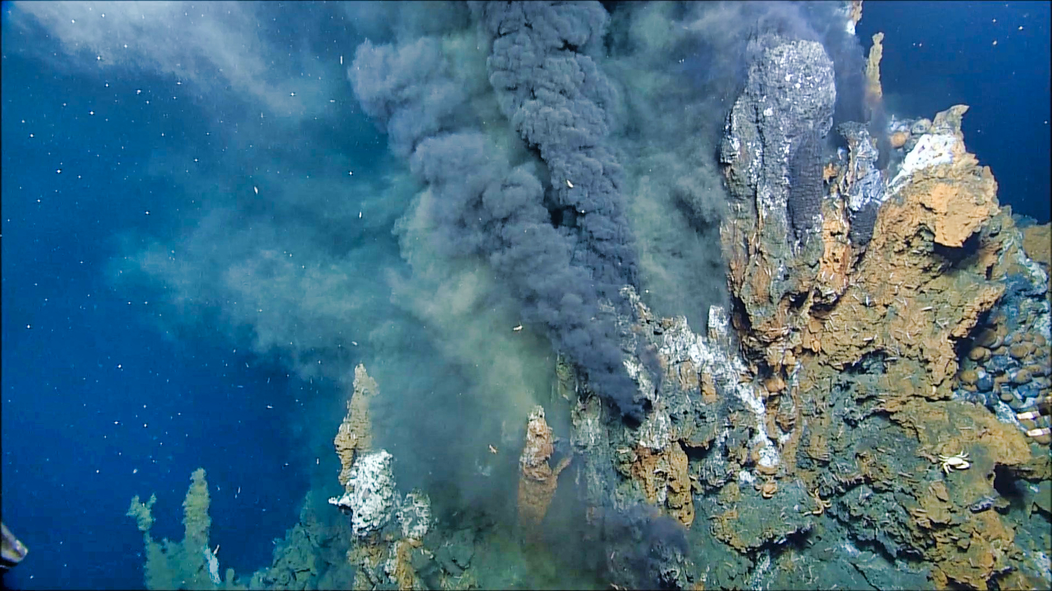
Hydrothermal Systems on Earth Support Life
25,000 feet deep
High temperature
No sunlight
Mineral rich -> Chemical energy
Yet life in our ocean thrives in this environment
800° F
This is why scientists are so excited by Enceladus!
Notes:
Relate back to why measuring H2 is exciting in Enceladus- reaction byproduct that can be used as fuel

Slide 14
Once upon a time there was STUFF…
floating all around in the sea.
It was just STUFF…disorganized and unconnected, but with a lot of
POTENTIAL….
Floatin’ around,
swishing here and there,
lonely and incomplete…
Just
STUFF.

Slide 15
“…all organisms are built from the same six essential elemental ingredients: carbon, hydrogen, nitrogen, oxygen, phosphorus and sulfur (CHNOPS).”
And some metals…
Just add salt
Ya know,
STUFF…

Slide 16
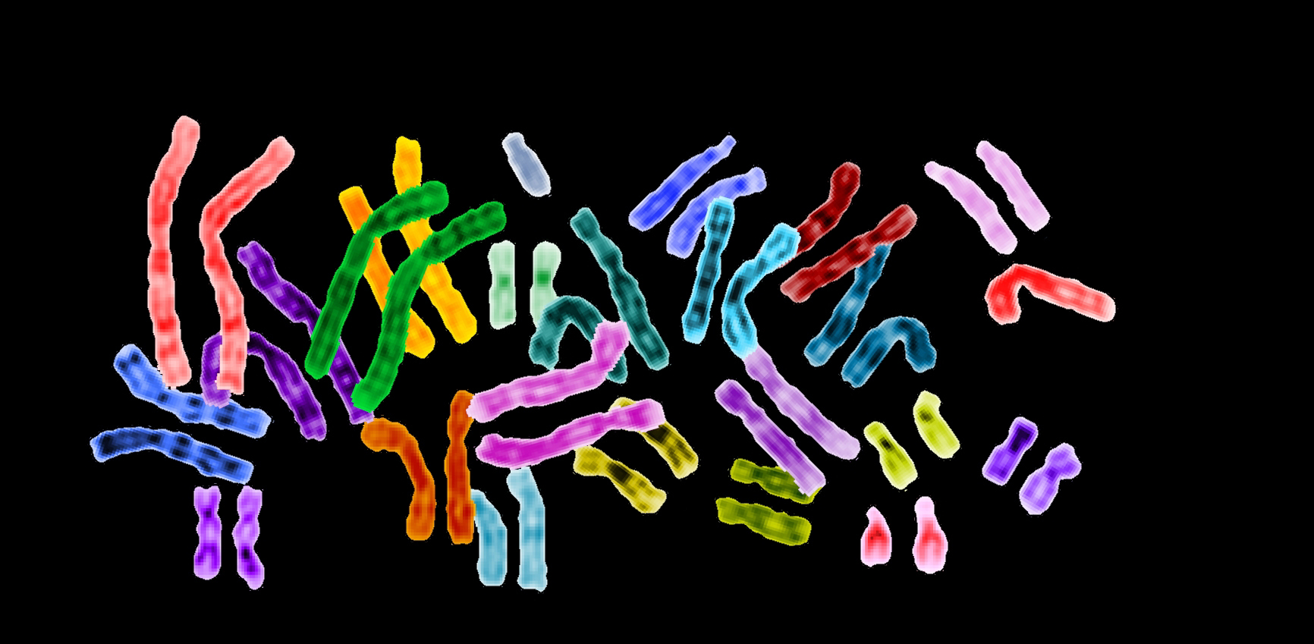

Slide 17
They needed a sack, a cell wall so they could organize.
With hydrothermal vents, the chimneys of the smokers have tiny little chambers to act as
cell walls.

Slide 18
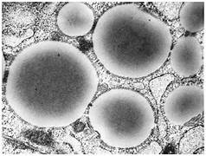
And then they met a buncha nice lipids
to hold the parts together so they could
percolate and dance and soon they were not just stuff,
but eventually
LIFE.

Slide 19
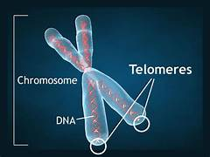
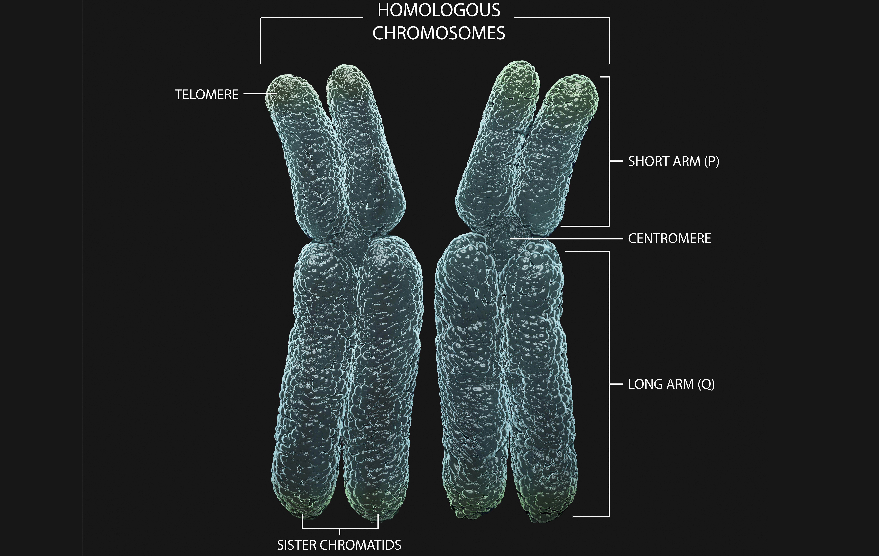

Slide 20
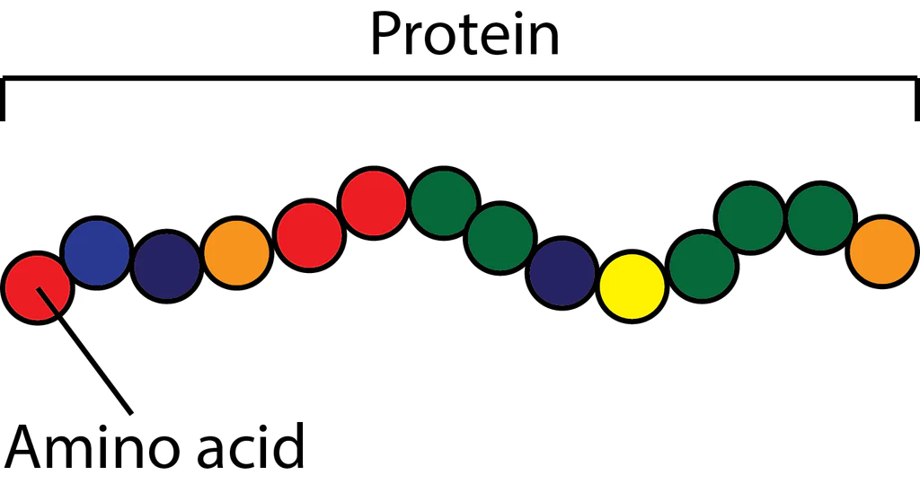

Slide 21
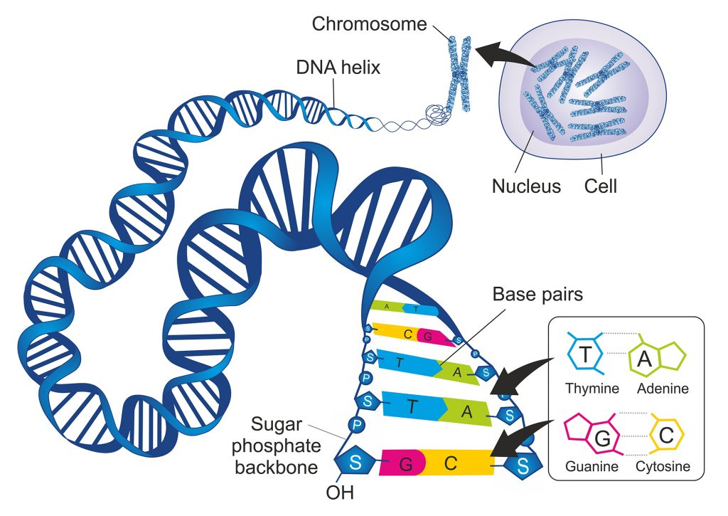

Slide 22
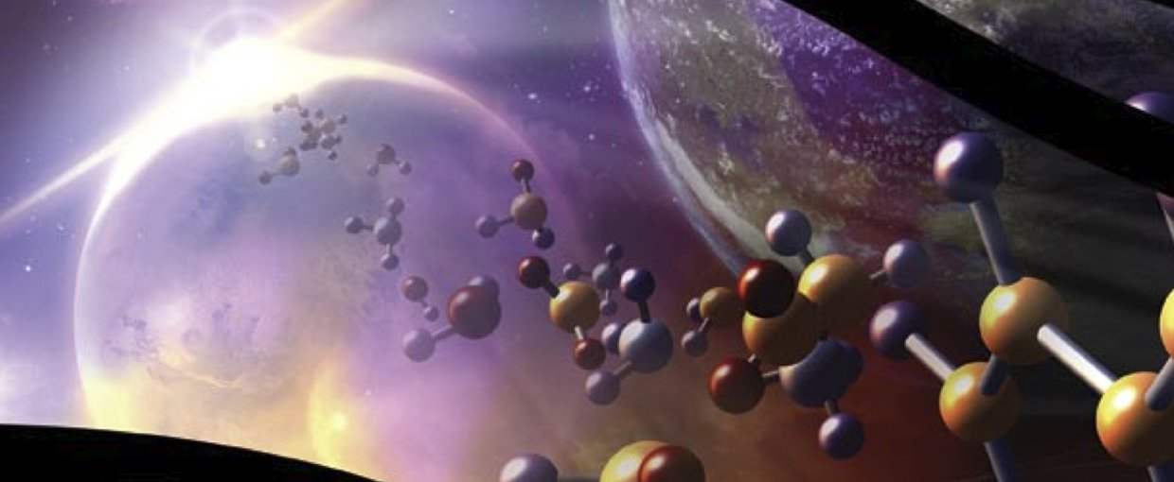
Astrobiology searches for life on Earth and Off Earth

Slide 23
Hydrothermal vents

Slide 24
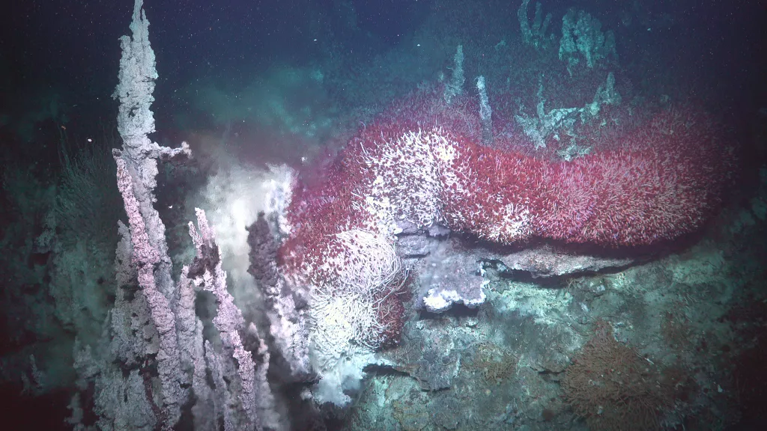
“Hydrothermal vents, chimneys, and tube worms.”.
(Image credit: ROV SuBastian / Schmidt Ocean Institute)”

Slide 25
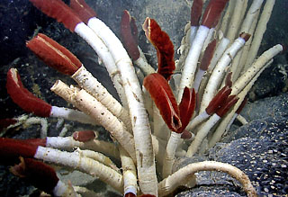
Close up of 8 ft long tubeworms at 5000 feet near Hydrothermal Vent.
“They depend on bacteria that live inside them for their food. This type of mutually beneficial relationship between two organisms is known as symbiosis. The bacteria actually convert the chemicals from the hydrothermal vents into organic molecules that provide food for the worm. (Note the bright red plume.) This is a specialized organ used for exchanging compounds such as
oxygen, carbon dioxide, and hydrogen sulphide with the seawater.”

Slide 26
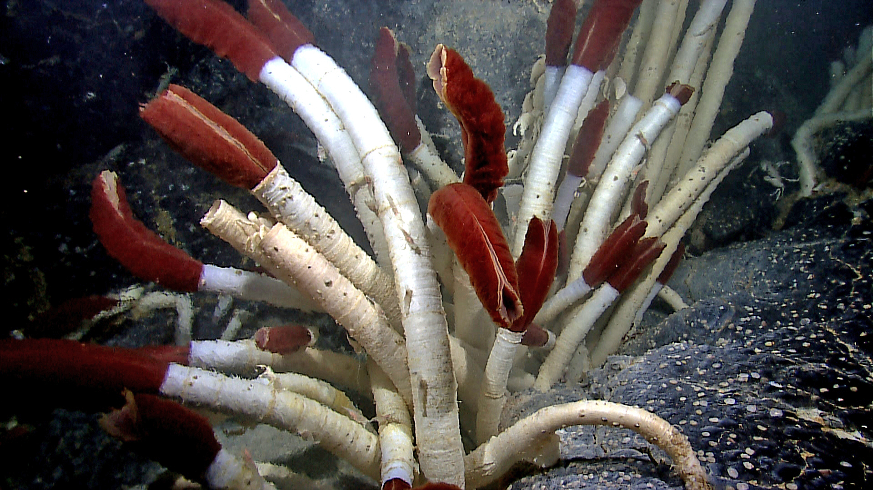
“Species like tubeworms, Riftia pachyptila, such as these found near the Galapagos islands, represent the kinds of life that can persist near deep sea hydrothermal vents.” Credit: NOAA Okeanos Explorer Program, Galapagos Rift Expedition 2011.

Slide 27
Vents and chemicals

Slide 28
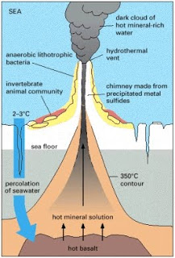

Slide 30
32 ° F

Slide 31
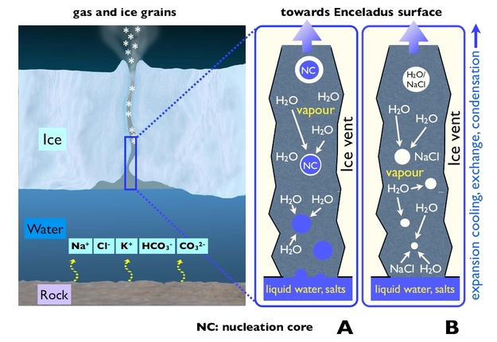
Sodium chloride
Sodium ,chlorine, potassium, anion, carbon trioxide

Slide 32
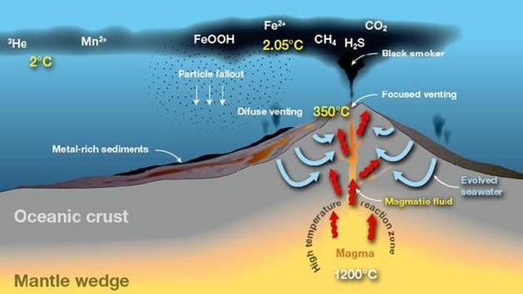
iron
Helium
manganese
Hydrous iron oxide
methane
Carbon dioxide

Slide 33
Clathtrate - a compound in which one component is enclosed within the crystal structure of another
Not from Life

Slide 34
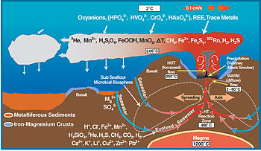

Slide 35
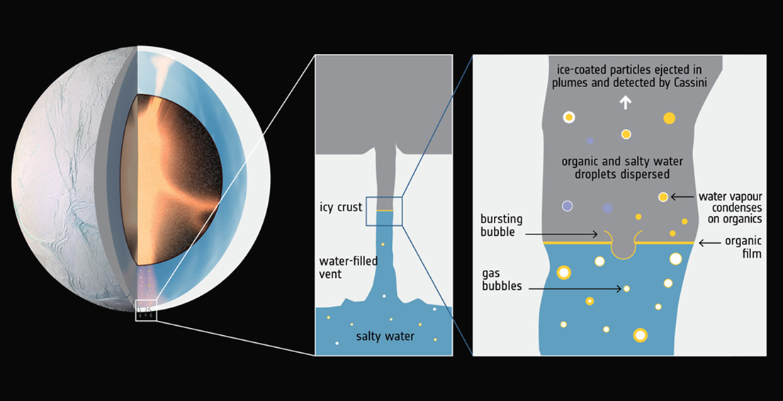
Cassini Spacecraft passed through Enceladus’ plumes. Data from NASA's Cassini spacecraft reveal complex organic molecules originating from Saturn’s icy moon Enceladus, strengthening the idea that this ocean world hosts conditions suitable for life. Research results show much larger, heavier molecules than ever before. …the makeup of the ejected ice and has recently identified fragments of large, complex organic molecules.” Jet Propulsion Laboratory
DETAIL

Slide 37
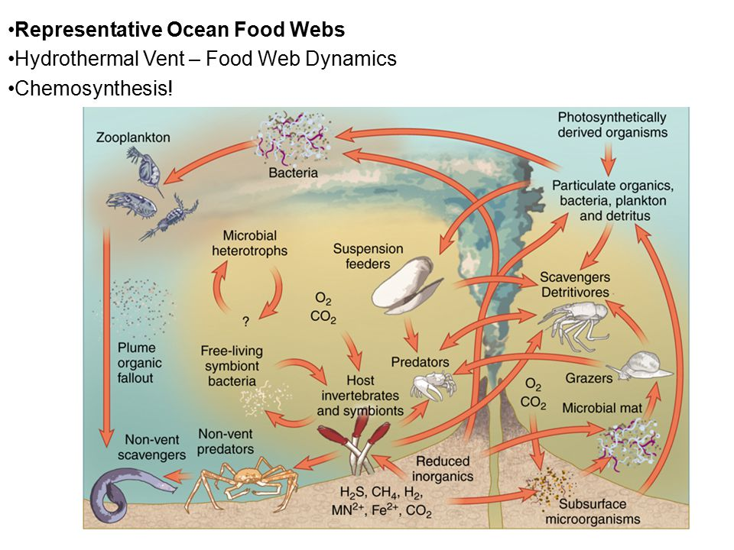

Slide 38
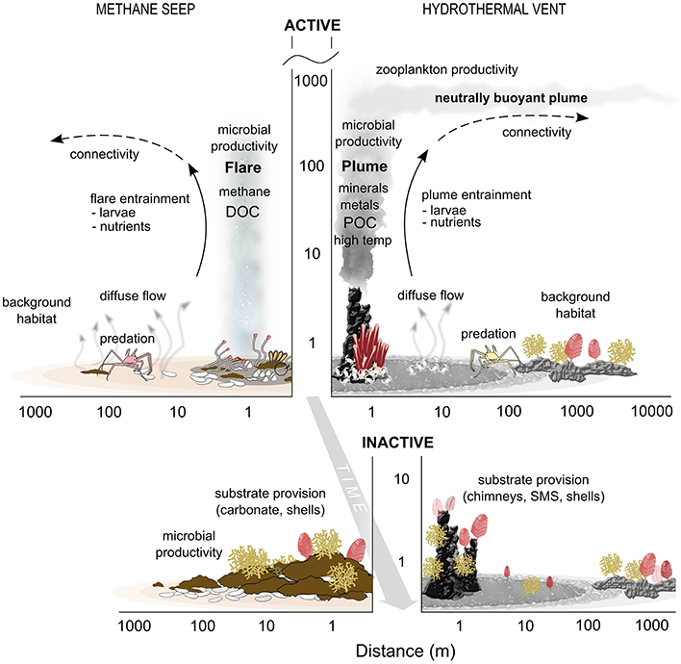

Slide 39
EARTH

Slide 41
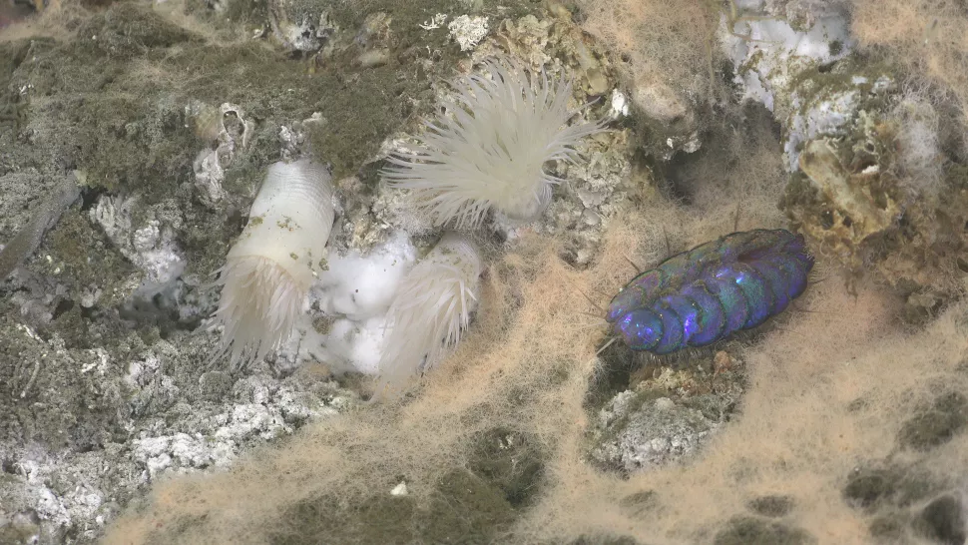
“The ROVer photographed this pink bacterial mat and Peinaleopolynoe orphanae scale worm at a depth of nearly 12,000 feet (3,656 m). (Image credit: Schmidt Ocean Institute). They also found at least six potential new species of crustaceans, mollusks, roundworms, arrow worms and bristle worms.”
EARTH

Slide 42
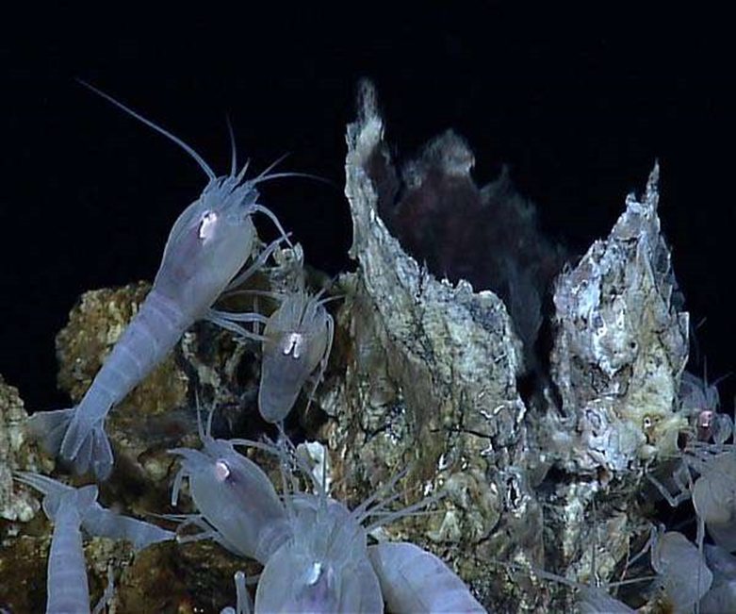
“A seafloor vent called a "white smoker" spews mineral-rich water into the ocean and serves as an energy hub for living creatures. Some scientists think life on Earth may have begun around similar vents on the ocean floor billions of years ago. The new experiment tested whether this reaction would have been likely to occur under the physical conditions around ancient seafloor vents, if such vents existed at the time. The answer? Yes.
The team created (potassium) formate and trace amounts of methane,
both organic molecules.”
EARTH

Slide 43
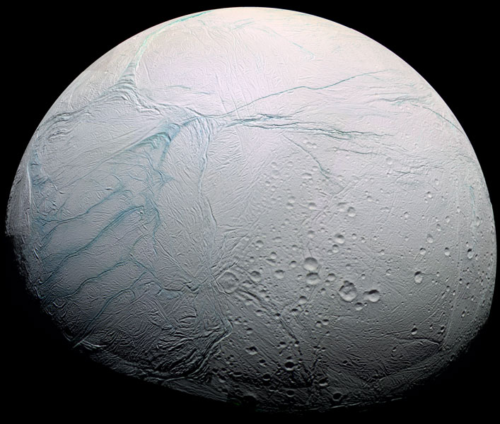
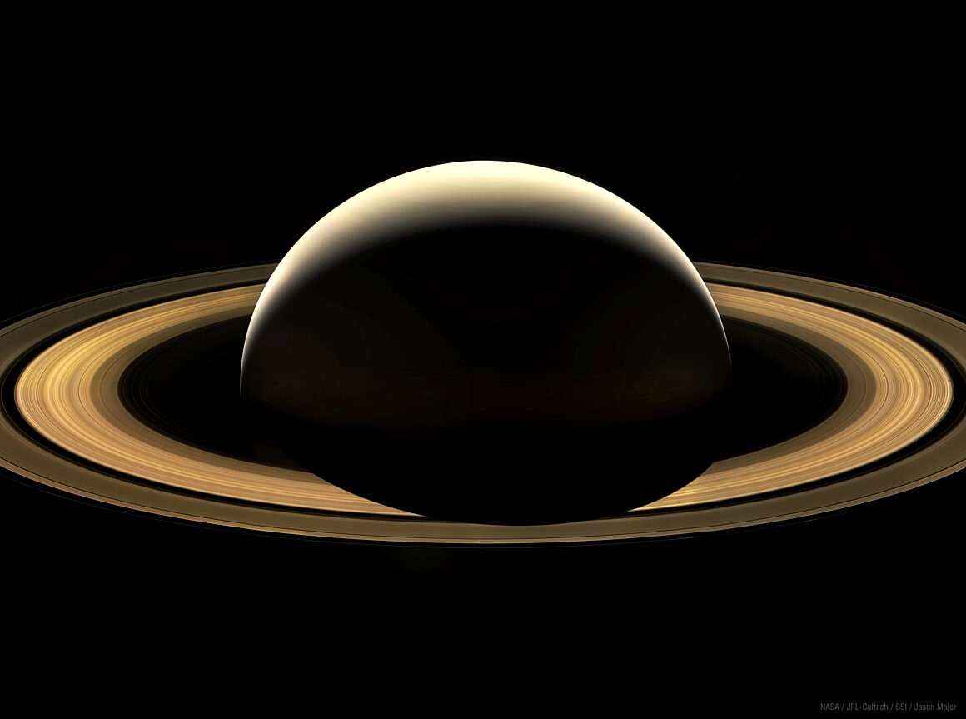
Enceladus

Slide 44
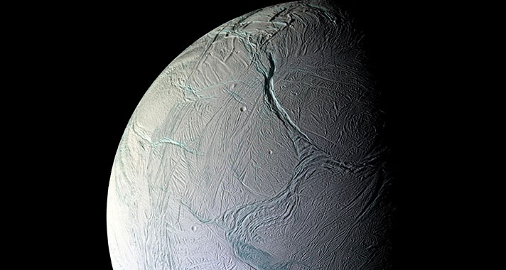
The cracks and canyons of Enceladus

Slide 45
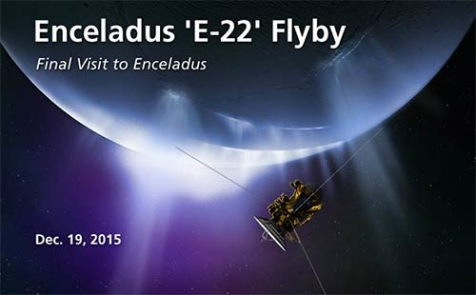

Slide 46
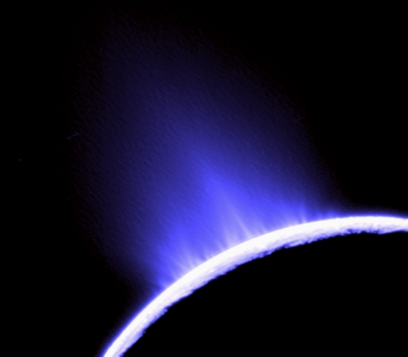
“Back in 2019, images of Europa taken by the Hubble Space Telescope revealed a high concentration of sodium chloride, a major component of sea salt, in a region known as Tara Regio.”

Slide 47
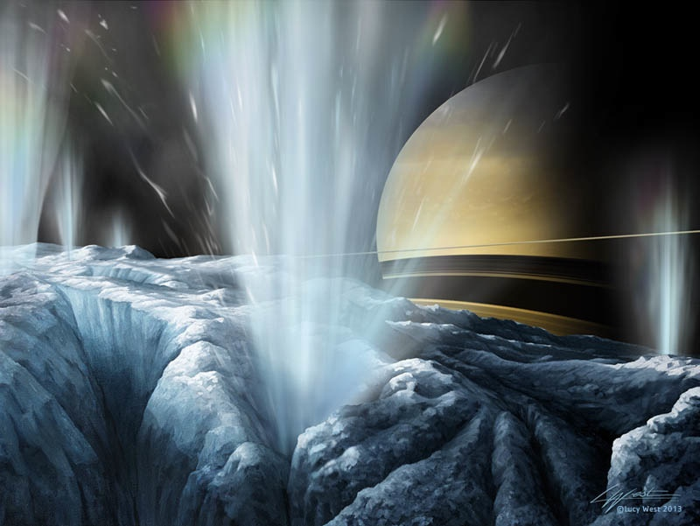
"We think this implies that the carbon probably has its ultimate origin in the internal ocean," said Samantha Trumbo, a planetary scientist at Cornell University …”
"That's not a trivial thing. Carbon is a biologically essential element.”

Slide 48
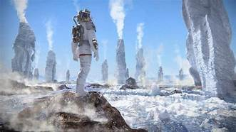
”James Webb Space Telescope's Near Infrared Camera allowed scientists to pinpoint, with greater accuracy than ever before, where carbon dioxide on the surface of Europa was concentrated. ”

Slide 49
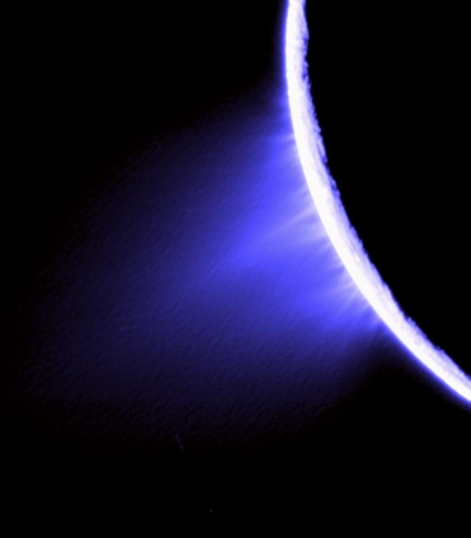
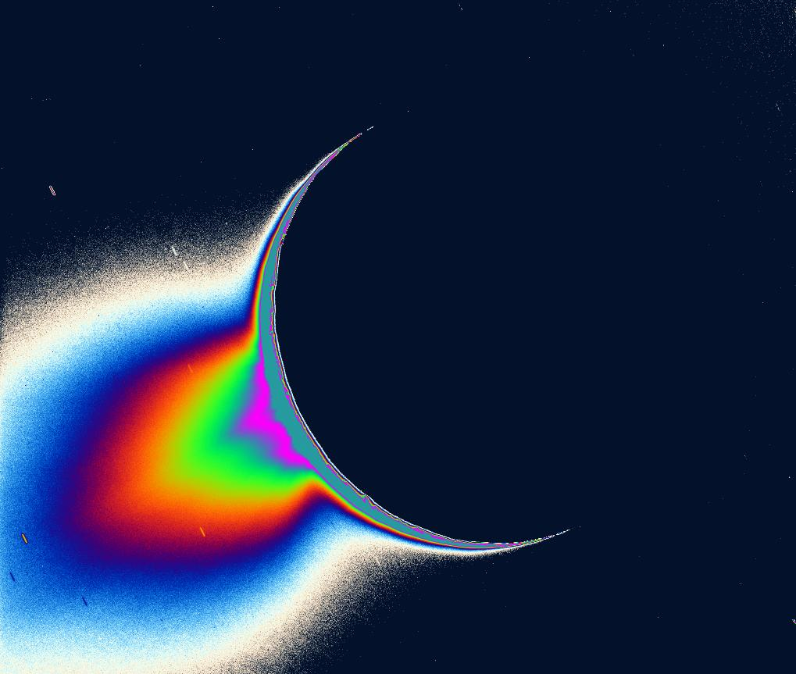
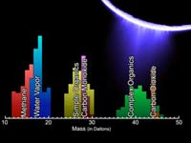
The plumes of Enceladus are spewing out geysers 100s of miles long. They contain water vapor, nitrogen gas, ice crystals, carbon dioxide, ammonia, propane, acetyline
Methane,
“Cassini Oct. 28, 2015: water vapor, carbon dioxide, methane, perhaps a little ammonia and either carbon monoxide or nitrogen gas.” * Also found on Mars.
Organic molecules
AND SULPHATES.

Slide 50
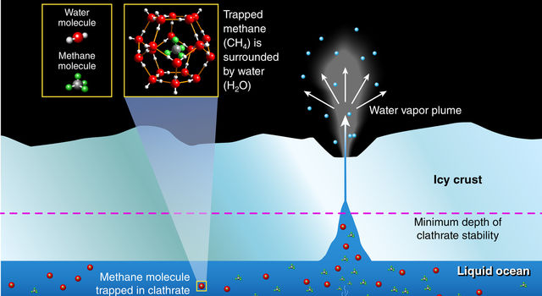
The data suggest life in the ocean of Enceladus.

Slide 51
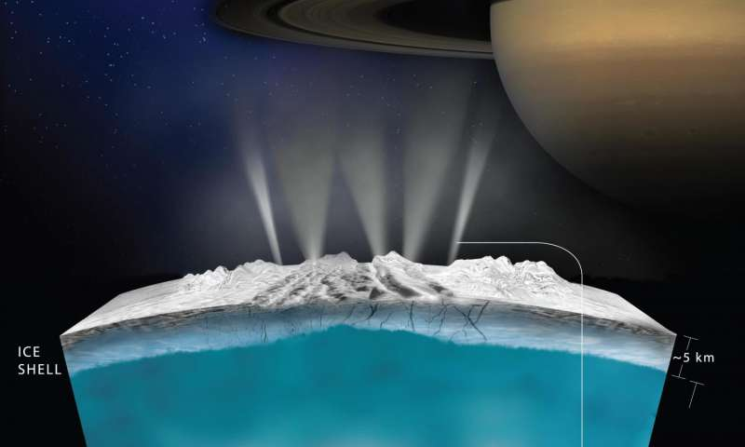
“Below the ice-covered surface of Saturn's moon Enceladus hides a vast ocean.
This sprawling ocean is likely 1 billion years old, which means it's the perfect age to harbor life said Marc Neveu, a research scientist at NASA Goddard Space Flight Center during a talk at the 2019 Astrobiology Science Conference.”

Slide 52
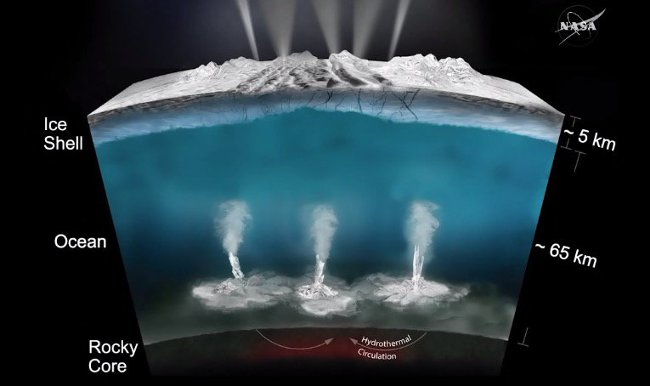
Hydrothermal Vents

Slide 53
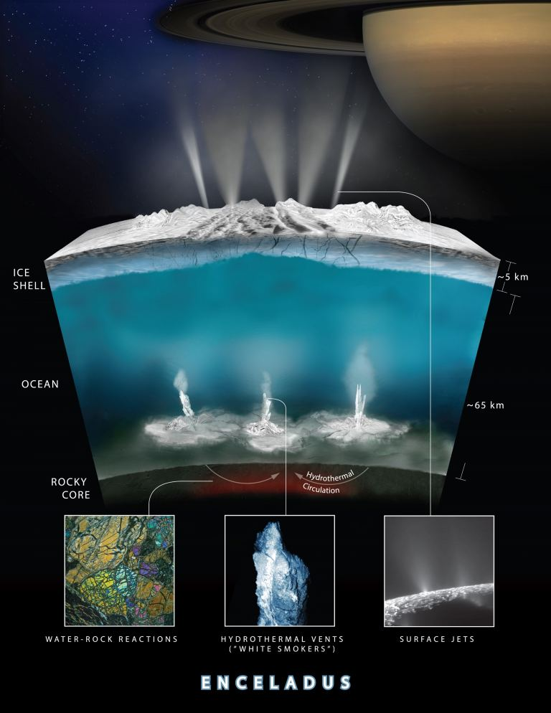

Slide 54
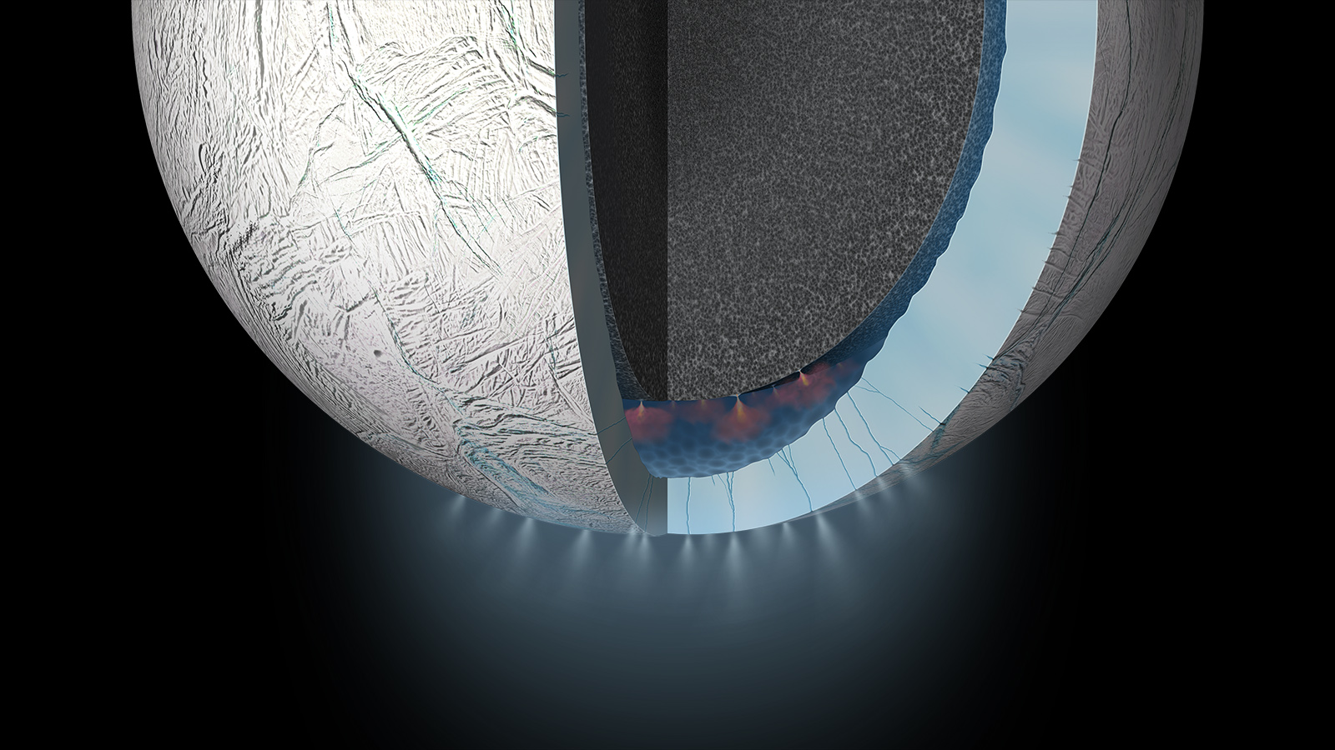
HYDROTHERMAL
VENTS
GEYSERS VENTING
INTO SPACE
“So, if hydrothermal vents are present on Enceladus, it hints at a pretty good possibility for the existence of life on the icy moon. Furthermore, the plumes were thought to contain water vapors, dihydrogen (H2), and various carbon-containing organic compounds,
including methane (CH4).”

Slide 55
“On earth, Hydrogen provides energy to some microbes to produce methane from carbon dioxide, in a process called methanogenesis. Surprisingly, the amount of methane found in the plumes seemed peculiarly high. Since Cassini also spotted carbon dioxide and methane, it further solidified the arguments in favor of methanogenesis on Enceladus.”
Detail A

Slide 56
“However, there also existed a possibility that instead of biological processes like methanogenesis, some weird abiotic or geochemical processes might be producing methane and carbon dioxide on the moon. So to assess the probability of Enceladus’ methane being generated biologically, researchers built a series of mathematical models. The investigations found that the known abiotic and geochemical processes could not perfectly explain the methane concentrations observed by Cassini. However, on adding the contributions from methanogenic microbes, the observed concentrations were justified.”
DETAIL B

Slide 57
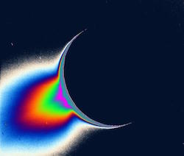
Warm water spewing from the vents…

Slide 58
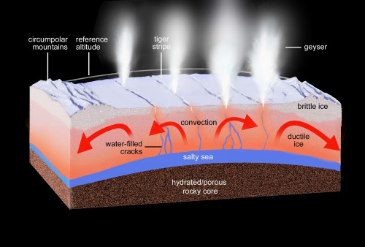
“One of (the spacecraft) Cassini's major discoveries was that Enceladus had an ocean filled with hydrothermal vents.”

Slide 59
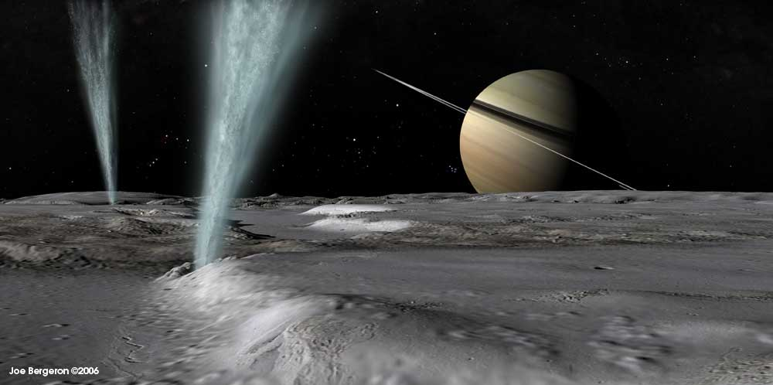

Slide 60
Webb Telescope spots a plume from Enceladus 6,000 miles long.
June 2023

Slide 61
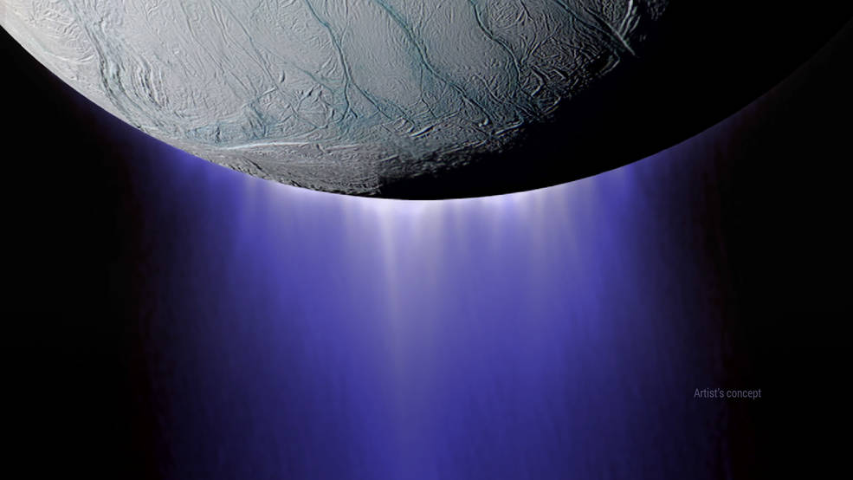
Cassini Spacecraft closest flyby of Enceladus plumes from 30 miles

Slide 62
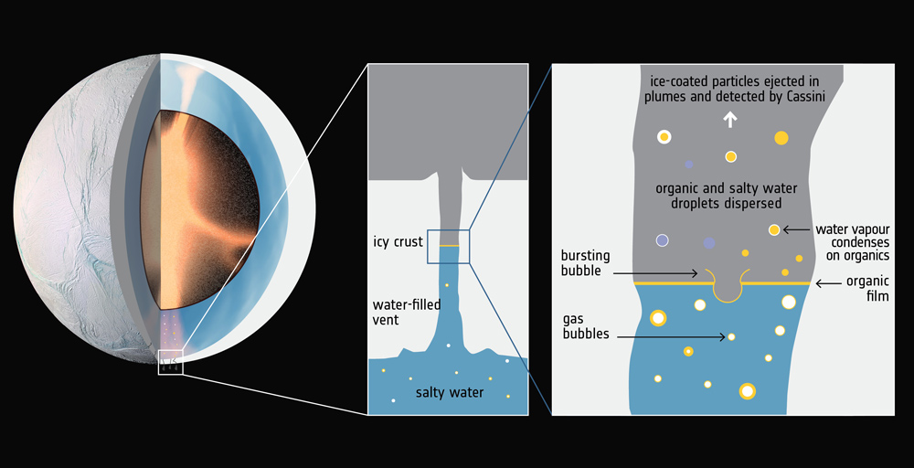
“Complex molecules comprising hundreds of atoms are rare beyond Earth. The presence of the large complex molecules, along with liquid water and hydrothermal activity, bolsters the hypothesis that the ocean of Enceladus may be a habitable environment for life.”

Slide 63
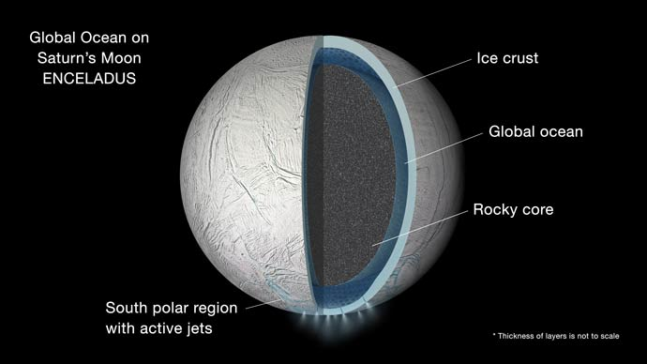
Now considered fact: Hydrothermal Vents – CASSINI
“How much water are we talking about here? …Scientists estimate that a staggering 7 tons of water are erupting from this geyser every second. The force behind the eruption is huge: The plume reaches 200 km (about 125 miles) high, with the water screaming out at 700 meters per second—more than 1,500 miles per hour, three times faster than a passenger jet!”

Slide 64
Add these simple hydrocarbon chains, an organic mixture, a heat source, add liquid water ---
all of these are the key ingredients for life.
“In my opinion, the fragments we found are of hydrothermal origin; in the high pressures and warm temperatures we expect there, it is possible that complex organic molecules can arise,” Frank Postberg (of the University of Heidelberg, Germany) said.”

Slide 65
98- 101 geysers.

Slide 66
Study pinpoints process that might have led to first organic molecules
“All life on Earth is built of organic molecules - compounds made of carbon atoms bound to atoms of other elements such as hydrogen, nitrogen and oxygen. In modern life, most of these organic molecules originate from the reduction of carbon dioxide (CO2) through several "carbon-fixation" pathways (such as photosynthesis in plants). But most of these pathways either require energy from the cell in order to work, or were thought to have evolved relatively late. So how did the first organic molecules arise, before the origin of life?
To tackle this question, Museum Gerstner Scholar Victor Sojo and Reuben Hudson from the College of the Atlantic in Maine devised a novel setup based on microfluidic reactors, tiny self-contained laboratories that allow scientists to study the behavior of fluids - and in this case, gases as well - on the microscale.”
DETAIL

Slide 67
A black smoker
“The researchers used their design to combine hydrogen with CO2 to produce an organic molecule called formic acid (HCOOH). This synthetic process resembles the only known CO2-fixation pathway that does not require a supply of energy overall, called the Wood-Ljungdahl acetyl-CoA pathway. In turn, this process resembles reactions that might have taken place in ancient oceanic hydrothermal vents.
"The consequences extend far beyond our own biosphere," Sojo said. "Similar hydrothermal systems might exist today elsewhere in the solar system, most noticeably in Enceladus and Europa - moons of Saturn and Jupiter, respectively - and so predictably in other water-rocky worlds throughout the universe."

Slide 68
Chemolithoautotrophes get their energy
from the chemical breakdown of rocks.

Slide 69
Rimicaris hybisae, thriving on the Earth’s deepest hydrothermal vents, at 7500 feet on 770 degree F volcanic thermal vents at the bottom of the Caribbean near the Grand Cayman Islands are being investigated by NASA as a possibility for life in Europa.
Chemolithoautotrophes

Slide 70
“Animals gather around these vents, which are sources of warmth and nutrients in the cold, black ocean depths.
More than 500 new species have been identified since the first vent was discovered in 1977, and researchers expect to discover many more in years to come.”

Slide 71
“Communities and Organisms: Chemosynthetic bacteria and archaea form the base of the food chain, supporting diverse organisms, including giant tube worms, clams, limpets and shrimp. Video: http://oceanexplorer.noaa.gov/edu/learning/player/lesson05.html
Octopuses, crabs, lobster, and giant tube worms are types of organisms that can survive in this harsh environment. Octopuses prey upon the many small crustaceans found around the vents. Other organisms are grazers and feed on the bacteria and minerals found around the vents. http://www.deepseaphotography.com/vent_animals.htm”

Slide 74
“In a new paper in the journal Astrobiology, scientists at NASA's Jet Propulsion Laboratory describe how they mimicked possible ancient undersea environments with a complex experimental setup. They showed that under extreme pressure, fluid from these ancient seafloor cracks mixed with ocean water could have reacted with minerals from the hydrothermal vents to produce organic molecules - the building blocks that compose nearly all life on Earth.
In particular, the research lays important groundwork for in-depth studies of such ocean worlds as Saturn's moon Enceladus and Jupiter's moon Europa, which are both thought to have liquid-water oceans buried beneath thick icy crusts and may host hydrothermal activity similar to what's being simulated at JPL. This area of research belongs to a field of study known as astrobiology, and the work was done by the JPL Icy Worlds team as part of the former NASA Astrobiology Institute.”
“The answer? Yes. The team created formate and trace amounts of methane, both organic molecules.”
DETAIL

Slide 75
Hydrothermal Vents in Mid Atlantic

Slide 76
Hydrothermal Vents in the Pacific

Slide 77
Jupiter’s Europa

Slide 78
Jupiter’s Moon Europa
Artist’s simulation
Geysers spouting water ice…
“Indeed, hydrothermal systems and other extreme environments on Earth are now considered analogs for extreme environments on other planets and planetary bodies.”

Slide 79
“Particles from Jupiter’s radiation belts split apart the hydrogen and oxygen that makes up the ice, forming a whole suite of molecules that living organisms could use to metabolize chemical nutrients from the vents.”

Slide 82
Jupiter’s Europa “appears to contain likely ingredients for life:
water
an energy source
(tidal heating by Jupiter)
organic compounds,
and millions of years for development…

Slide 83
Europa’s seas are estimated to be 60 miles deep, containing twice as much water as the Earth.

Slide 84
“The ‘chaos’ regions on Jupiter's moon Europa might hold keys to the possible existence of life in the ocean under the moon's icy crust.
A fresh look at an older theory lends more weight to the idea that abundant oxygen might exist in Europa's sub-surface ocean, after drizzling from the Jupiter moon's icy shell as the jumbled terrain forms at the surface. In fact, oxygen levels in Europa's subsurface oceans might be as high as those of Earth's oceans, the new study suggests, giving credence to arguments about habitability of the icy moon.”

Slide 85
“We already know of oxygen on the surface of Europa, which means the new study is focused on to what extent oxygen flushes into the ocean, which is hidden underneath the moon's10-mile-thick (15 kilometers) ice crust. The ice crust is made of hydrogen and oxygen. Radiation funneling to the moon's surface from nearby Jupiter reacts with the ice, creating free oxygen along with other compounds with oxidants (such as hydrogen peroxide.)”

Slide 86
In 2013, The Hubble Space Telescope “reported plumes of liquid water spraying from Europa’s South Pole.”
“Particles from Jupiter’s radiation belts split apart the hydrogen and oxygen that makes up the ice, forming a whole suite of molecules that living organisms could use to metabolize (eat) chemical nutrients from the vents.”
Theories suggest the ice is from several miles to 19 miles thick.

Slide 87
Europa possesses a salty ocean beneath its ice shell, and this sea is apparently in contact with the moon's rocky mantle, making possible a number of complex chemical reactions, scientists say.
In addition, scientists think that Europa's seafloor also features hydrothermal vents, providing a potential energy source for life-forms, if any exist in the dark depths.
(Life thrives at Earth's undersea vents, and some researchers think these environments gave rise to the planet's first organisms.)

Slide 88
The Europa Clipper
Many Scientists think our best bet to find life in the Solar System is Jupiter’s Moon Europa. Europa is tidally locked to Jupiter whose gravitational forces create tides with frictional heat which warms an ocean under the ice “twice as large as all of Earth’s ocean’s combined” and it has them now. Europa circles Jupiter every 3.5 days. There is also a theory that the warm, rocky mantle of Europa heats the ocean.
Ice Canyons

Slide 89
“The spacecraft (Galileo) made 12 close flybys of Europa and one of its instruments, a magnetometer, detected that a magnetic field was being created within Europa as Jupiter's powerful magnetic field swept past the moon. Scientists think the most likely thing that could create this magnetic signature
is a global ocean of salty water.”

Slide 90
Jupiter’s charged particles pelt Europa’s surface and this creates oxygen which is churned under the surface. Sulfur from Jupiter’s Moon Io’s many volcanoes covers Europa’s surface, creating energy-rich compounds.
Europa
Io
As Europa’s warm, salty ocean under the ice churns it brings up materials (and hopefully signs of life) from beneath.

Slide 92
Ganymede
“Jupiter’s moon Ganymede may have layered oceans that support life. Ganymede is the largest moon in our solar system and is bigger than the planet Mercury.”

Slide 93
Does Jupiter's moon contain LIFE?
Nasa confirms Ganymede has an underground ocean beneath its icy surface.
A saline ocean under the moon’s icy crust best explains shifting in the auroral belts measured by Hubble.

Slide 94
“As Jupiter rotates, its magnetic field shifts, causing Ganymede's aurora to rock.
Scientists measured the motion and found it fell short.
Using computer models, they realized that a salty, electrically conductive ocean beneath the moon's surface was counteracting Jupiter's magnetic pull.
Jupiter is like a lighthouse whose magnetic field changes with the rotation of the lighthouse. It influences the aurora,' said geophysicist Joachim Saur, with the University of Cologne in Germany.”

Slide 95
Callisto may also have an ocean under its surface.

Slide 96
NASA has revisited the findings of Voyager 2 and ground based telescopes and now consider Uranus’ Titania, Oberon, Ariel and Umbriel to be icy moons which probably contain sub-surface oceans.
2023
2023

Slide 97
Hints of life on Venus
“An international team of astronomers, led by Professor Jane Greaves of Cardiff University, have announced the discovery of a rare molecule - phosphine - in the clouds of Venus. On Earth, this gas is only made industrially, or by microbes that thrive in oxygen-free environments.
Astronomers have speculated for decades that high clouds on Venus could offer a home for microbes - floating free of the scorching surface, but still needing to tolerate very high acidity. The detection of phosphine molecules, which consist of hydrogen and phosphorus, could point to this extra-terrestrial 'aerial' life. The new discovery is described in a paper in Nature Astronomy.”

Slide 98
How Much Life Would Be Required to Create the Phosphine Signal on Venus?
“Finding phosphine in Venusian clouds is truly remarkable because we don’t presently know of any way to create phosphine abiotically or without life being a part of the equation. Question is – how much life??
However, contemporary research suggests that microbial life might be better suited to the Venusian clouds. Research by Dr. Sara Seager predicts microbes existing within droplets in the cloud layers because “the requirement for a liquid environment is one of the general attributes of all life regardless of its biochemical makeup.”

Slide 99
“Although the high clouds of Venus have temperatures up to a pleasant 30 degrees centigrade, they are incredibly acidic - around 90% sulphuric acid - posing major issues for microbes to survive there. Professor Sara Seager and Dr Janusz Petkowski, also both at MIT, are investigating how microbes could shield themselves inside droplets.”

Slide 100
"We have detected a rare gas called phosphine in the atmosphere of our neighbor planet Venus," said Jane Greaves, a professor at Cardiff University in the United Kingdom and lead author of a report published in Nature Astronomy. "And the reason for our excitement is that phosphine gas on Earth is made by microorganisms that live in oxygen-free environments. And so there is a chance that we have detected some kind of living organism in the clouds of Venus."

Slide 101
Here begins a section quoted extensively from Michael L. Wong of the University of Washington,
Astrobiology Rock Star.

Slide 102
“Around 4 billion years ago there lived a microbe called
LUCA: the Last Universal Common Ancestor.
There is evidence that it could have lived a somewhat ‘alien’ lifestyle, hidden away deep underground in iron-sulfur rich hydrothermal vents.
Anaerobic and autotrophic, it didn’t breathe air and made its own food from the dark, metal-rich environment around it.
Its metabolism depended upon hydrogen, carbon dioxide and nitrogen, turning them into organic compounds such as ammonia.
Most remarkable of all, this little microbe was the beginning of a long lineage that encapsulates all life on Earth.”

Slide 103
There are now 124 confirmed moons of Saturn.

Slide 104
“These massive structures, some more than 50 meters tall, were created by the precipitation of iron-bearing minerals when two very different kinds of water met.”
Some spires are 164 feet high
“The majority of Earth’s ancient ocean was acidic like a lightly carbonated soft drink, thanks to an overlying carbon dioxide–rich atmosphere. Just beneath the ocean floor, seawater and rock interacted in a process called serpentinization. This chemical reaction changed the water’s pH, rendering it alkaline (the opposite of acidic). It also heated the water and infused it with molecular hydrogen, a valuable chemical fuel for life.”

Slide 105
“When this alkaline groundwater seeped into the ocean, it found itself out of equilibrium with the surrounding colder, acidic, carbon dioxide–rich seawater.
“Out of equilibrium” is just jargon for “unbalanced,” but its ramifications for life are enormous.
An out-of-equilibrium situation is full of untapped energy—the potential to enact change and create complexity.”
“ELECTRONS AND PROTONS POWER LIFE
Consider how disequilibria power humans. We eat and breathe to gain energy, but what does that really mean? At its heart, it’s all about electrons. Our bodies take electrons from the electron-rich food that we eat and transfer them to the electron-greedy oxygen in the air that we breathe.”
Von Damn Shrimp

Slide 106
“This electron transfer, mediated by a series of chemical reactions that happen inside of our cells’ mitochondria, releases useful energy. Proteins in our mitochondria use this energy to pump protons across an inner membrane, transforming what used to be an imbalance in electrons into an imbalance in protons.
A protein called ATP synthase uses the potential energy stored in the imbalance of protons to create adenosine triphosphate (ATP) molecules.
Actually, ATP exists as part of yet another imbalance: that between its wholesome self and its broken pieces,
adenosine diphosphate and a lone phosphate.
ATP is often thought of as the “energy currency of life,” and now the origin of that stored energy is clear:
it’s the useful energy derived from a disequilibrium.”

Slide 108
“It’s not just our cells that harness these
disequilibria to create ATP.
Almost all the other living things on Earth do too,
down to the most primitive single-celled organisms.
It’s so universal, in fact, that these
disequilibria might even be related
to how life started.”

Slide 109
“A HYDROTHERMAL HATCHERY OF LIFE
Back in your time-traveling submarine 4 billion years in the past, you put a microscope up against a hydrothermal chimney. You find that this colossal tower is built like a high-rise apartment building with trillions of tiny mineral rooms, or vesicles, each roughly the size of a biological cell.
Inside these vesicles, H2 from serpentinization and CO2 from the surrounding seawater swirl in chemical disequilibrium
In this case, H2 is the fuel (electron donor) and carbon dioxide is the air (electron acceptor).
There’s a second disequilibrium present
between the alkaline vent fluid and the acidic seawater.
The contrast in pH is a natural proton imbalance that resembles the proton imbalance created in modern-day cells.”

Slide 110
“CHEMICAL GARDEN
Chemical garden experiments simulate the chemistry of active hydrothermal vents. In the experiments, two fluids that are in chemical disequilibrium react with each other, and then mineral precipitates grow. These precipitates are analogous to the hydrothermal chimneys that form at sea-floor vents. Chemical gardens illustrate how non-equilibrium systems can drive the emergence of self-assembly and complexity.”

Slide 111
“We don’t know how life really began, but here’s a plausible scenario involving the untapped geochemical energy present in these ancient hydrothermal chimneys:
Travel forward through time and you might see H2 and CO2 react with each other, aided by the catalytic metals in the vesicle’s walls.
They would not only form organic molecules but release pent-up energy as well, and if some organic-mineral precursor to ATP synthase could use the natural proton gradient to bind phosphates together, an energy currency is within the realm of possibility. Incorporating nitrogen- and sulfur-bearing molecules dissolved in the surrounding water, these processes could lead to the first metabolic network:
a web of reactions that reinforces itself, growing more stable and more complex with time.”

Slide 112
“Eventually, this network might lead to information-carrying and self-replicating molecules like RNA,
allowing for greater adaptive abilities to changing conditions
It might also construct lipid membranes to replace the
Inflexible and immutable mineral walls and build ion pumps to regulate its own proton imbalance,
thereby effecting the ability to escape these hydrothermal confines.
In the end, it would be a fully functional cell—
a product of its geochemical past afloat in the formerly sterile abyss of this ancient sea,
soon to encounter new places to thrive and evolve into new ways of being.”
Thank you, Michael L Wong, for permission to quote you extensively and for your insights and kindness.

Slide 113
Missions

Slide 114
“Europa Clipper” will launch in 2024 and arrive in April of 2030.
The SLS will get the robotic Europa Clipper to Jupiter orbit in two years where it will fly by Europa 45 times, as low as 16 miles away, looking for habitability possibility for life.
Europa is slightly smaller than Earth’s Moon. with an iron core, rocky mantle, and salty global ocean under an icy crust.

Slide 115
The Icy Worlds of Jupiter and Saturn will be busy for NASA and the ESA:
Juice launched April 14, 2023 to study Europa, Ganymede, and Callisto.
The Europa Clipper launches October of 2024.

Slide 116
“The Europa Clipper with carry 2 cameras which will map 90% of the moon with a resolution of 164 feet. It also will carry a magnetometer and magnetic sounder to measure the thickness of the ice shell and the depth and salinity of the ocean. It also will carry ice penetrating radar and a heat detector.”
The Clipper will study Europa, Ganymede, and Callisto.

Slide 118
NASA’s Icy Worlds Orbiter
“The Jupiter Icy Moons Orbiter is an ambitious proposed mission to orbit three planet-sized moons of Jupiter -- Callisto, Ganymede and Europa -- which may harbor vast oceans beneath their icy surfaces.
“The orbiter would also raise NASA's capability for space exploration to a revolutionary new level by pioneering the use of electric propulsion powered by a nuclear fission reactor. This technology not only makes it possible to consider a realistic mission for orbiting three of the moons of Jupiter, one after the other, it would also open the rest of the outer solar system to detailed exploration in later missions.”

Slide 119
The Europa Tunnelbot

Slide 120
The Europa Tunnelbot would melt its way down through the ice to study the hydrothermal vents on the ocean floor.

Slide 121
This design uses hot plates to melt its way down through the ice.

Slide 122
This design uses a nuclear reactor powered by radioactive plutonium to melt its way down.

Slide 123
NASA's Robotic Squid Rover -
Yes, that is what I said!
A robotic squid rover
“This suite of bio-inspired technology represents a tremendous leap forward in what we understand a rover to be.“

Slide 124
“...the skin of the robot will be a stretchable, electroluminescent display for illuminating the local marine environment, to enable underwater imaging.”
ICE
VENT

Slide 125
“In a nutshell, the idea is that the rover will ingest water from the ocean; and we will use electrical power to split that water into its oxygen and hydrogen constituent molecules.
When the rover needs to move, a spark ignites that explosive gas; the gas swells up part of the body of this ‘squid’, and thereby changes its shape --- and when a shape changes, a body moves in the water. That’s the kind of swimming motion we’re seeking.”

Slide 126
Name: The Soft-Robotic Rover with Electrodynamic Power Scavenging
…a “soft-robotic rover resembling a squid with tentacle-like structures that will harvest electrical energy from locally changing magnetic fields.”
“We’d be able to use the magnetic field of Jupiter” (and its other Moons.)
Funded 2015

Slide 127
.
F

Slide 129
LIFE

