Slide 1
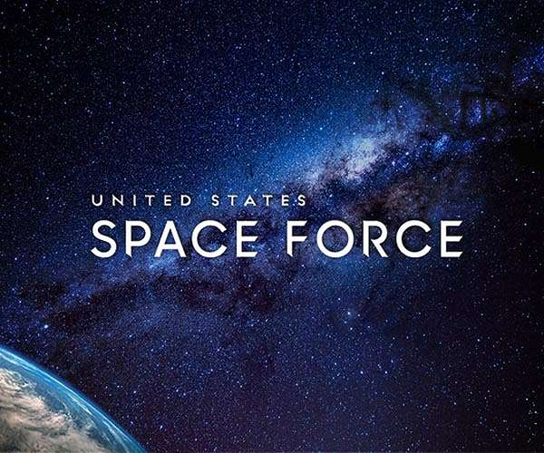
The War in Space Has Already Begun

Slide 2
References
“United States Space Force” Military.com
“The US Space Force” Wiki
“Pentagon Activates Space Command to Prepare for War in the Final Frontier” Military.com
“What Is the U.S. Space Force?” Space.com
“How Trump's Space Force Would Help Protect Earth from Future Asteroid Threats” Space.com
“Us Space Force Fact Sheet” USSF
“How Russia’s sleeping satellites could wreak havoc on the West” Science Tech
“U.S. Says Small Russian Satellite A Space Weapon” Washington Free Beacon
“Mysterious X-37B space plane lands after record 780 days in orbit” c/Net
“The Hidden History of the Soviet Satellite-Killer” Popular Mechanics
“India unveils anti-satellite missile” NKG-Japan
“What is Mission Shakti — ASAT? India Express
“PM Modi says ‘Mission Shakti’ a success, shot down live satellite in low earth orbit” India Express
“China’s Anti-Satellite Test” Council on Foreign Relations
“India Tests Anti-Satellite Missile” Bankinfosecutiry – Asi
“China, Russia Building Attack Satellites and Space Lasers: Pentagon Report” Defense One
“How China Is Weaponizing Outer Space” The Diploma
“Revealed: China Tests Secret Missile Capable of Hitting US Satellites” The Diplomat
“U.S. Air Force Has a Plan to Counter China's Super Lethal 'Satellite-Killer' Weapons” The National Interest
“China Will Soon Be Able to Destroy Every Satellite in Space” The National Interest
“How China Could Win a War Against America: Kill The Satellites” The National Interest
“Chinese Anti-Satellite [ASAT] Capabilities” Global Security.org

Slide 3
References
“Russia develops advanced anti-satellite aircraft-mounted laser” Defense Blog –Online Military Magazine
“US military space force: what do we know so far?” Air Force Technology
“Hacking a Satellite is Surprisingly Easy” Slashdot
“Chinese hackers took control of NASA satellite for 11 minutes” GEEK.com
“Hacking Satellites Is Surprisingly Simple” ExtremeTech
“What happens when all the tiny satellites we’re shooting into space get hacked?” Fast Company
“We don’t know what to do if a satellite gets hacked” The Future
“It’s Possible To Hack NASA Satellites… But Then What ...” You Tube
“NASA Computer Hacked, Satellite Data Accessed
“Barrett points to recent activities as a clear example for why the US Space Force is needed” Space War
“GPS NEWS Contingency Operations Program and GPS III SV02 Receives Operational Acceptance from US Space Force” Space Daily
“China May Have Operational Anti-Satellite Program” Global Security
“Pentagon successfully tests hypersonic missile” Space War
“Chinese Anti-Satellite [ASAT] Capabilities” Global Security
“Russia positions S-500 as game changer for missile defense” Space War
“Russia's Killer Mach 20 Avangard Hypersonic Weapon Is About to Enter Production” The National Interest
“Hypersonic Weapons Enter Service with Russian Aviation” Defense Update
“US Building Ground-Based Network of Offensive Weapons to Jam Russian Satellites” Space War
“U.S. Space Force is Building Weapons to Block Russian and Chinese Satellites”
“US Space Force is Building Weapons to Block Russian and Chinese Satellites” Newsweek

Slide 4
References
“Space Force Developing Weapon Systems To Block Chinese, Russian Satellites” International Business Times
“Russia declassifies footage of 'Tsar Bomba’” Live Science
“DARPA's air-breathing hypersonic missiles ready for free-flight tests” Space War Daily
“India eyes hypersonic cruise missile with domestically-made scramjet engine” Space War Daily
“Northrop Wins $13.3B Contract to Design New ICBMs” Air Force Magazine
“ Chinese spacecraft launched mystery object into space before returning to Earth” Space Daily
“Putin Hails Successful Launch of Zircon Hypersonic Cruise Missile as 'Major Event' for Russia” Global Security
“Army secretary reveals that US hypersonic missile hit within 6 inches of its target: report” Fox News
“The Space Force Turns One” Air & Space Magazine
“Investing in Space”
“The US says Russia just tested an “anti-satellite weapon” in orbit” MIT Technology Review
“Russian spacecraft following US spy satellite in ‘disturbing’ manner, Space Force general says” CNBC
“Space Force declares anti-spoofing GPS signal operational” C4ISR Net
“Fourth GPS III satellite receives operational acceptance in record time” C4ISR Net
“US conducts 'successful' test of hypersonic missile technology” Space War Daily Missile News
“Russians reportedly building a satellite-blinding laser — an expert explains the technology” Space.com

Slide 5
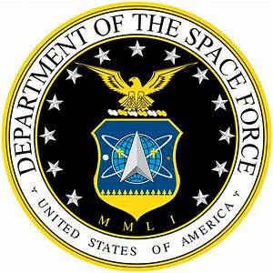
The U S Space Force – “Guardians of the High Frontier”
Not to be confused with United States Space Command or Air Force Space Command

Slide 6
Organization and Mandate

Slide 8
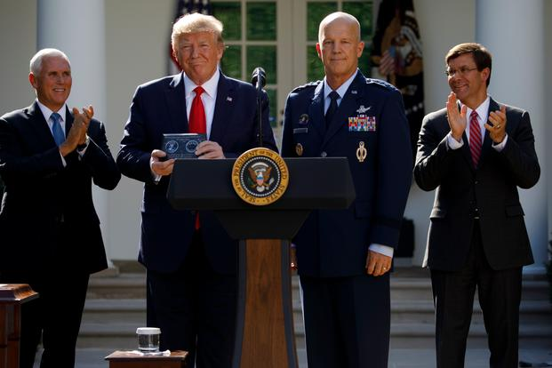
Organization
A ceremony to establish the U.S. Space Command in the Rose Garden of the White House on Aug. 29, 2019. (AP Photo/Carolyn Kaster)
“29 Aug 2019
Military.com | By Matthew Cox
The Pentagon on Thursday officially established United States Space Command, a precursor to the Space Force military service President Donald Trump has called for.
As the nation's 11th geographic combatant command, Space Command was created to defend U.S. space-enabled capabilities in this new warfighting domain, said Air Force Gen. John "Jay" Raymond, who assumed command of U.S. Space Command on Thursday.”

Slide 9
Organization
On June 18, 2018, President Donald Trump directed the Pentagon to begin planning for a Space Force: a 6th independent military service branch to undertake missions and operations in the rapidly evolving space domain.
On Aug. 29, 2019, the Pentagon activated U.S. Space Command, a new U.S. combatant command led by Air Force Gen. John "Jay" Raymond, intended to serve as a precursor to U.S. Space Force. The Pentagon had a U.S. Space Command from 1985 to 2002, but it had a far more limited scope and was not a geographic combatant command.”

Slide 10
Organization
Air Force Gen. John "Jay" Raymond
“We do not want a conflict to begin or extend into space.
We want to deter that conflict from happening.
The best way I know how to do that is from a position of strength.”
— Gen. John “Jay” Raymond, chief of space operations of the U.S. Space Force. Credit: U.S. Air Force photo by Andy Morataya

Slide 11
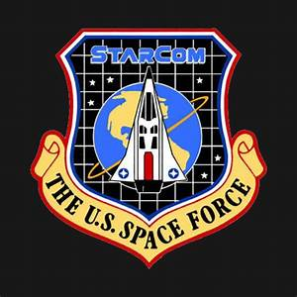
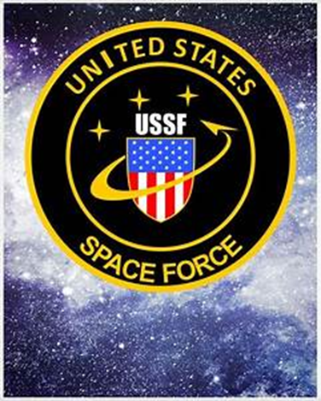
Organization
Organization:
“Space Command will start out with a traditional headquarters made up of about 287 personnel who are currently assigned to the Joint Force Space Component Command and those who have been conducting the space mission of the U.S. Strategic Command, Raymond said.
The Air Force has identified six candidate bases that could serve as the command's new headquarters. Once the evaluation is complete, the secretary of the Air Force will make the decision, he added.
The new command will have service components from the Army, Navy, Air Force and Marines and will be organized into two operational elements.”
The rate of acquisition of personnel is expected to increase exponentially in future years.
Main base is at Cape Caneveral, Florida.

Slide 12
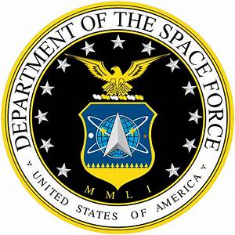
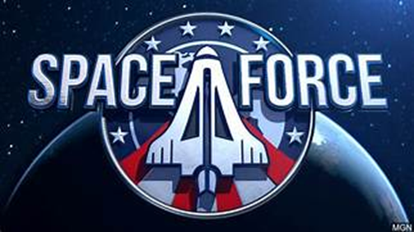
Organization
“The second component is the
Joint Task Force for Space Defense,
a new organization that will focus on protecting and defending the space domain.”

Slide 13
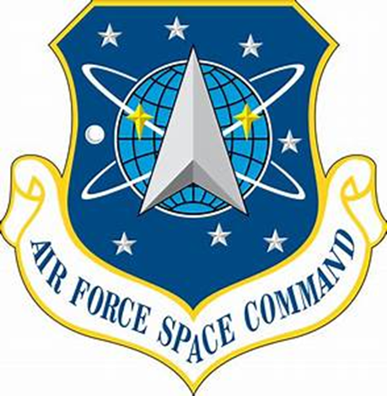
Organization
“I[When] established, it would be organized as a military service branch within the Department of the Air Force, one of the three military departments within the Department of Defense.
The Space Force, through the Department of the Air Force, would be headed by the civilian Undersecretary of the Air Force for Space and the Secretary of the Air Force, who reports to the Secretary of Defense, and is appointed by the President with Senate confirmation.
The highest-ranking military officer in the Space Force would be the Chief of Staff of the Space Force, who would exercise supervision over Space Force units and serve as one of the Joint Chiefs of Staff. Space Force components would be assigned, as directed by the Secretary of Defense, to the combatant commands, and neither the Secretary of the Air Force, Undersecretary of the Air Force for Space, or the Chief of Staff of the Space Force would have operational command authority over them.
Along with performing independent space operations, the Space Force would be responsible for providing space support to land, air, naval, and cyber forces.”

Slide 14
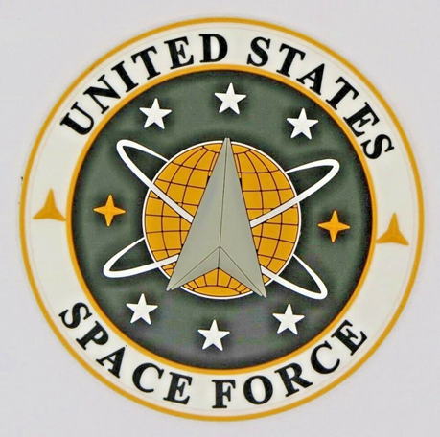
Organization
Space Force Organization “The USSF Headquarters and Office of the CSO are located in the Pentagon, just like the Army, Navy, Marine Corps, and Air Force.
This staff will focus on establishing a fully-functioning headquarters;
preparing to execute the full scope of its organize, train, and equip responsibilities;
and, in conjunction with the U.S. Air Force, developing a detailed plan to transfer forces into the U.S. Space Force.
As a new military service, the U.S. Space Force will leverage the Department of the Air Force for more than 75 percent of its enabling functions to significantly reduce cost and avoid duplication. The Department of the Air Force will provide support functions that include
logistics,
base operating support,
civilian personnel management,
business systems,
IT support,
audit agencies, etc. ”

Slide 15
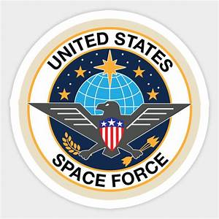
Organization
“Immediately following Pence's announcement in August, the Pentagon released a report that detailed some of the Department of Defense's immediate actions for creating the Space Force:
Establish a Space Development Agency – This is an agency tasked with developing and testing new and improved national-security capabilities and technology in space.
Establish a Space Operations Force – This force will be a collection of space experts from throughout the military who will provide needed expertise to combat commanders and anyone else throughout the Space Force.
Create a United States Space Command – Led by a four-star general or flag officer, the new space command would direct and improve operations for space war fighting.
These three components would later be united to become the final Space Force.”

Slide 16
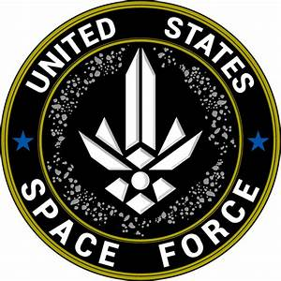
Mandate
“Role and mission
“Once established, the U.S. Space Force is intended to become the lead military service for space operations, responsible for space doctrine, organization, training, matériel, leadership and education, personnel, facilities, and policy.
The Space Force would be organized with the missions of:
Protecting the United States' interests in space and the peaceful use of space for all responsible actors, consistent with all applicable law, to include international law;
Ensuring the unfettered use of space for the United States' national security and economic interests, as well of that for U.S. allies;
To deter aggression against the United States, its allies, and interests from hostile acts in and from space;
To ensure that space capabilities are integrated and available to all combatant commands;
To project military power in, from, and to space in support of the U.S.'s interests;
And to develop, maintain, and improve national security space professionals.”

Slide 17
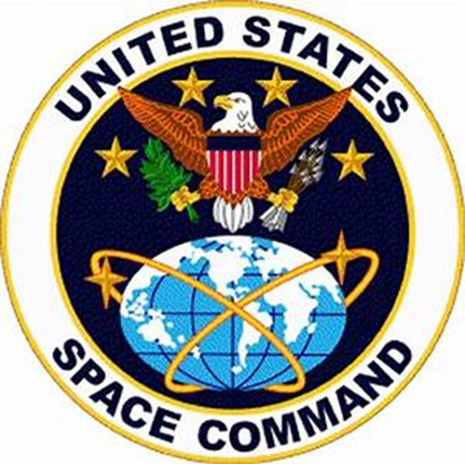
Mandate
“The Space Force would develop forces for:
space situational awareness;
satellite operations, and global, integrated, command and control of military space forces;
global and theater military space operations to enable joint campaigns (to include missile warning); space support to land, air, naval, and cyber forces;
spacelift and space range operations;
space-based nuclear detonation detection;
and prompt and sustained offensive and defensive space operations to achieve space superiority.”

Slide 18
Mandate

Slide 19
“Under the Maintenance Of Space Situational Awareness Integrated Capabilities (MOSSAIC) contract, L3Harris will provide sustainment services for current and future ground-based space domain awareness sensors and space battle management command and control capabilities. MOSSAIC is a follow-on program to the Systems Engineering and Sustainment Integrator program, which L3Harris won in 2002.
"Space as a warfighting domain has a complex and interdependent system supporting it from the ground, air and space," said Ed Zoiss, President, Space and Airborne Systems, L3Harris.”

Slide 20
US Assets at Risk

Slide 21
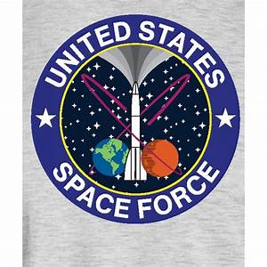
US Assets
The U S Infrastructure in Space includes:
Weather satellites
Communications satellites (your cell phone, etc.)
GPS satellites
Military satellites
Nuclear capability
X-37B Robotic Space Plane
The International Space Station
Space Launch capability
Threats from asteroids, comets, and space debris

Slide 22
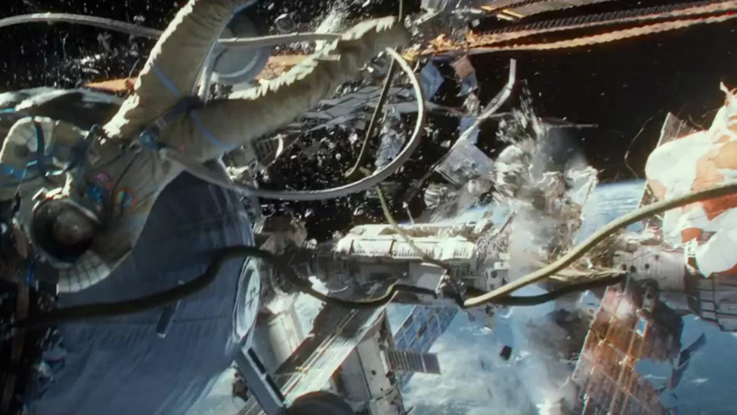
US Assets
“What would we lose in a satellite war in space?
TV, radio, credit cards, bank accounts, a possible economic crash, air ground and sea GPS navigation, weather satellites, cell phones, the internet, the ISS Space Station, air traffic control, clock accuracy, and possibility electricity. Say goodbye to your “smart home” and its appliances and welcome to WWII technology. “

Slide 23
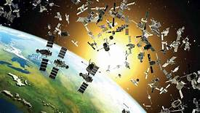
A Kessler Event, such as in the film “Gravity” would be a ”cascade” that would shred satellites.
“In 2007 the risks from debris skyrocketed when China launched a missile that destroyed one of its own weather satellites in low-Earth orbit. That test generated a swarm of long-lived shrapnel that constitutes nearly one-sixth of all the radar-trackable debris in orbit.” In 1985, a US F-15 took out one of our failing satellites in LEO. U.S. Air Force has the “highly maneuverable X-37B robotic space planes.” “’Offensive space control’” is a clear reference to weapons. ‘Active defense’ is much more nebulous, and refers to undefined offensive countermeasures.”
A Carrington Event (such as one in 1859) is a Solar Storm which would blind and disrupt satellites, also.
It would wipe out anything with a chip --- computers, cars, phones, appliances.
It would take 11 years for Low Earth Orbit (LEO) to clean itself through attrition.
Meanwhile we would be back to WWII technology.”

Slide 24
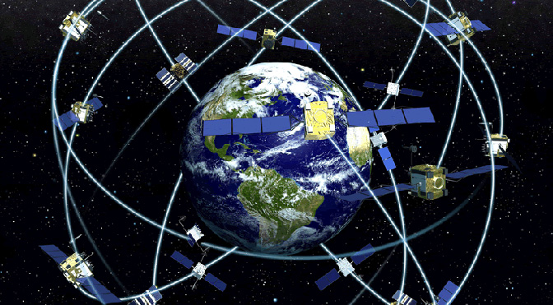
US
GPS System (Global Positioning System)
These are too high for ICBMs (solid fueled rockets) to reach.
These orbit at 22,000 so are in range of liquid fueled rockets.

Slide 25
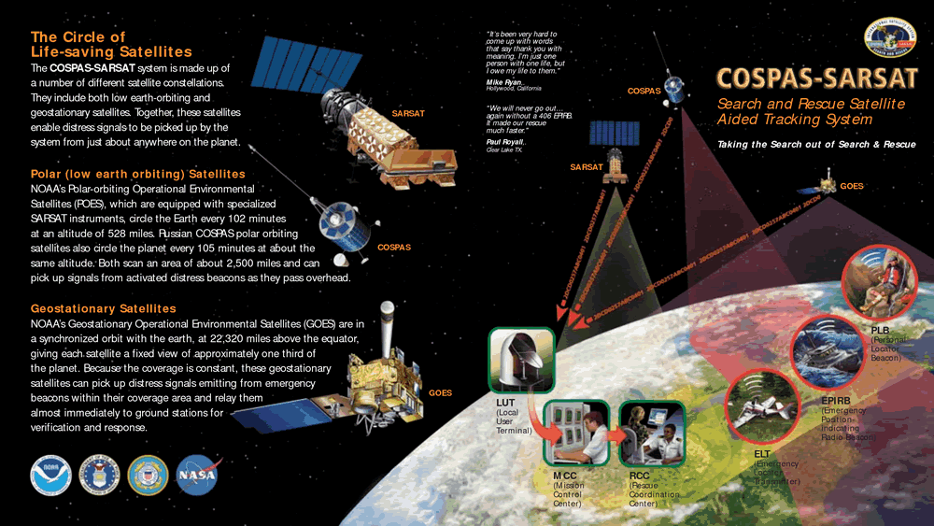
US
The Air Force, the Military, and Air Force Auxiliary (Civil Air Patrol) use this system as well as other nations on Earth

Slide 26
US
Emergency Beacons
EPIRBS – Ship Beacons
Personall
Aircraft

Slide 27
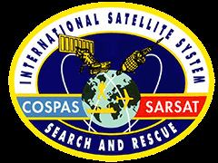
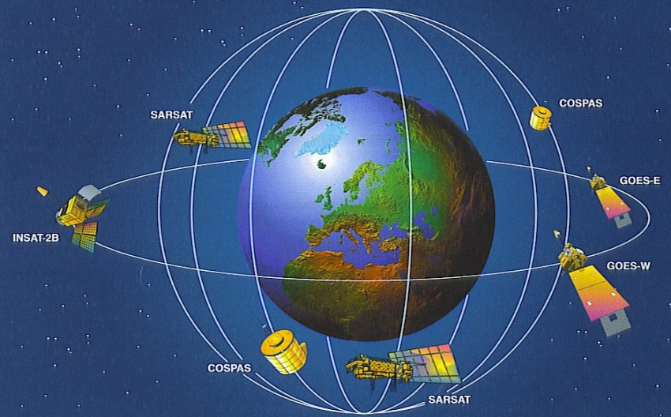
US
The SARSAT-COSPAS
(US/Russian) Search and Rescue Satellite System

Slide 28
“ The fourth Lockheed Martin-built GPS III satellite launched Nov. 5, 2020, from the SpaceX Falcon 9 rocket at Cape Canaveral Air Force Station in Florida. It joins the global positioning satellite constellation that provides positioning, navigation and timing signals for more than 4 billion military, civil and commercial users. (Lockheed Martin)
GPS … as in THE GPS?
Yes, these Lockheed Martin-built satellites are helping to modernize the constellation by providing three times better accuracy and up to eight times improved anti-jamming capabilities to the U.S. Space Force … while also showing civilians everywhere how to navigate to the closest pizza place.
What’s next for GPS?
The fourth and fifth GPS III satellites are ready for launch, while satellites 6-8 are fully-assembled and now being tested. Look for SV04’s launch later this year .”

Slide 29
US
“The OCX program is part of the GPS Enterprise Modernization. OCX will deliver two-times more satellite capacity, modern cyber secure infrastructure, improved accuracy, globally deployed modernized receivers with anti-jam capabilities and improved availability in difficult terrain.”
Coming soon…Software had to be redone because system had been sold to a Chinese company.
“The U.S Space Force's Space and Missile Systems Center, located at the Los Angeles Air Force Base, California, is the U.S. Air Force's center of excellence for acquiring and developing military space systems. Its portfolio includes the Global Positioning System, military satellite communications, defense meteorological satellites, space launch and range systems, satellite control networks, space based infrared systems, and space situational awareness capabilities.”

Slide 30
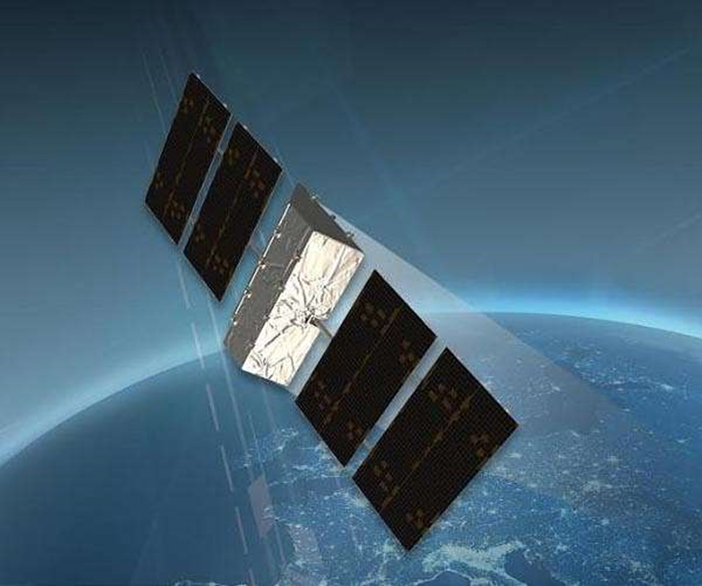
US
“SEAKR Engineering has been selected to join Lockheed Martin's team to help design and build a prototype payload for the U.S. Space Force's Protected Tactical Satellite Communications (SATCOM), or PTS, program. PTS is a next-generation capability connecting warfighters with more agile and jam-resistant SATCOM. The complete system will deploy a constellation of dedicated geostationary satellites, commercially hosted payloads, and coalition partner satellites integrated through a ground control network to provide U.S. and coalition forces protected communications in a data hungry battlespace.”

Slide 31
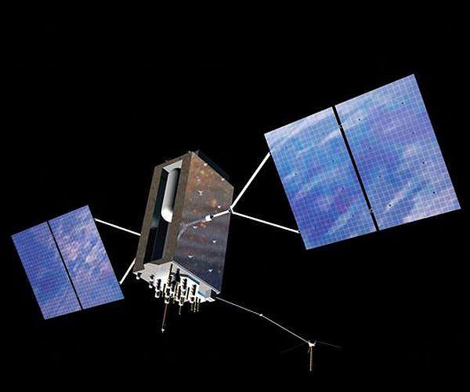
US
GPS-3 class satellite
“Contingency Operations Program and GPS III SV02 Receives Operational Acceptance from US Space Force
COps is an upgrade to the current GPS Operational Control System to operationally command and control GPS III satellites. These satellites are the newest generation built by Lockheed Martin providing precise positioning, navigation and timing information with three times better accuracy, and up to eight times improved anti-jamming capability than previous generations of GPS satellites.”

Slide 32
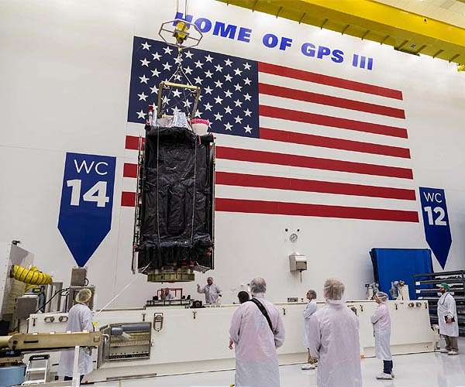
US
"Our warfighters depend on GPS signals every day for many critical missions, so anything we can do to make these signals more resistant to jamming and spoofing is extremely important - and available today," said Johnathon Caldwell, Lockheed Martin Vice President of Navigation Systems. "The more powerful GPS III/IIIF satellites coupled with Lockheed Martin's upgrades to the GPS ground system are making that possible."

Slide 33
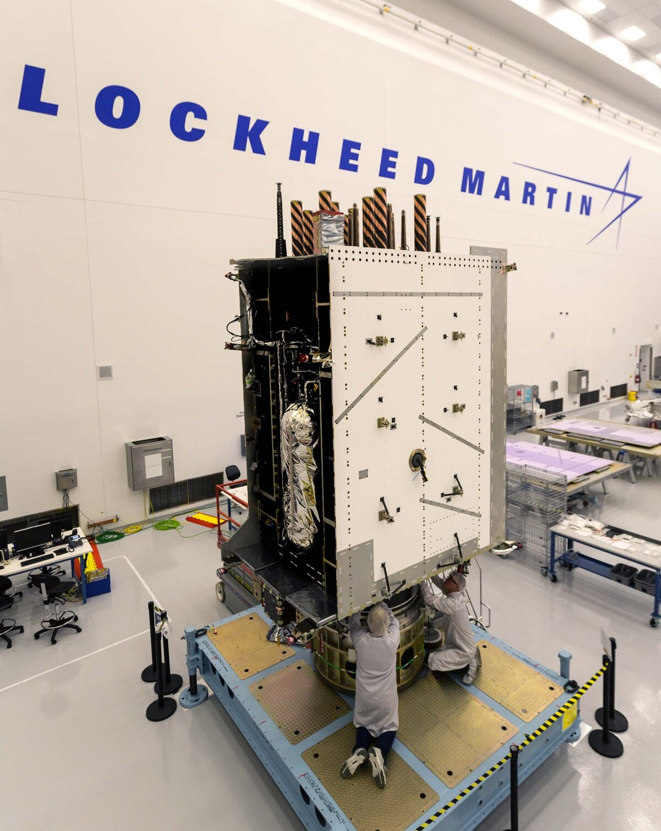
Space Force declares anti-spoofing GPS signal operational
“More accurate than the civilian signal, the encrypted M-Code programming language provides advanced anti-spoofing and anti-jamming capabilities designed to provide positioning, navigation and timing data to the war fighter even when adversaries are trying to block or degrade the signal. But even as the military has successfully added more and more GPS satellites with M-Code availability — 23 and counting — the ground system being purpose-built for GPS III and M-Code is years behind schedule.” Expected to be finished in 2021.
GPS III satellite S III satellite

Slide 34
US
“IN 2004 President George W. Bush directed the DHS (Dept of Homeland Security) and the DOT (Dept of Transportation) to create a backup system.
“The Deputy Defense Secretary and Deputy of Transportation told Congress they would collaborate on a system known an eLoran (enhanced long-range navigation. which does exactly what the 2018 Bill requires.
Adam Sullivan, DPT Assistant Secretary for governmental affairs, told Peter DeFazio, chair of the House Transportation and Infrastructure Committee, in a May 8 (2019) letter that the DOT is planning to conduct a field demonstration of technologies…capable of providing backup [position, navigation, and timing] service crucial to infrastructure” by the end of 2019.

Slide 35
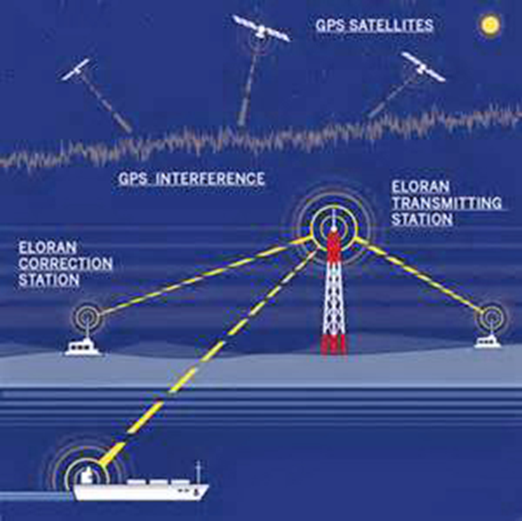
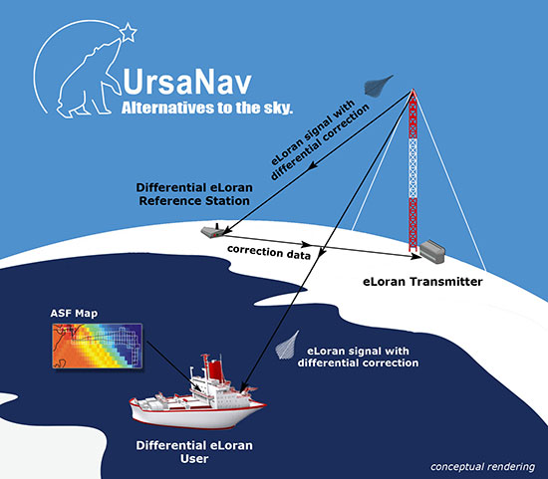
eLoran System

Slide 36
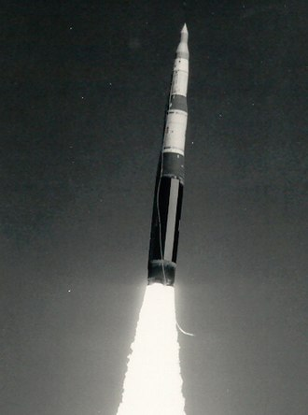
US
US Minuteman II ICBM (Intercontinental Ballistic Missile)
So will taking out the GPS system confuse our anti-nuke rockets?
“GPS is definitely one, but so are other transmitters in space, and ground-based radio beacons. There is also 'inertial' guidance, which is measuring angles (using gyroscopes) and forces (using accelerometers) to measure where the rocket has travelled.” The rocket can also gimbal to aim rocket engines and use smaller engines to direct the rocket to target.”

Slide 37
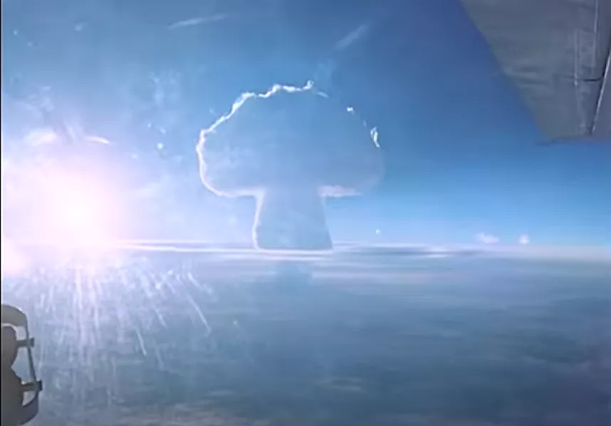
“Russia declassifies footage of 'Tsar Bomba’
The blast was more powerful than 50 million tons of TNT, and was felt hundreds of miles away.
the Tsar Bomba was enormous, weighing 27 tons (24 metric tons) and measuring about as long as a double-decker bus.
An aerial bomber carried the massive weapon high over the Novaya Zemlya islands in the Russian Arctic, then dropped it via parachute before clearing the area. “

Slide 38
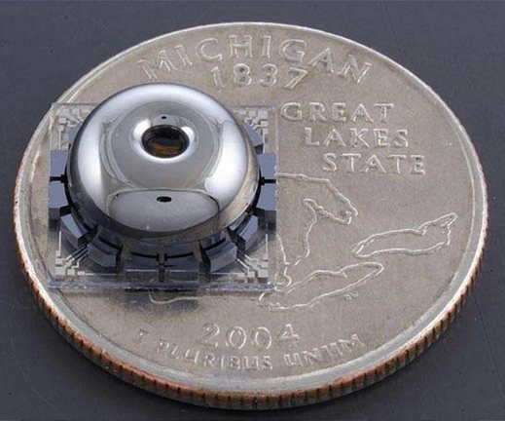
US
New on 3-30-20
“A small, inexpensive and highly accurate gyroscope, developed at the University of Michigan, could help drones and autonomous cars stay on track without a GPS signal. A small, inexpensive and highly accurate gyroscope, developed at the University of Michigan, could help drones and autonomous cars stay on track without a GPS signal. Better backup navigation equipment could also help soldiers find their way in areas where GPS signals have been jammed. Or in a more mundane scenario, accurate indoor navigation could speed up warehouse robots.”
“

Slide 39
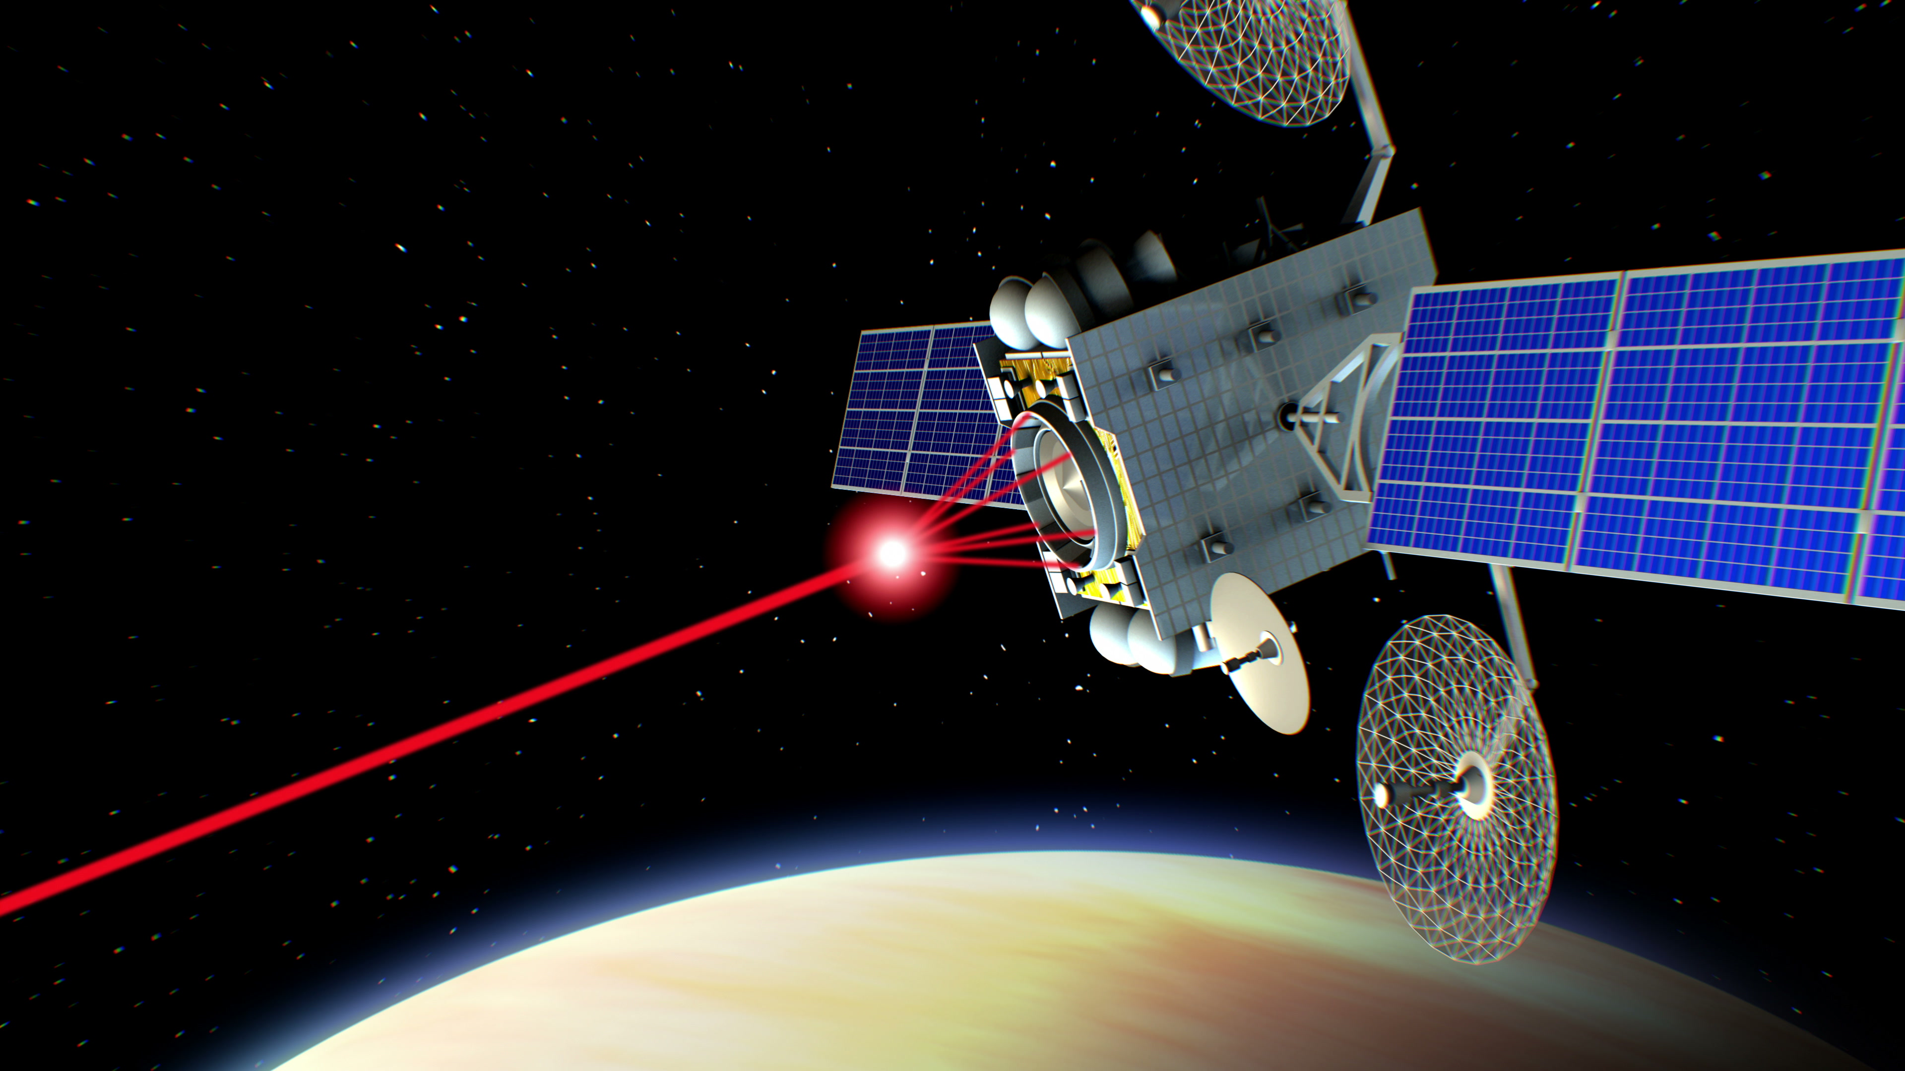
Anti-satellite weapons (ASATs)

Slide 40
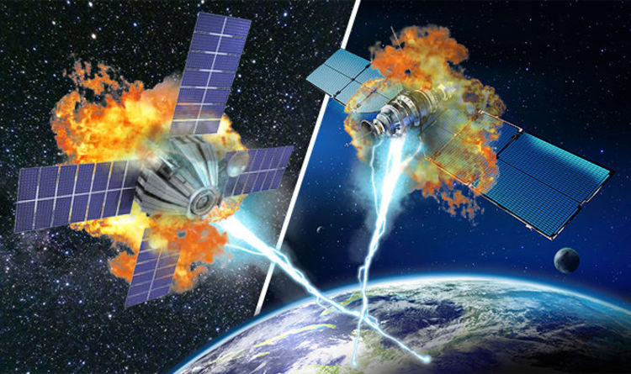
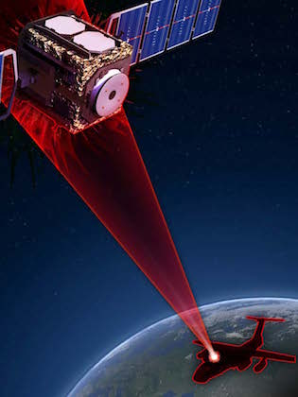
“(The US) Russia, China, India & North Korea have tested satellite warfare systems on the “New High Ground.”
“Lasers can also blind or destroy satellites and the military’s ability to sense and repel attacks from orbit and the ground.
Accordingly, the U. S. Military has recently budgeted $5 billion for space warfare.”

Slide 41
“China, Russia Building Attack Satellites and Space Lasers: Pentagon Report
“DIA (Defense Intelligence Agency) estimates that China will deploy a terrestrial laser that can shoot down satellites in low Earth orbit by 2020 and may be able to hit targets in geostationary orbit ‘by the mid-2020s.’”
“For sure, they are developing” space-based attack satellites Kokorich told congressional staffers.
”The Washington Free Beacon quotes unnamed defense officials as saying that the DN-3 is “primarily a direct-ascent missile designed to ram into satellites and destroy them, even if intelligence assessments hold that the weapon has some missile defense capabilities.”

Slide 42
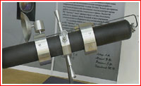
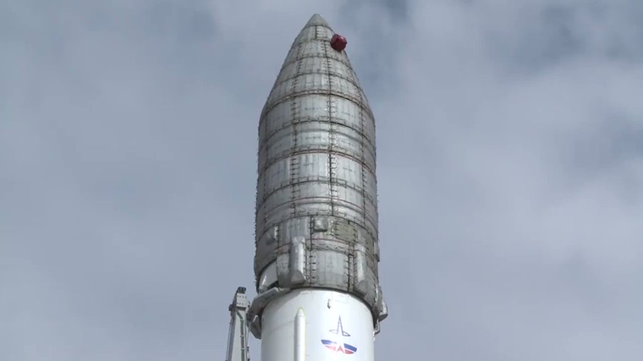
Russia
“In March 2009, the Kremlin, announced systems which the country could use for anti-satellite purposes. According to the Russian military officials, the country "retained basic assets" in Naryad-VN and Naryad-VR systems. At the same time …the Russian military was developing anti-satellite weapons in response to US and China conducting the same activities. " He added that Russia needed the capability to shoot down satellites in case ‘somebody put weapons into space.’”
“Russian space weaponry includes a new anti-satellite missile fired from aircraft and a mobile attack anti-satellite system.” This includes “communication satellites, early warning missile defense spacecraft, …radar reconnaissance satellites, anti-satellite weapons and their targets, and navigation satellites.”
Kosmos is a system
of Russian spy
& attack satellites.
Naryad, 14F11 project.

Slide 43
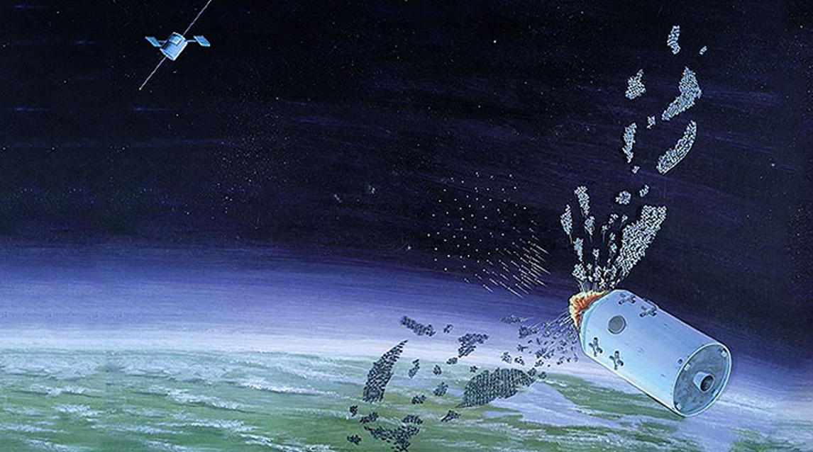
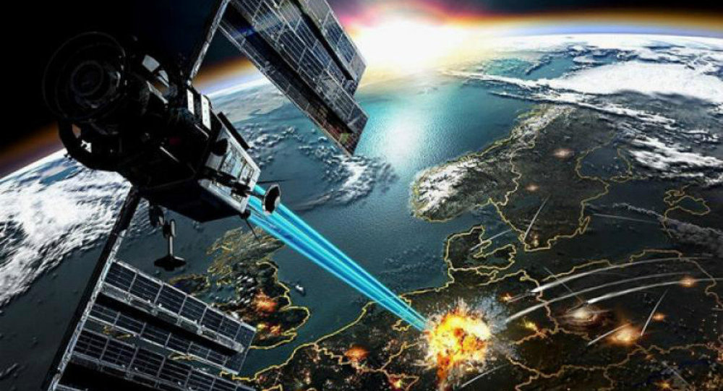
Russia
Practicing to disrupt our satellites.
“Three Russian satellites Kosmos-2491, Kosmos-2499 and Kosmos-2504 that were sent into low earth orbit in 2013 and were dormant all these years have been lately spotted moving in an unpredictable pattern.
Nobody in space circles knows what these satellites are capable of.
Some say they could be refueling other satellites or cleaning up space debris. Russian space agency chief Oleg Ostapenko claimed in 2014 that the satellites were for peaceful purposes. Perhaps Ostapenko is right and the satellites do have peaceful uses, but they could also have anti-satellite (ASAT) capability.
Such satellites can easily launch an attack on any adversary’s space assets and cripple his communication and intelligence gathering systems, delivering a knockout punch before the guns open up on the ground.
This is a capability Moscow has possessed since 1968 and was acquired via the satellite killer project.”

Slide 44
“In February, satellite experts noticed that another Russian satellite (Kosmos 2542) was seemingly stalking an American satellite (USA 245).
And in 2017, a Russian satellite released a high-speed projectile in close proximity to another Russian satellite.
At the time, the US said this was a weapons demonstration.”

Slide 45
“This is all circumstantial evidence, but there are a hell of a lot of circumstances that make it look like a known Russian inspection satellite is currently inspecting a known U.S. spy satellite.”
Sky watchers monitored the satellite chase overhead as Kosmos 2543 closed the distance and then, days later, backed away. The State Department officially complained, although the U.S. government never disclosed the identity of its own satellite.
On July 15 the now infamous Kosmos 2543 performed its next trick by deploying an object that appeared to jet away from it, then pass within a few kilometers of another Russian satellite it was observing. Or was it targeting it?”

Slide 46
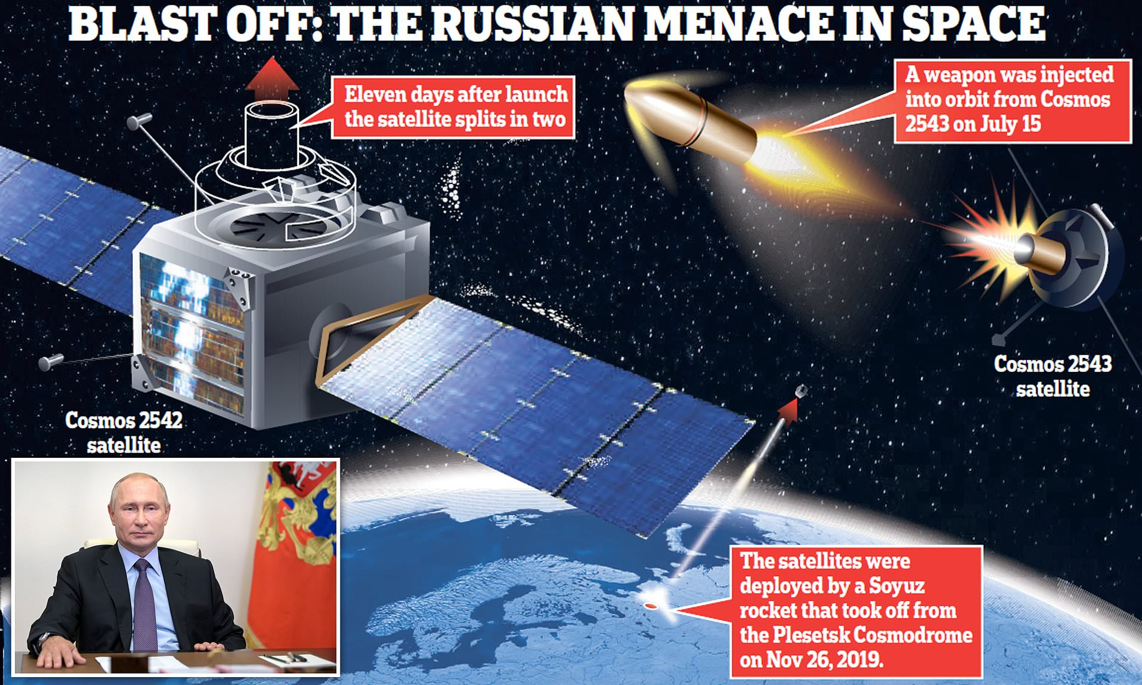

Slide 47
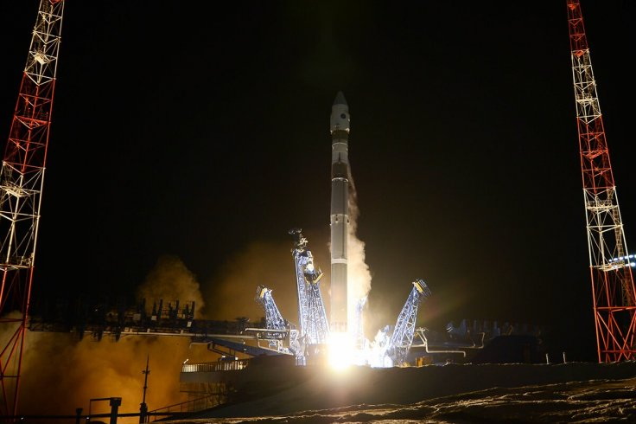
“Did Russia just launch a spacecraft to stalk a US spy satellite?
Russia launches a Kosmos 2558 launched into the same orbital plane as USA 326, an American spy satellite that rode a SpaceX Falcon 9 rocket to orbit this past February, Langbroek noted. The two satellites are close in altitude as well, and they're scheduled to have a relatively close encounter soon, provided neither one performs any significant maneuvers over the next day or so.

Slide 48
is supported by its audience. When you purchase
Russians reportedly building a satellite-blinding laser
“Laser technology has evolved to the point where this type of anti-satellite defense is plausible, though there is limited evidence of any nation successfully testing such a laser.
If the Russian government is able to build the laser, it would be capable of shielding a large part of the country from the view of satellites with optical sensors. The technology also sets the stage for the more ominous possibility of laser weapons that can permanently disable satellites.”

Slide 49
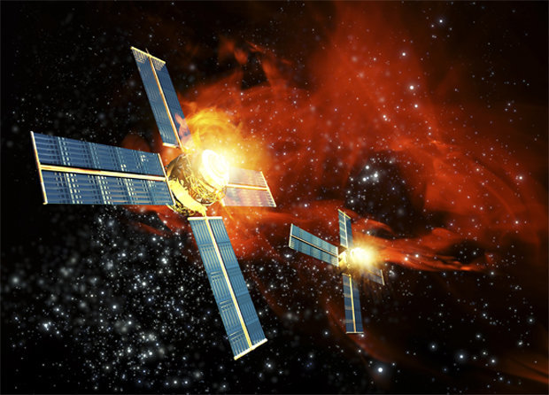
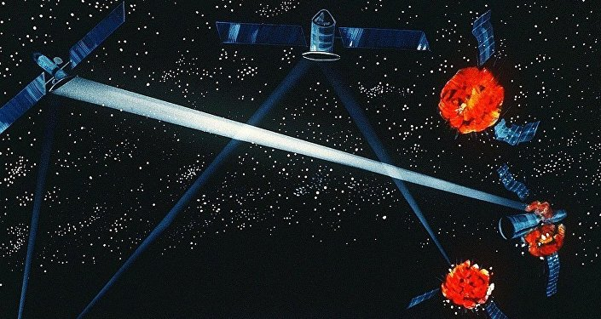
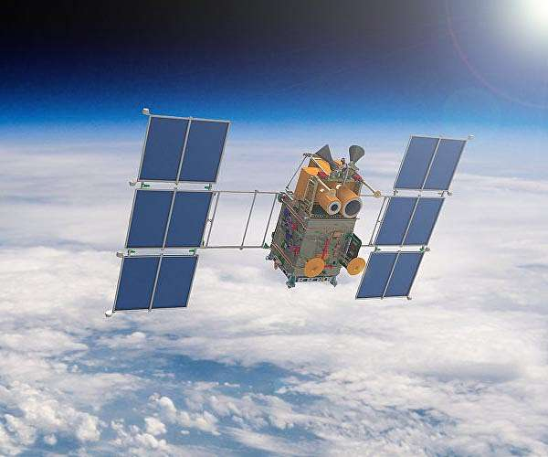
“Last year, the US National Air and Space Intelligence Center issued a report indicating that Russia and China were working on advanced space-based technologies aimed at ‘challenging US superiority’ in the potential war-fighting domain.
The US Air Force-affiliated think tank cited Russian and Chinese developments in missile technology, as well as directed-energy radio frequency and laser weaponry, which it said could pose a threat to US efforts in this area.”

Slide 50
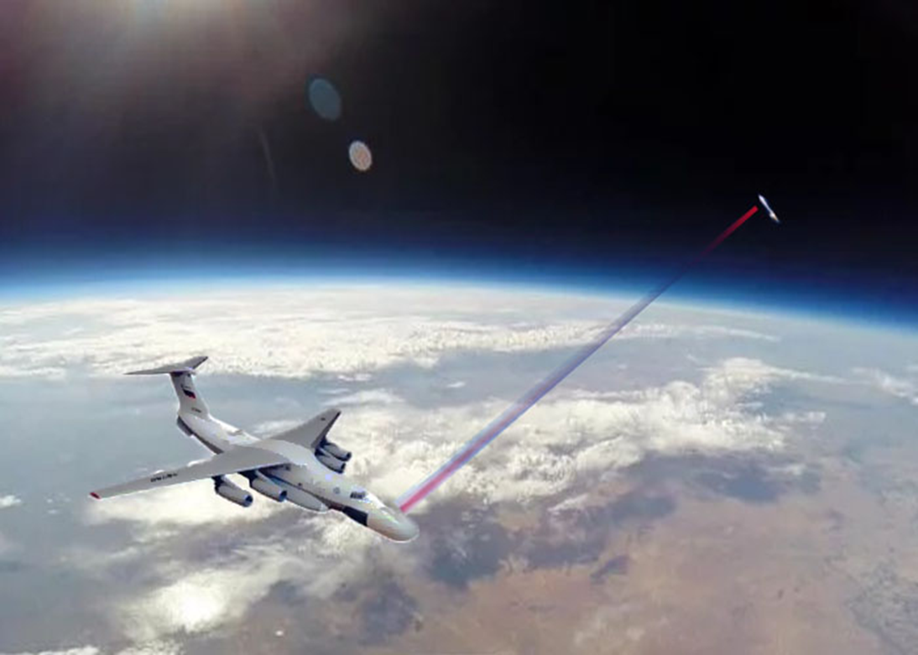
“Russia developed an advanced anti-satellite aircraft-mounted laser.
Russia has revealed new details of the new special aviation complex with an aircraft-mounted laser to operate as an anti-satellite weapon, the InterFax news agency reported.”

Slide 51
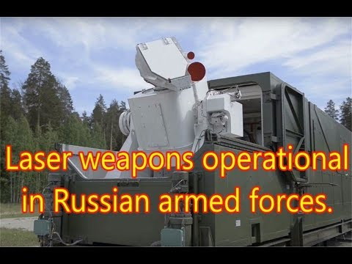
RUSSIA
Russian Laser Weapons

Slide 52
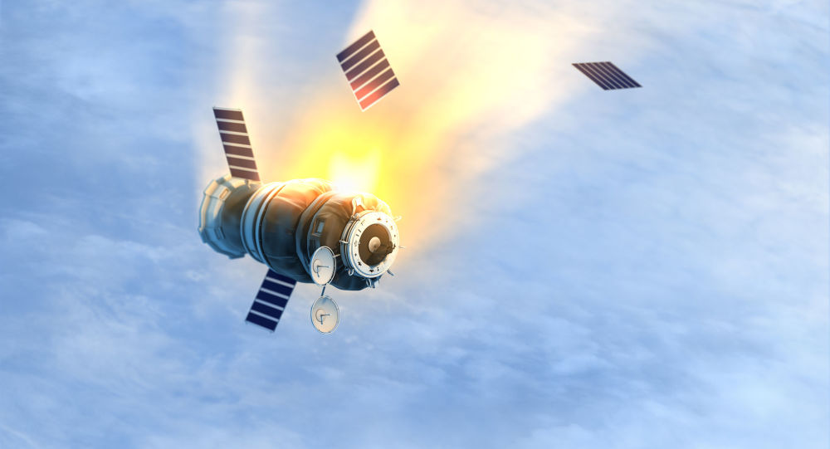
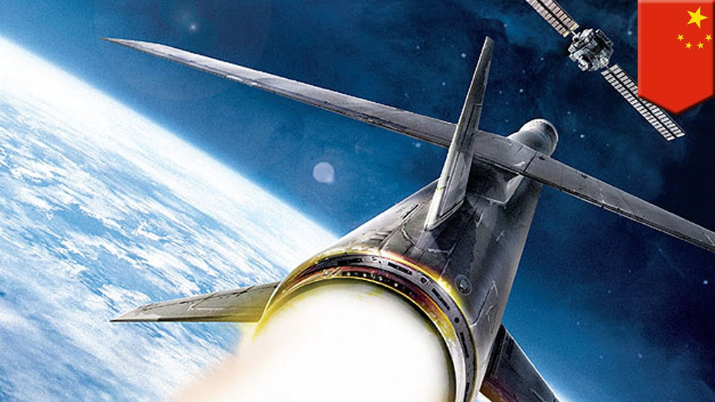
RUSSIA
“In November 2017, the new Russian federal defense procurement program from 2018 to 2027 had allocated funding for the development of the Rudolph mobile anti-satellite complex, RIA Novosti reported. Ochasov was also quoted disclosing the development of the Tirada-2S electronic warfare complex apparently specialized in jamming communications satellites and expected to be available in ‘ground’ and ‘mobile’ architectures.”

Slide 53
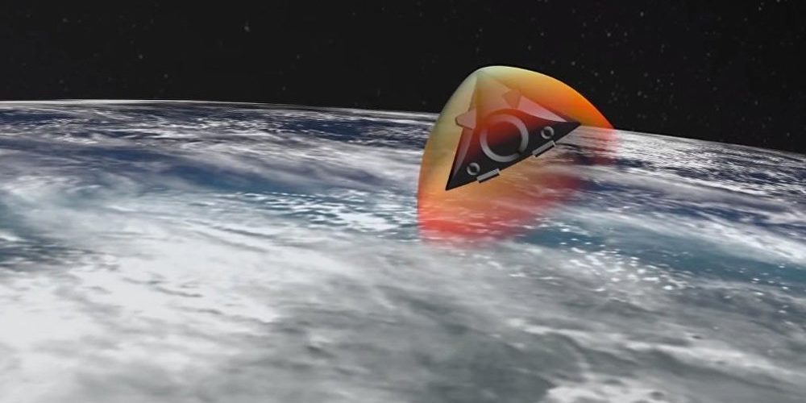
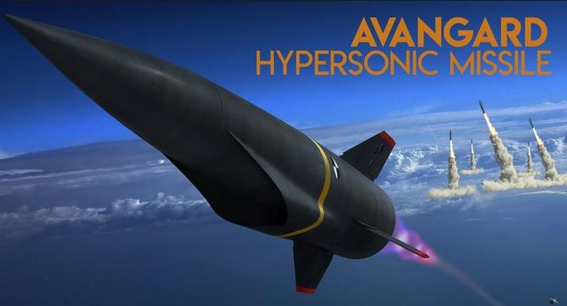
Russia
RUSSIA ANNOUNCED THIS IS NOW OPERATIONAL Sept 2020
Nuclear capable
“(The Avanguard hypersonic missile) [Vladimir Putin] mentioned is well tested,” Borisov told the Russian language newspaper Red Star. “It came about through considerable effort, because temperatures on the surface of a combat unit reach up to 2000 degrees [Celsius]. It really does go through the air surrounded by plasma. Practical tests have confirmed the chosen approach’s feasibility. In fact, we have secured a contract for mass production of these systems. So this is no bluff, but a serious undertaking.” Russia recently launched a hypersonic missile, the Zircon, from a submarine, and since late 2019 has had the hypersonic nuclear-capable Avangard missiles in service. The Avangard can travel at up to Mach 27, changing course and altitude.

Slide 54
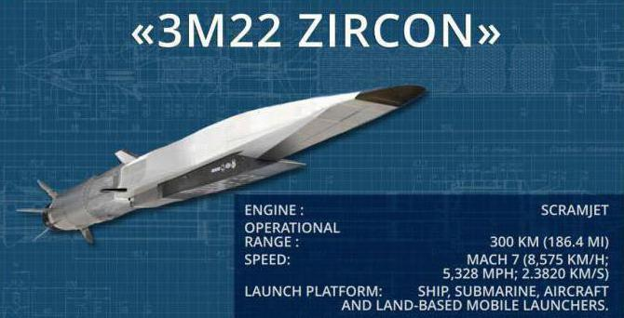
Putin Hails Successful Launch of Zircon Hypersonic Cruise Missile as 'Major Event' for Russia
“A Zircon hypersonic cruise missile has successfully hit a target in the Barents Sea, the Russian Ministry of Defence stated. The military stressed that the missile flew around 450 kilometres, reaching Mach 8 speeds.”

Slide 55
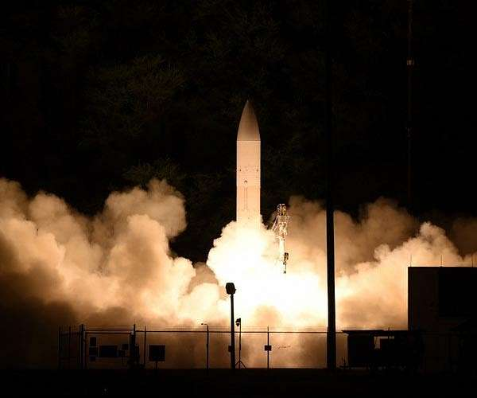
“US conducts 'successful' test of hypersonic missile technology
by AFP Staff Writers
Washington (AFP) Oct 21, 2021”
“Hypersonic missiles, like traditional ballistic missiles, can fly more than five times the speed of sound (Mach 5).
But they are more maneuverable than their ballistic counterparts and can trace a low trajectory in the atmosphere, making them harder to defend against.”

Slide 56
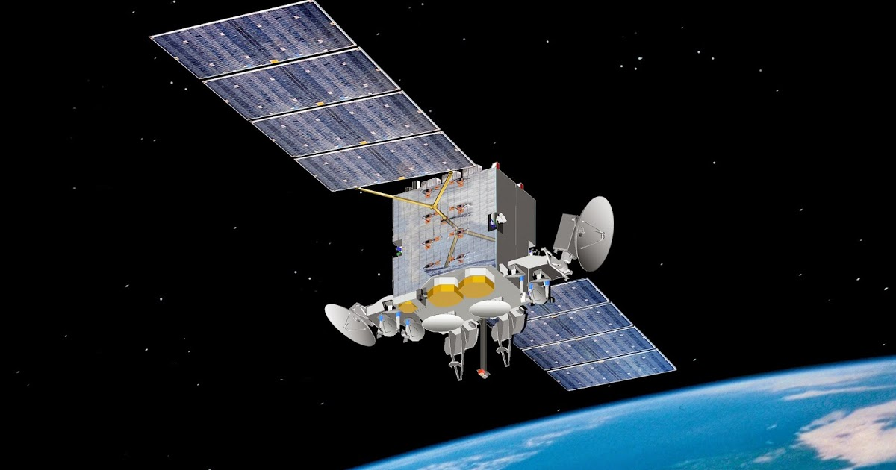
Chinese ASAT

Slide 57
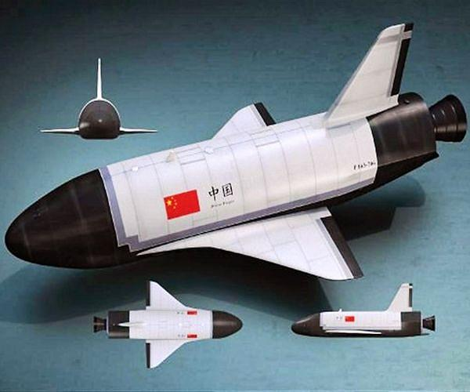
Chinese spacecraft launched mystery object into space before returning to Earth

Slide 58
“China, Russia Building Attack Satellites and Space Lasers”: Pentagon Report
“DIA (Defense Intelligence Agency) estimates that China will deploy a terrestrial laser that can shoot down satellites in low Earth orbit by 2020 and may be able to hit targets in geostationary orbit ‘by the mid-2020s.’”
“For sure, they are developing” space-based attack satellites Kokorich told congressional staffers.
”The Washington Free Beacon quotes unnamed defense officials as saying that the DN-3 is “primarily a direct-ascent missile designed to ram into satellites and destroy them, even if intelligence assessments hold that the weapon has some missile defense capabilities.”

Slide 59
China
“Lt. Gen. Jay Raymond, (of the US Space Force),
said this week that China’s amassing formidable anti-satellite capabilities. Raymond claimed that Beijing is already capable of holding every low-orbit satellite at risk, and ‘soon every satellite in every orbit will be able to be held at risk’ by China’s anti-satellite (ASAT) capabilities.” (2018)

Slide 60
China
“China shot down its own satellite to tell the world it could blind our navigation and military in one shot in 2007. That test generated a swarm of long-lived shrapnel that constitutes nearly 1/6 of all the radar-trackable debris in orbit. 40,000 new pieces)” “…From the U.S. perspective, China’s capacity to destroy satellites means it can target an American military weakness: the reliance on satellites for intelligence gathering and the operations of high-precision weaponry.”

Slide 61
“China, in addition to Russia, also has a well-developed space warfare capability that includes three types of ground-launched anti-satellite missiles, anti-satellite lasers, and maneuvering satellites.
U.S. intelligence agencies have observed small Chinese maneuvering satellites with robotic arms capable of grabbing and crushing satellites.”
U.S. defense officials familiar with the DN-3 told The Washington Free Beacon that it is “primarily a direct-ascent missile designed to ram into satellites and destroy them, even if intelligence assessments hold that the weapon has some missile defense capabilities.”

Slide 62
China
China may have deployed its new ASAT
“Aviation Week highlighted that the SC-19 kinetic missile that took down the FengYun 1C satellite in 2007 "appears to have been declared operational," according to the March 30 report. Researchers also noted that China has in development "as many as three direct ascent ASAT systems," but it is not clear whether all of them are dedicated to counterspace missions.”

Slide 63
CHINA
“The S-500 is not just a conventional air and missile defense system, but an anti-space weapon whose introduction will fundamentally change Russia's air defense capabilities, says Col. (ret) Sergei Khatylev With its ability to take out targets at a range of up to 600 km and an altitude of nearly 200 km, the S-500 can effectively defend against targets in near space. In other words, "this is an anti-space weapon," Khatylev stresses.”

Slide 64
CHINA
Notice the people
for size.

Slide 65
“China -Beijing’s recent space activities indicate that it is developing co-orbital anti-satellite systems to target U.S. space assets. Co-orbital anti-satellite systems consist of a satellite “armed with a weapon such as an explosive charge, fragmentation device, kinetic energy weapon, laser, radio frequency weapon, jammer, or robotic arm.”
A-Sat (anti-satellite) weapons are here to stay.

Slide 66
India. “India successfully shot down a satellite in low earth orbit using an Shaki Anti-Satellite (A-SAT) missile, Prime Minister Narendra Modi said. With this technological mission, India becomes the fourth country, after US, China and Russia, with the capability to destroy a low-orbit satellite.”

Slide 67
“India's state-funded DRDO has flight tested the Hypersonic Technology Demonstrator Vehicle (HSTDV) using the domestically-developed scramjet propulsion system, Indian Defense Minister Rajnath Singh announced on Monday.
The development will pave the way for the development of a hypersonic cruise missile which will have a speed of over Mach 6.5. It will have multiple civilian applications, including the launching of low-cost satellite and long-range cruise missile.”
“After successfully demonstrating an anti-satellite missile last year, Narendra Modi's government has given the green light to the maiden test flight of a prototype of the Hypersonic Technology Demonstrator Vehicle. The state-owned Defense Research and Development Organization (DRDO) developed the prototype for the test a few years ago.”

Slide 68
“The Wednesday launch marks the second successful test of a hypersonic missile by North Korea and the second test in two months. The new test proves North Korea has no intention of backing down and disarming and will instead press on with plans to modernize its arsenal. “

Slide 69
US Anti-satellite Systems

Slide 70
“U.S. disarmament ambassador Robert Wood said that Washington is concerned about China’s possible deployment of hypersonic weaponry, and said the United States hadn’t developed a means of countering it. “Thus, reports that China has combined a HGV [hypersonic glide vehicle] strike system with a Fractional Orbital Bombardment System (FOBS) must be taken very seriously.”
HGVs are highly maneuverable vehicles that skip or “glide” their way to a target after being brought to low orbit by a rocket booster. FOBS is a system first theorized in the Soviet Union, in which a missile enters low orbit before striking its target, rather than arcing out of orbit before coming back to the surface.
The combination of the two technologies is important because, unlike a traditional intercontinental ballistic missile (ICBM) that exits the atmosphere and reenters using a predictable arc, the HSV/FOBS design allows for a payload to strike out with near-unlimited range from any direction once it is in orbit, effectively negating traditional early warning systems.”

Slide 71
US
“ In 2008, the Pentagon announced it would shoot down it’s dead spacecraft. Officially, Washington insisted that the anti-satellite operation was a safety measure, to prevent the defunct craft’s toxic fuel from harming someone when the satellite’s orbit decayed and it tumbled to Earth.” “A high-tech Aegis radar, launched a specially modified SM-3 antiballistic-missile interceptor… struck the malfunctioning satellite, destroying it.”
“In 1985, a US F-15 A took out one of our failing satellites in LEO.”
(Low Earth Orbit - 100 to 1240 miles).

Slide 72
US
“A vision for the future of the US Space Command for 2020: a space-based high-energy laser destroys a terrestrial target.”

Slide 73
US Lasers
These are deployed and operational.

Slide 74
U.S. Air Force has the “highly maneuverable X-37B robotic space planes.” “’Offensive space control’” is a clear reference to weapons. ‘Active defense’ is much more nebulous, and refers to undefined offensive countermeasures.”
There are 2 planes
so far…
One mission lasted 780 days

Slide 75
US
2010
New York to Los Angeles in 12 minutes

Slide 76
Pentagon successfully tests hypersonic missile March 2020
US
Nuclear capable
“The United States … has successfully tested an unarmed prototype of a hypersonic missile, a nuclear-capable weapon (hypersonic speeds more than five times the speed of sound, or Mach 5) that could accelerate the arms race between superpowers.
They can travel much faster than current nuclear-capable ballistic and cruise missiles at low altitudes, can switch direction in flight and do not follow a predictable arc like conventional missiles, making them much harder to track and intercept.
The Pentagon is pressing to catch up with rivals Moscow and Beijing in the race to develop hypersonics.”

Slide 77
“Army secretary reveals that US hypersonic missile hit within 6 inches of its target.” Oct 2020
Nuff Said.

Slide 78
US
“This optionally manned aircraft currently dubbed the SR-72 “Son Of Blackbird” would achieve Mach 6 (7,400km/h) 4,500 mph.
May already exist.” President Trump alluded to such an aircraft.

Slide 79
US

Slide 80
US

Slide 81
Lockheed Martin Space Systems is now testing a Hypersonic Air-breathing Weapon
The Hypersonic Air-breathing Weapon Concept program "seeks to develop and demonstrate critical technologies to enable an effective and affordable air-launched hypersonic cruise missile," a DARPA statement on Tuesday said.
The HAWC weapon employs "hydrocarbon scramjet-powered propulsion," meaning the traditional fuel and air mixture but in prolonged airflow at
speeds in excess of five times the speed of sound.”
e Hypersonic Air-breathing Weapon Concept program "seeks to develop and demonstrate critical technologies to enable an effective and affordable air-launched hypersonic cruise missile," a DARPA statement on Tuesday said.
The HAWC weapon employs "hydrocarbon scramjet-powered propulsion," meaning the traditional fuel and air mixture but in prolonged airflow at speeds in excess of five times the speed of sound.

Slide 82
US
“Northrop Grumman and Raytheon Missiles and Defense Partner on a Next Generation Interceptor
Northrop Grumman and Raytheon Missiles and Defense currently provide the interceptor booster, kill vehicle, ground systems, fire control and engagement coordination for the country’s Ground-Based Midcourse Defense system.”

Slide 83
Northrop Wins $13.3B Contract to Design New ICBMs
A Minuteman III on alert status at F.E. Warren Air Force Base, Wyo., is worked on by 90th Maintenance Group Airmen. ICBMs must be repaired and maintained frequently. Photo: Senior Airman Abbigayle Williams

Slide 84
Northrop Wins $13.3B Contract to Design New ICBMs
Nuclear
Deterrent
“Northrop Grumman will officially move ahead as the sole company in the Air Force’s competition to design a new intercontinental ballistic missile, under a $13.3 billion contract, the service said Sept. 8, 2020. Northrop’s design for the Ground-Based Strategic Deterrent will replace the 400 nuclear-tipped Minuteman III missiles that are scattered in silos around Montana, North Dakota, and Wyoming. The engineering and manufacturing development contract formally unseats Boeing as the Air Force's future ICBM provider after more than 60 years as the primary contractor.”

Slide 85
Army’s
Precision
Strike Missile test
May 2020
“Lockheed Martin received a $6.07 billion contract from the U.S. Army for the production of Patriot Advanced Capability-3 (PAC-3) Missile Segment Enhancement (MSE) interceptors and associated equipment, to be delivered across FY21, FY22 and FY23 contract years.” (May 2020)
"This contract demonstrates our customer's continued confidence in our ability to deliver unmatched Hit-to-Kill technology that defeats the ever-expanding global threats of today and tomorrow," said Scott Arnold, vice president, Integrated Air and Missile Defense at Lockheed Martin Missiles and Fire Control.”

Slide 86
Lockheed Martin

Slide 87
US
“US Building Ground-Based Network of Offensive Weapons to Jam Russian Satellites
Over the next seven years, the US Space Force is looking to amass dozens of ground-based weapons systems capable of jamming Russian or Chinese communication satellites en masse, Bloomberg has reported, citing military sources.
The arsenal is expected to consist of Counter Communications System (CCS) ground-based satellite communications jamming units, with 16 of these already delivered and 28 more on the way.” Its successor is called Meadowland.

Slide 88
US
US Space Force Satellite
“The (AEHF)satellite constellation provides "global, survivable, protected communications capabilities for strategic command and tactical warfighters operating on ground, sea and air platforms," according to Lockheed Martin.
And it gives "senior leadership a survivable line of communications to military forces in all levels of conflict, including nuclear war," it said.
The system features encryption, a low probability of interception and detection, and it is jammer-resistant and
able to penetrate the electro-magnetic interference caused by nuclear weapons, it added.”

Slide 89
HACKERS

Slide 90
HACKERS

Slide 91
Hackers
U.S.-German ROSAT X-ray satellite
One of the U.K.’s SkyNet satellites
“This scenario played out in 1998 when hackers took control of the U.S.-German ROSAT X-ray satellite. They did it by hacking into computers at the Goddard Space Flight Center in Maryland. The hackers then instructed the satellite to aim its solar panels directly at the sun. This effectively fried its batteries and rendered the satellite useless.
Hackers could also hold satellites for ransom, as happened in 1999 when hackers took control of the U.K.’s SkyNet satellites.”

Slide 92
“Hackers can jam a signal by drowning it out with meaningless noise, or they can spoof it by feeding the receiver false time or coordinates, which will disorient the receiver in time or space.”
Systems affected by loss, distortion of GPS:
The military
Atomic clocks
Weather satellites,
Cars, ships, and planes, air traffic control
Electricity
Delivery organizations such as Fed Ex and UPS
Financial systems, the stock market, credit cards, sales
Medical records
Cell towers and cell phones
TV networks, radio, signal, TV commercials (2 billion GPS devices used to prove transmission).
“The 5G enabled Internet of Things will depend heavily on GPS because devices need precise timing to sync with one another and across networks.”

Slide 93
Hackers
LANDSAT 7
LANDSAT 7
Artist's rendering of the Terra satellite
.
(Image: © NASA/JPL)
“Hackers interfered with two U.S. government satellites four separate times in recent years, according to a congressional commission report to be released next month.
In October 2007 and July 2008, a NASA-managed Landsat-7 satellite experienced 12 or more minutes of interference, and a Terra AM-1 satellite was disrupted for two minutes in June 2008 and again that October for nine minutes, according to Bloomberg Businessweek's analysis of the annual report by the U.S.-China Economic and Security Review Commission.” China denied the interference.

Slide 94
Hackers
“A malicious actor could fake their IP address, which gives information about a user's computer and its location. This person could then get access to the satellite's computer system, and manipulate where the satellite goes or what it does. Alternatively, an actor could jam the satellite's radio transmissions with earth, essentially disabling it. The cost of such an attack could be huge. If a satellite doesn't work, life-saving GPS or online information could be withheld to people on earth when they need it most. What's worse, if part of a satellite -- or an entire satellite -- is knocked out of its orbit from an attack, the debris could create a domino effect and cause extreme damage to other satellites.”

Slide 95
Hackers
CUBESATS are especially vulnerable to hackers
“If hackers were to take control of these satellites, the consequences could be dire. On the mundane end of the scale, hackers could simply shut satellites down, denying access to their services. Hackers could also jam or spoof the signals from satellites, creating havoc for critical infrastructure. This includes electric grids, water networks, and transportation systems.
Some of these new satellites have thrusters that allow them to speed up, slow down, and change direction in space. If hackers took control of these steerable satellites, the consequences could be catastrophic. Hackers could alter the satellites’ orbits and crash them into other satellites or even the International Space Station.”

Slide 96
Hackers
NASA Computer Hacked, Satellite Data Accessed
“NASA has a Vulnerability Assessment Program (VAP) in its cybersecurity branch, designed to evaluate and minimize threats on these assets.” “
A Romanian hacker claims to have breached a computer server at NASA's Goddard Space Flight Center and gained access to confidential satellite data.
The hacker, who calls himself TinKode, took to Twitter shortly before noon today (May 17) to boast: "NASA Goddard Space Flight Center — (Hacked) 1 Server Access."
On his blog, TinKode posted a screen grab of what he said was a Goddard Space Flight Center FTP server. The screen shot shows files that appear to be connected with NASA's SERVIR program, which uses satellite data to aid in disaster relief, health risk assessments, and climate change and biodiversity issues, wrote Paul Roberts from the security firm Kaspersky Lab.”

Slide 97
An artist's depiction of American Defense Satellite Communication System satellites. U.S. Air Force
“In the event of an attack on a space asset, the 1967 Outer Space Treaty does nothing. It dictates that nations are not supposed to have war in space, since it’s an arena for the “benefits” and “interests” of mankind (but neither term is clearly defined).
The treaty reads, “States shall not place nuclear weapons or other weapons of mass destruction in orbit or on celestial bodies or station them in outer space in any other manner.”
Even if a crashed satellite fell to earth and caused major damage, it’s not obvious that it would violate the treaty, even though it might meet the U.S. definition of a “weapon of mass destruction.”

Slide 98
Per Article 51 of the UN Charter, a country is justified in retaliating on another country if it’s in an act of “self-defense.” But according to Listner, “self-defense” is completely subjective, & various responses could be justified.
“Are you gonna launch a reciprocal cyber attack on one of their satellites, launch a diplomatic protest, or use some other means to retaliate?” Listner said. “All in all, you’ve gotta frame that within the context of Article 51 saying ‘this is self-defense’ so you can basically ‘justify’ whatever response you do.”
So why is it so unclear how this would all go down? According to Fidler, crafting a safe, agreed-upon response to a cyber attack on a satellite requires policymakers to have technical knowledge about satellites. “Recognition that space cybersecurity is an important issue is, actually, fairly recent,” Fidler said. “But the growing awareness comes at a time when governments are experiencing increasing difficulties in international cooperation on cyber and space issues.”

Slide 100
Russia
Russian Laser Space Gun
In the 60s “…the device appears to be an anti-satellite weapon, designed to blind sensitive optics and other sensors aboard a hostile spacecraft…”

