Slide 1
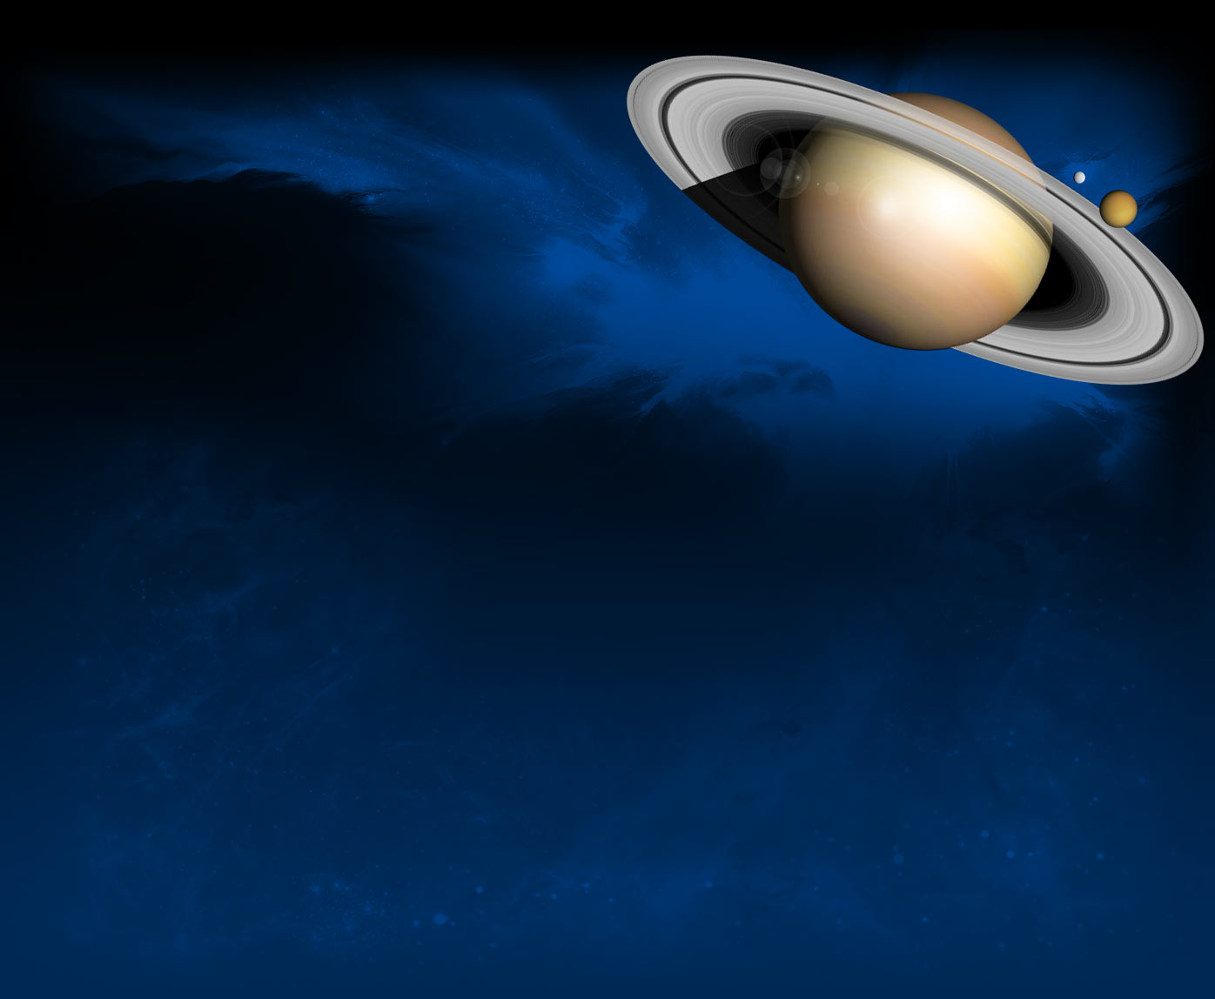
WOO HOO !
WHAT’S THIS
UNIVERSE THING,
ANYWAY ?

Slide 2
REFERENCES
“What is Dark Matter?” Space.com
“Where’s the Edge of the Universe?” Astronomy.com “Cosmology: Uncovering the Story of the Universe?” Live Science “How will the Universe End?” Live Science
“THE LAMDA COLD DARK MATTER MODEL of Cosmology? NASA
“Physicists Think We Might Have a New, Exciting Dark Matter Candidate” Science Alert
“What is the Shape of the Universe?” Space.com
“This Cosmologist Knows How It’s All Going to End” Quanta magazine
“A Brief History of Time” Stephen Hawking
“How will the Universe end, and will anything survive?” BBC Earth
“Four Ways That Our Universe Might End, According to Science” Futurism Mag
“Scientist Describes When and How the Universe Will Die a Sad and Lonely Death”
Mysterious Universe
“Sad! This Is When the Universe Will Truly End” Popular Mechanics
“The Big Freeze: How the universe will end” Big Think

Slide 3
THAT IS, THE
THEORY
OF THE UNIVERSE.

Slide 4
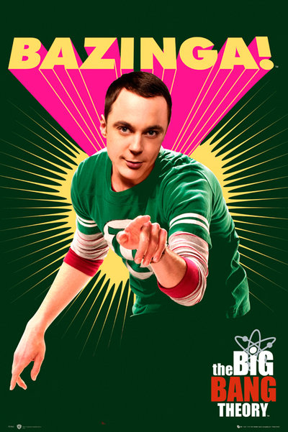
HEY
WHERE DID ALL THIS STUFF
COME FROM ?

Slide 5
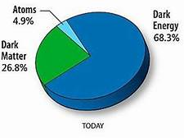
The Universe we see is called Baryonic Matter, regular stuff,
But that is only 5% of the universe.

Slide 6
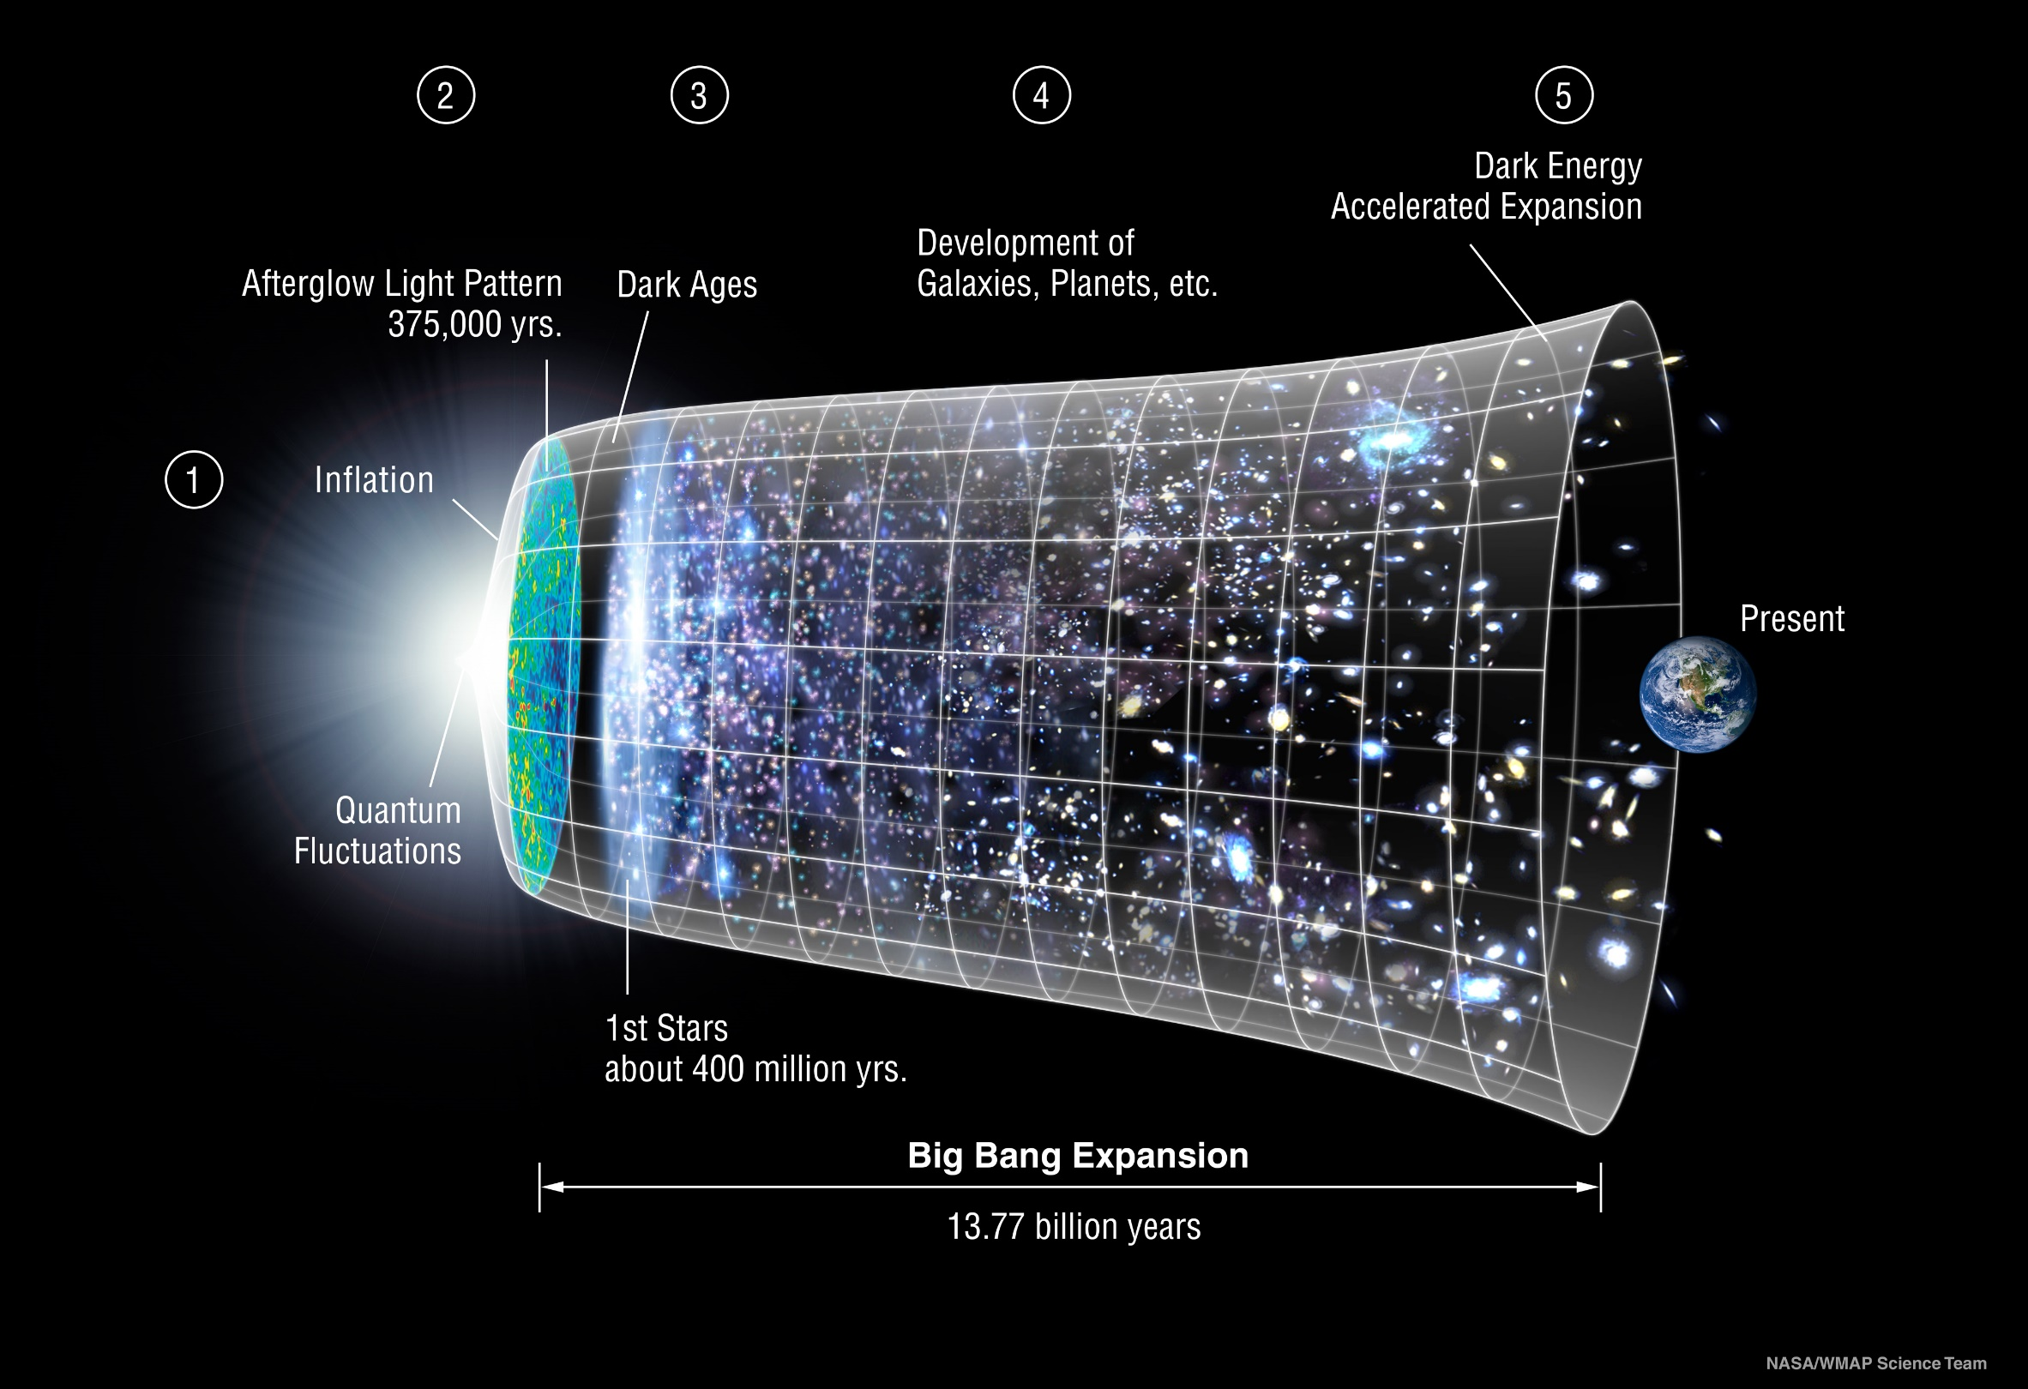
THE LAMDA COLD DARK MATTER MODEL OF COSMOLOGY
THE BIG BANG

Slide 7
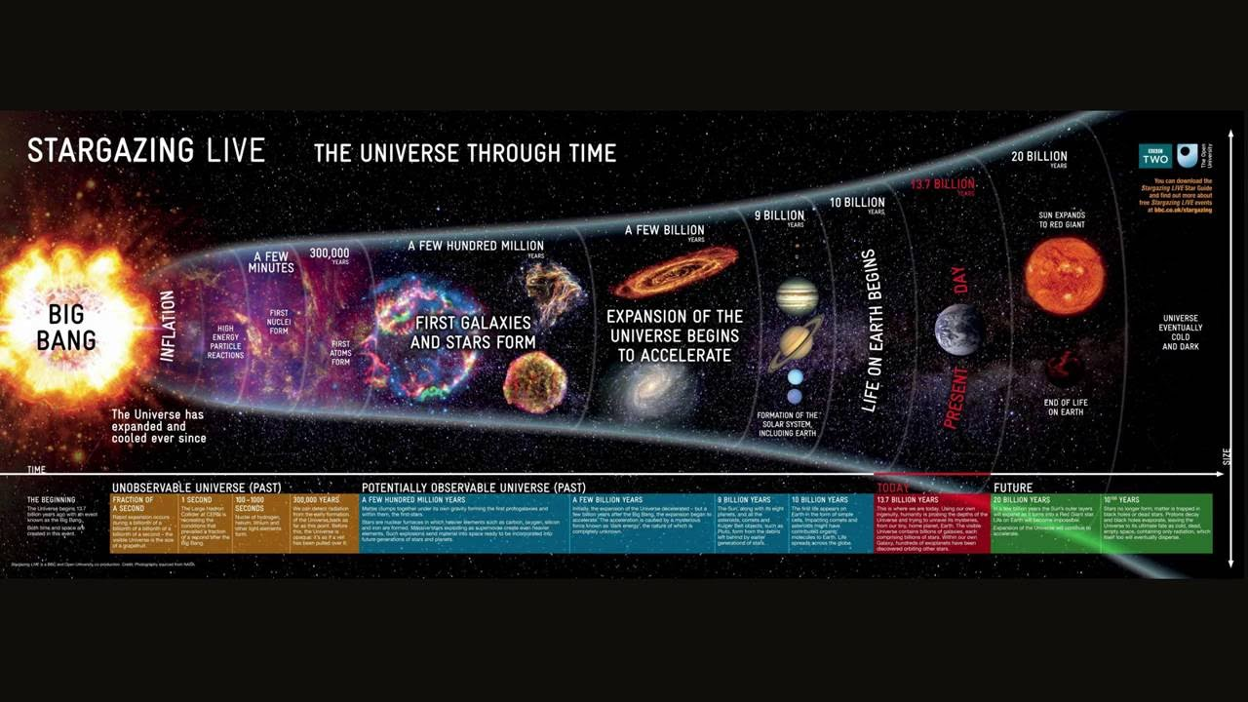

Slide 8
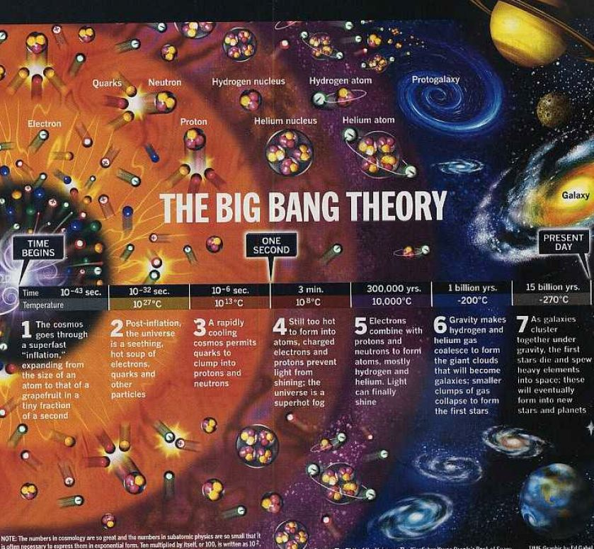

Slide 9
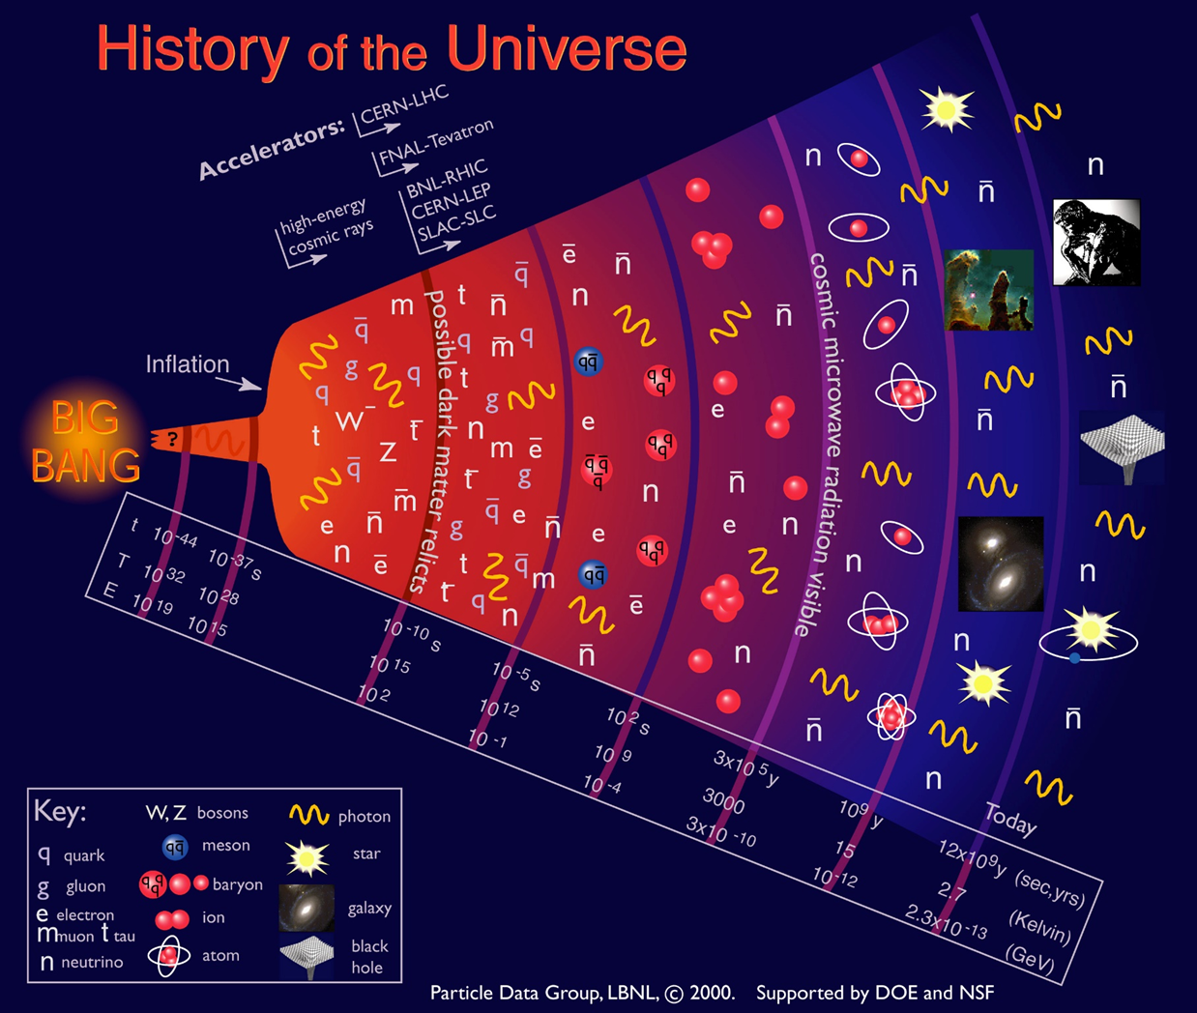
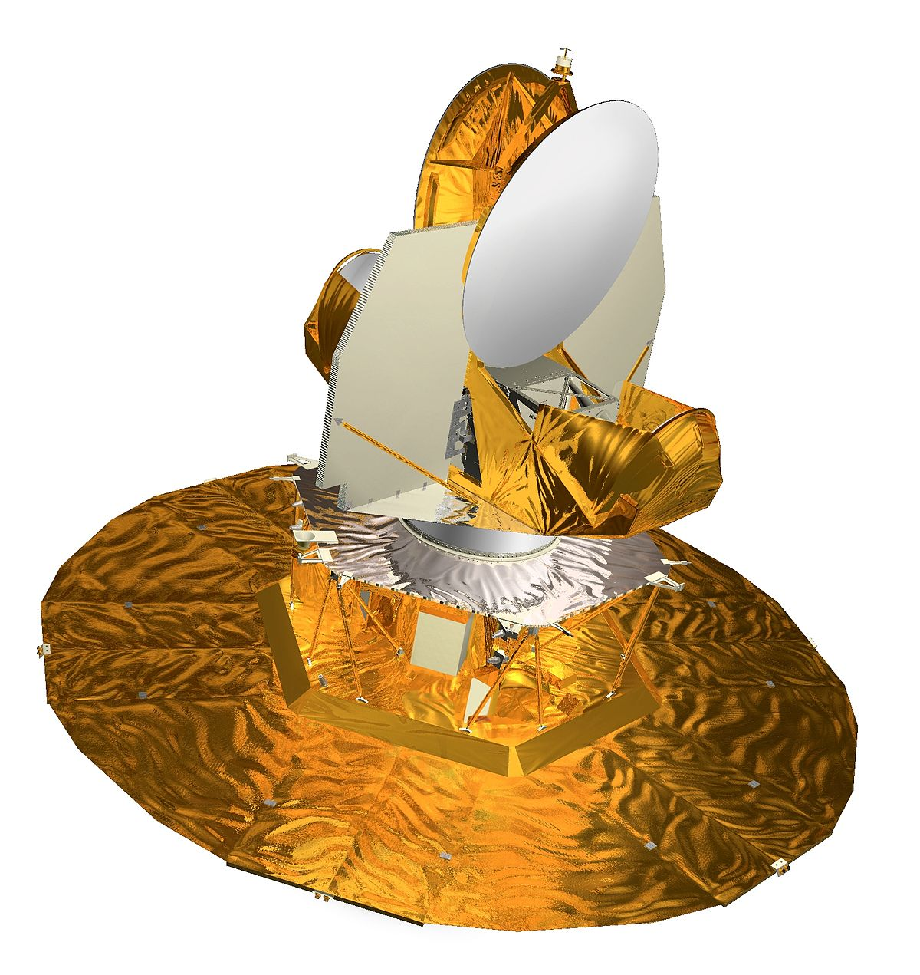
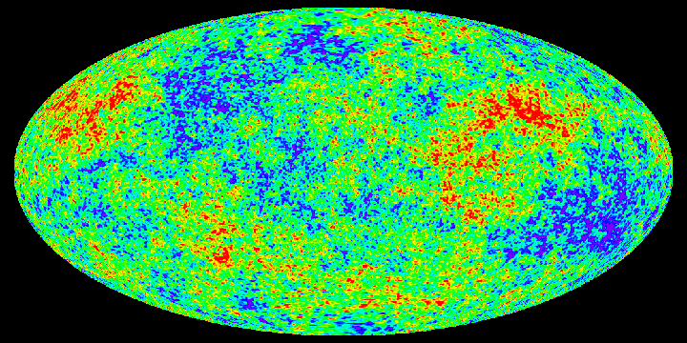
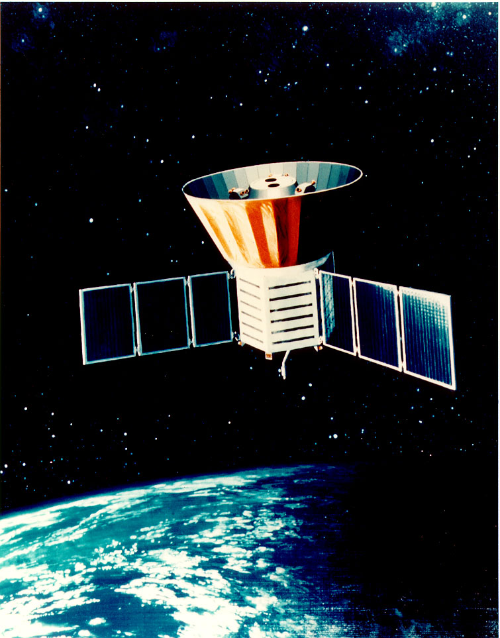
Cosmic Microwave Background

Slide 10
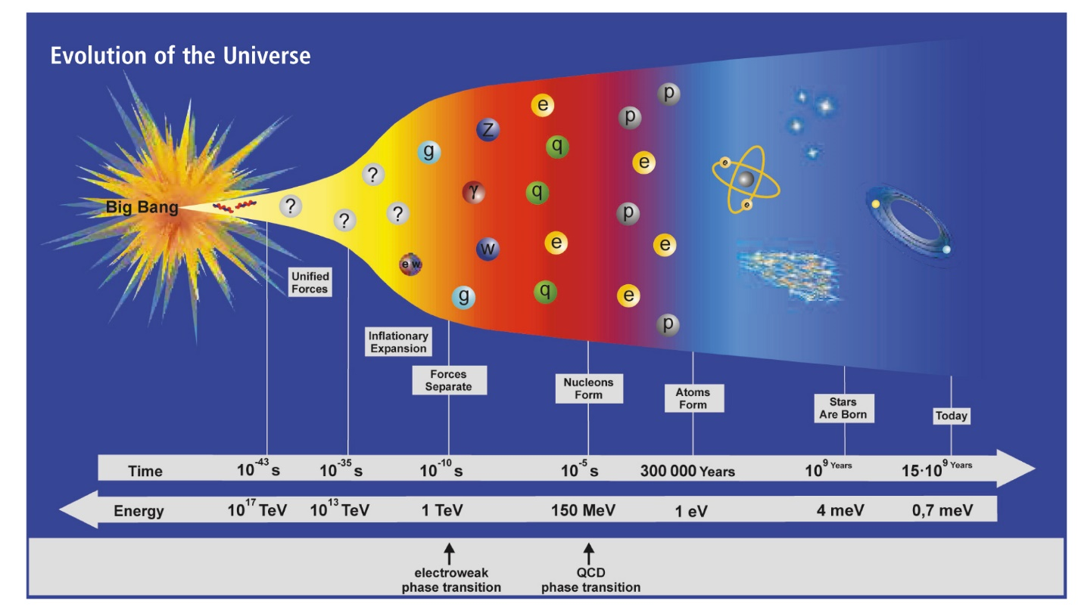

Slide 12
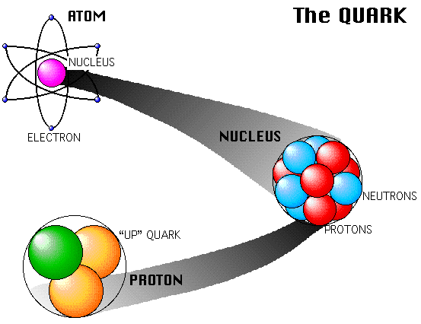
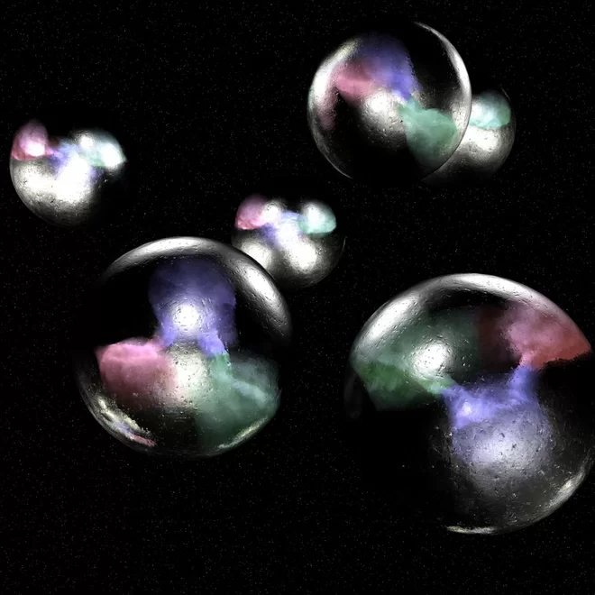

Slide 14
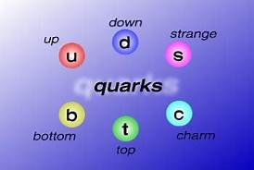
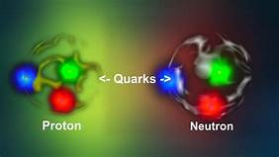
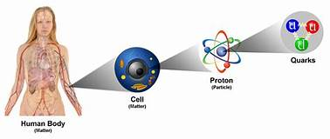
“FLAVORS” OF QUARKS
Quarks is Quarks

Slide 15
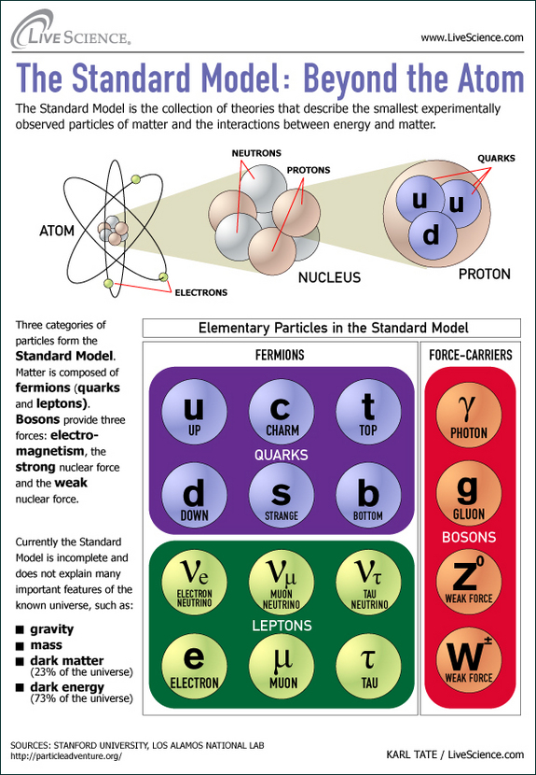

Slide 16
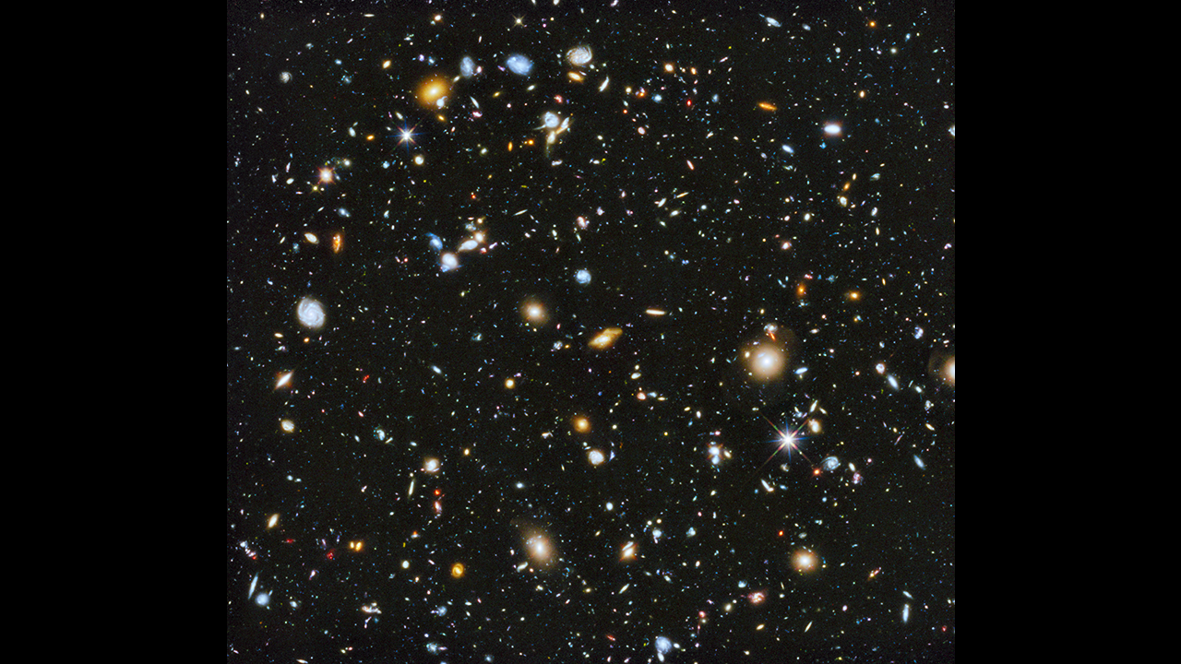
Each point of light is one of 2 trillion galaxies with 30 to 70 billion trillion stars--- a septillion stars. That’s 1 followed by 24 zeros: 1,000,000,000,000,000,000,000,000 stars with at least that many planets.

Slide 17
BUT THAT’S ONLY 5%
OF THE UNIVERSE

Slide 20
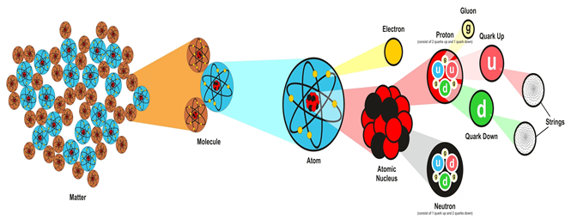
Remember the Quark?

Slide 21
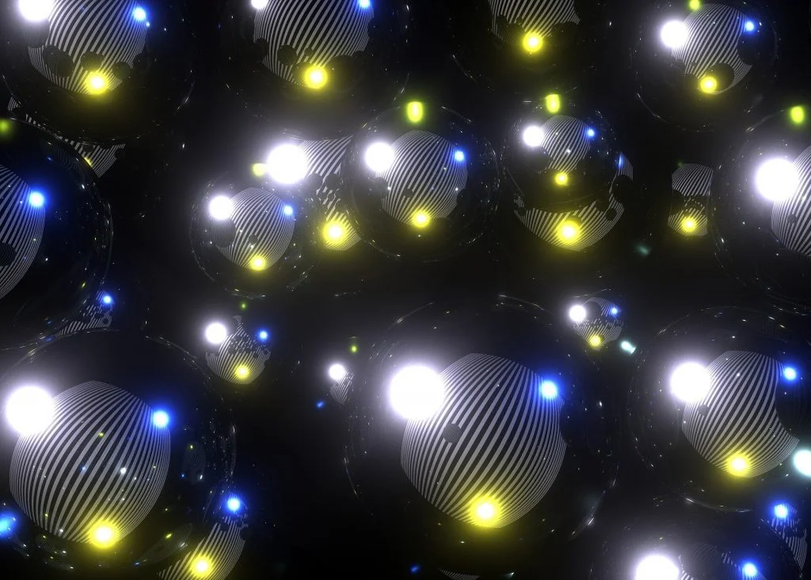
Coming Attractions: The d-star hexaquark

Slide 22
There is a brand new particle proposed (a good guess) for Dark Matter.
It is the d-star hexaquark.
“The particle is composed of six quarks---the fundamental particles that usually combine in threes to make up protons and neutrons.
Importantly, the 6 quarks in a d-star result in a boson particle, which means that when many d-stars are present they can combine together in very different ways…”

Slide 23
D-star hexaquarks are interesting because they're bosons, a type of particle that obeys Bose-Einstein statistics, a framework for describing how particles behave. In this case, it means that collection of d-star hexaquarks can form something called a Bose-Einstein condensate.
Also known as the fifth state of matter, these condensates form when a low-density gas of bosons is cooled to just above absolute zero. At that stage, the atoms in the gas go from their regular wiggling and jiggling to quite still - the lowest quantum state possible.
If such a gas of d-star hexaquarks was floating around in the early Universe as it cooled in the wake of the Big Bang, according to the team's modelling, it could come together to form Bose-Einstein condensates. And those condensates could be what we now call dark matter.

Slide 24
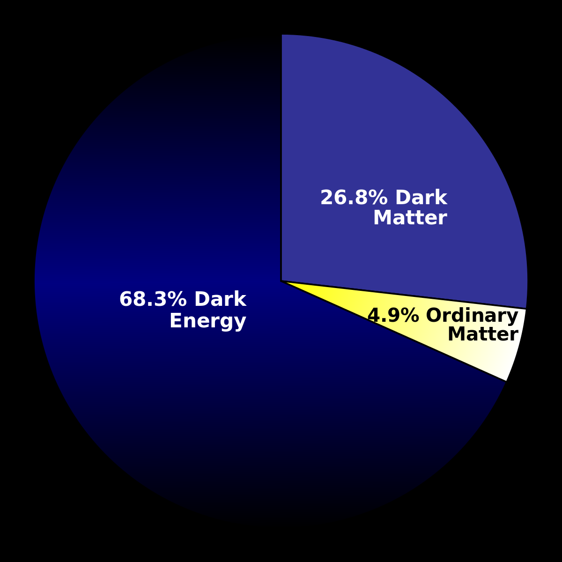

Slide 25
The Big Bang gave the Universe a big push.
BANG, it’s over.
So then the Universe should have slowed down because of Gravity,
BUT the EXPANSION OF THE UNIVERSE DIDN’T SLOW DOWN.
The Universe’s expanded apart EVEN FASTER. WHA ?????
Scientists named the FORCE that was making the Universe SPEED UP
“DARK ENERGY”.
WOO HOO !!!
Big Bang

Slide 26
Why is it called “DARK” ENERGY?
We call it “dark” because we have
no idea what it is !!!
It’s just
PUSHY STUFF

Slide 27
BUT THAT DOESN’T ADD UP
TO 100 % . . .

Slide 28
So what is this “dark” matter stuff?
WELL, YEAH
REMEMBER WE SAID WE CALL IT “DARK” BECAUSE WE DON’T KNOW WHAT IT IS?

Slide 29
WE CAN’T SEE “DARK” MATTER,
BUT WE CAN SENSE
ITS GRAVITATIONAL EFFECTS.

Slide 30
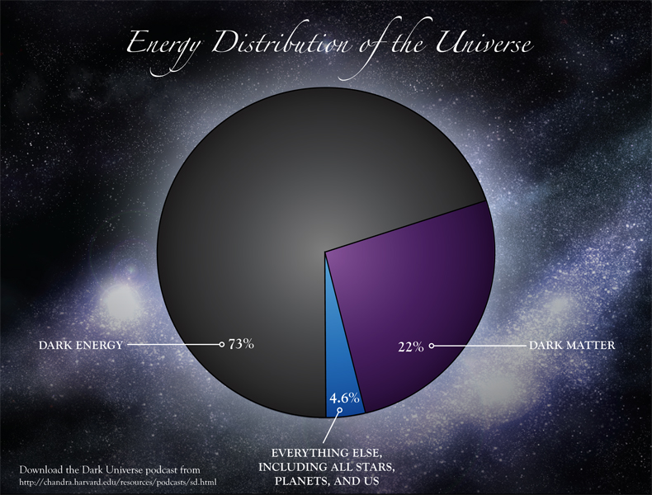

Slide 31
The Universe is FLAT!
NO it isn’t!
Yes, it is.

Slide 32
What is the SHAPE of the Universe?
Physicist Nola Redd says,
The size of the universe depends a great deal on its shape. Scientists have predicted the possibility that the universe might be closed like a sphere, infinite and negatively curved like a saddle, or flat and infinite.
A finite universe has a finite size that can be measured; this would be the case in a closed spherical universe. But an infinite universe has no size by definition.

Slide 33
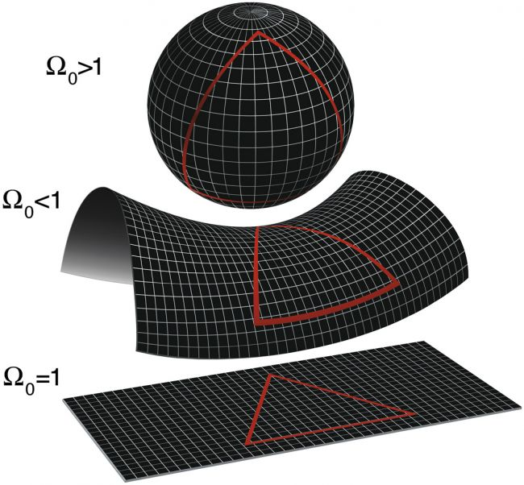

Slide 35
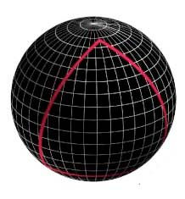
A positively-curved Universe would look somewhat like a four-dimensional sphere. This type of Universe would be finite in space, but with no discernible edge. In fact, two distant particles travelling in two straight lines would actually intersect before ending up back where they started.

Slide 36
To be positively-curved, or closed, the Universe would first have to stop expanding – something that would only happen if the cosmos housed enough energy to give gravity the leading edge. Present cosmological observations suggest that the Universe should expand forever. So, for now, we’re tossing out the easy to imagine (SPHERE) scenario.

Slide 37
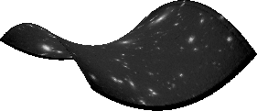
A negatively-curved Universe would look like a four-dimensional saddle. Open, without boundaries in space or time. It would contain too little energy to ever stop expanding.
Here two particles traveling on straight paths would never meet. In fact, they would continuously diverge, getting farther and farther away from each other as infinite time spiraled on.

Slide 38
According to NASA, scientists know that the universe is flat with only about a 0.4 percent margin of error (as of 2013). And that could change our understanding of just how big the universe is.
"This suggests that the universe is infinite in extent; however, since the universe has a finite age, we can only observe a finite volume of the universe," NASA says on their website. "All we can truly conclude is that the universe is much larger than the volume we can directly observe."

Slide 39
In “a flat Universe. Particles in a flat cosmos continue on their merry way in parallel straight paths, never to meet, but never to diverge either.”
This is the theory embraced by most physicists.

Slide 40
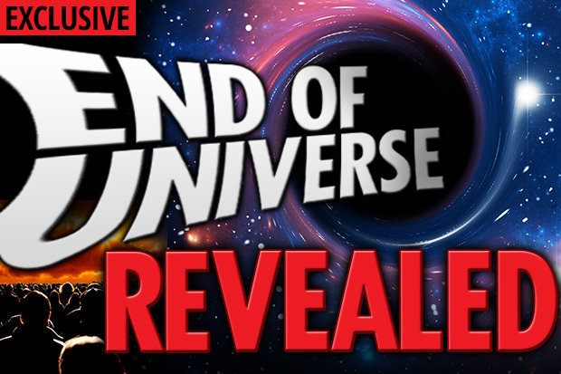

Slide 41
So how will the Universe End?”
“Some say the world will end in fire,
Some say in ice.
From what I’ve tasted of desire
I hold with those who favor fire.
But if it had to perish twice,
I think I know enough of hate
To say that for destruction ice
Is also great
And would suffice.”
Robert Frost

Slide 42
“Science has outlined four ways that our universe could meet its doom.
They're called
the Big Freeze,
the Big Crunch,
the Big Change,
and the Big Rip.”
And the Big Slurp.

Slide 43
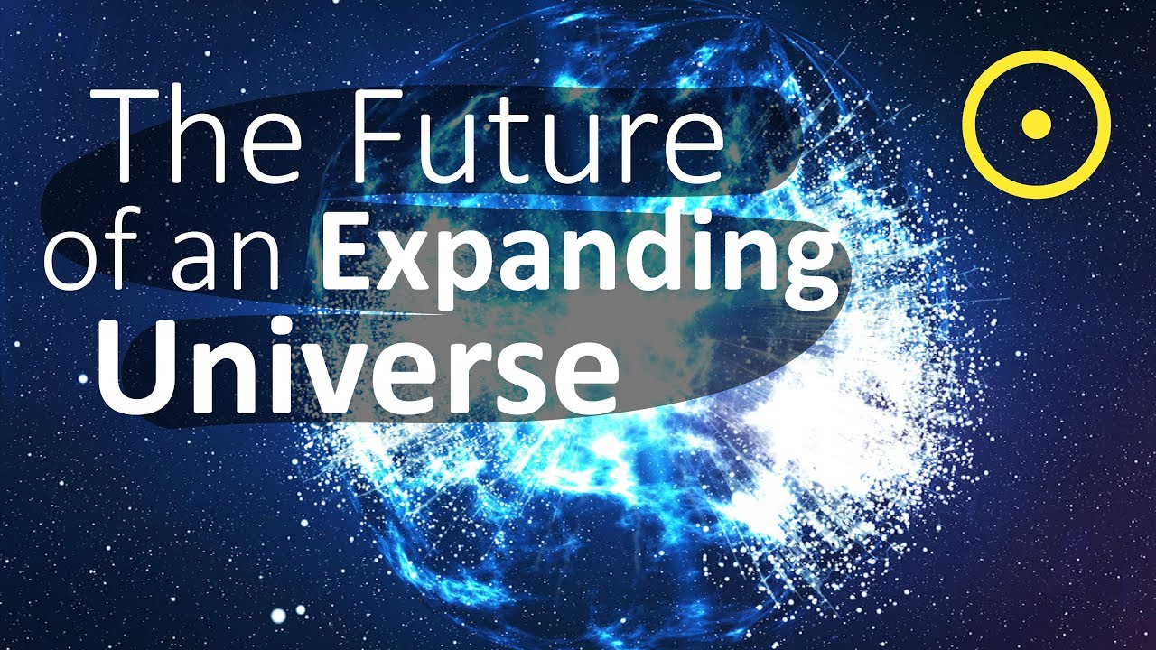

Slide 44
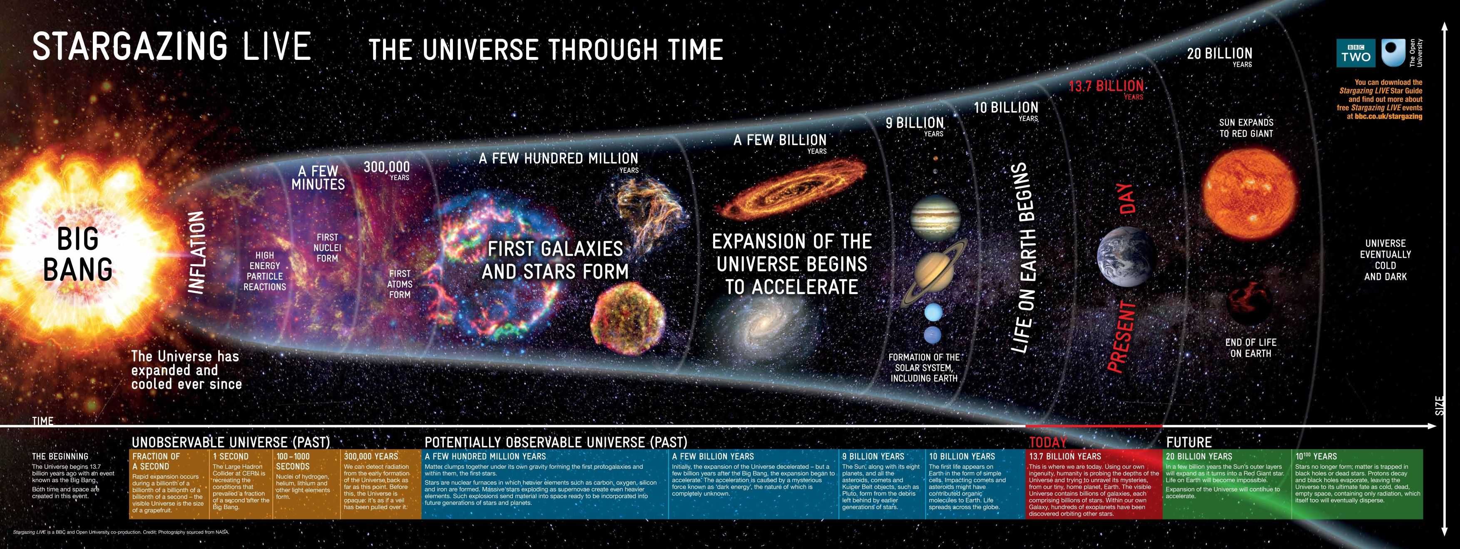
The Big Freeze, The Heat Death,
or the Big Chill
“In this "Big Freeze", the universe ends up uniformly cold, dead and empty.”
Driven by Dark Energy, galaxies continue to get farther apart and the Universe gets colder and colder.”

Slide 45
“So as the Universe continues to expand, galaxies become farther and farther apart,
They grow old and the Universe becomes colder and colder.
“Eventually, planets, stars, and galaxies would be pulled so far apart that the stars would eventually lose access to raw material needed for star formation And thus, the lights would inevitably go out for good.”

Slide 46
“It will continue to get colder and colder until the temperature throughout the universe reaches absolute zero. At absolute zero, all movement stops.
Nothing can exist in such a place, as there is literally no energy.
At all. Anywhere.”
Just black, cold, nothing.

Slide 47
“This is the point at which the universe would reach a maximum state of entropy. Instead of fiery cradles, galaxies would become coffins filled with the remnants of dead stars.
Many scientists (astronomers and physicists alike) believe this is one of the most probable scenarios.”

Slide 48
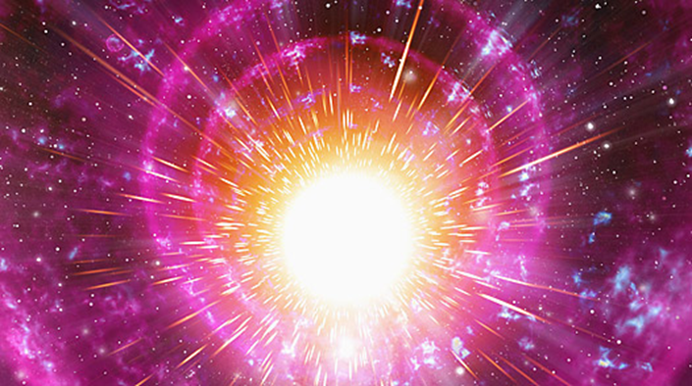
The Big Crunch, The Big Bounce,
Driven by Dark Energy, the Universe expands until it reaches its limit and then begins to collapse until it comes together in the Big Crunch and then there is another Big Bang.

Slide 49
“The Big Crunch is thought to be the direct consequence of the Big Bang. In this model, the expansion of the universe doesn’t continue forever.
After an undetermined amount of time (possibly trillions of years), if the average density of the universe was enough to stop the expansion, the universe would begin the process of collapsing in on itself. Eventually, all of the matter and particles in existence would be pulled together into a super dense state (perhaps even into a black hole-like singularity).”

Slide 50
“Unlike the first two scenarios, this model relies on the geometry of the universe being “closed” (like the surface of a sphere). An event like this would be like a single breath: the universe would “breathe out” the Big Bang, and “breathe in” the Big Crunch.”

Slide 51
“Under the Big Crunch, … the gravitational attraction of stars and galaxies would one day start pulling the entire universe together again. The process would run sort of like a backward Big Bang, with galactic clusters crashing and merging, then stars and planets fusing together, and finally, everything in the universe would form a dense spot of infinitely small size once again.”

Slide 52
The Big Change
“The properties of fundamental particles like electrons and quarks could be entirely different, radically rewriting the rules of chemistry and perhaps preventing atoms from forming.”

Slide 53
“Humans, planets and even the stars themselves would be destroyed in this Big Change. In a 1980 paper, Physicists Sidney Coleman and Frank de Luccia called it "the ultimate ecological catastrophe".
Adding insult to injury, dark energy would probably behave differently after the Big Change.
Rather than driving the universe to expand faster,
dark energy might instead
pull the universe in on itself,
collapsing into a Big Crunch.”

Slide 54
The Big Rip
“Driven by Dark Energy, the Universe expands until the fabric of Space rips.
“One theory of our ultimate end relies on the assumption that this expansion will continue indefinitely — until the galaxies, stars, planets, and matter (even the subatomic building blocks that comprise all matter) can no longer hold themselves together. At which point, they rip apart.
This theory is called (surprise!) the Big Rip.”

Slide 55
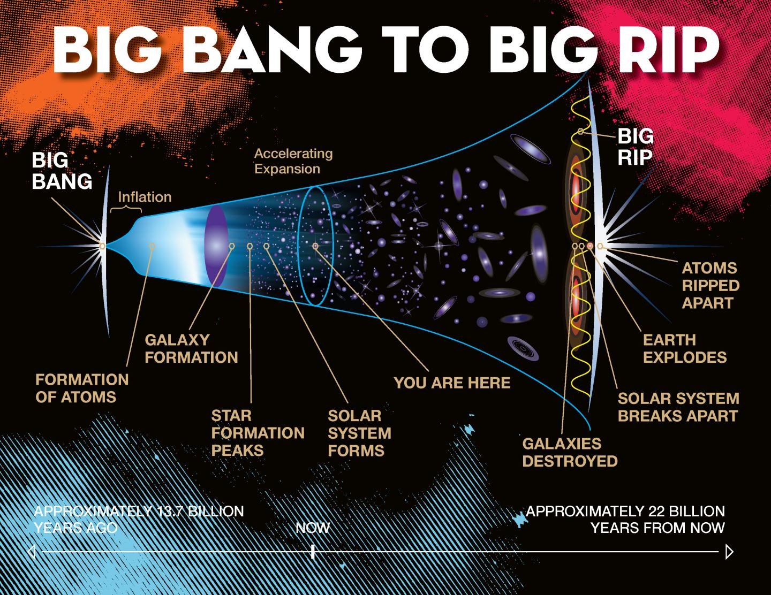

Slide 56
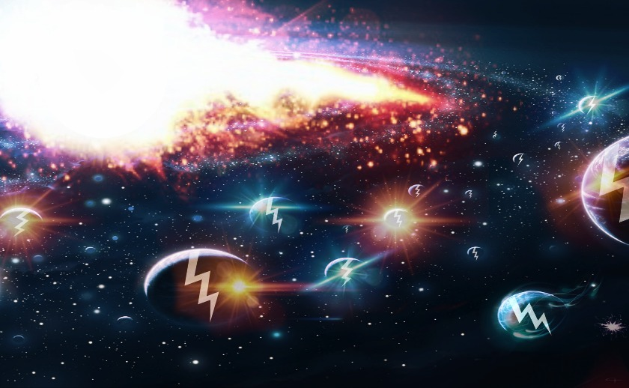

Slide 57
The Big Slurp
[Swallowed by another Universe]
“This theory surfaced just a few years ago, after revelations were released about the true nature of the Higgs Boson, which is the particle that plays a role in granting mass to elementary particles.
In this model, if the Higgs Boson particle weighs in at a certain mass, it could indicate that the vacuum of our universe may be inherently unstable, perhaps existing in a perpetual “metastable’ state — something that has been discussed at length many times before.”

Slide 58
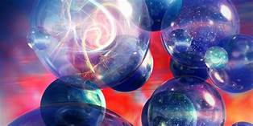
“If this were the case, our universe might experience a catastrophic event when a “bubble” from another alternate universe appears in ours. If this bubble exists in a lower-energy state than our bubble. the universe could be completely annihilated.”

Slide 59
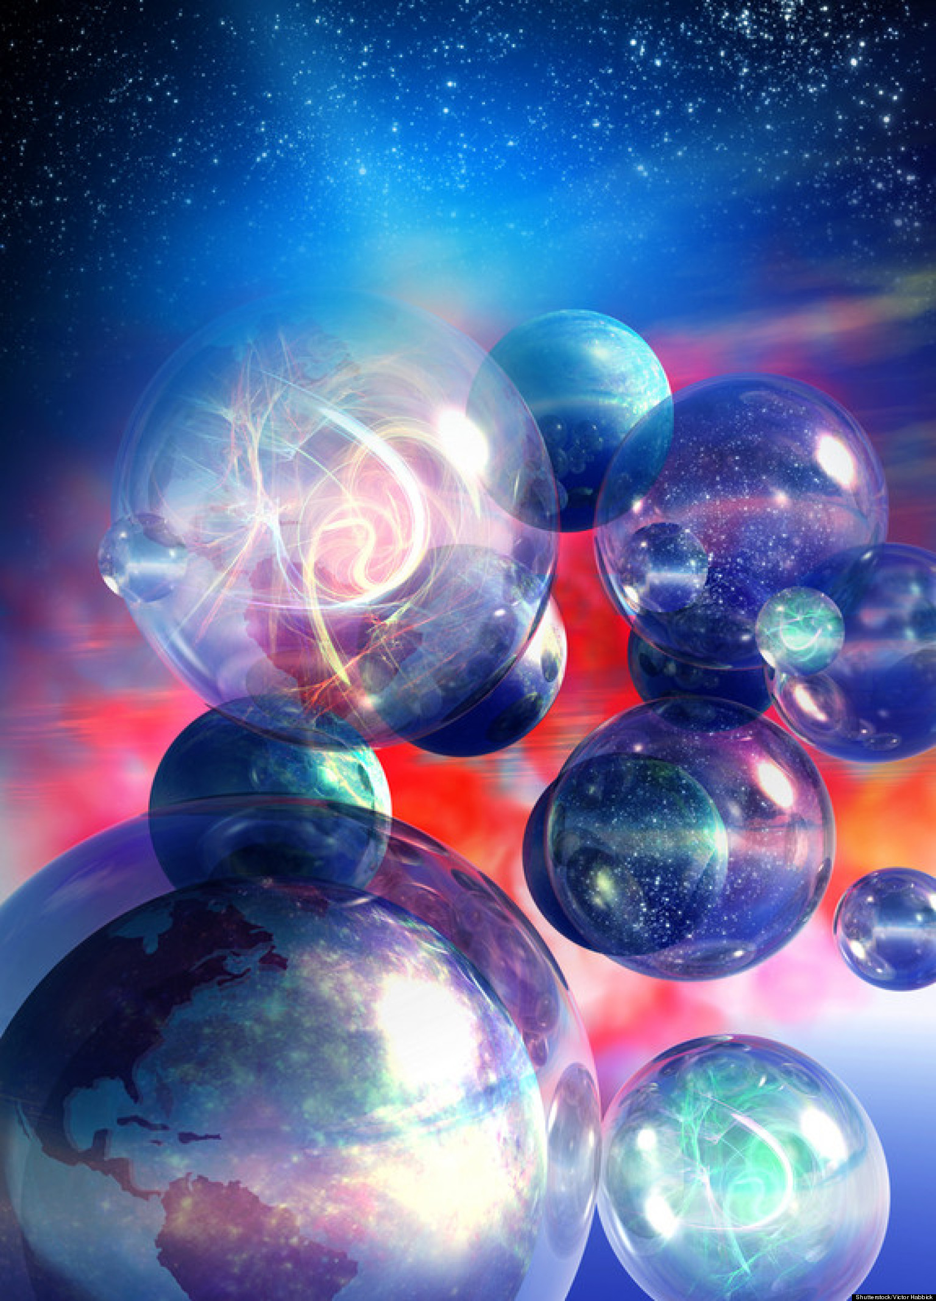
“In essence, it would cause all the protons in all matter in our universe to decay. By proxy, so would we. If that doesn’t sound unpleasant enough, this sort of a vacuum metastability event could happen at virtually any moment, anywhere in our universe. The bubble could pop over and start expanding at light-speed until it swallowed us entirely.”

