Slide 1


Emergency Services:
Search & Rescue, Disasters, Homeland Security,
Cadet Programs and Aerospace Education

Slide 2
Civil Air Patrol was created by Act of Congress to serve the nation through
Emergency Services
Aerospace Education
Cadet Programs

Slide 3


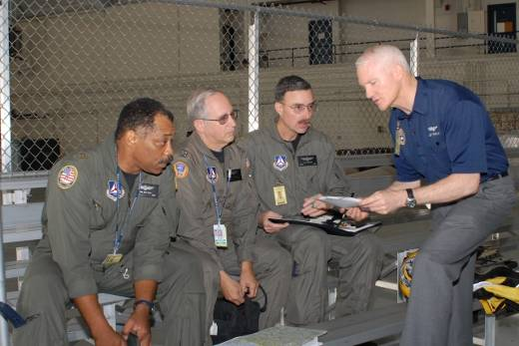
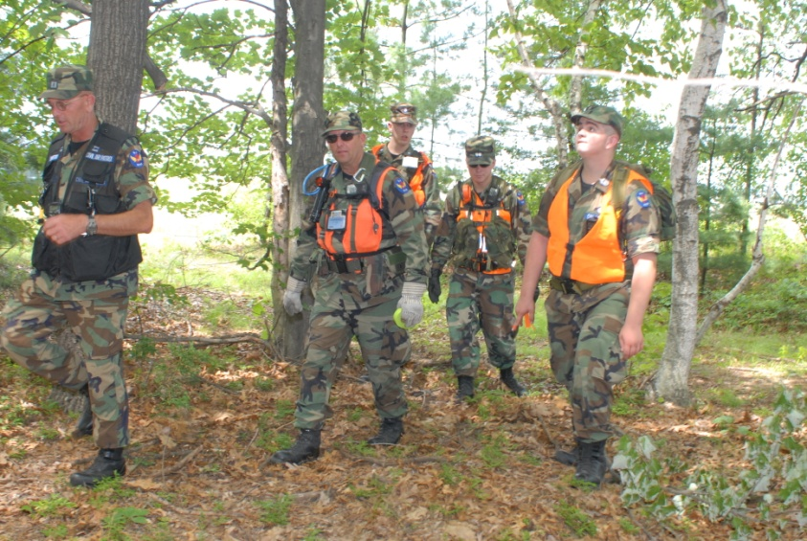
Civil Air Patrol Missions
Emergency Services
Search and Rescue
Disaster Relief
Homeland Security
Counterdrug Missions
Humanitarian Services
Air Force ROTC Flights
        Orientation Flights
        Teacher Orientation Flights
        Cadet Programs
        Aerospace Education
Notes:
3
3
So, what does CAP do?
We have three core missions: Emergency Services, Cadet Programs and Aerospace Education
Best known for our work in search and rescue and disaster relief missions, CAP is expanding its role in the 21st century to include an increasing number of homeland security operations and exercises. CAP also performs counterdrug reconnaissance missions at the request of law enforcement agencies and can do radiological monitoring and damage assessment. CAP members undergo rigorous training to perform these missions safely and cost-effectively.

Slide 4
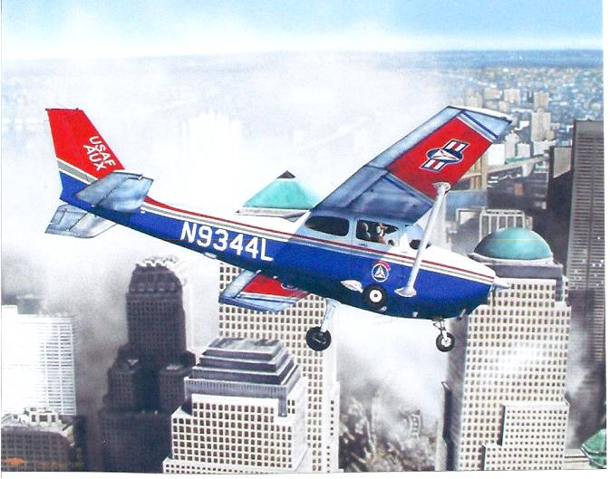
We were there September 11, 2001
Painting by Diane Kraus

Slide 5
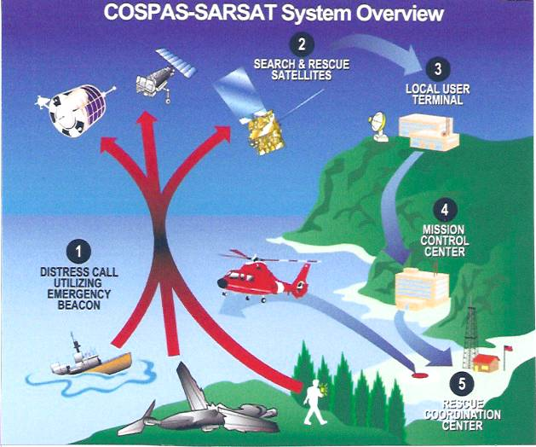

Slide 6
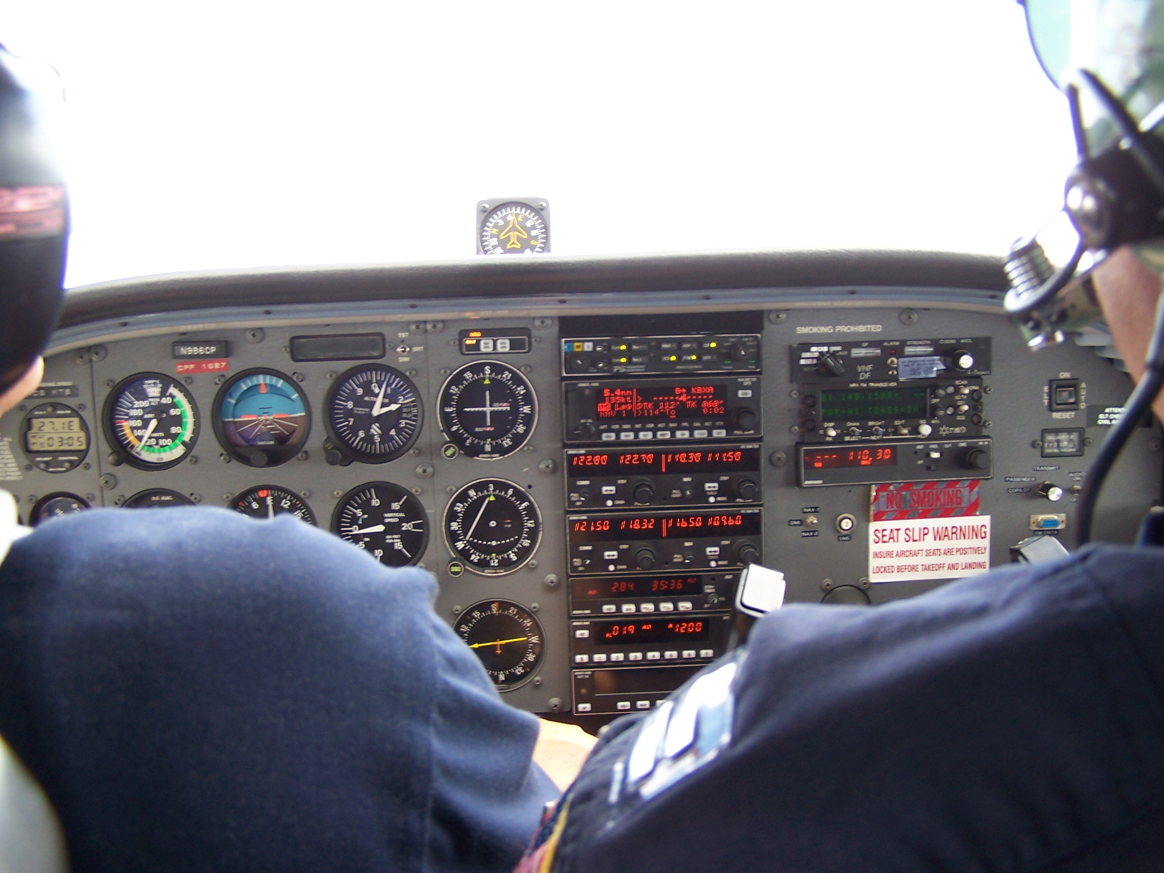
On a rescue flight

Slide 7


Slide 8
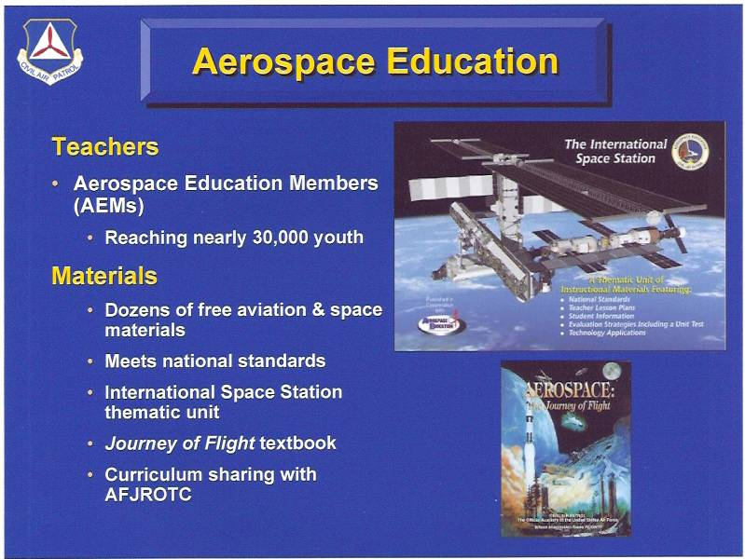

Slide 9
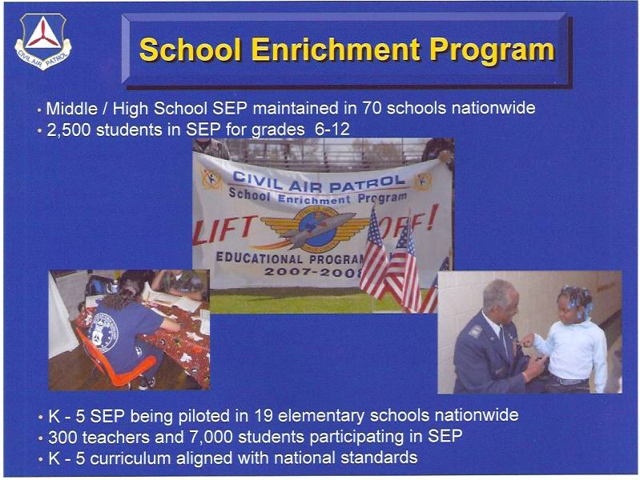

Slide 10
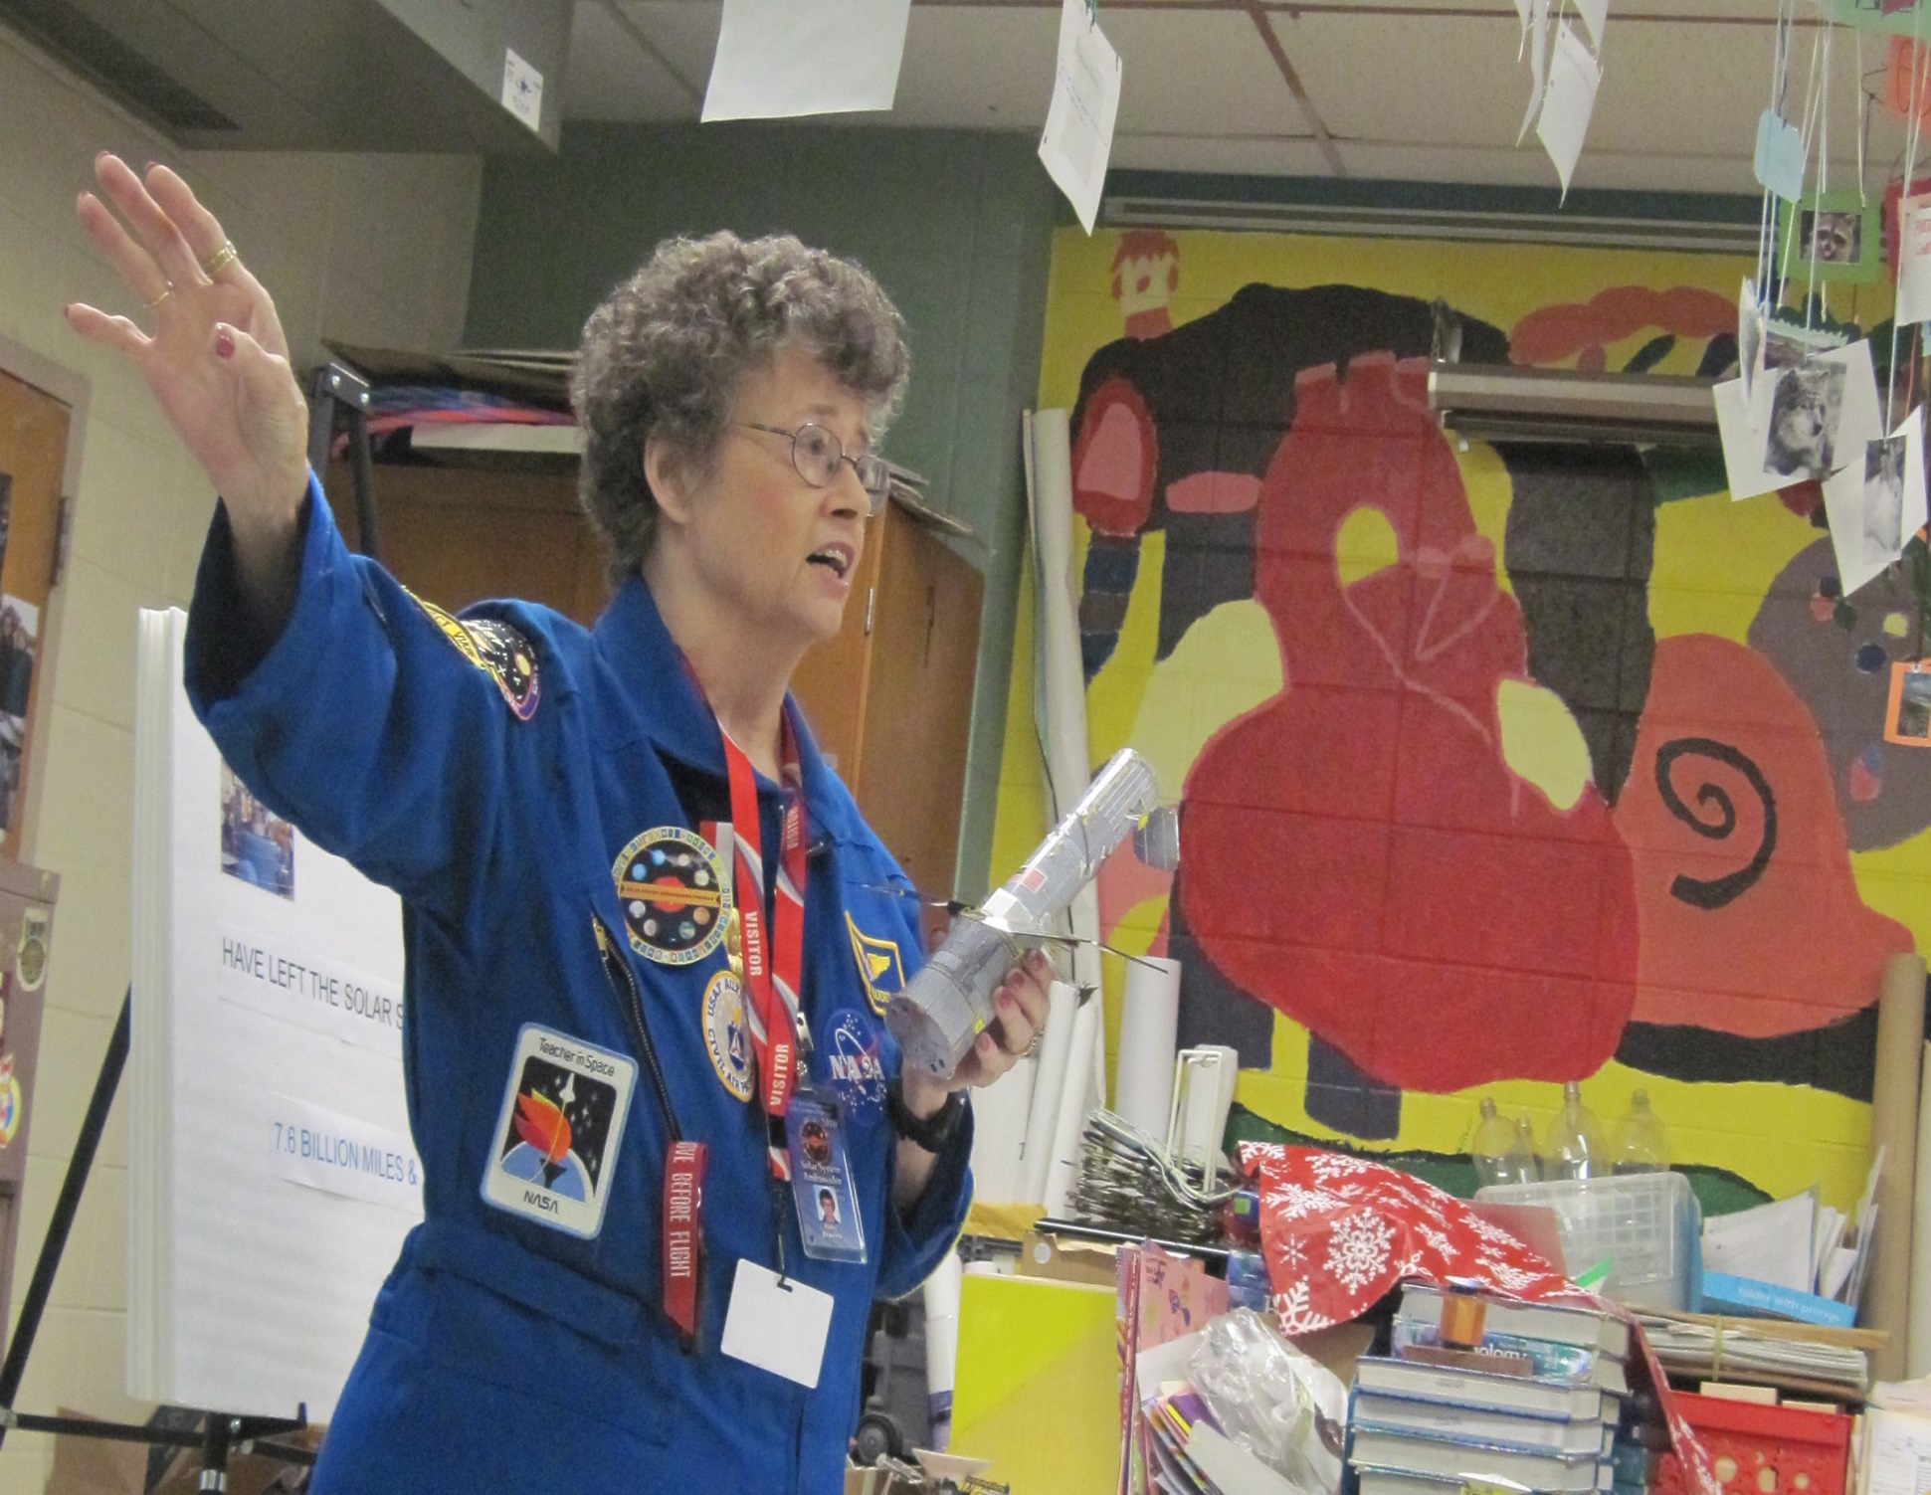
Solar System Ambassador
Free School Visits

Slide 11
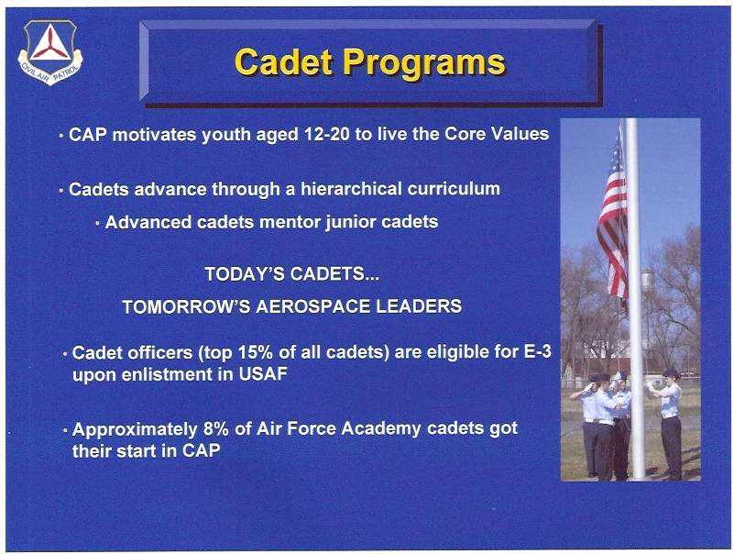

Slide 12
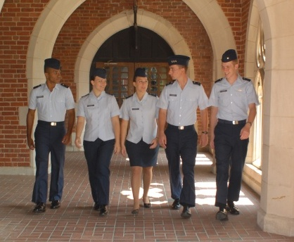
CAP Missions
Cadet Programs
Leadership Skills
Aerospace Education
Physical Fitness
Character Development
Activities
Notes:
12
12
Through their experiences as CAP cadets, young people develop into responsible citizens and become tomorrow's aerospace leaders.
CAP introduces CAP Cadets to Air Force perspectives on leadership through classroom instruction, mentoring and hands-on learning. The fundamentals of aerospace science are learned in the classroom and through first-hand experience.
CAP offers weekend and summer activities that allow cadets to fly, learn to lead, explore aerospace careers, assist in CAP’s emergency services missions and make friends.
The leadership skills, self-confidence, and discipline cadets gain through CAP prepares them to achieve whatever goals they set for themselves in life.

Slide 13
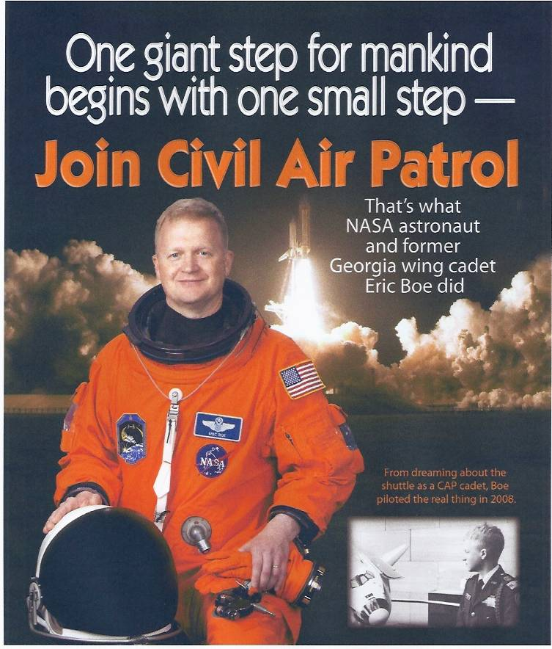

Slide 14
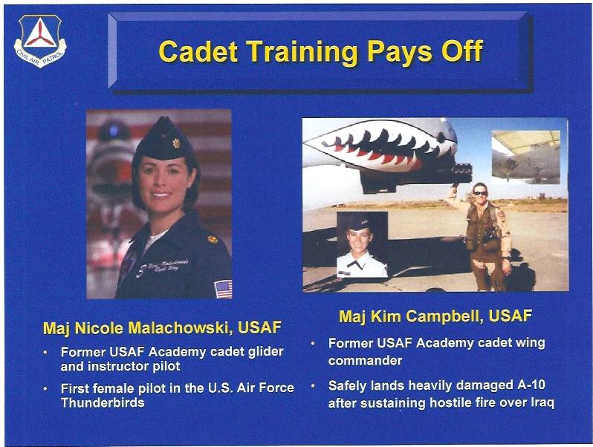

Slide 15
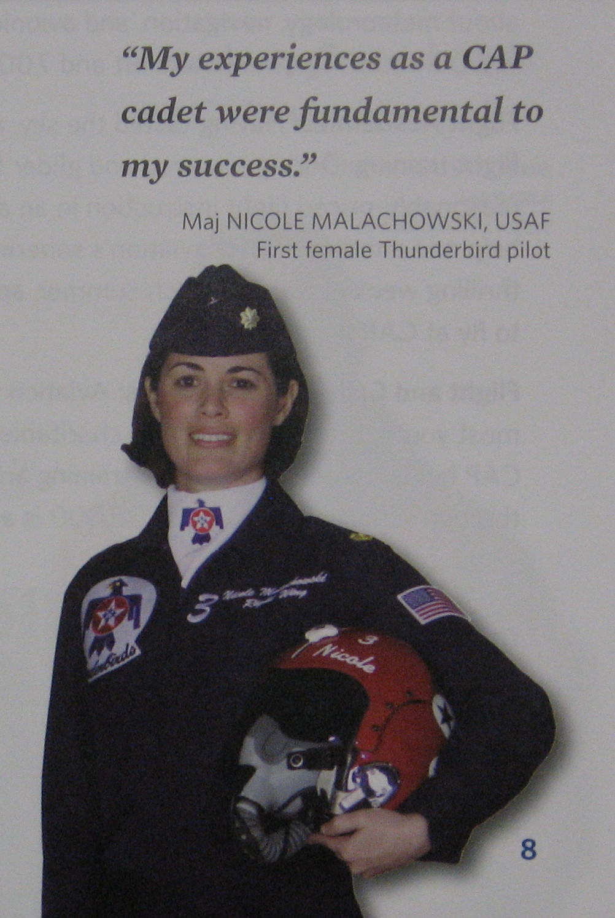
“My experiences as a CAP Cadet were fundamental to my success.”

Slide 16
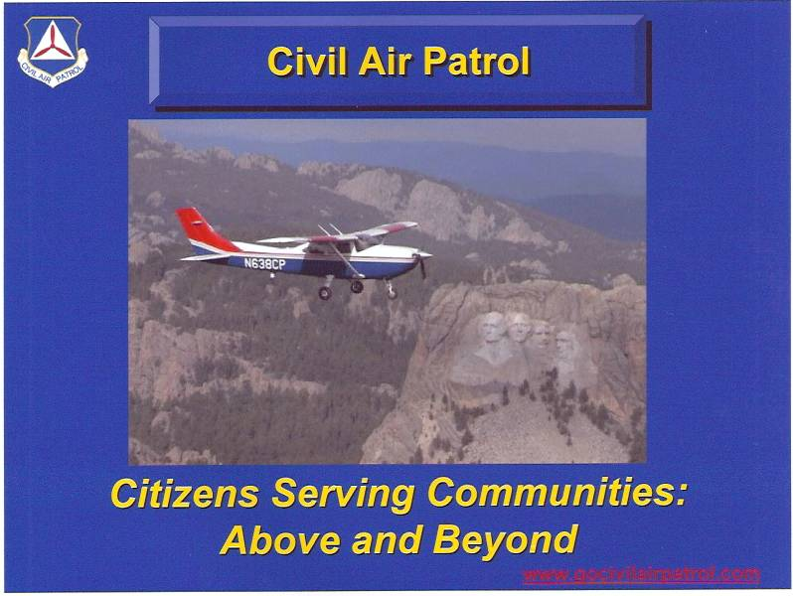

Slide 17
Leadership

Slide 18
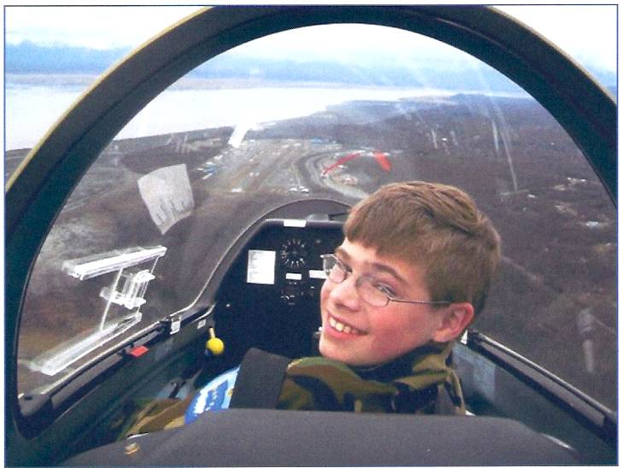
Come fly with us !

Slide 19


