Slide 1
Aerospace Education in Louisiana Wing is HOT !!

Slide 2
Introducing
The Gertrude Beauford Memorial Scholarship

Slide 3
You can choose:
National Flight Academy in Pensacola
or Advanced Space Camp
or Robotics Camp
or Family Space Camp in Huntsville

Slide 4
Who was Gertrude Beauford ?
She was
Lt. Col. Kathy Beauford’s
Mom

Slide 5
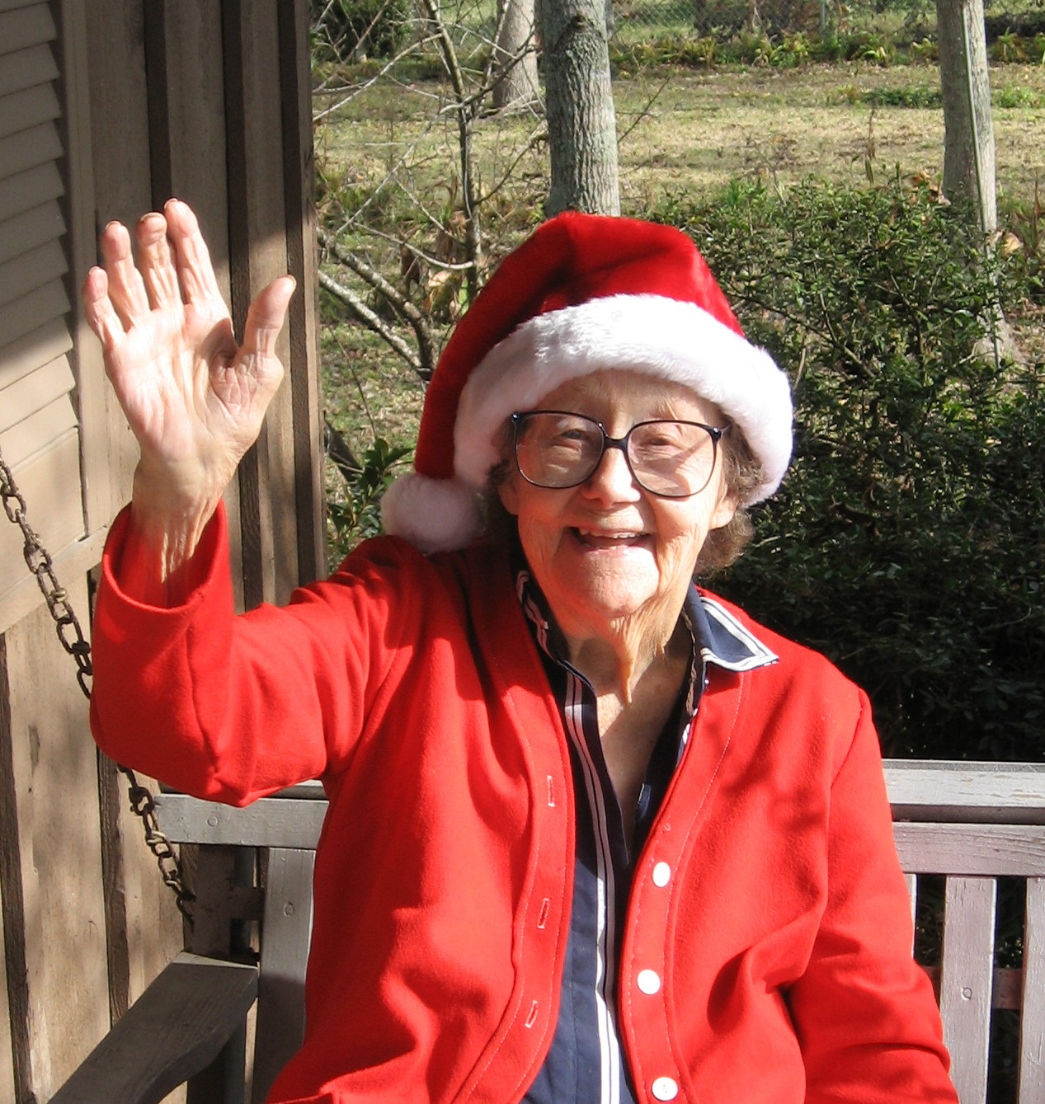
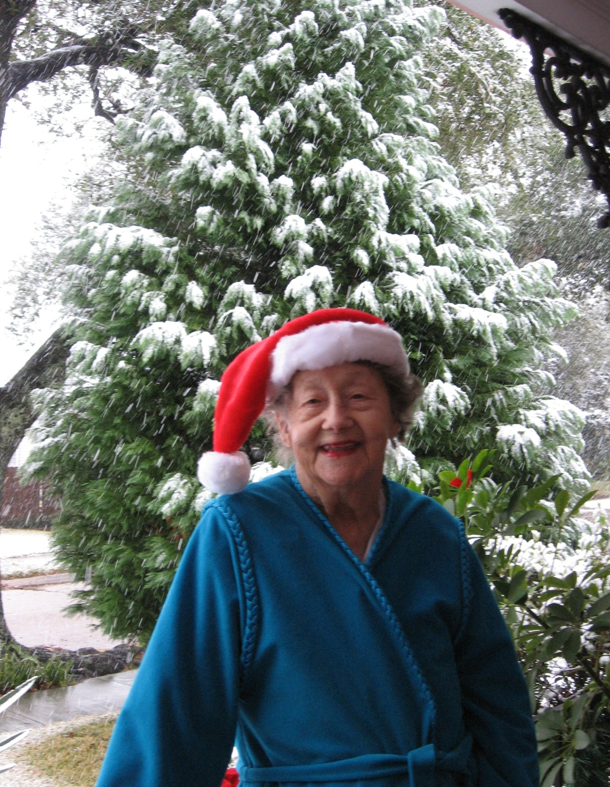
Who passed away at the age of 100 !

Slide 6
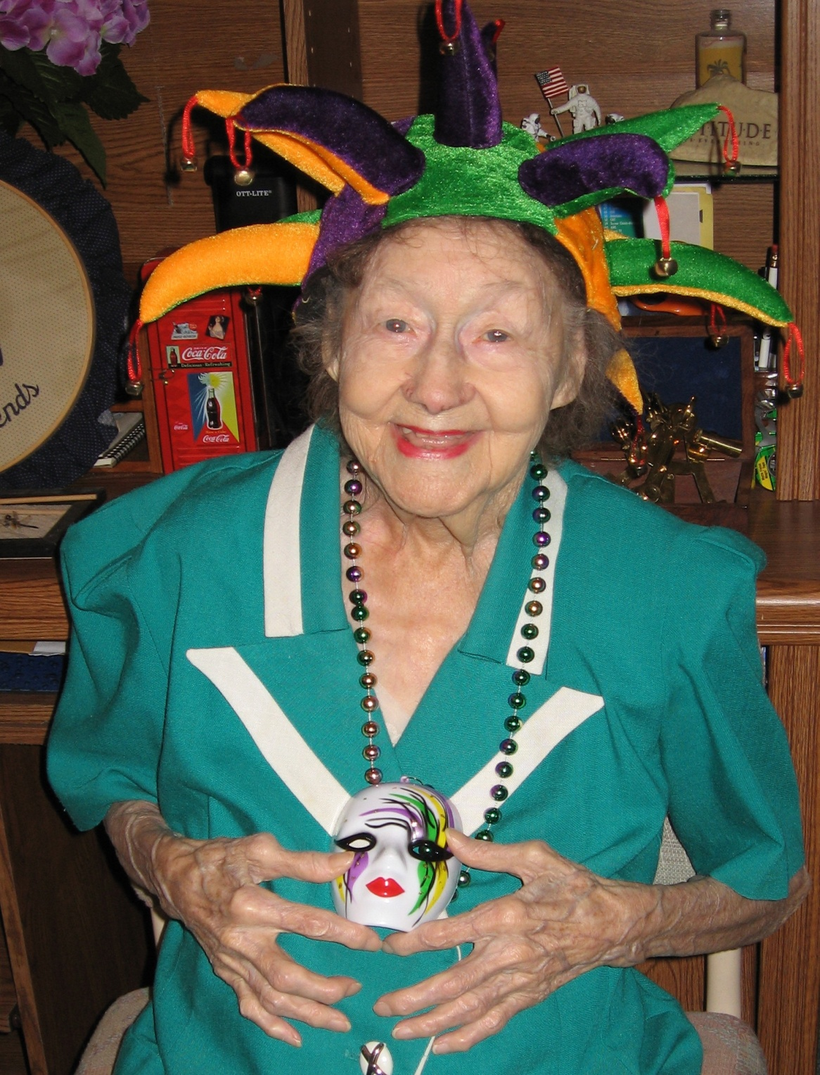
She was always so proud of Lt. Col. Beauford’s CAP activities --- even though she cried when the Colonel went away to a CAP SAREX or encampment.

Slide 7
The Scholarship is a reward in recognition of your achievements in CAP and your community.
You must have earned the grade of
Sergeant or above.

Slide 8
Space Camp?
Where: The U.S. Space & Rocket Center in Huntsville, Alabama
When: Year round
How long? One week

Slide 9
What does the Scholarship to Space Camp include?
Airfare
Tuition, Room, and Meals
Transportation from Huntsville Airport to Space Camp & back
$20 for the Gift Shop and a
$20 for wheelchair assistance for your suitcase and guide
$90 Flightsuit

Slide 10
What does the Scholarship to the
National Flight Academy include?
The “Cruise” includes 6 days and 5 nights.
The Scholarship includes tuition, room, meals, and transportation and $20 for wheelchair assistance for your suitcase and guide.

Slide 11
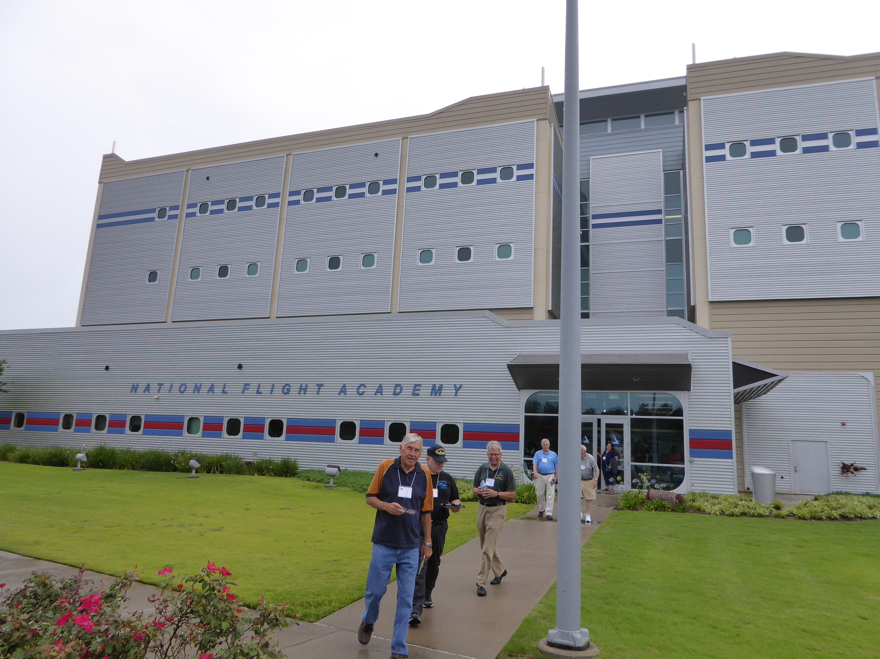
The National Flight Academy is a million dollar replica of an Aircraft Carrier, faithfully designed from halls to command center to bunks.
Announcing a new opportunity for the
Gertrude Beauford Memorial Scholarship:
National Flight Academy
Pensacola, Florida

Slide 12
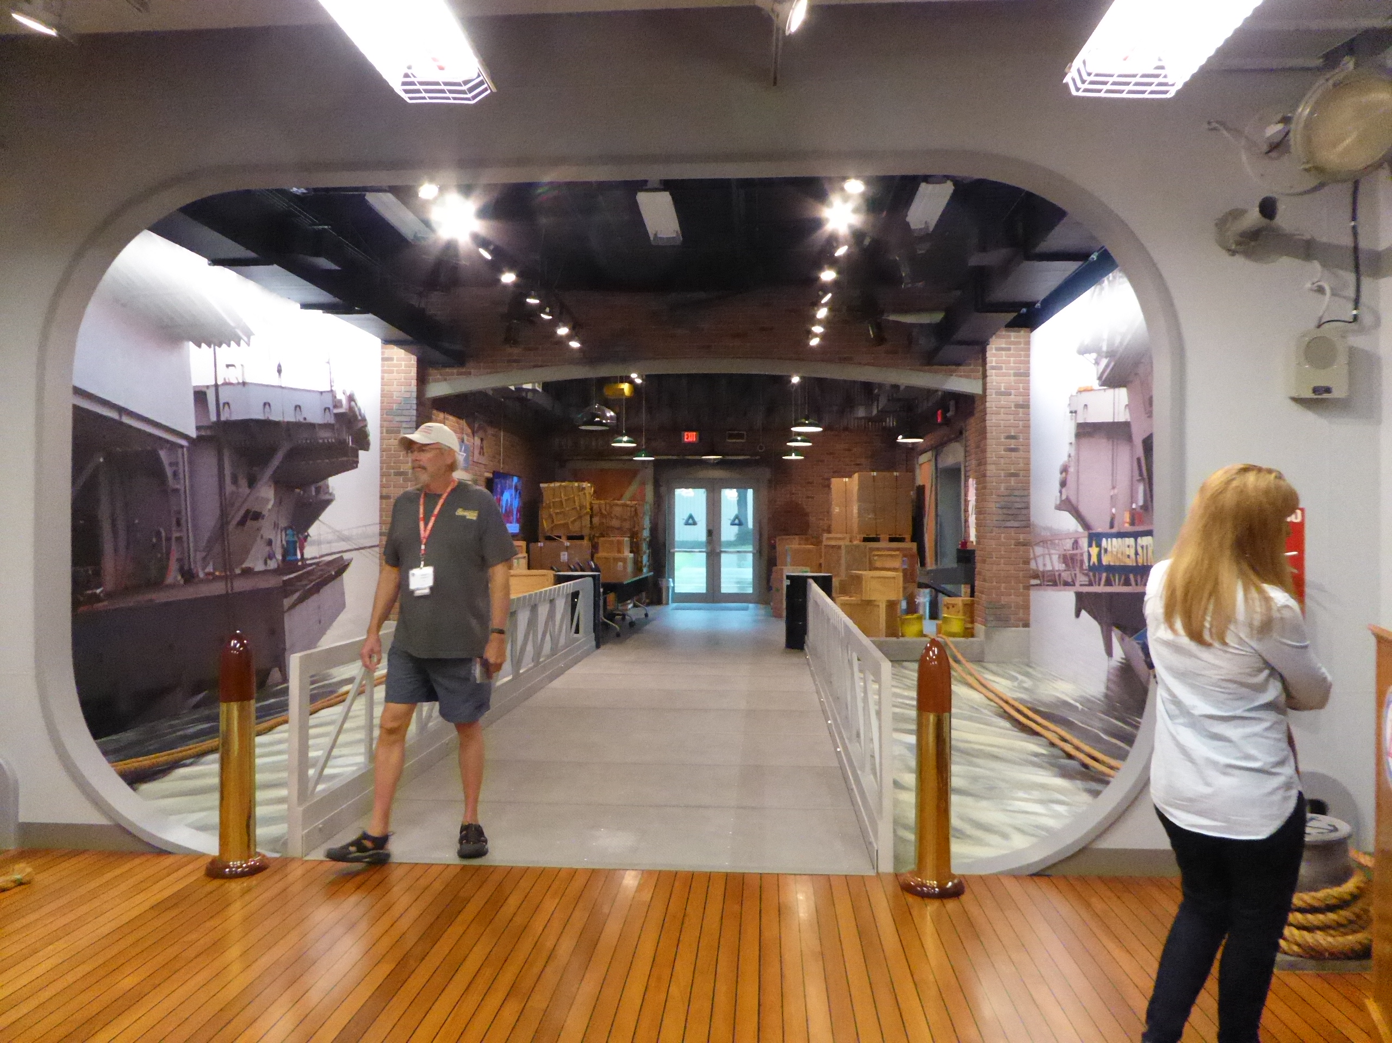
Welcome Aboard

Slide 13
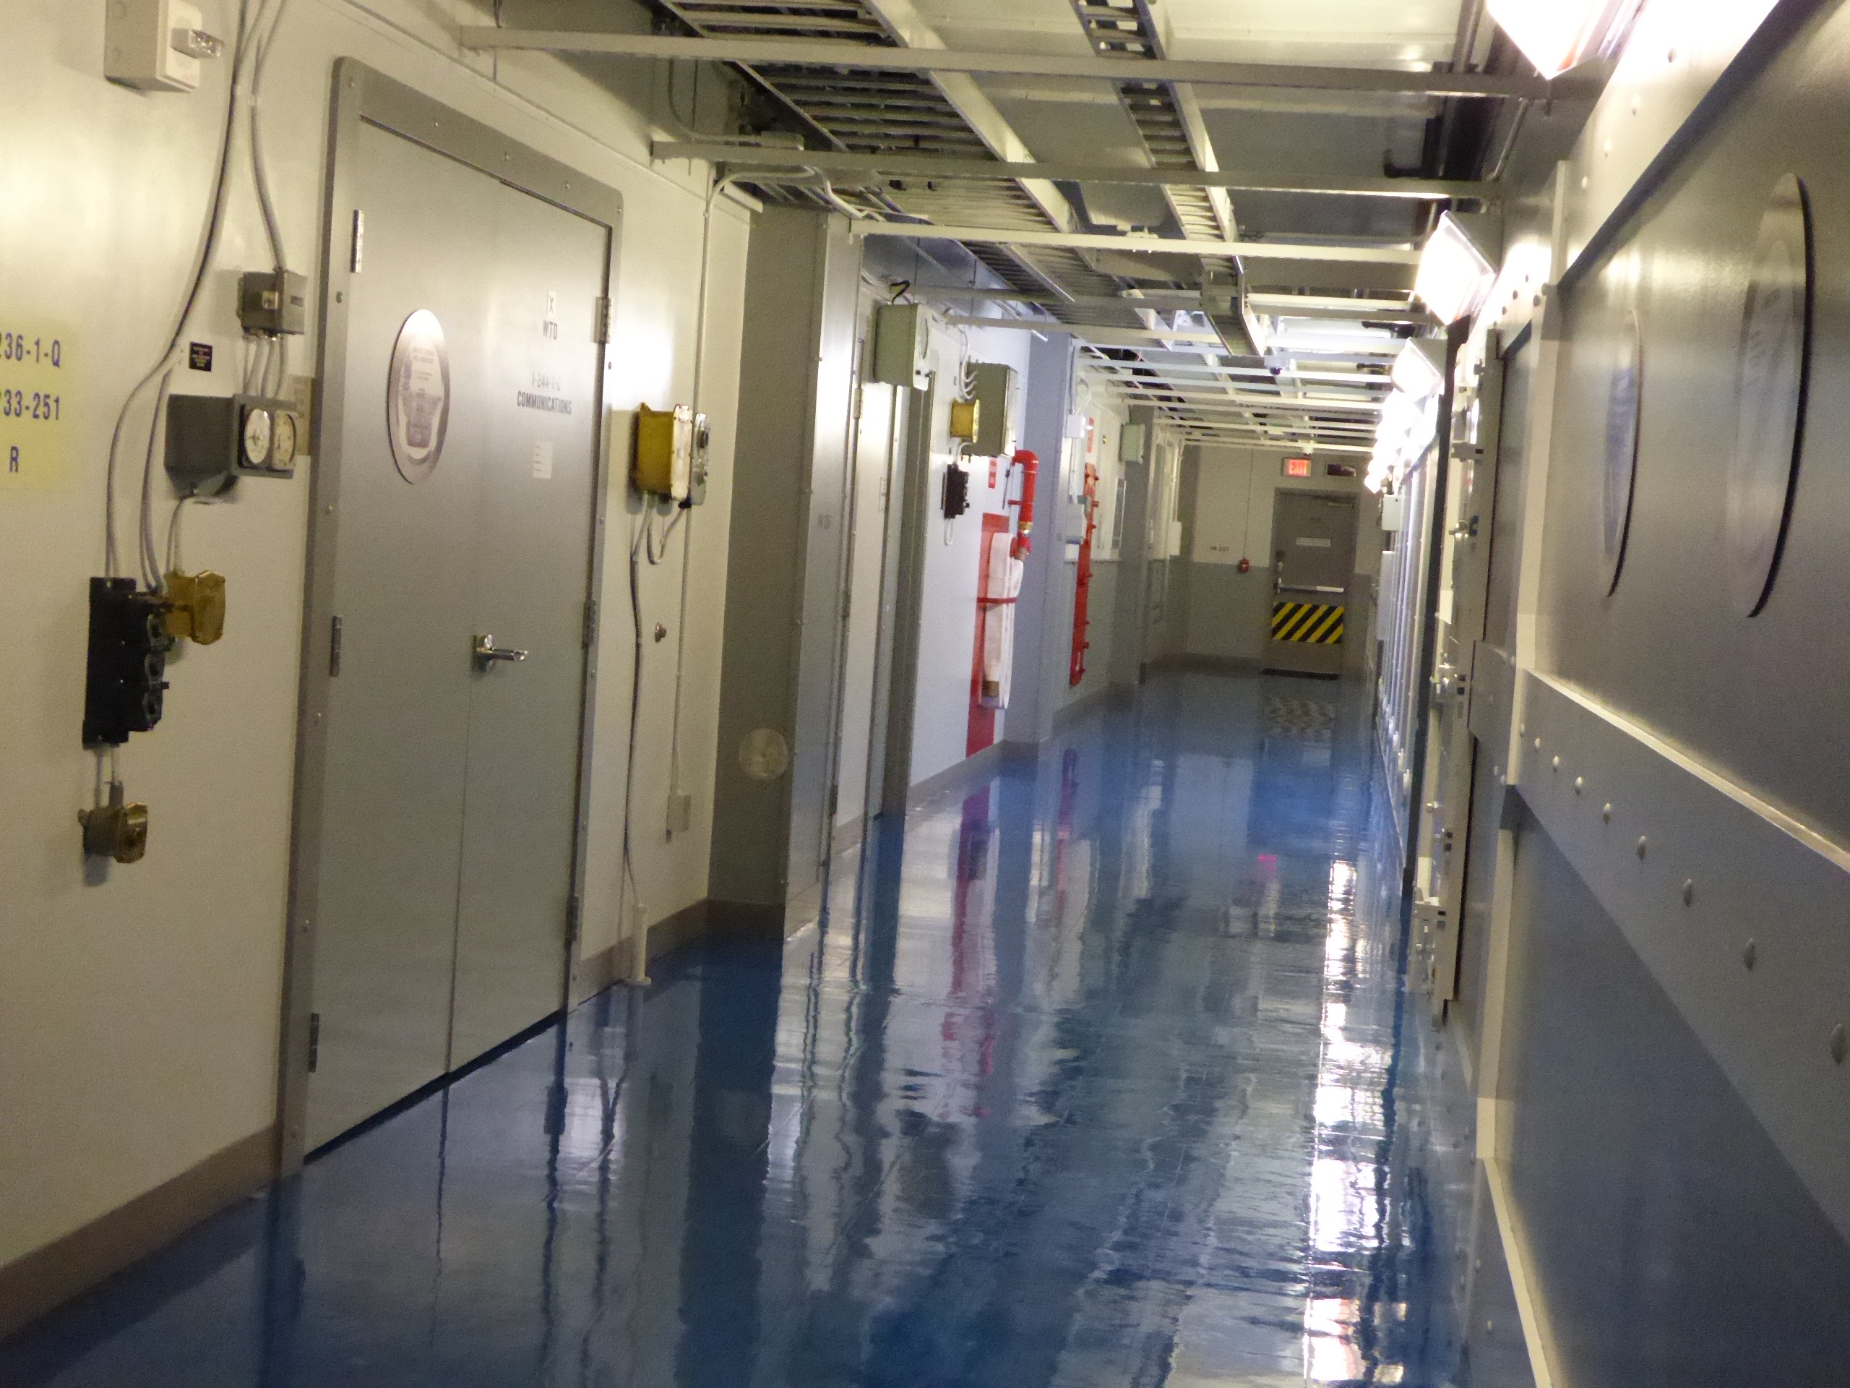
Every section is like a real aircraft carrier

Slide 14
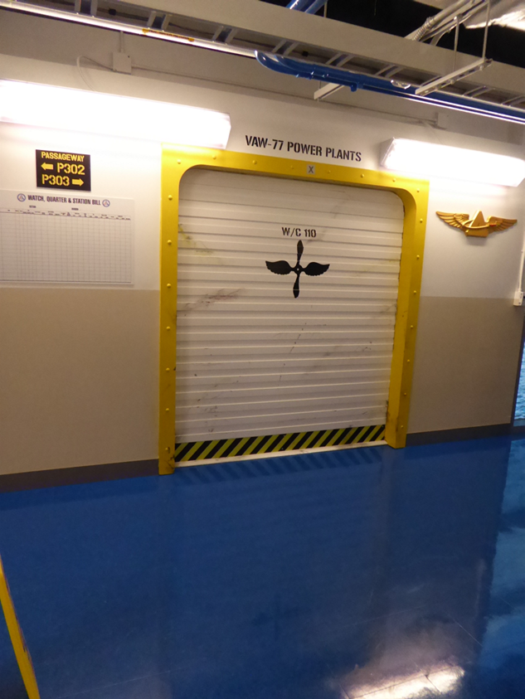
It is a
“dream
Walk.”

Slide 15
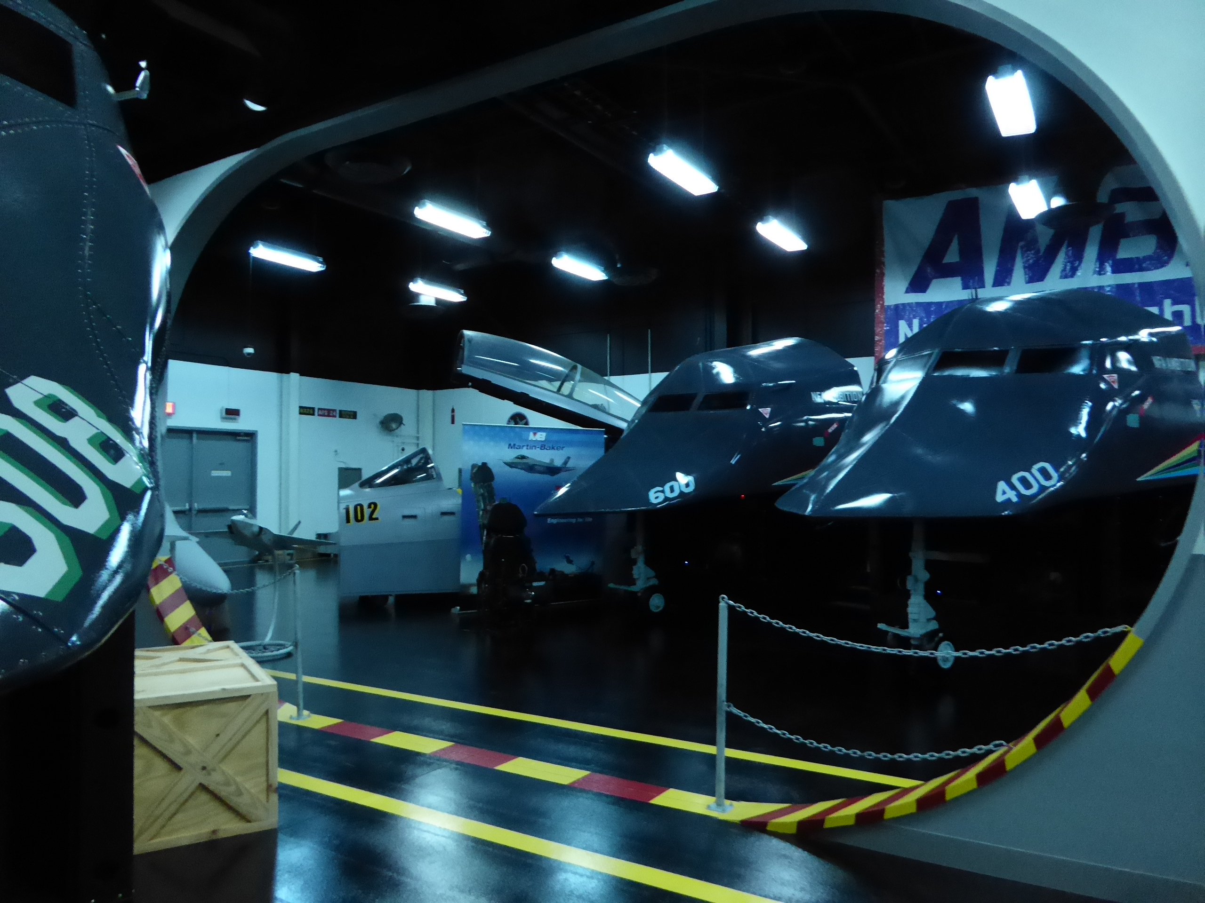
Nine flight simulators

Slide 16
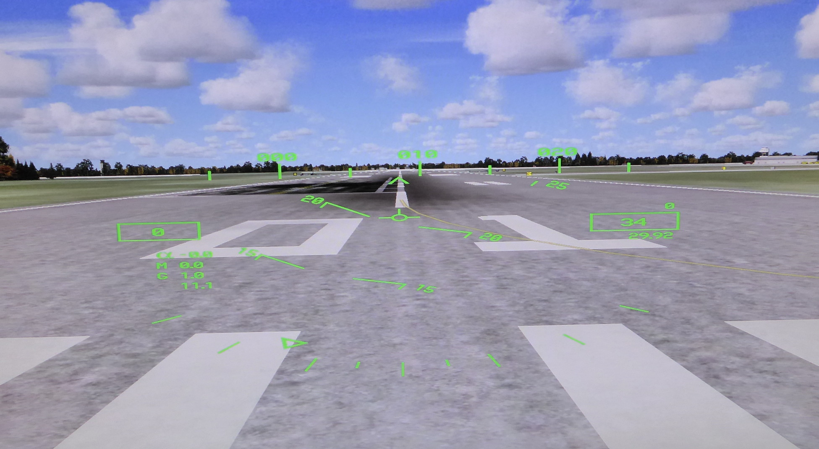
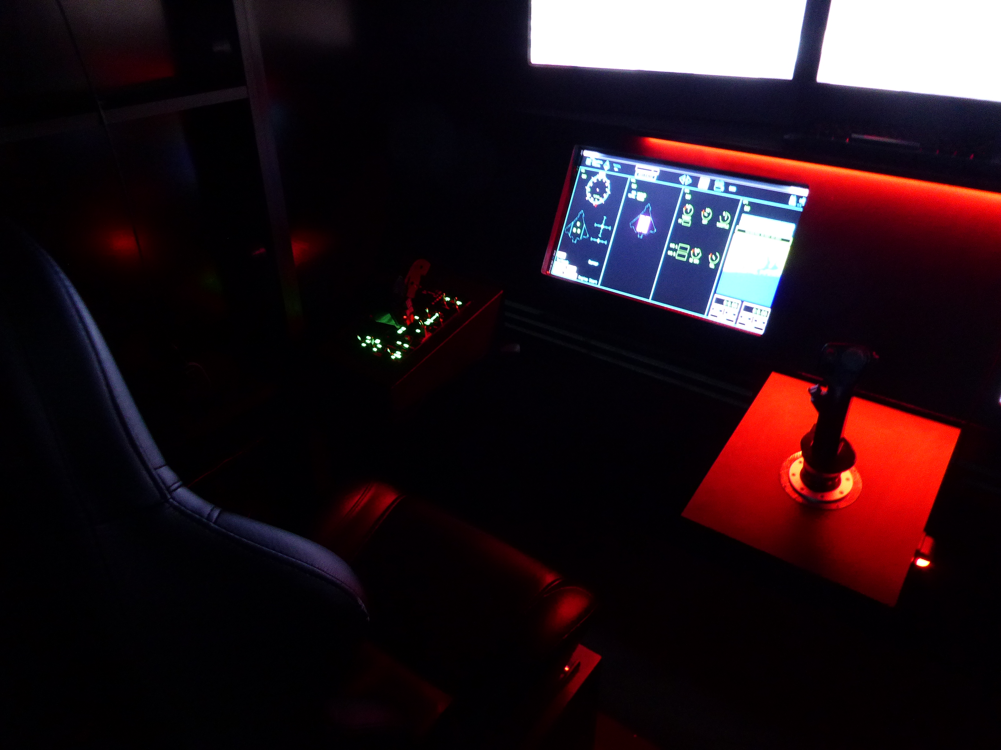
Cockpit

Slide 17
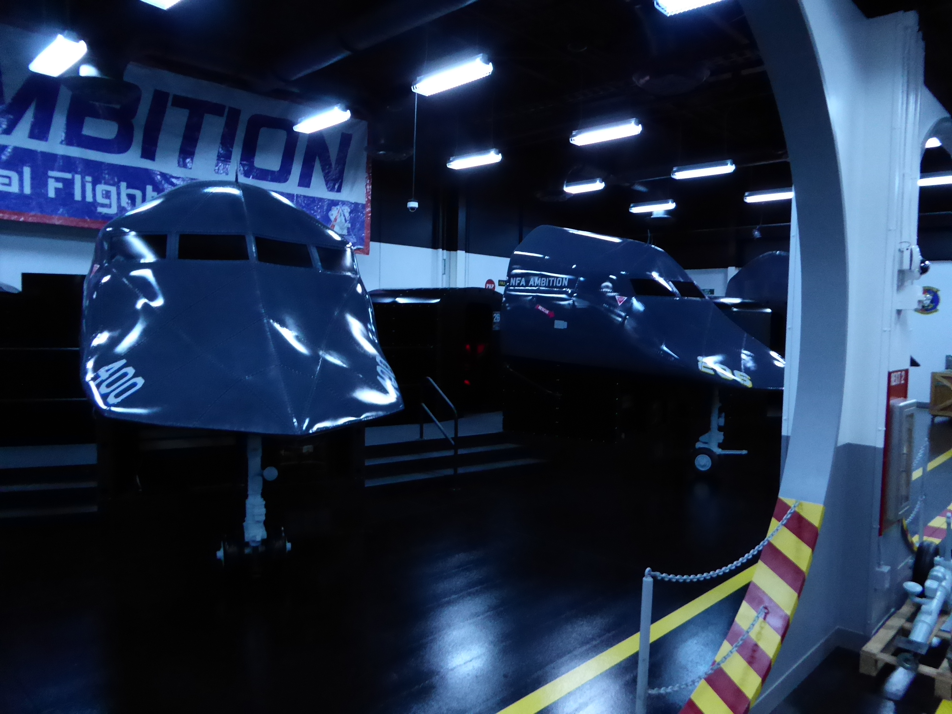
Can you see yourself here?

Slide 18
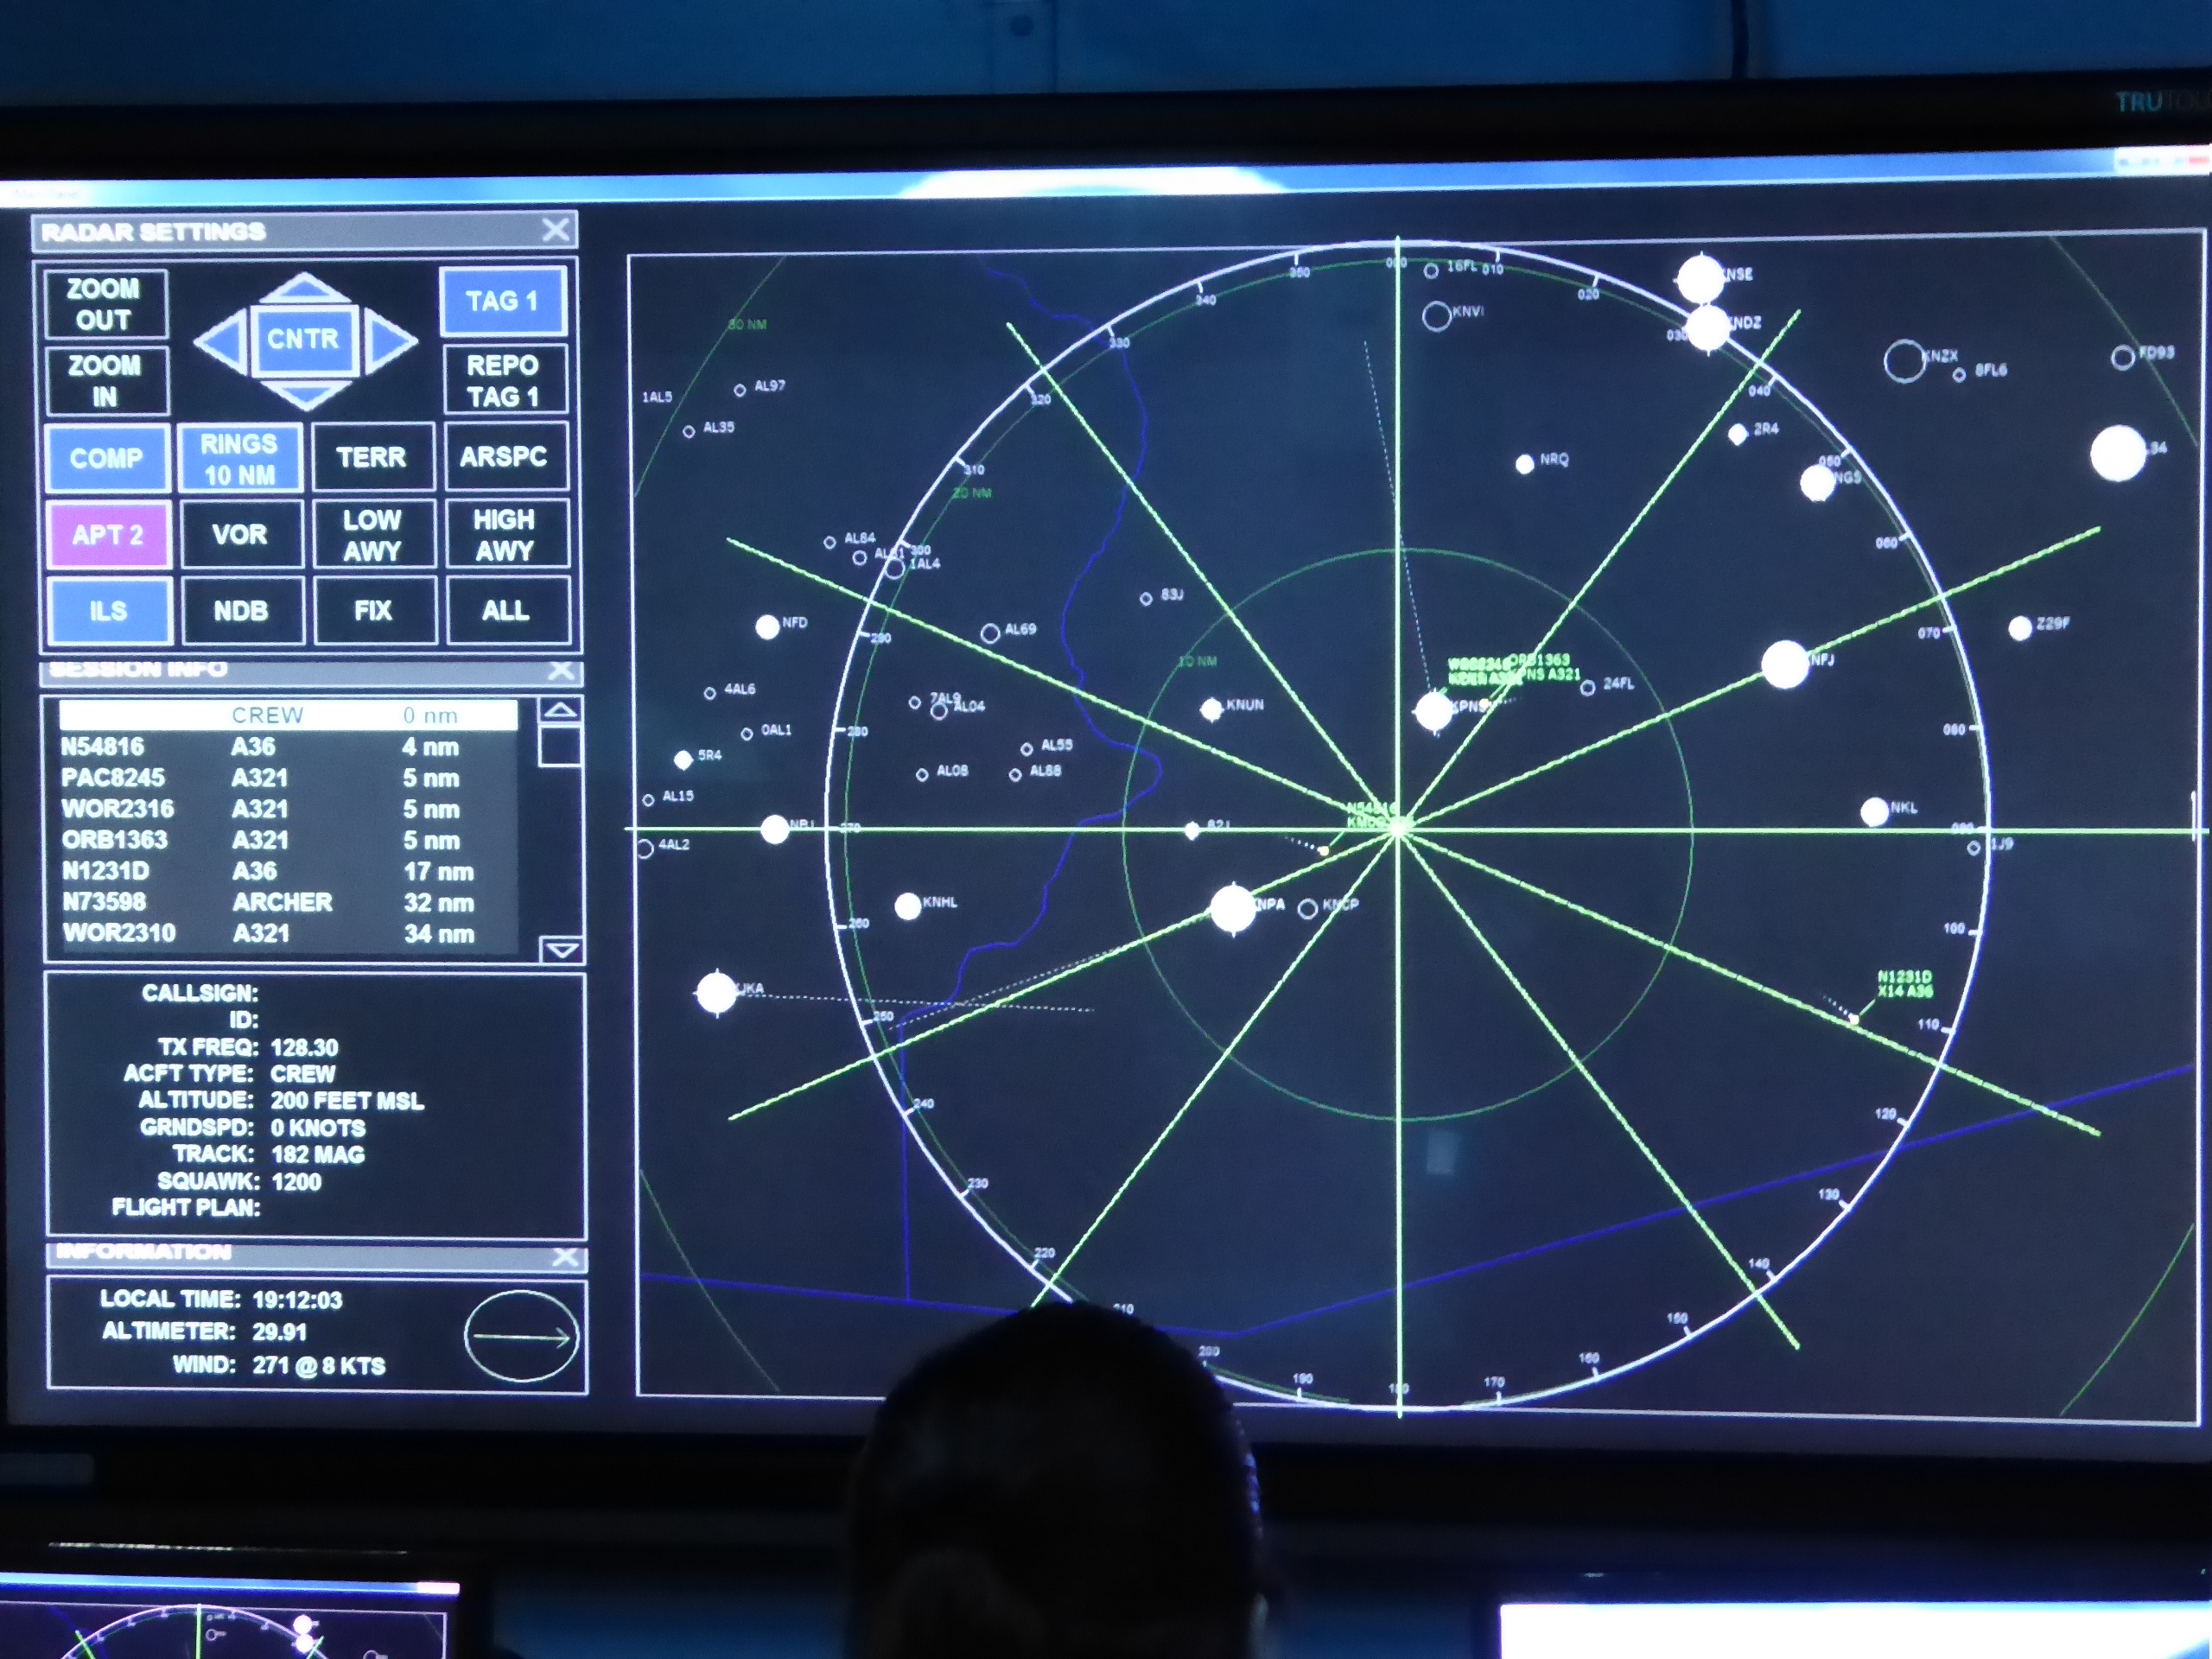
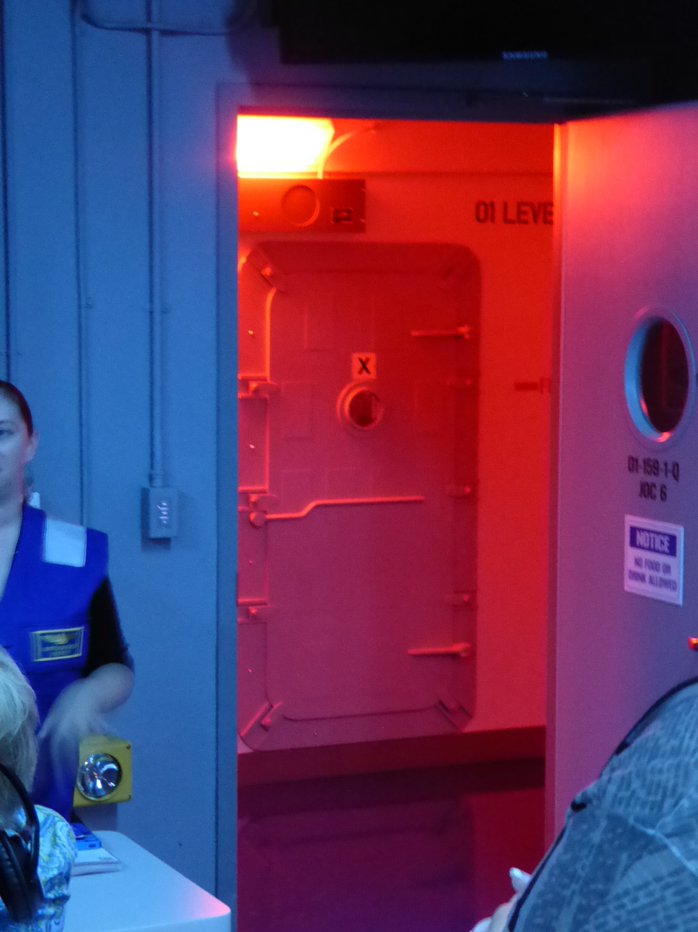
Flight control

Slide 19
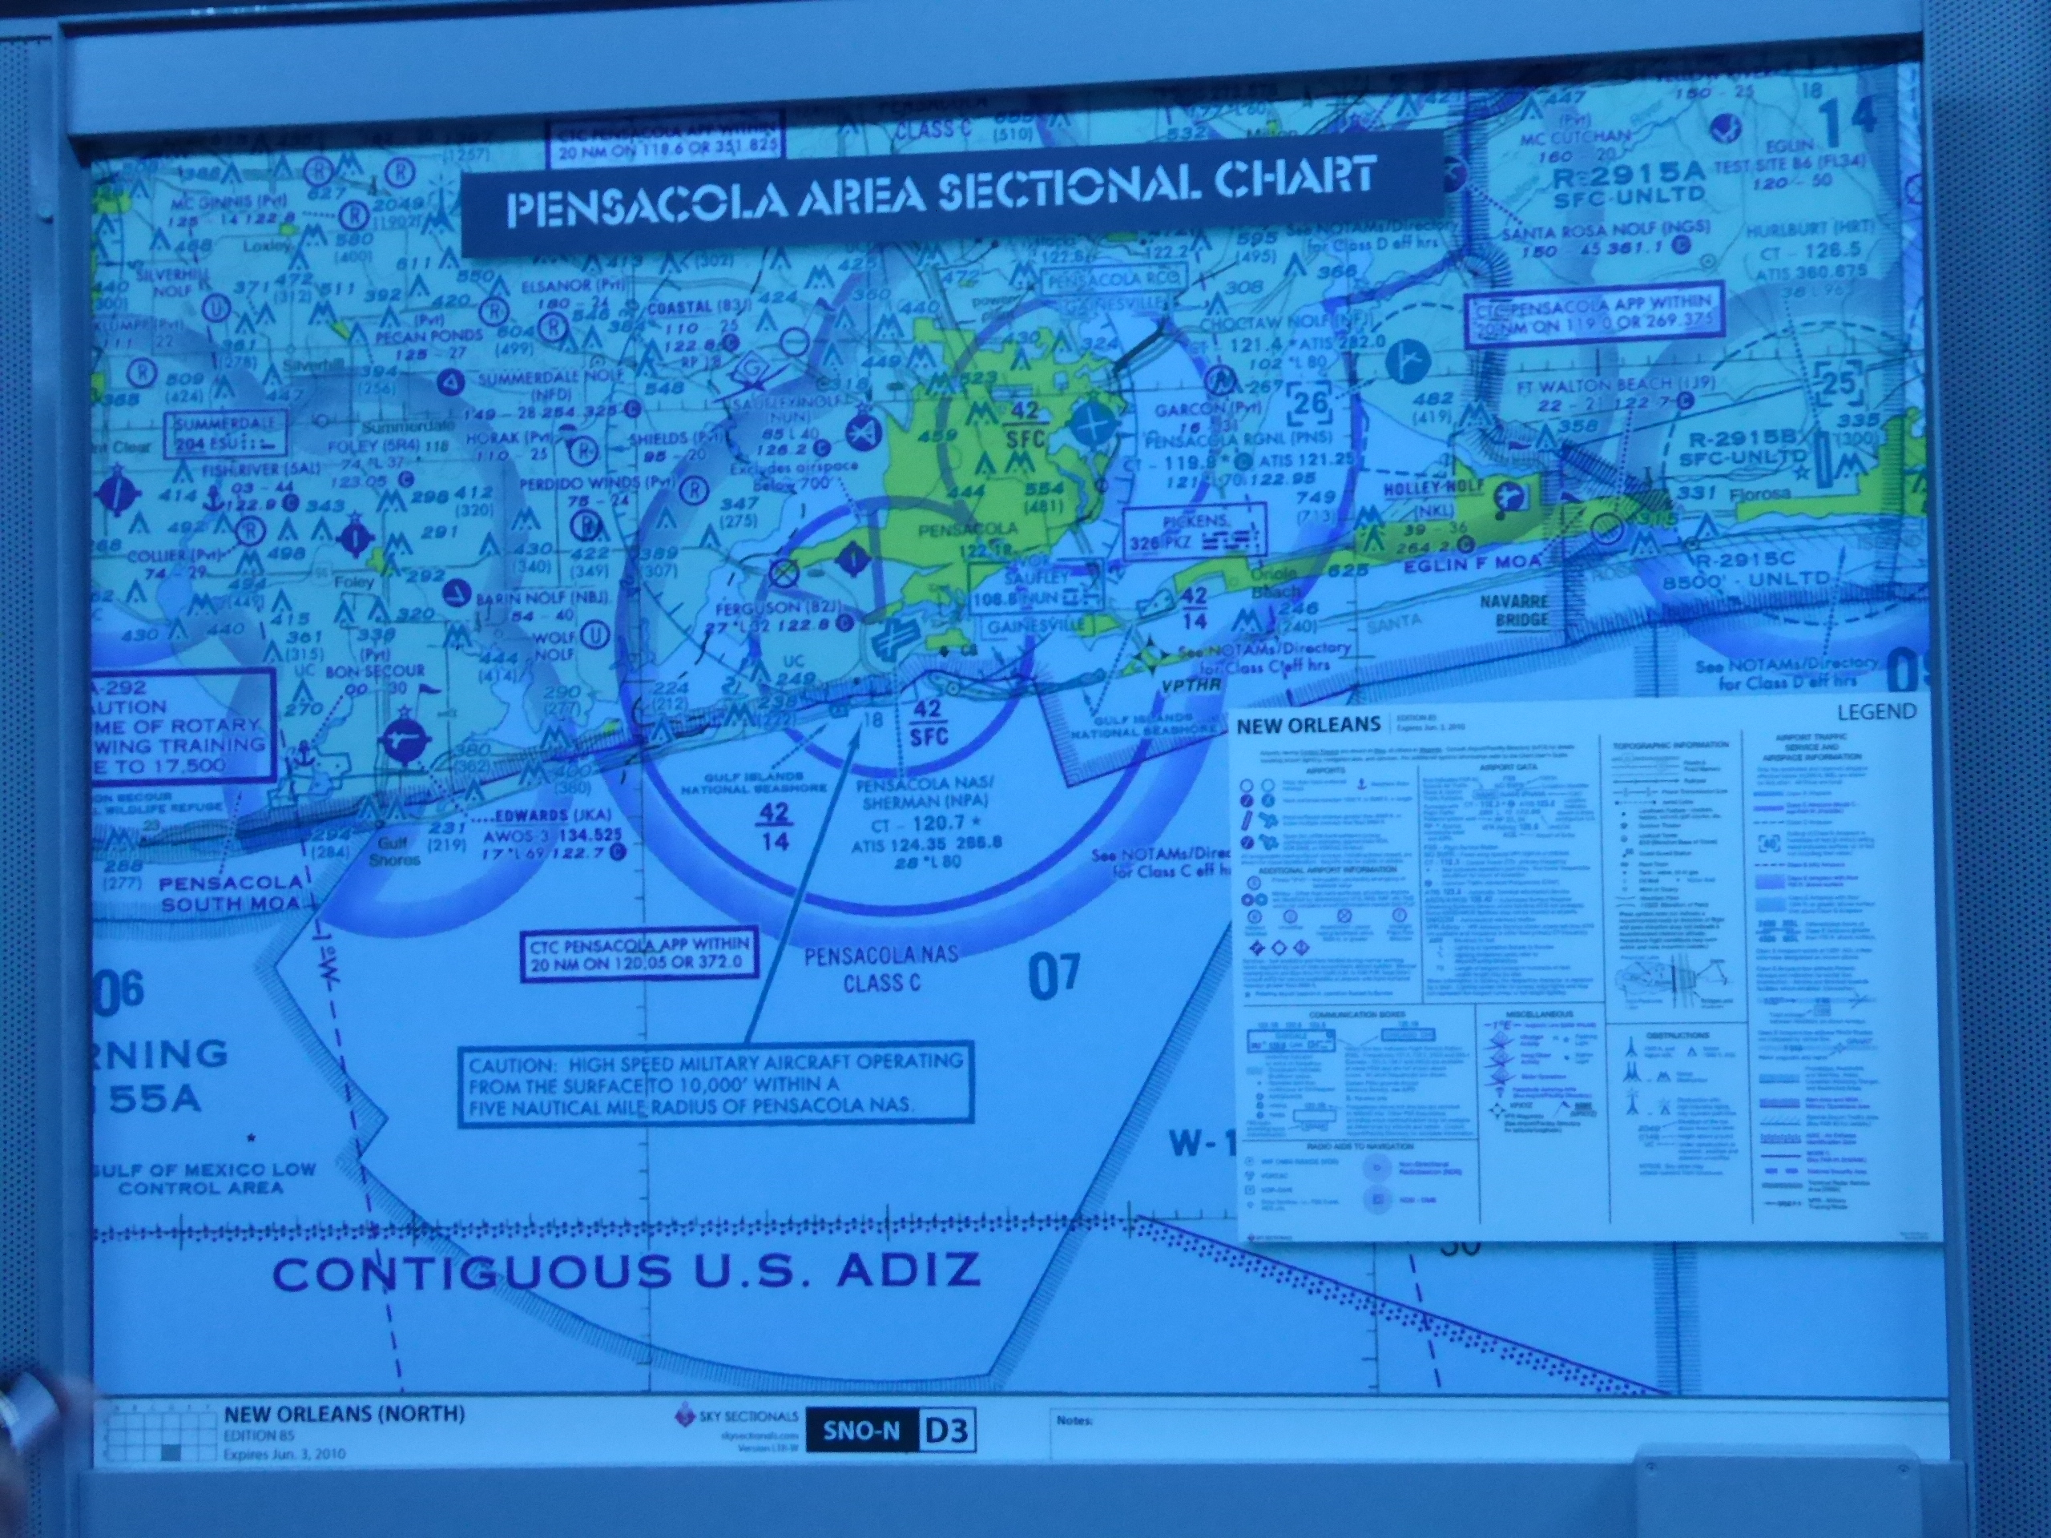
Flight control

Slide 20
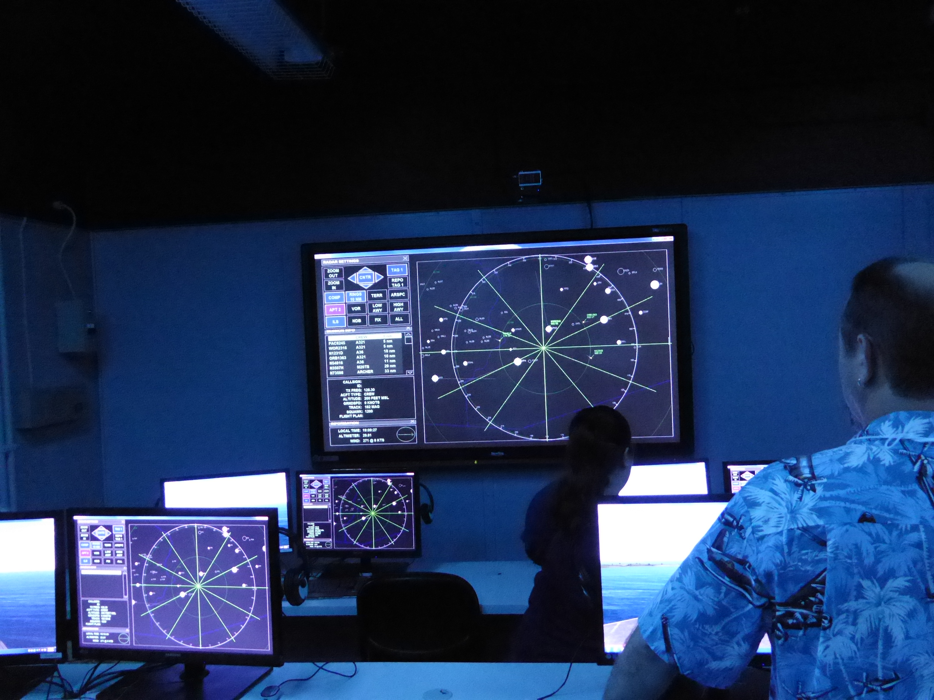
Flight Control

Slide 21
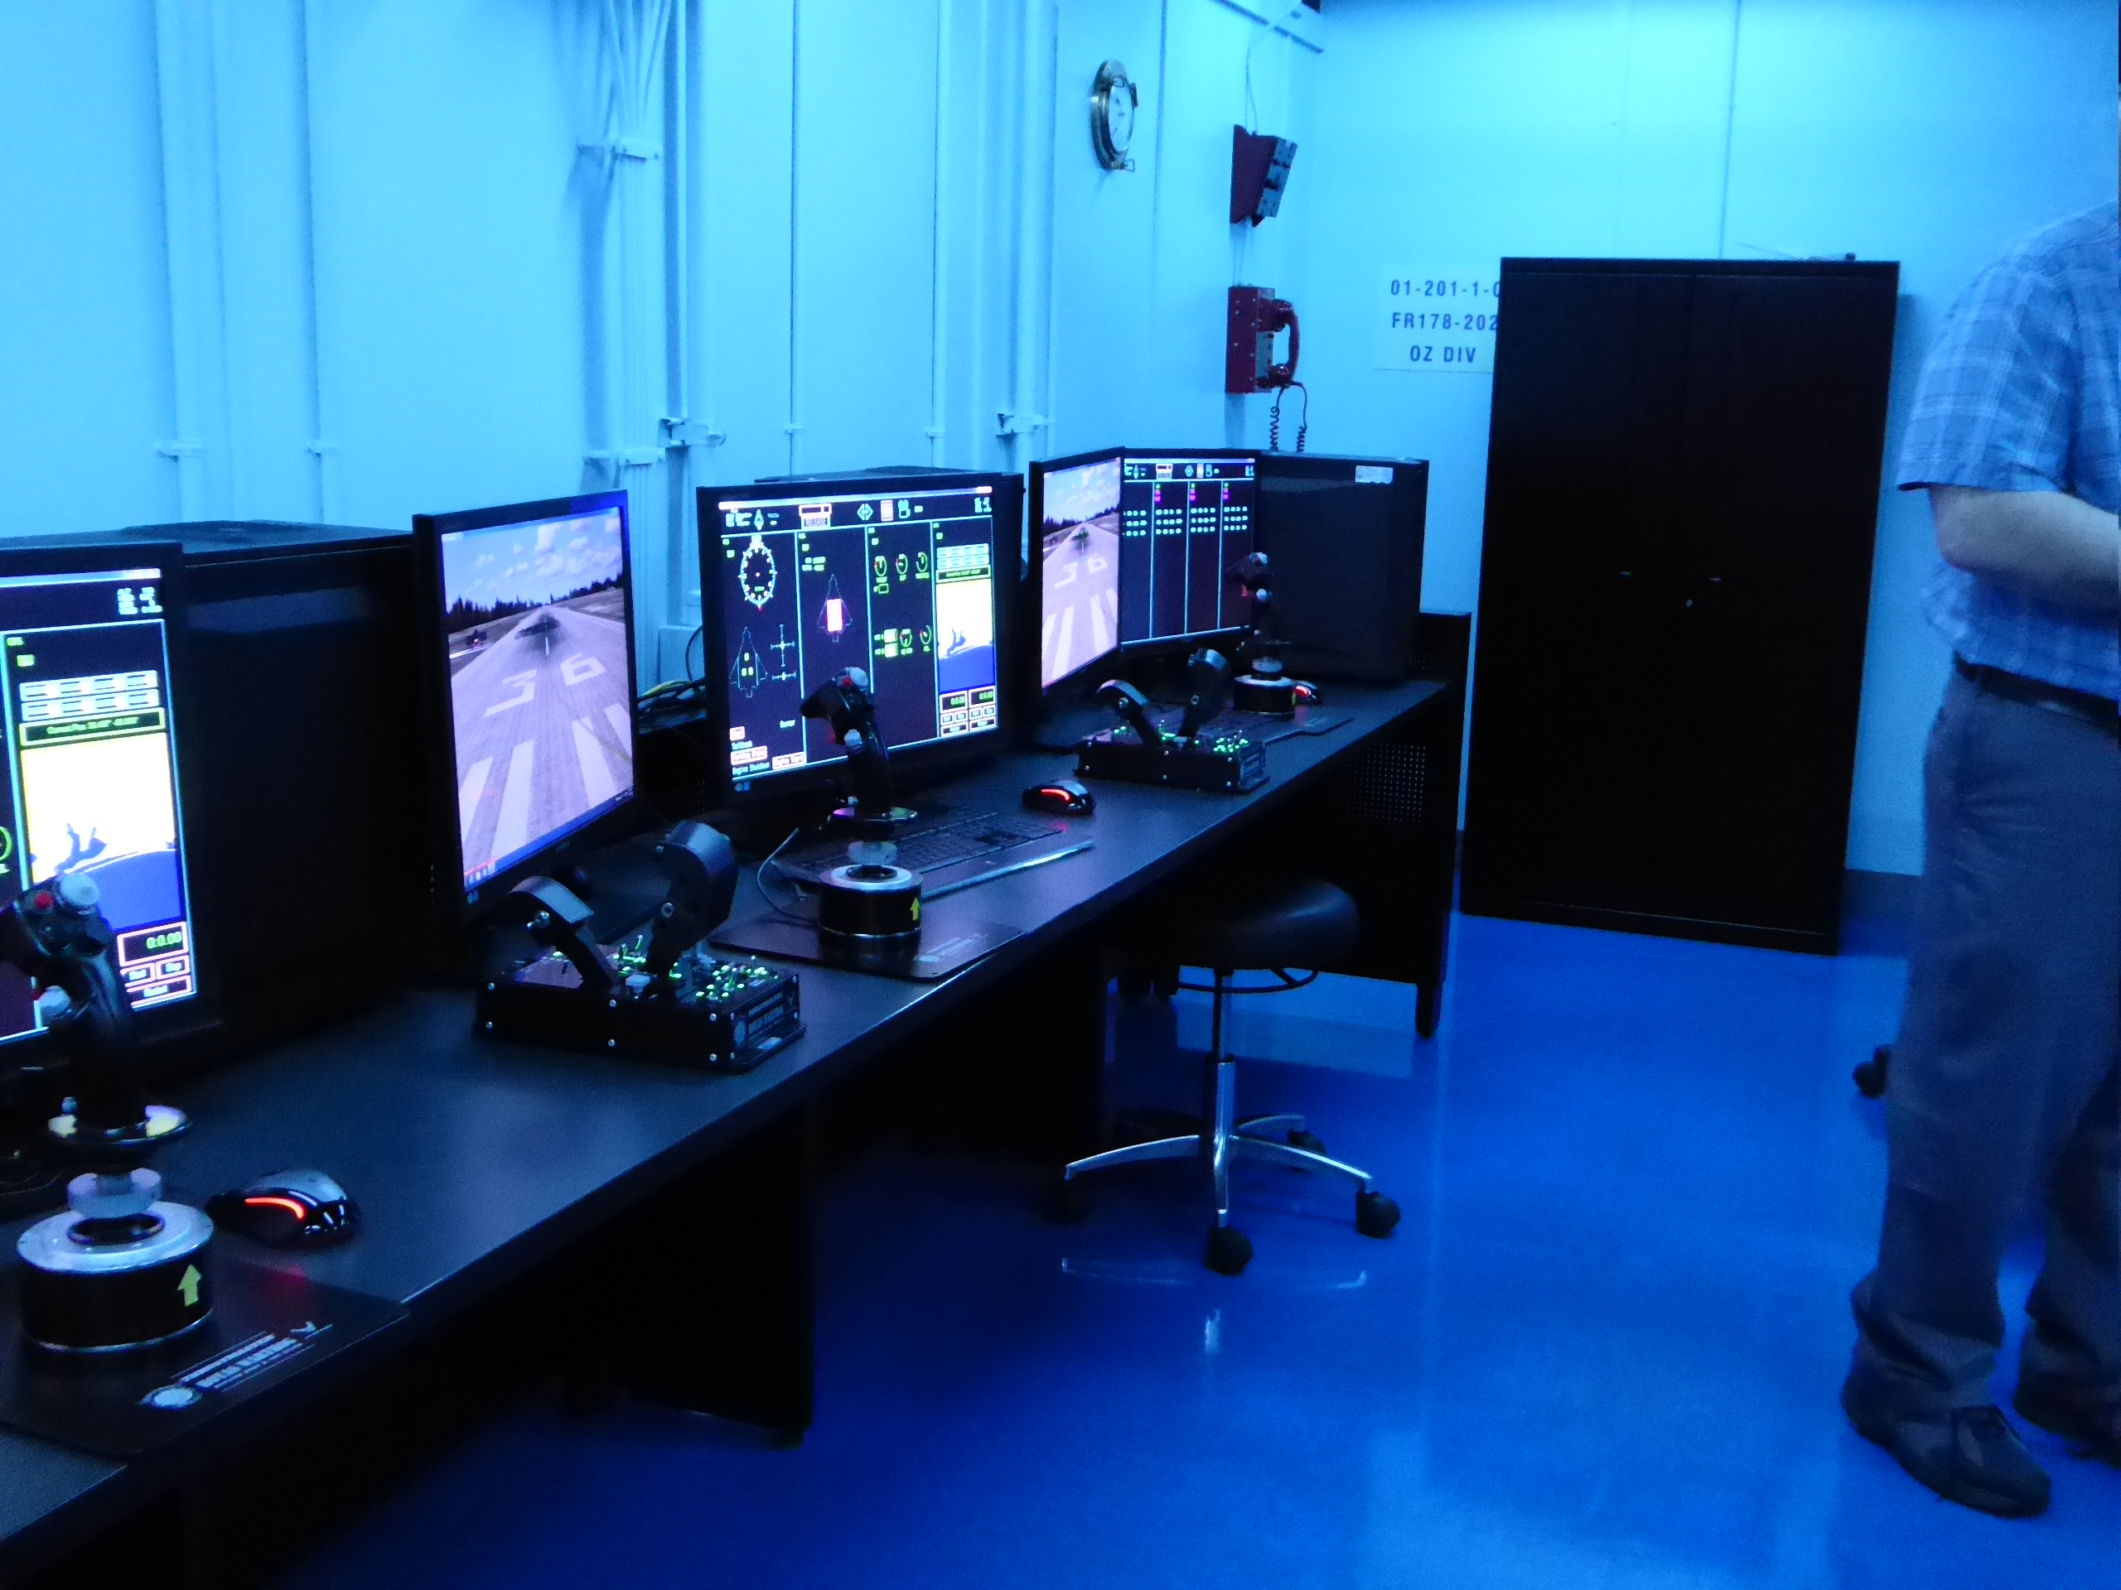
The left side of the bridge

Slide 22
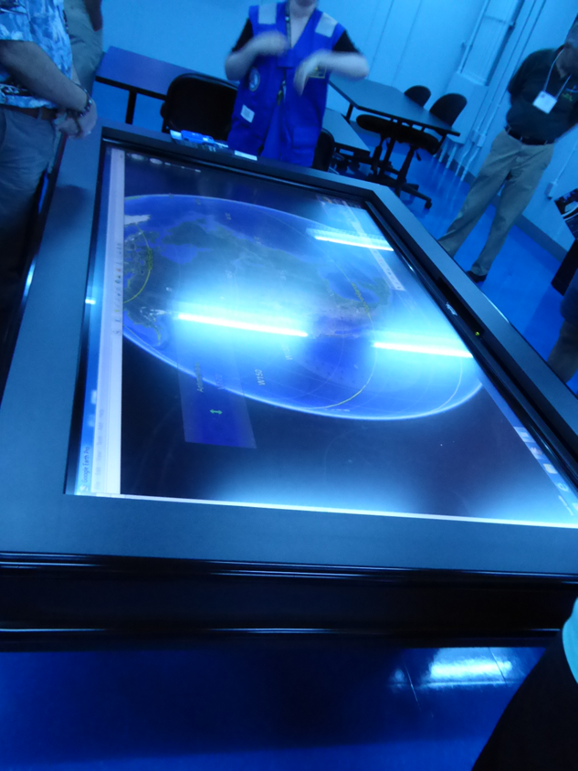
You run world missions
Giant iPAD chart table
with world maps

Slide 23
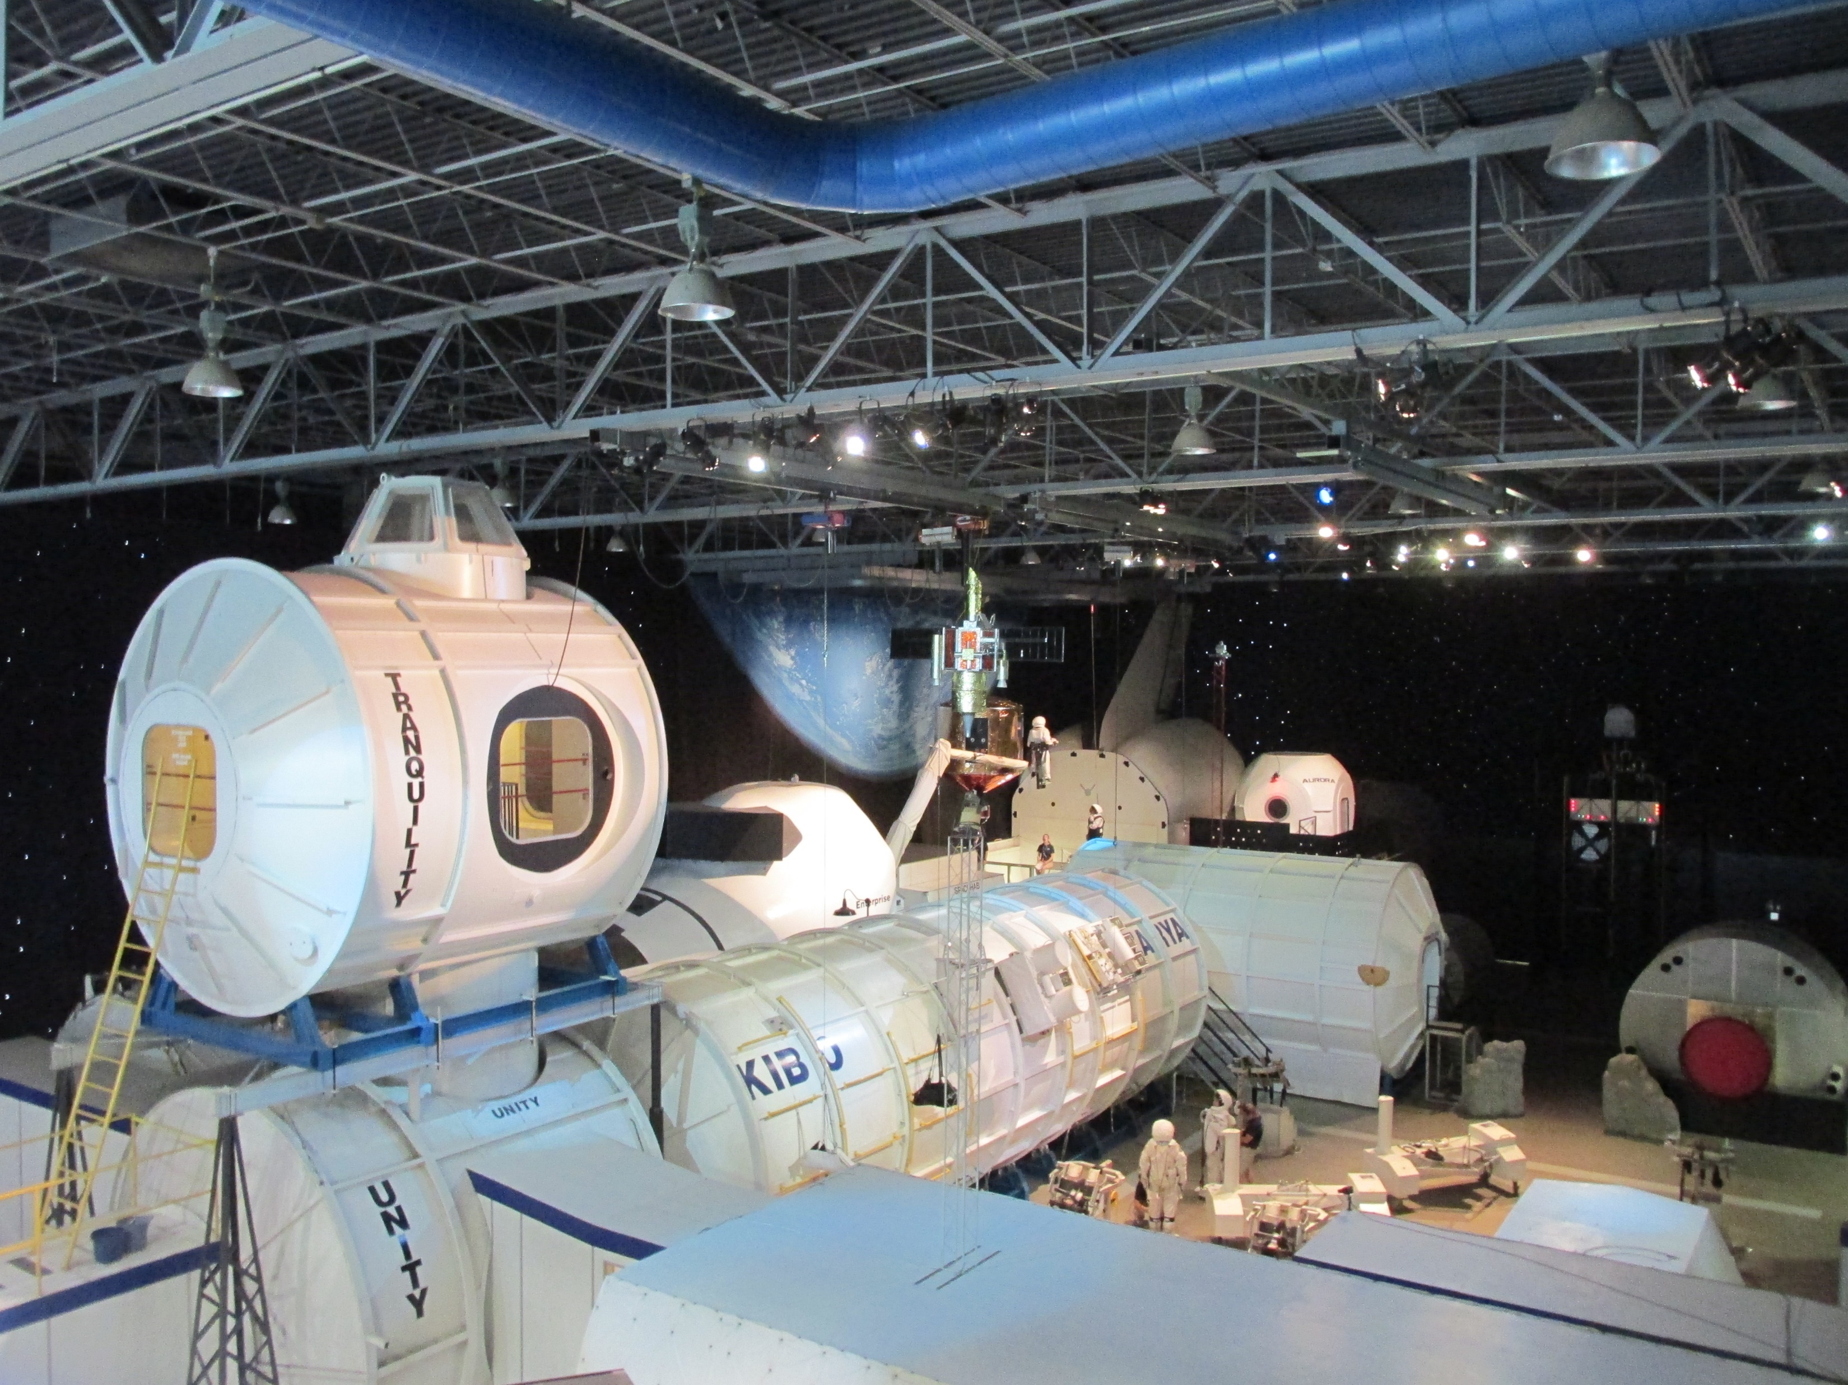
Space Camp

Slide 24
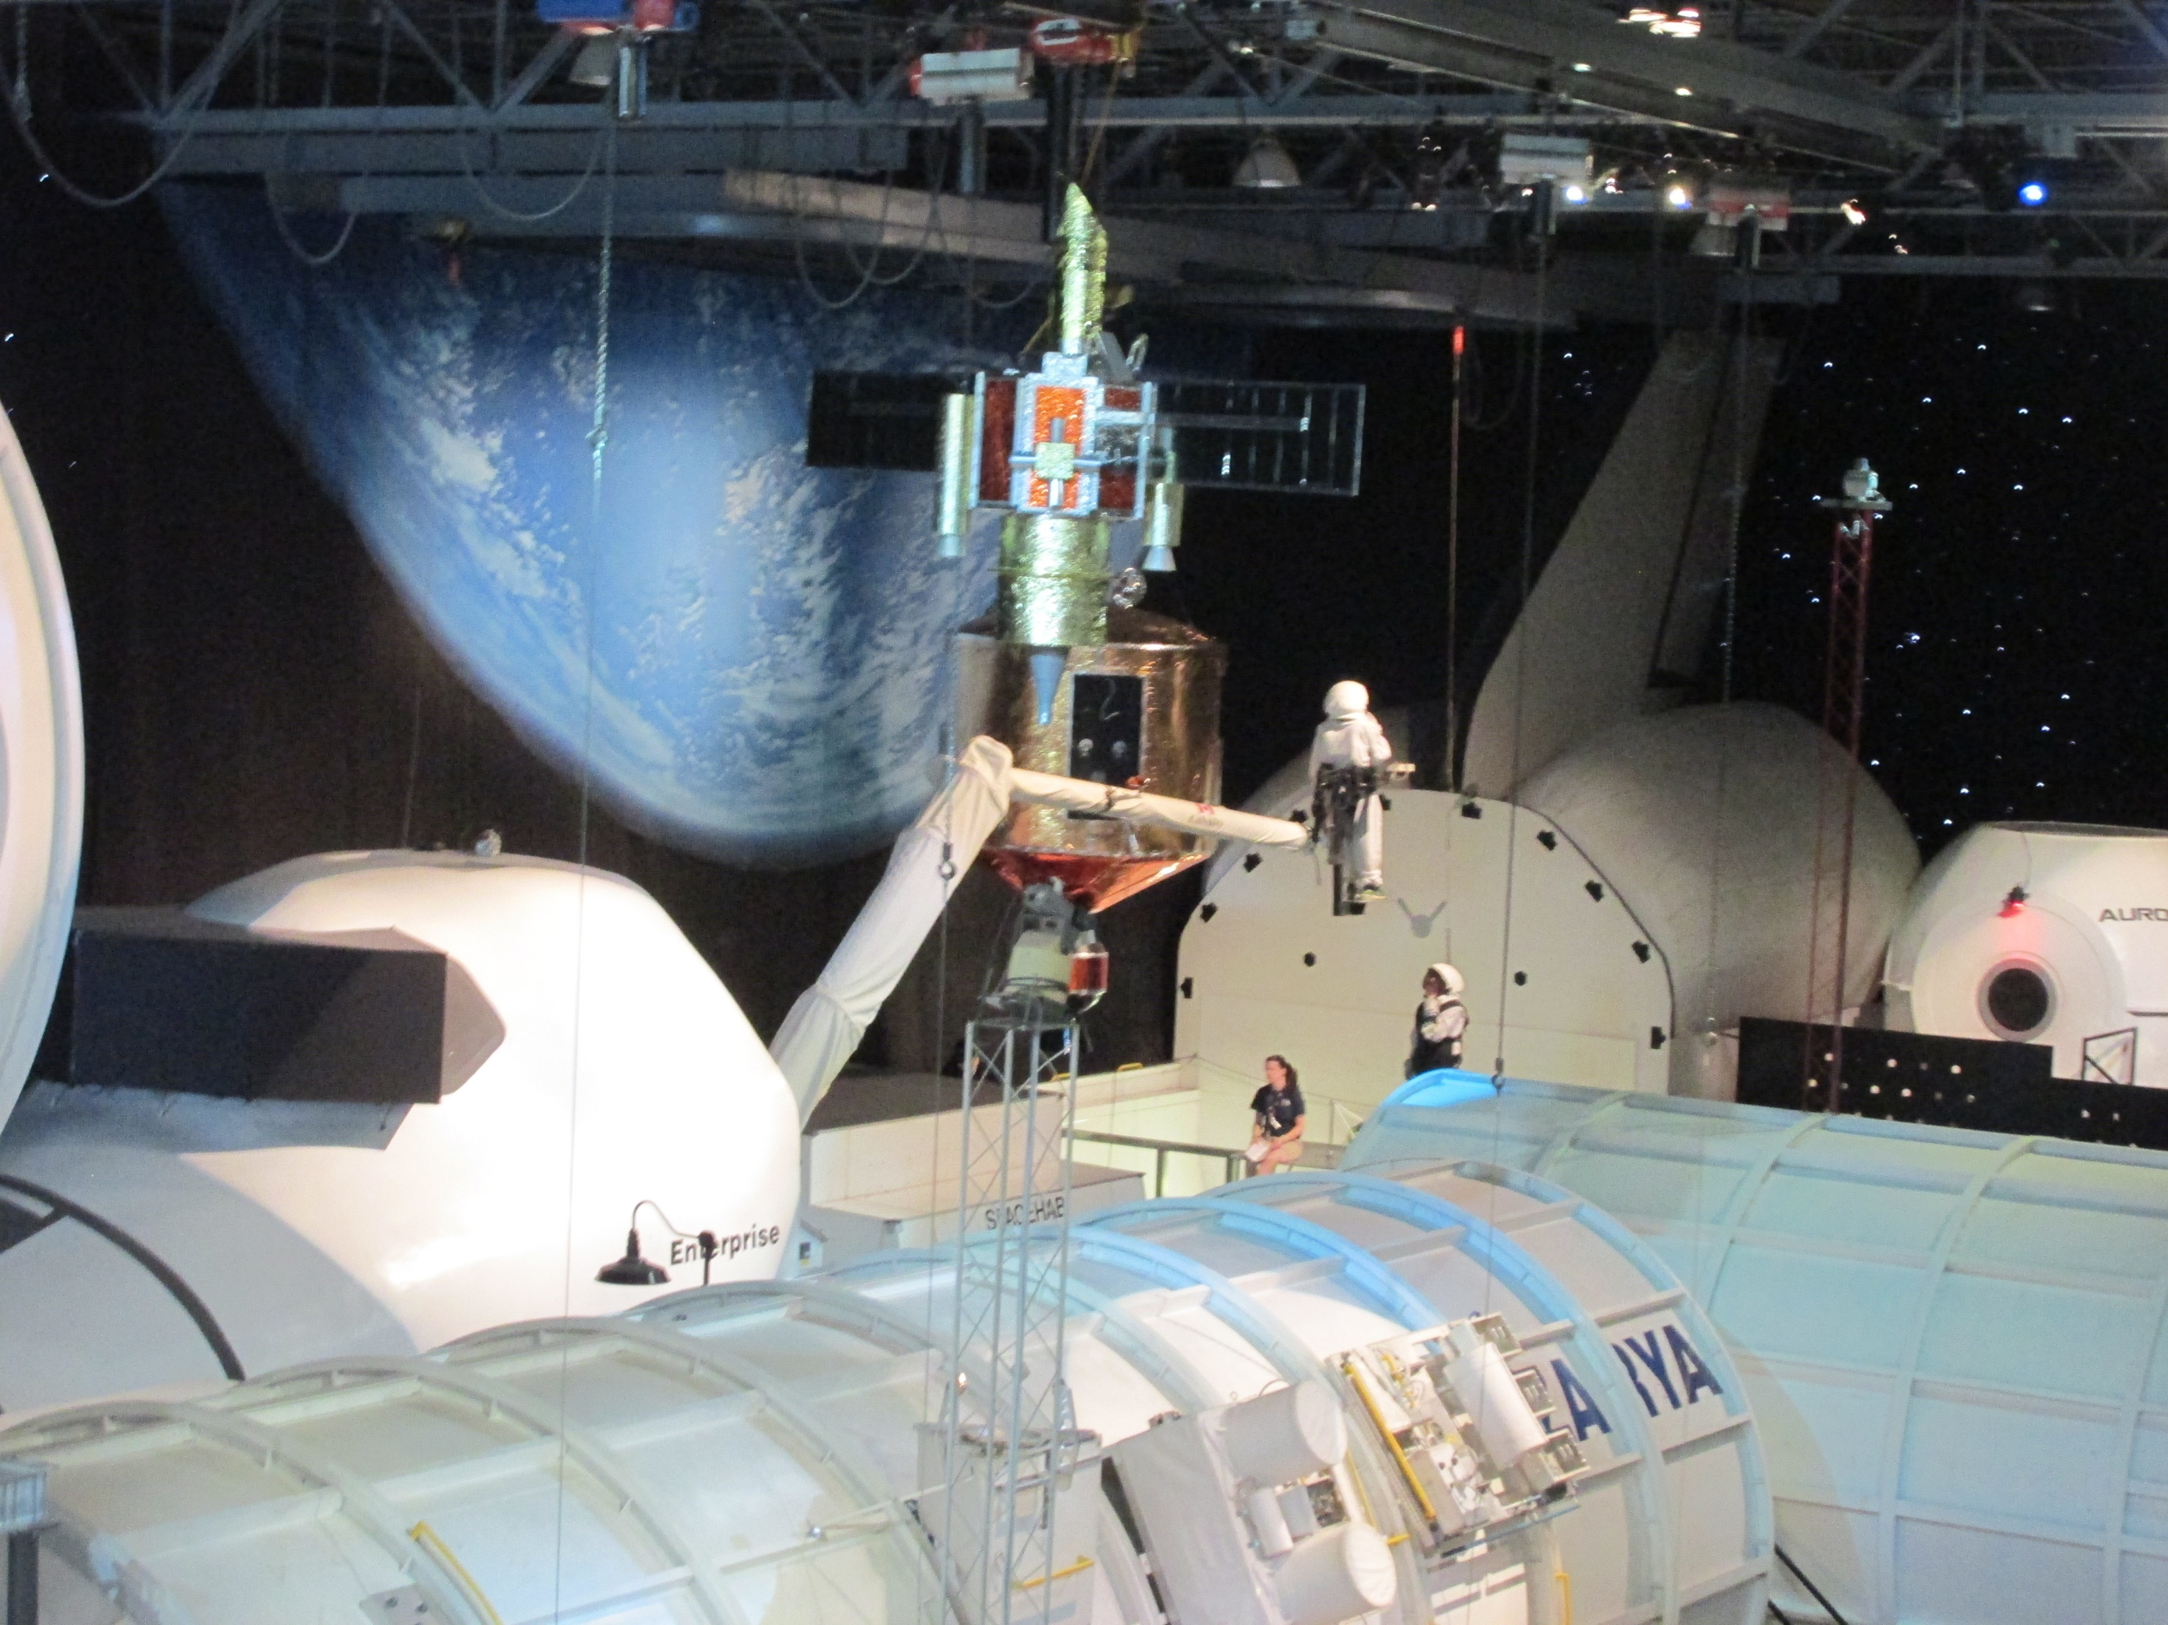

Slide 25
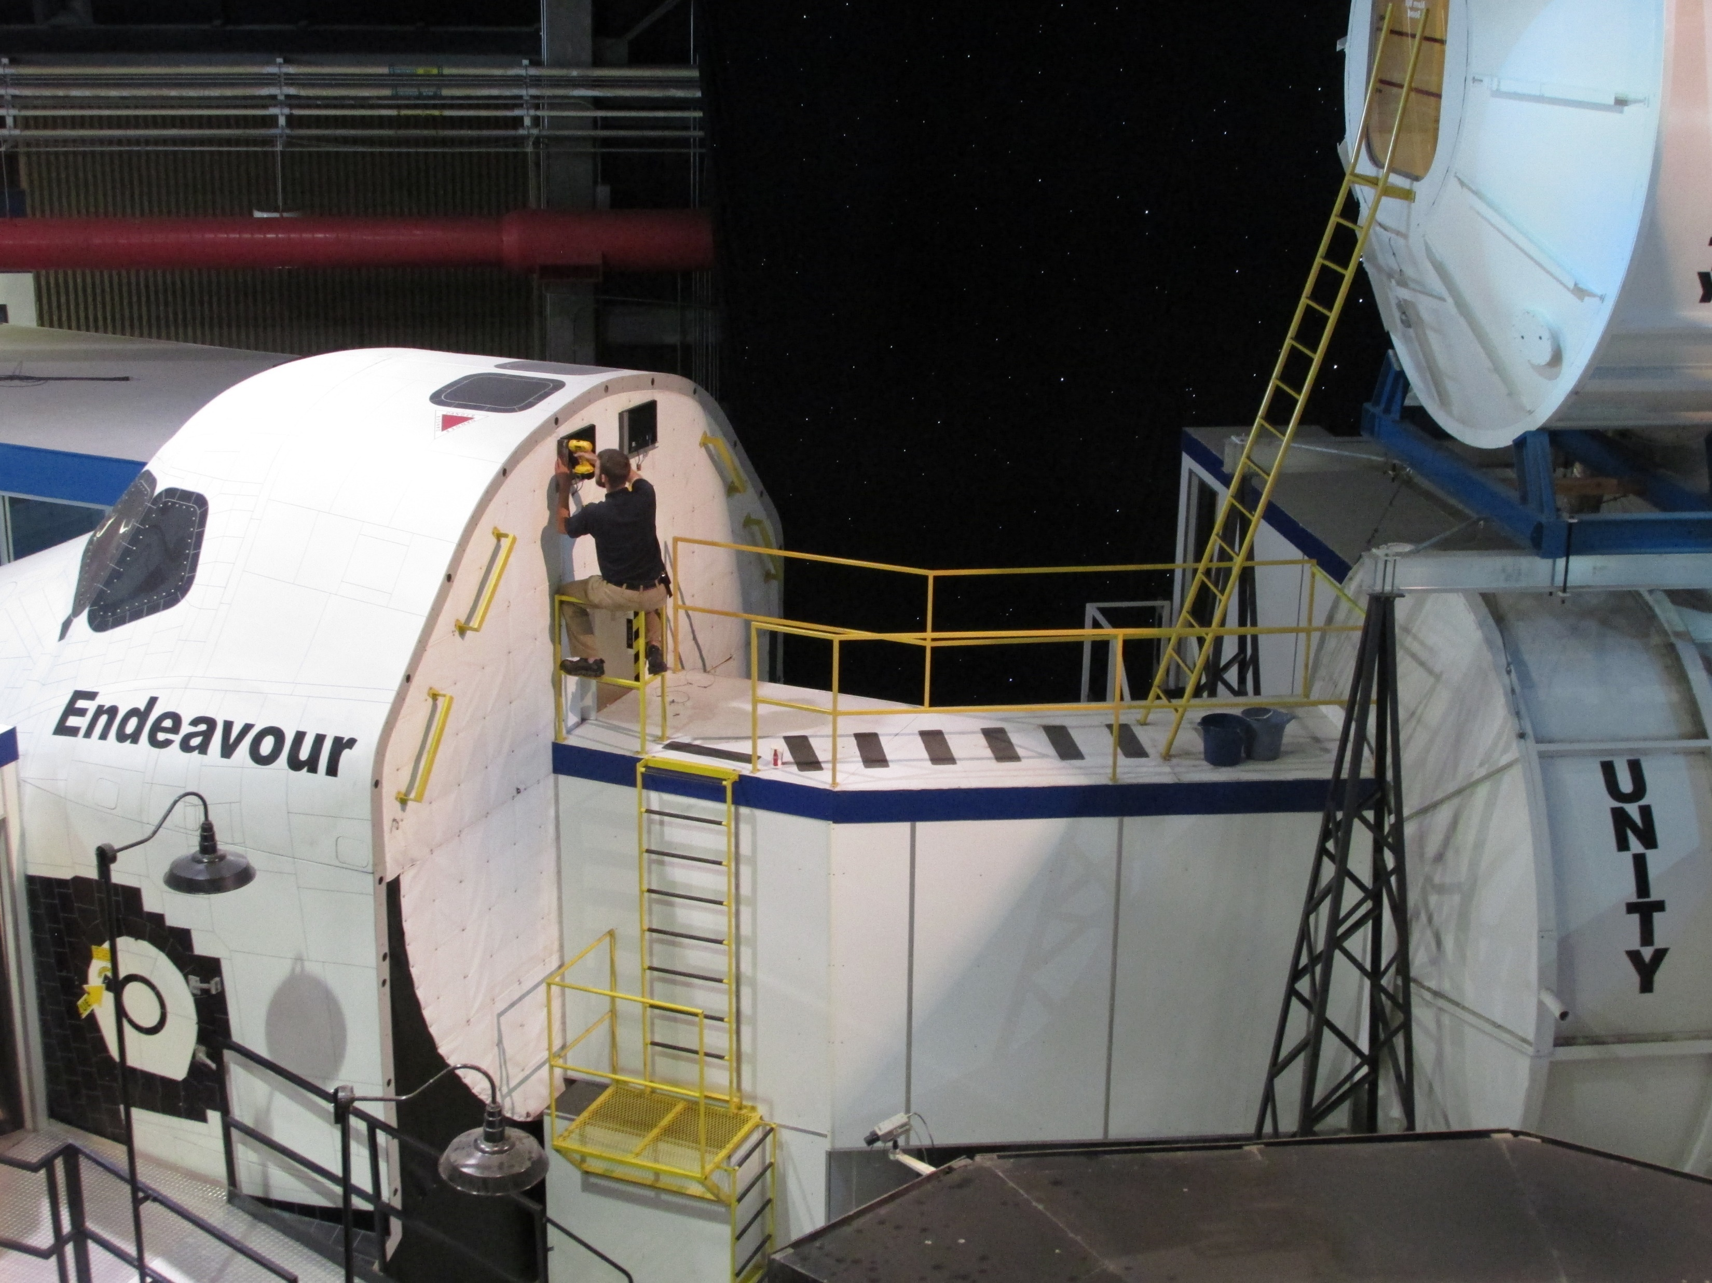

Slide 27
The 1/6th G Moon Simulator

Slide 28
The Multi-axis Astronaut Trainer

Slide 29
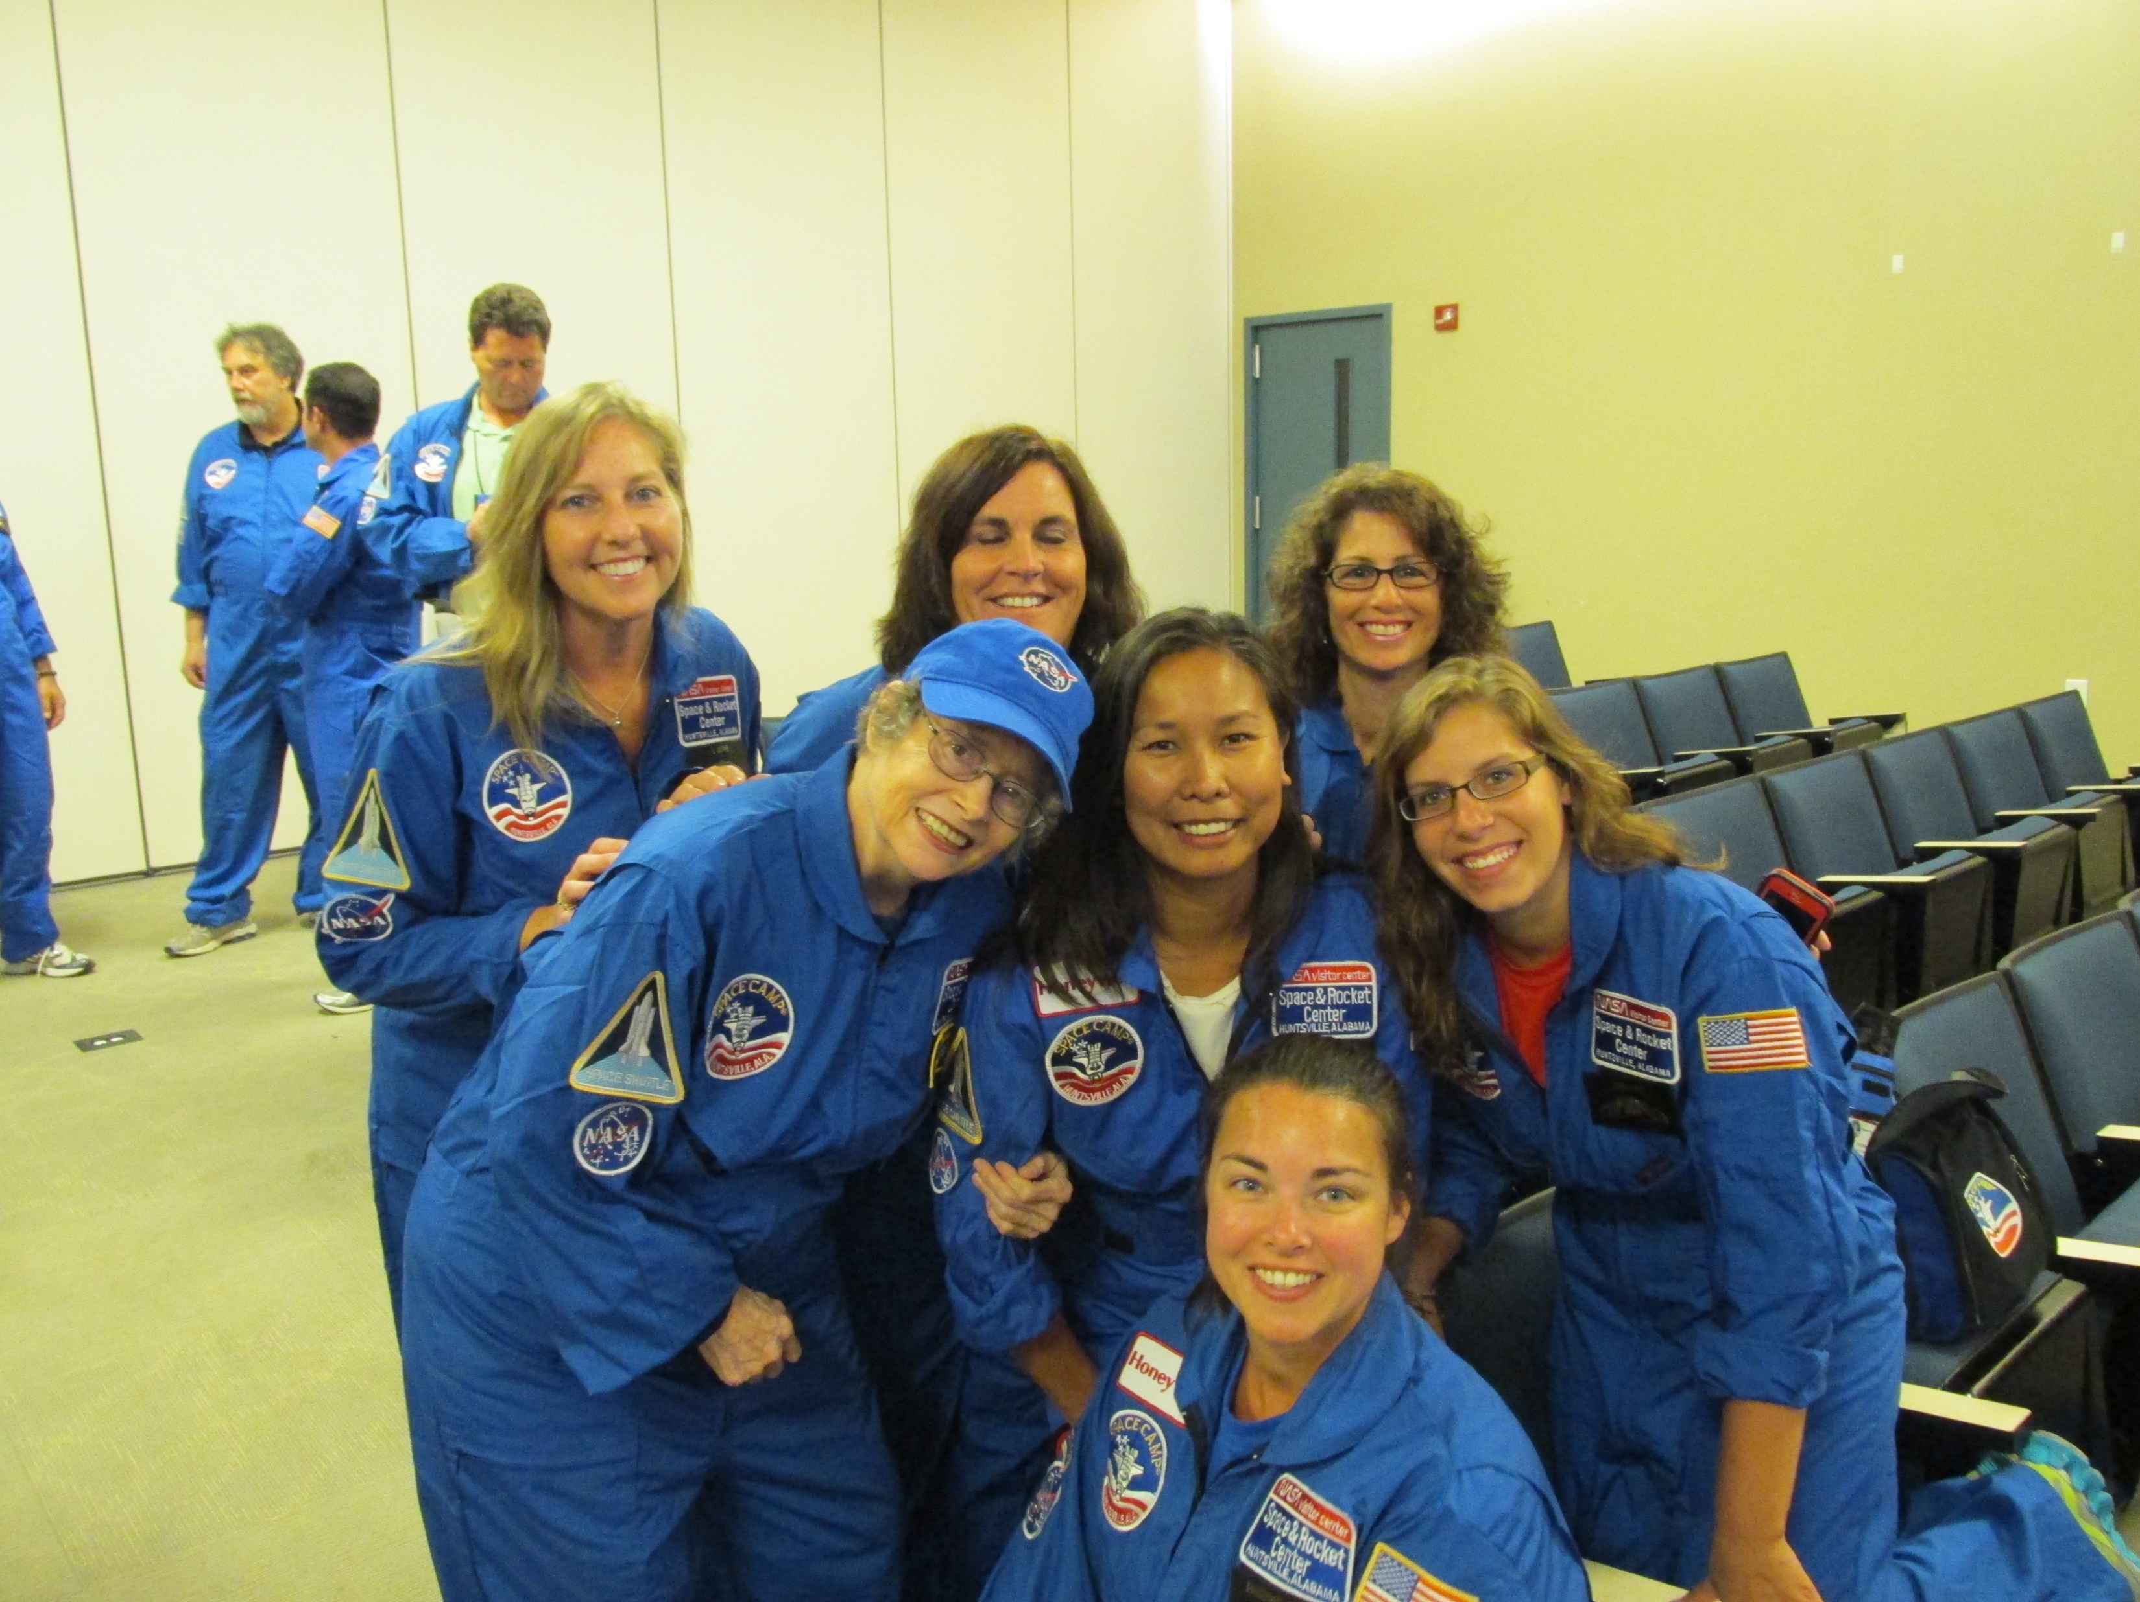
Learn new teamwork skills…

Slide 30
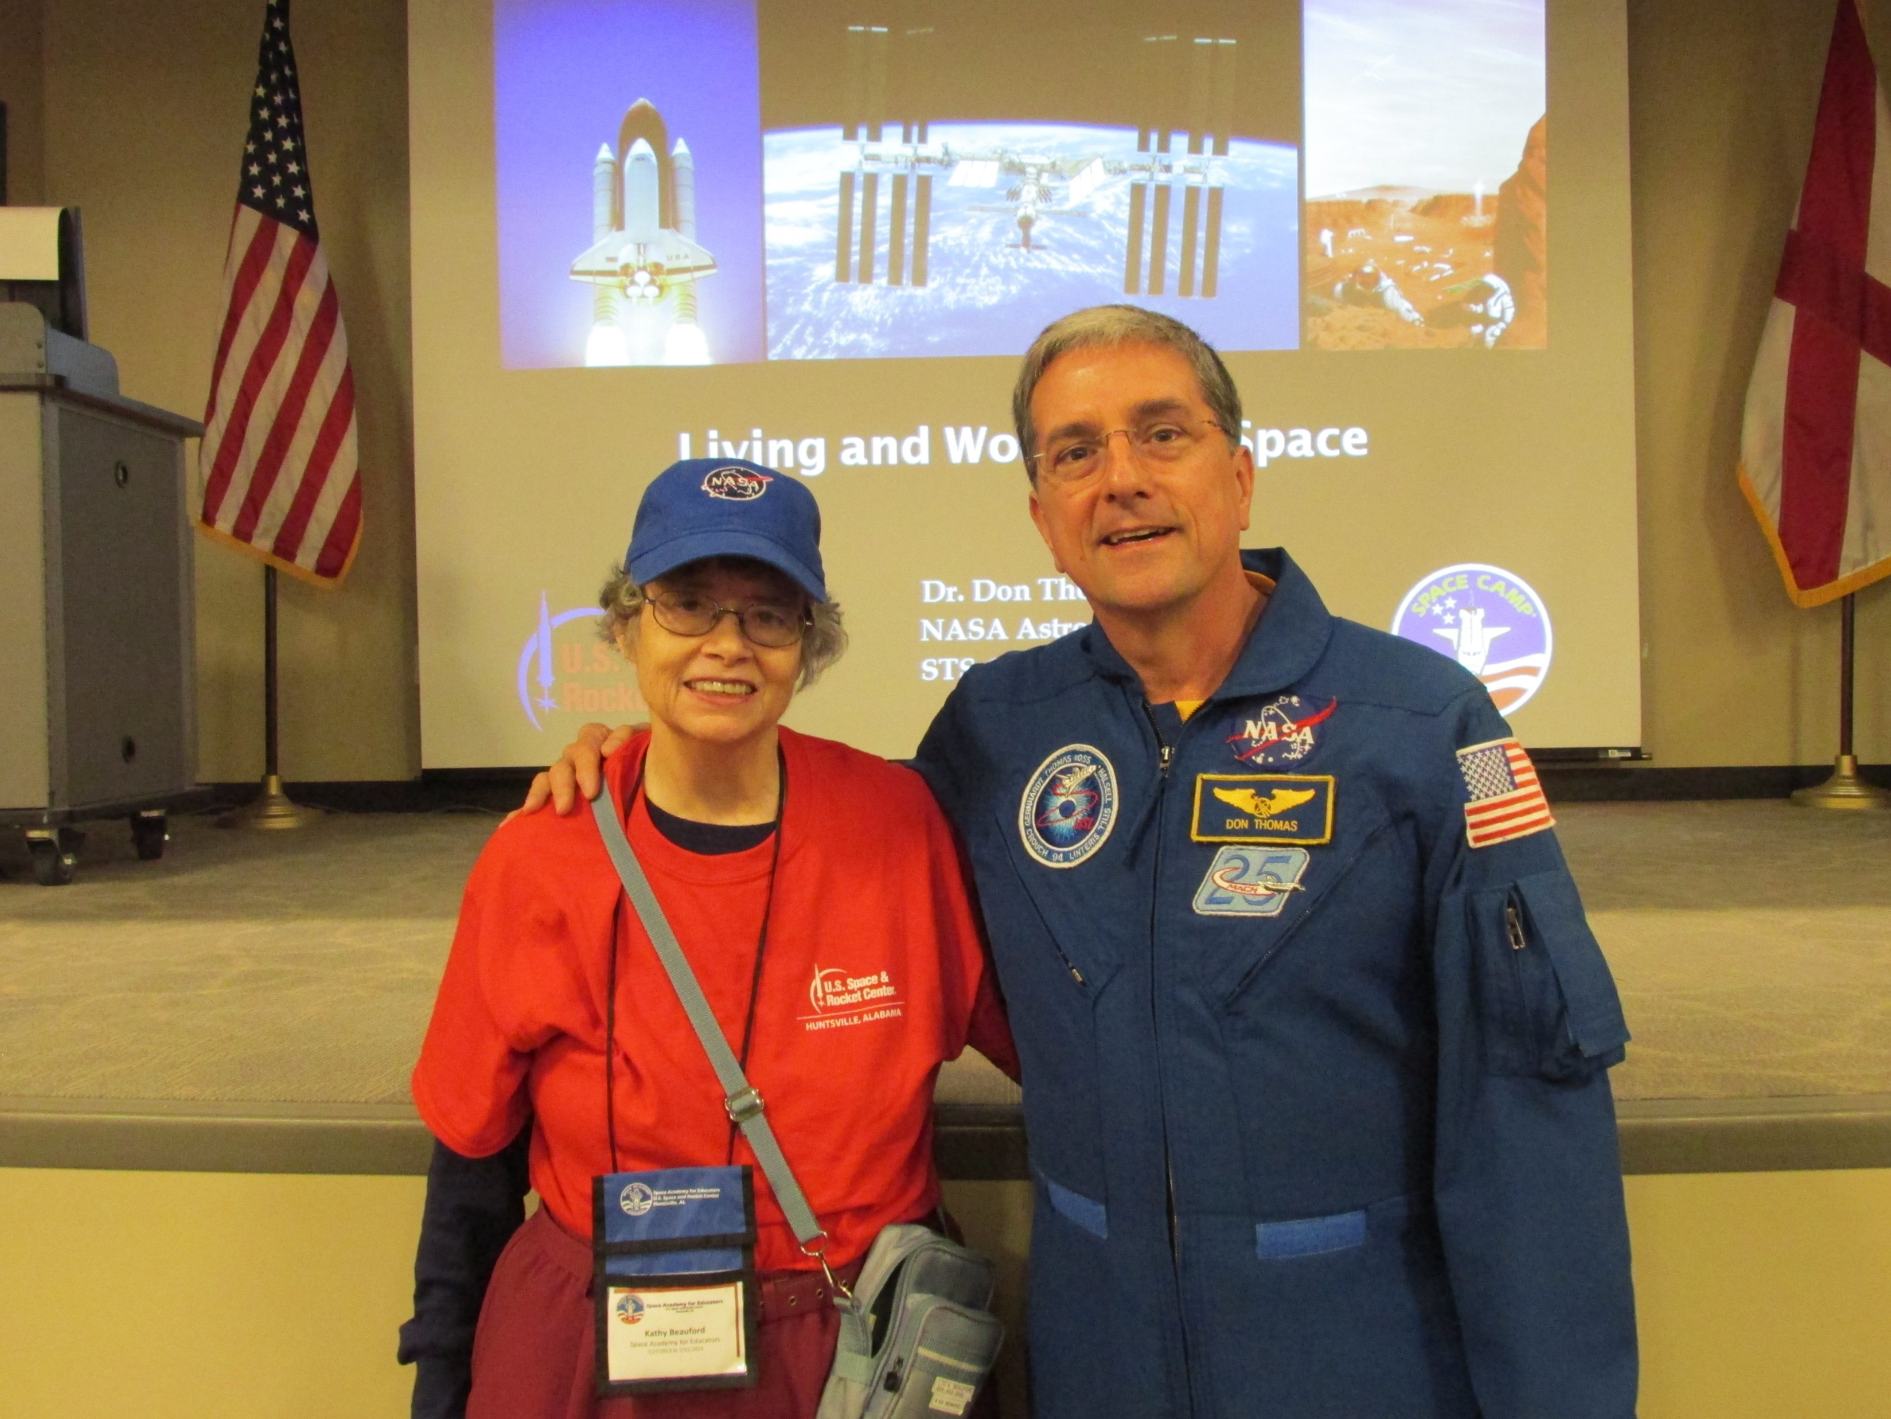
Space Shuttle Astronaut
Don Thomas

Slide 31
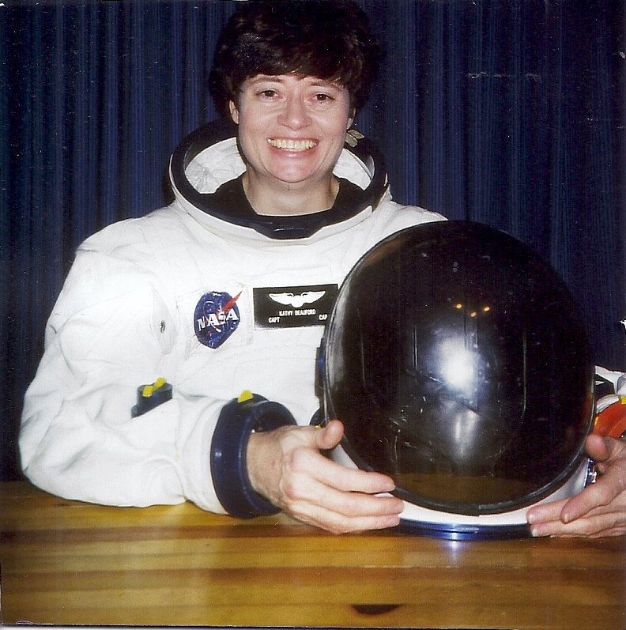
America NEEDS SPACE to GROW !!!
It’s time to DREAM and to
HAVE FUN !!

Slide 32
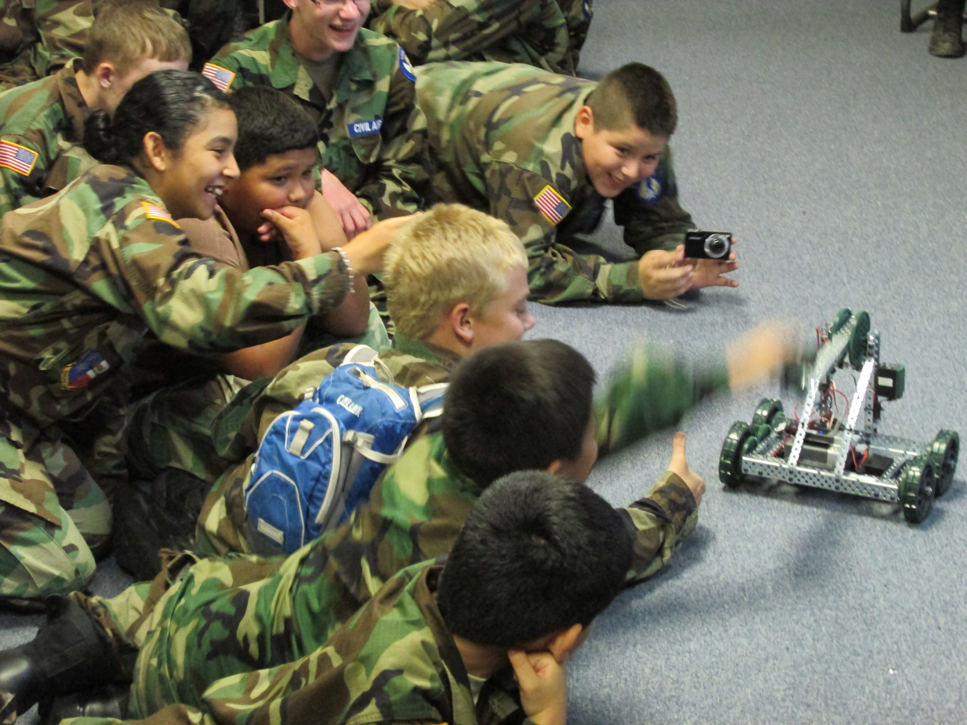
HAVE FUN !!!

Slide 33
Aerospace Education in Louisiana Wing in HOT !!!

