Slide 1
The Effects of Solar Storms
Jerry L. Wall, Lt Col CAP
Internal Aerospace Officer, Louisiana Wing

Slide 2
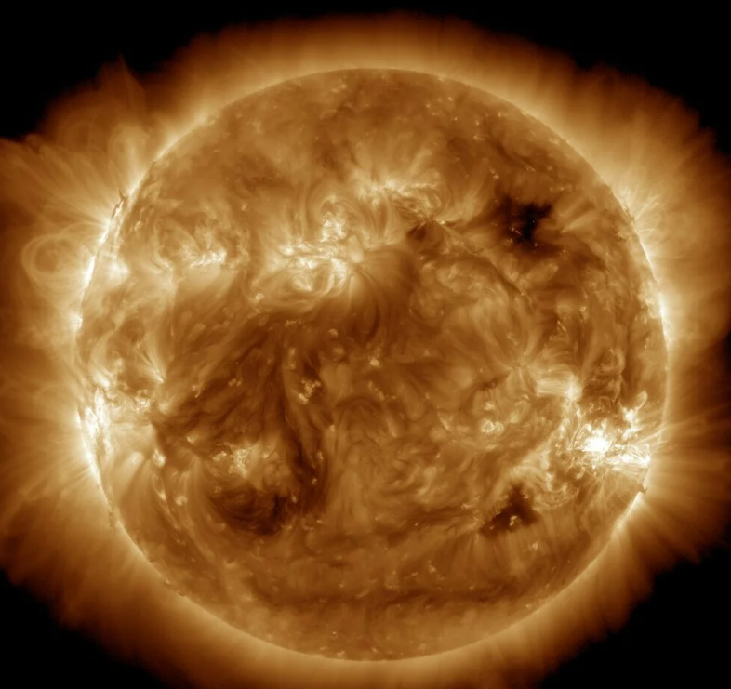
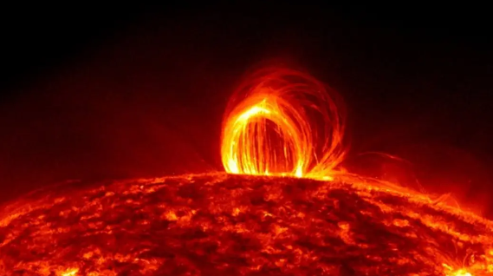
What Are Solar Storms?
Caused by solar “flare” activity
Releases energy and plasma mass called a Coronal Mass Ejection (CME)
Creates intense burst of radiation and light
“Flare” could be bigger than 15 Earths
Takes 8 minutes to reach & affect Earth
May last several days or longer

Slide 3
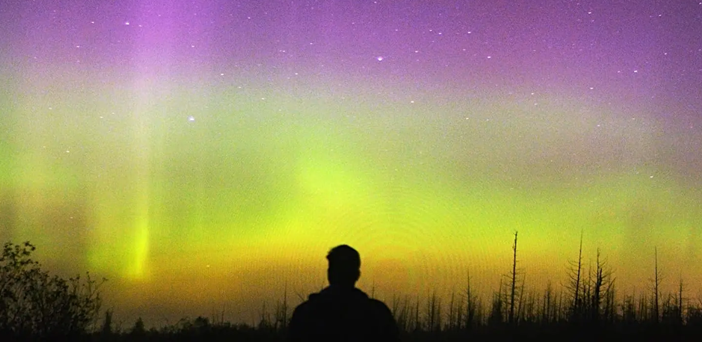
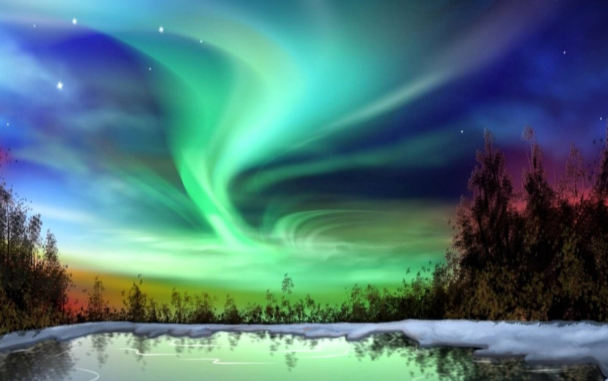
Ionospheric Changes
Solar wind interaction with earth’s magnetic field
Causes fluctuations in the ionosphere (upper atmosphere)
Directly affects satellites, spacecraft, and earth
Alters orientation and electronics
Auroras were seen in southern Louisiana

Slide 4
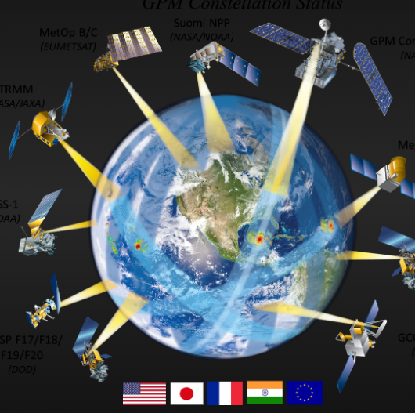
Effects on GPS
GPS satellites rely on signals penetrating the ionosphere
Geomagnetic disturbance can disrupt GPS accuracy
GPS is critical for planes, ships, agriculture, and oil industries

Slide 5
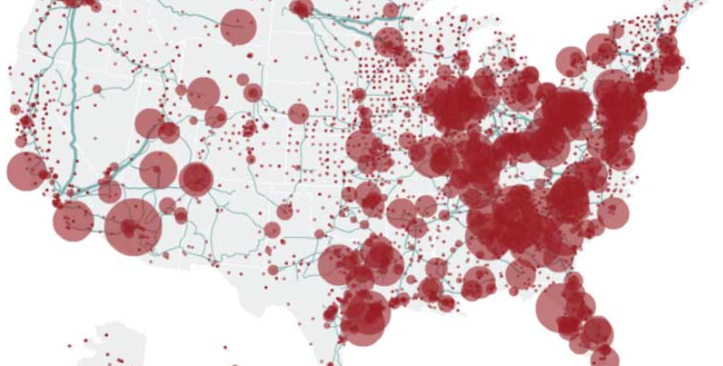
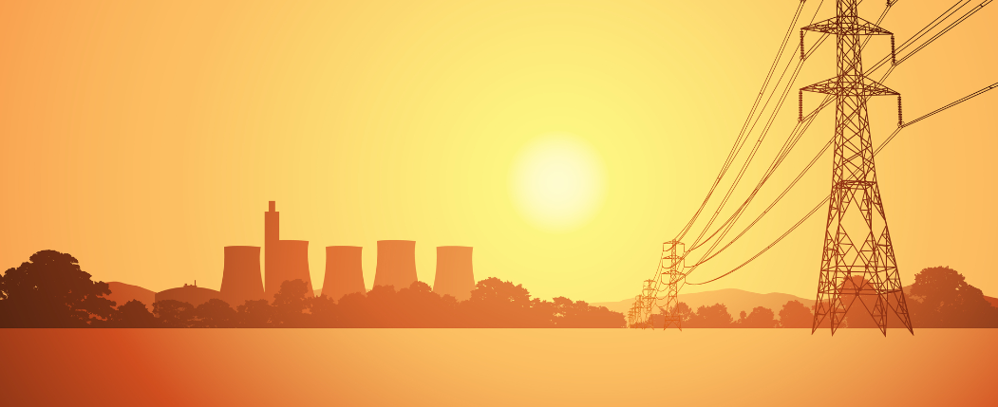
Power Grid Risks
Severe space weather jeopardizes power grids
Widespread voltage control problems possible
Protective systems may trip-out overload controls causing cascading loss across U. S.

Slide 6
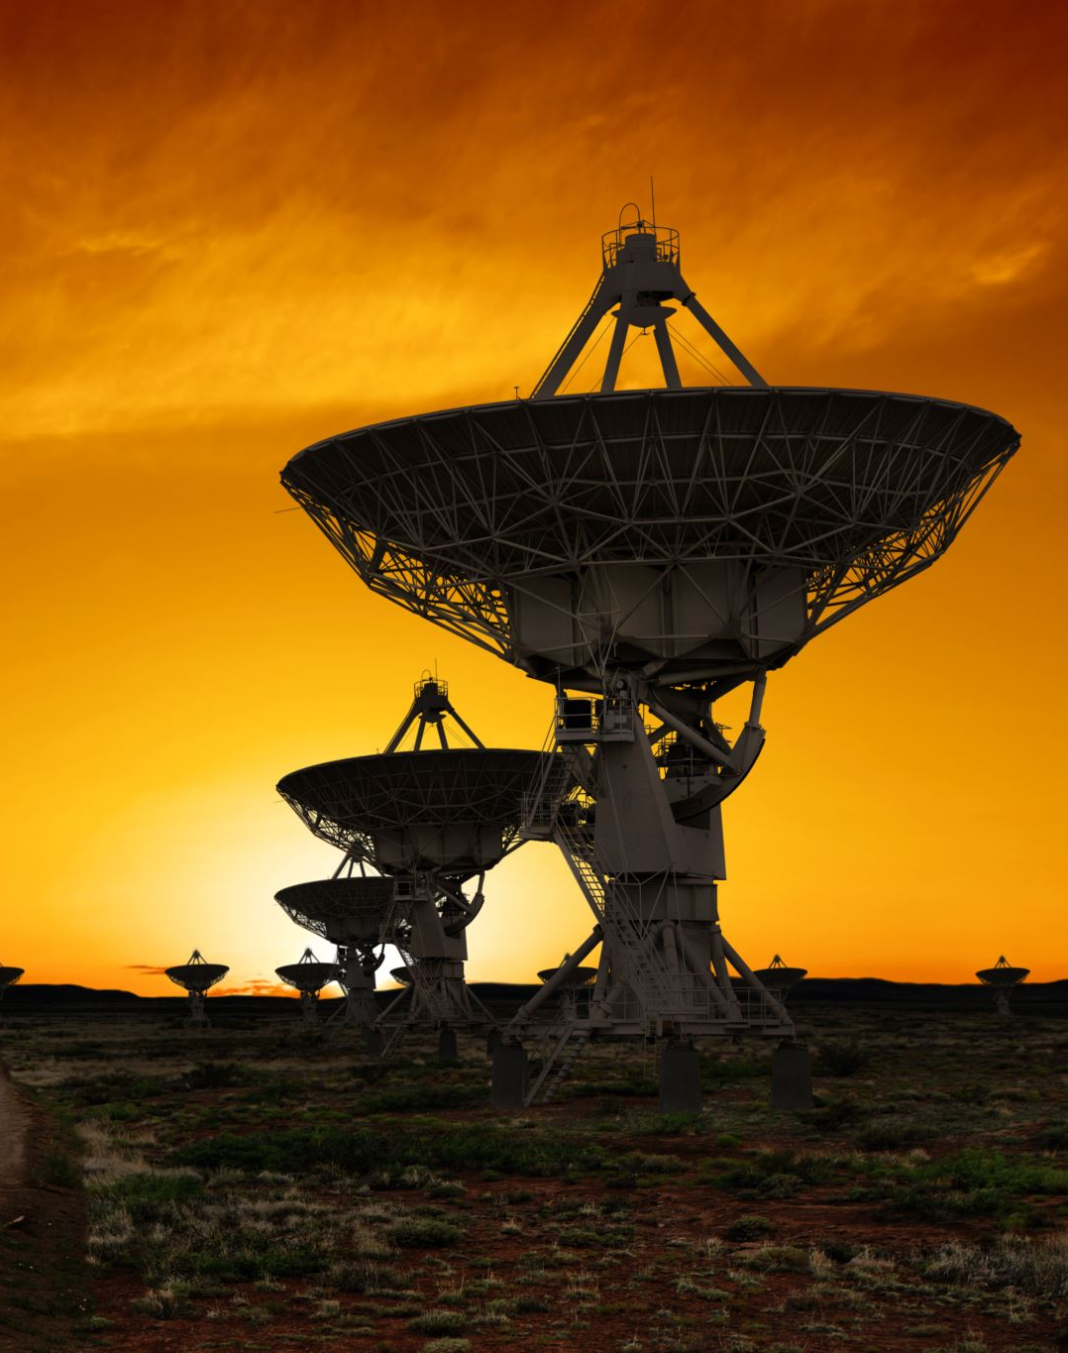
Communication Disruptions
High-frequency radio transmissions blocked or degraded
Shortwave radio, emergency services such as CAP, and military affected
Cellphone GPS may still work with rough location fix

Slide 7
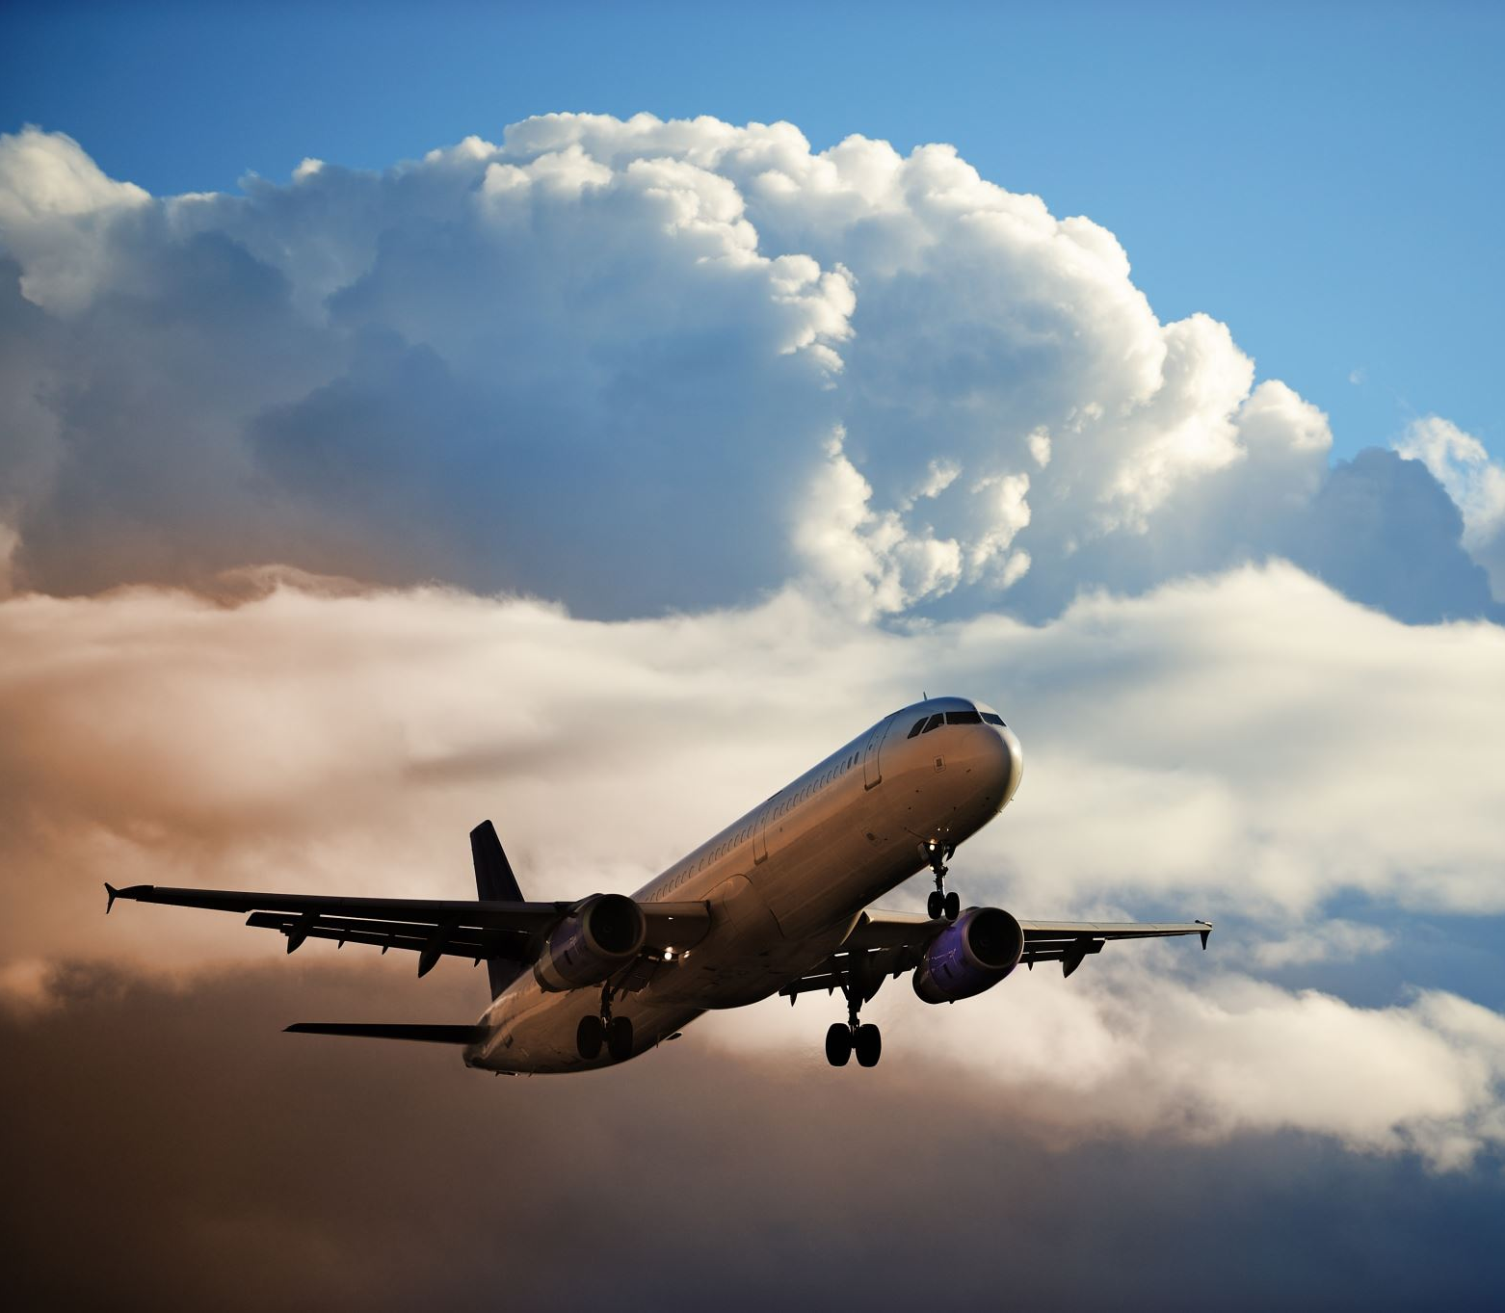
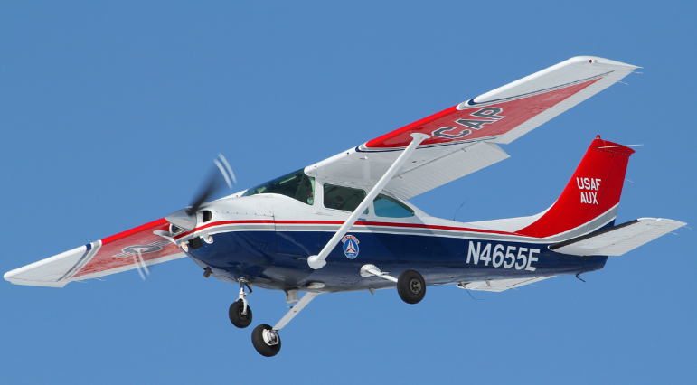
Conclusion
Solar storms can have long-term far-reaching effects on business, industry and aviation, including the Civil Air Patrol

